Slide 1
How “Pytesseract” will work ?

Slide 2
Hierarchy
Levels
1
2
3
4
5
Block
Paragraph
Line
Words

Slide 3
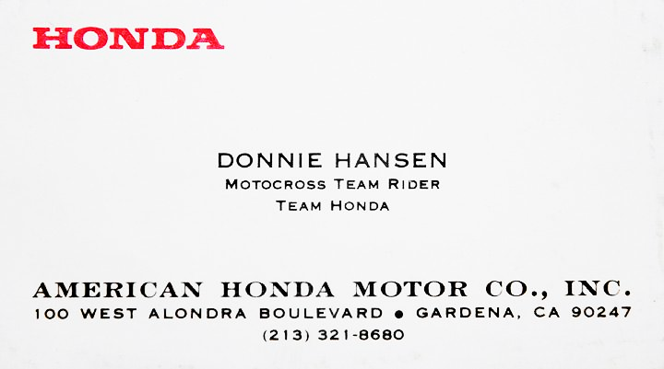
Business Card

Slide 4
Level -1 (Page)

Slide 5
Level -2 (Block)

Slide 6
Level -3 (Paragraph)
c
c
c
Scanned Business Cad

Slide 7
Level -4 (Line)
c
c

Slide 8
Level -5 (Word)

Slide 9
Letter

Slide 10

Letter
HONDA
DONNIE
HASEN
A
TEAM HONDA
AMERICAN
HONDA
MOTOR
INC
CO
213
3218680

Slide 11
next
Image to data

