Slide 1
Data Preprocessing

Slide 2
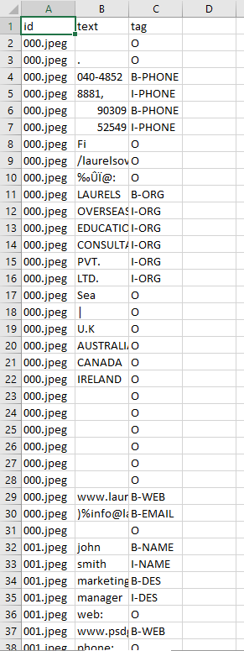
Data

Slide 3
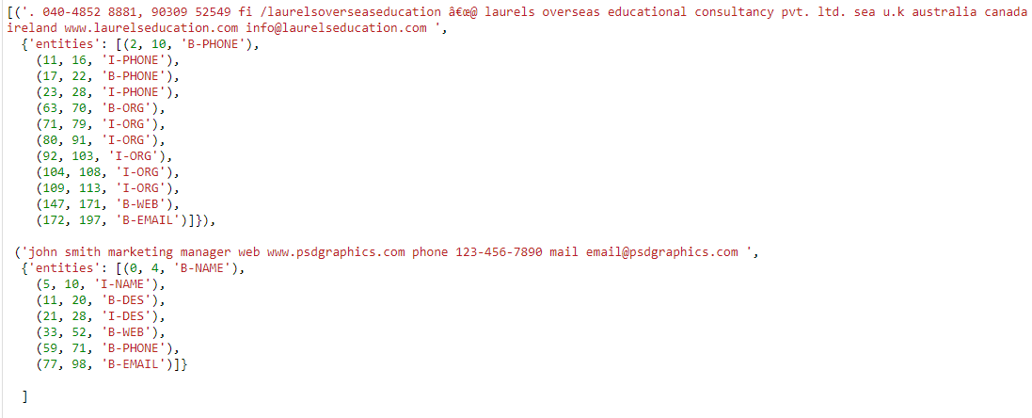
Training Data Format
10
0123456789

Slide 4
next
tagging

