Slide 1
Ideas to Improve model Performance

Slide 2
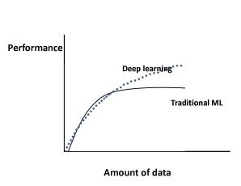
Improving model performance
Data
Add more training data
This course is Proof of Concept.
Our focus majorly on framework used for document extraction.
Beauty of the course is you can use same framework and you add more data that can increase the model accuracy
Training Data Increases $→$ Model accuracy Increases

Slide 3
Improving model performance
Change Data Preparation Framework (not guarantee method)
Cleaning Data

Slide 4
next
Version - 2 model

