Slide 1
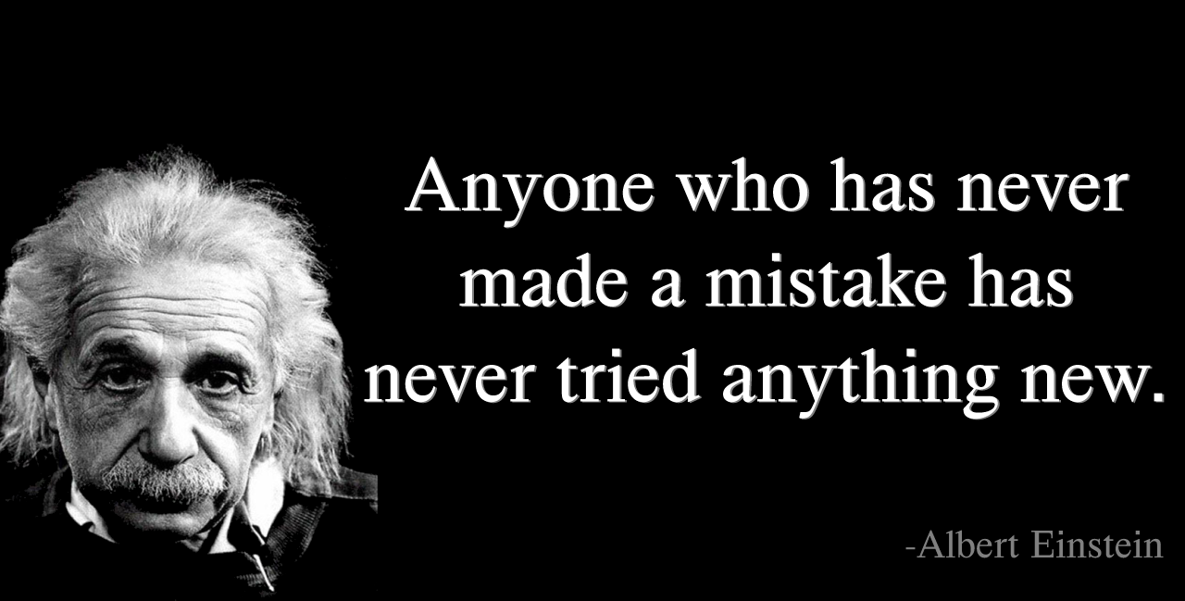
Facing Issue ?

Slide 2
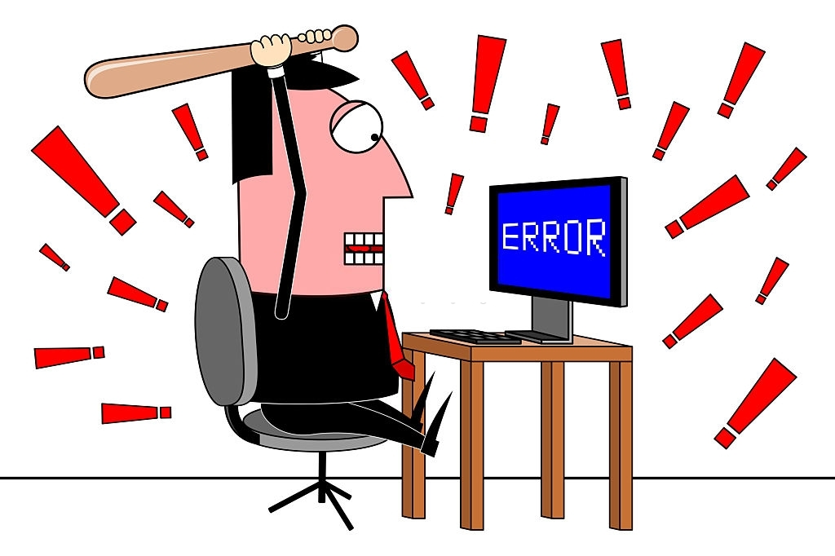
Don’t Discourage with Error
A student can become professional
if he know how to solve error

Slide 3
next
Version - 2 model

