Slide 1
flipkart
Sales Data analysis
Project owner : Samiksha Jagne

Slide 2
ContentS
1 | INTRODUCTION
2 | OBJECTIVE
3 | RECOMENDED ANALYSIS
4 | CONCLUSION
5 | CONTACT

Slide 3
iNTRODUCTION
What is the problem?
The aim is to analyze the Flipkart sales dataset to understand customer preferences, product performance, and sales trends. The analysis will focus on identifying the most popular categories, brands, pricing strategies, and customer ratings.
Why is it important to solve it?
Solving this problem will help Flipkart make data-driven decisions to improve product listings, pricing strategies, and customer satisfaction. The insights gained from this analysis could lead to increased sales, better customer retention, and improved overall business performance.

Slide 4
Recomended analysis
1. Which are the top 5 product categories based on the number of listings?
2. How many products have customer ratings?
3. What is the average discount offered by Flipkart across all products?
4. Which are the top 3 most expensive products listed on Flipkart?
5. Which products have the longest and shortest descriptions?

Slide 5
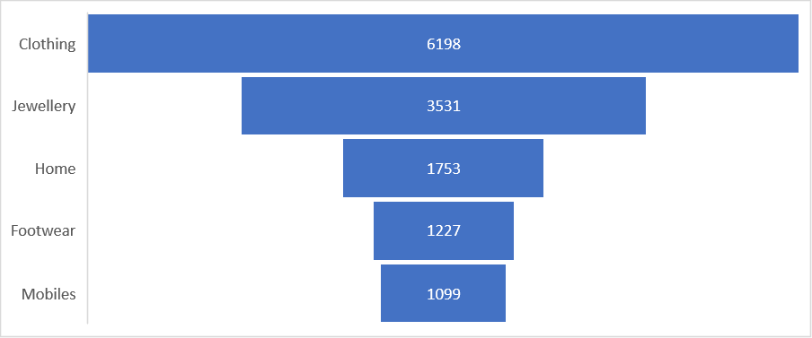
1. Which are the top 5 product categories based on the number of listings?

Slide 6
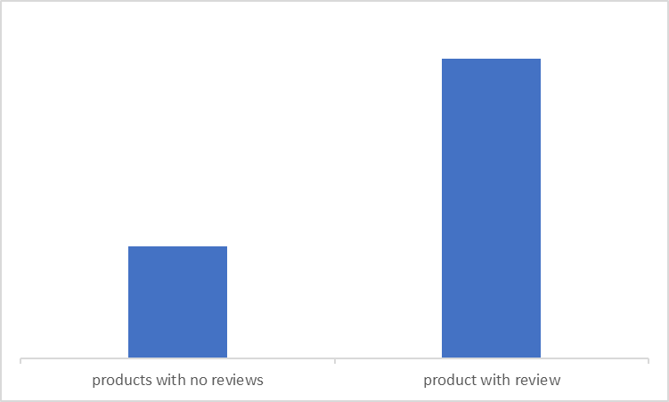
2. How many products have customer ratings?
products with no reviews = 27007 | products with no reviews = 27007 | products with no reviews = 27007 | products with no reviews = 27007
product with reviews = 16204 | product with reviews = 16204 | product with reviews = 16204 | product with reviews = 16204

Slide 7
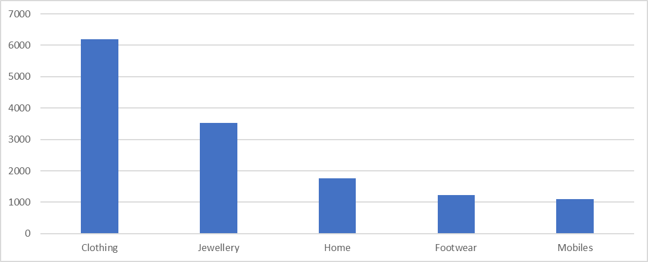
3. What is the average discount offered by Flipkart across all products?

Slide 8
4. Which are the top 3 most expensive products listed on Flipkart?
product_name | Category | retail_price
Breitling AB011010/BB08 131S Chronomat 44 Analog Watch - For Boys, Men | Watches | 571230
Durian Leather 2 Seater Sofa | Furniture | 250500
Durian Laze/3 Leather 3 Seater Sofa | Furniture | 217500

Slide 9
5. Which products have the longest and shortest descriptions?
Largest description | shortest description
Clothing | arlz
Jewellery | art
Home | ashvat
Automotive | azing
Footwear | B

Slide 10
Conclusion
As Conclusion it can be said that flipkart has a great number of audience traffic . Customers mostly buys clothes and jwellery from flipkart also customers share their review of product they buy.

Slide 11
Thank You
Project owner : Samiksha Jagne
LinkedIn : https://www.linkedin.com/in/samiksha-jagne/
Github: https://github.com/samikshajagne
Peerlist : https://peerlist.io/samiksha_jagne

