Slide 1
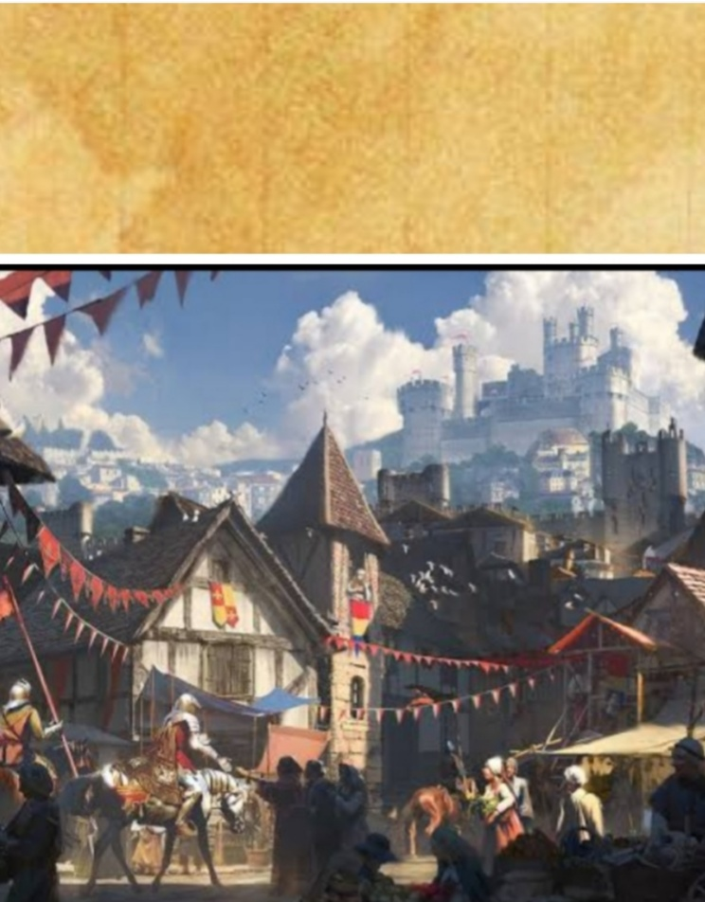
Welcome to the
Wizarding World
of
Harry
Potter

