Slide 1
Machine Predictive Maintenance
Presented by
Miss. Samiksha Narayan Gujar

Slide 2
Problem Statement
The goal of this project is to develop a predictive maintenance model to anticipate potential failures of machines based on historical operational data.
By analyzing various sensor measurements and operational parameters, The objective is to implement proactive maintenance costs and optimize machine performance.

Slide 3
About the Dataset:
Datashape:
Categorical Columns:
Numerical Columns:
Target Column
Rows=10000
Columns=10
ProductID,Type,Failuretype
UDI,Airtemperature,Processtemperature,Rotationalspeed,Target,
Toolwear
Target is the target column

Slide 4
Flow of the Project
Data Collection
Data
Preprocessing
Data Frame 1
Class
Imbalance
EDA
Data Frame 2
Feature
Selection
Data Frame 3

Slide 5
Preprocessing
Missing Value Treatment
Data Type Conversion
Duplicate Checking

Slide 6
DataFrame 1
S.no | ModelName | Accuracy | fpr | tpr | f1score
0 | Logistic Regression | 98.20 | 0.507246 | 0.999482 | 0.990760
1 | Decision Tree | 99.65 | 0.014493 | 0.996893 | 0.998185
2 | Random Forest | 99.95 | 0.014493 | 1.000000 | 0.999741
3 | Naïve Bayes | 67.20 | 0.826087 | 0.998964 | 0.984937
4 | Support Vector Machine | 96.55 | 0.347826 | 0.672708 | 0.798402
5 | KNN | 97.00 | 0.782609 | 0.996893 | 0.984655
6 | AdaBoost | 99.75 | 0.014493 | 0.997929 | 0.998704
7 | Xgboost | 99.95 | 0.014493 | 1.000000 | 0.999741

Slide 7
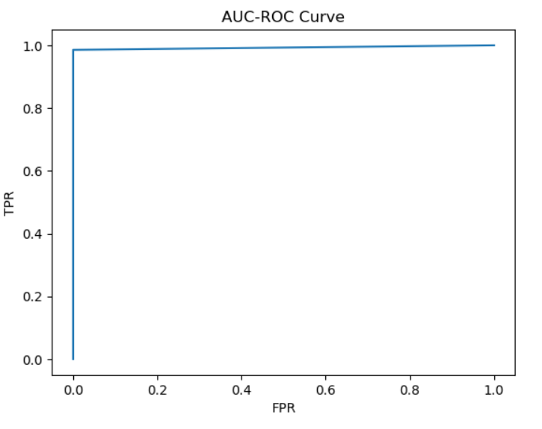
Conclusion for DataFrame 1: The best fitted model is Xgboost in this accuracy,f1score and tpr is high and fpr is low.

Slide 8
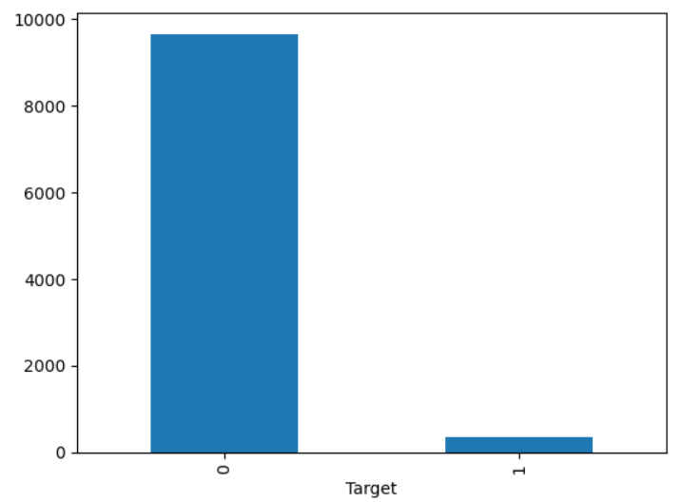
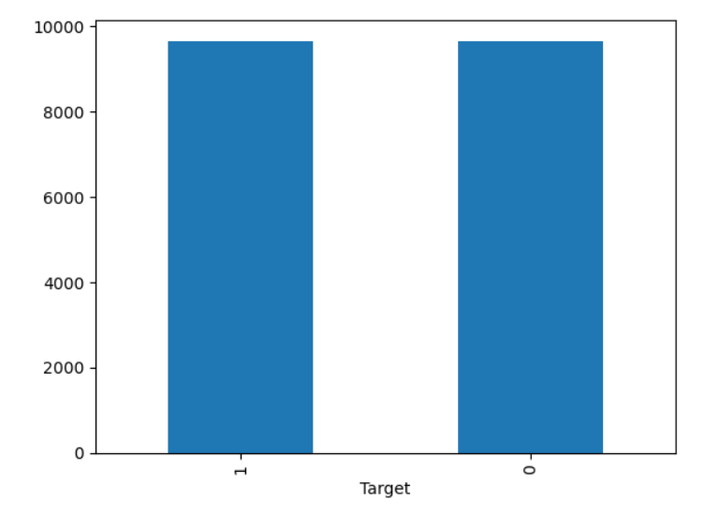
Class Imbalance: I perform undersampling technique this are before and after the class imbalance.

Slide 9
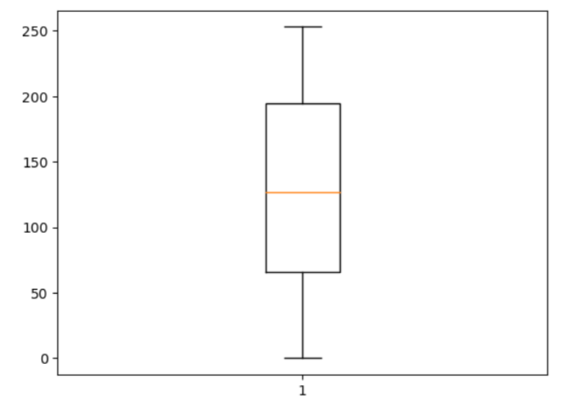
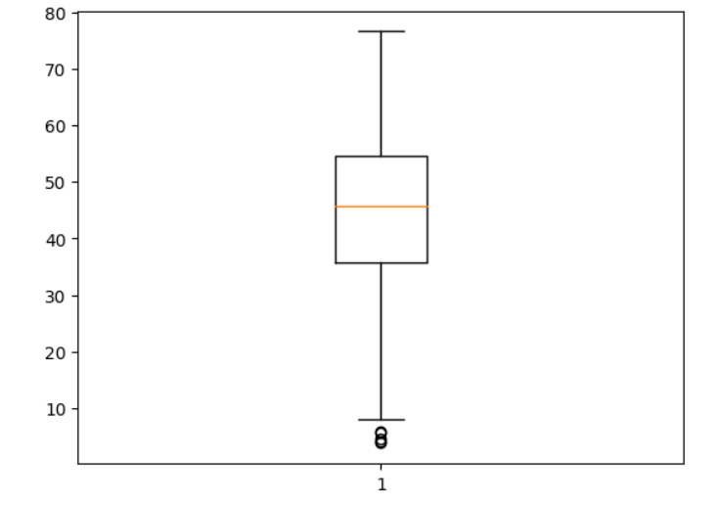
Outliers Treatment Tool Wear Torque

Slide 10
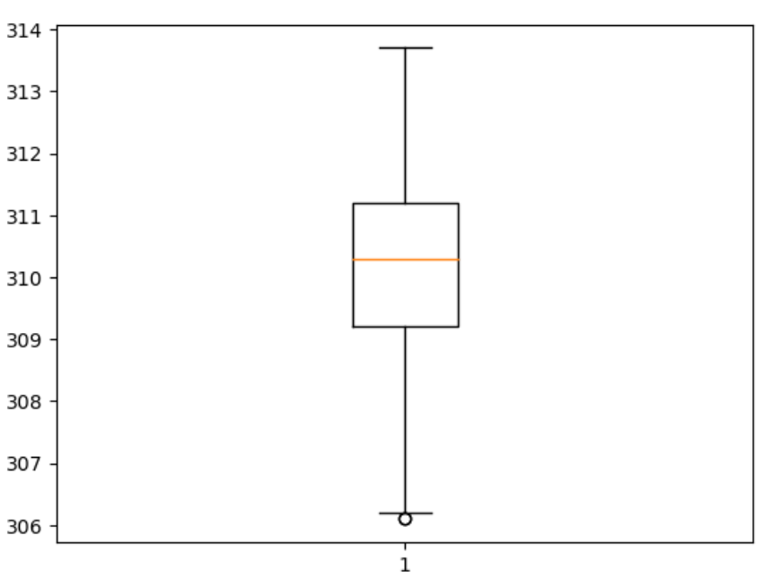
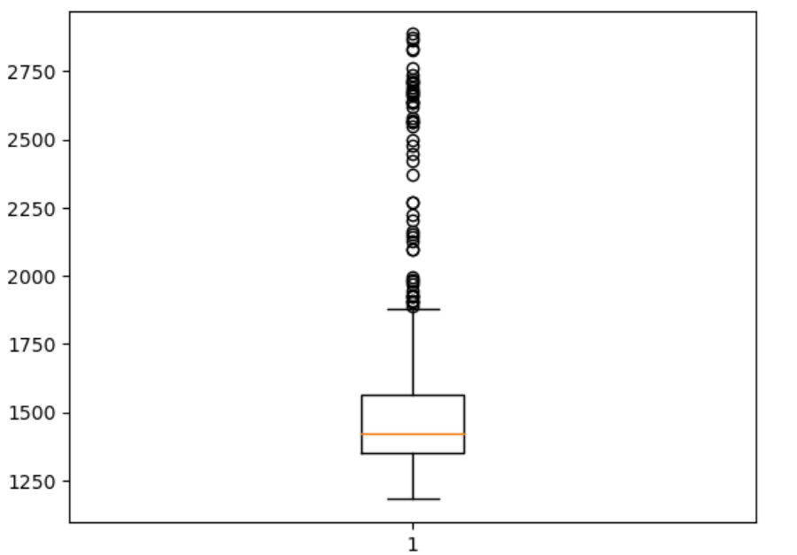
Process temperature
Rotational Speed

Slide 11
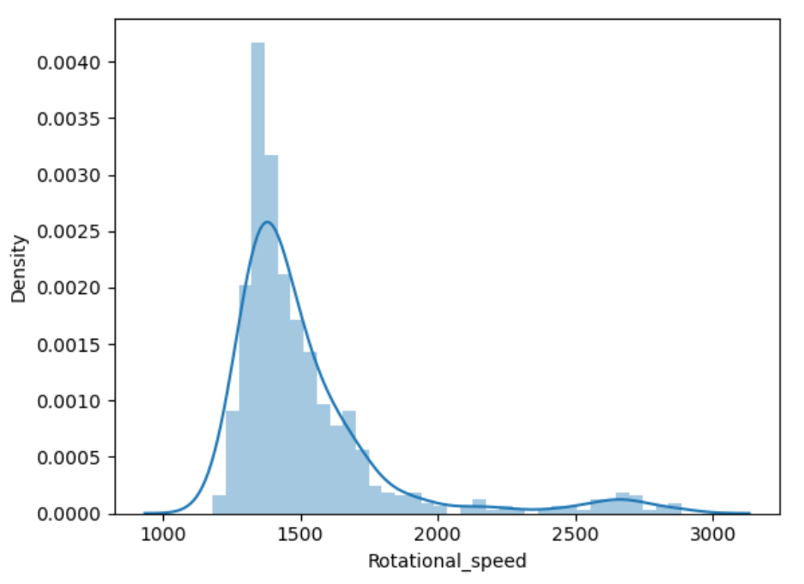
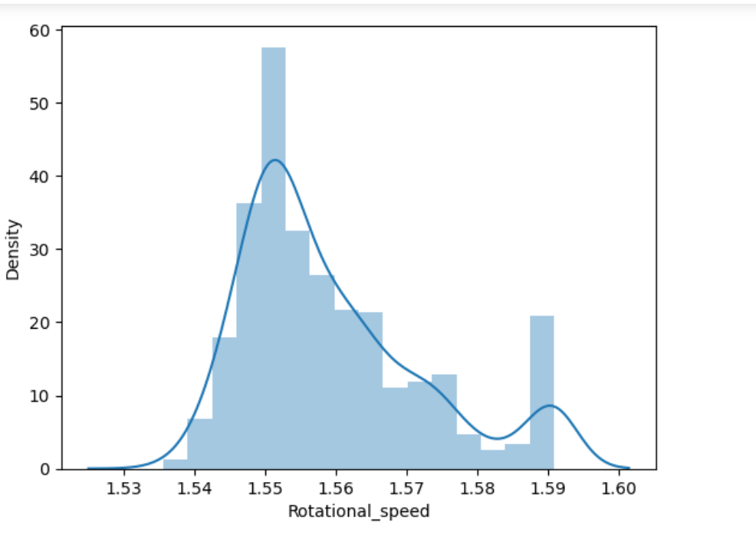
SKEWNESS
Before
After

Slide 12
DataFrame 2
Sr no | ModelName | Accuracy | fpr | tpr | f1score
0 | Logistic Regression | 77.205882 | 0.266667 | 0.802632 | 0.797386
1 | Decision Tree | 96.323529 | 0.050000 | 0.973684 | 0.967320
2 | Random Forest | 96.323529 | 0.050000 | 0.973684 | 0.967320
3 | Naïve Bayes | 66.911765 | 0.366667 | 0.697368 | 0.701987
4 | Support Vector Machine | 72.058824 | 0.433333 | 0.842105 | 0.771084
5 | KNN | 72.058824 | 0.383333 | 0.802632 | 0.762500
6 | AdaBoost | 95.588235 | 0.050000 | 0.960526 | 0.960526
7 | Xgboost | 97.794118 | 0.050000 | 1.000000 | 0.980645

Slide 13
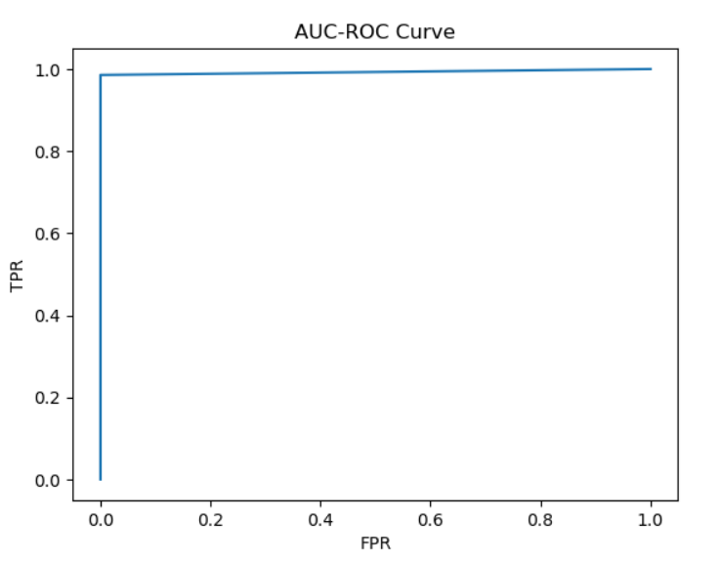
Conclusion for DataFrame 2: The best fitted model is xgboost in this accuracy,f1score and tpr is high and fpr is low.

Slide 14
Feature Engineering
Using RFE Method

Slide 15
DataFrame 3
Sr no | ModelName | Accuracy | fpr | tpr | f1score
0 | Logistic Regression | 73.529412 | 0.366667 | 0.815789 | 0.775000
1 | Decision Tree | 97.058824 | 0.050000 | 0.986842 | 0.974026
2 | Random Forest | 97.794118 | 0.050000 | 1.000000 | 0.980645
3 | Naïve Bayes | 83.088235 | 0.383333 | 1.000000 | 0.868571
4 | Support Vector Machine | 66.176471 | 0.600000 | 0.868421 | 0.741573
5 | KNN | 58.823529 | 0.550000 | 0.697368 | 0.654321
6 | AdaBoost | 97.058824 | 0.050000 | 0.986842 | 0.974026
7 | Xgboost | 97.794118 | 0.050000 | 1.000000 | 0.980645

Slide 16
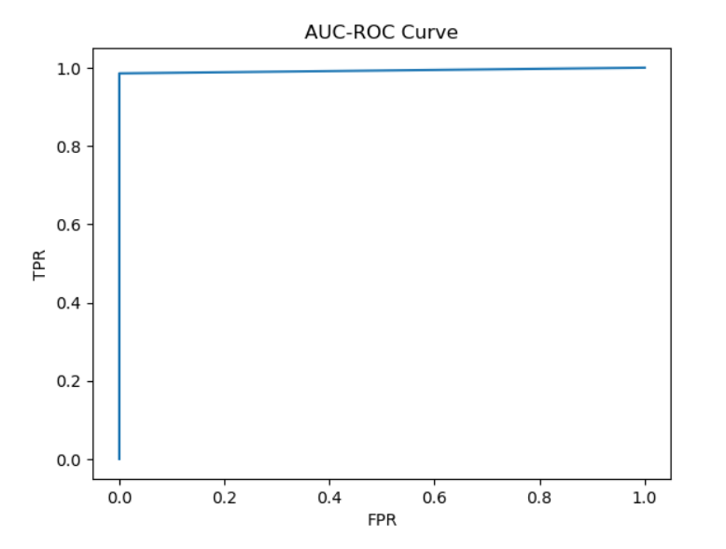
Conclusion For DataFrame 3: The best fitted model is xgboost in this accuracy,tpr and f1score is high and fpr is low

Slide 17
Merits: Cost Savings: Predictive maintenance can help prevent unexpected failures and reduce downtime, leading to significant cost savings by avoiding unscheduled repairs and production losses. Enhanced Safety: Proactive maintenance reduces the likelihood of equipment failures that could pose safety risks to workers and the surrounding environment.
Demerits:
Initial Investment: Implementing predictive maintenance systems typically requires an initial investment in sensors, data collection infrastructure, analytics software, and training, which can be costly for some organizations.
Data Quality and Availability: Predictive maintenance relies heavily on the quality and availability of data. Issues such as incomplete or inaccurate data can undermine the effectiveness of predictive maintenance efforts.

Slide 18
THANK YOU!!

