Slide 1
GLOBAL SUPERSTORE ANALYTICS
Executive Decision Report & Business Intelligence Capstone
Data-Driven Insights for Revenue Growth, Profitability & Business Optimization
Prepared by: Samiksha
September 2026

Slide 2
Executive Summary
02
• Strong business scale: 51,290 transaction records, approximately $12.64M sales and $1.47M profit.
• Technology is the leading sales category in the current dashboard.
• Profitability differs across categories and sub-categories, showing that revenue and margin need to be managed together.
• Monthly sales show an overall upward long-term pattern with periodic fluctuations.
• Business opportunity: grow high-performing areas while strengthening margin and product-level controls.
Global Superstore Analytics | Executive Decision Report
September 2026

Slide 3
Business Problem & Analytical Objectives
03
• Business problem: management needs a consolidated view of sales, profitability, products, markets and segments to support business decisions.
• 01 — Measure performance: sales, profit, orders, average order value and margin.
• 02 — Identify revenue drivers: categories, products, regions and segments.
• 03 — Understand profitability: compare profit and margin across product groups.
• 04 — Support decisions: convert analytical findings into measurable actions.
Global Superstore Analytics | Executive Decision Report
September 2026

Slide 4
Data & Analytical Methodology
04
• Dataset: Global Superstore Orders.
• 51,290 records and 24 columns; analysis period 2011–2014.
• Key measures: Sales, Profit, Quantity, Discount and Shipping Cost.
• Dimensions: Category, Sub-Category, Region, Country and Segment.
• Workflow: Raw Data → Cleaning → Transformation → EDA → KPI Analysis → Interactive Dashboard → Recommendations.
• Tools: Python, Pandas, Matplotlib/Plotly, Streamlit and Excel.
Global Superstore Analytics | Executive Decision Report
September 2026

Slide 5
Business Performance at a Glance
05
TOTAL SALES
TOTAL PROFIT
TOTAL ORDERS
AVERAGE ORDER VALUE
PROFIT MARGIN
$12.64M
$1.47M
25,035
$504.99
11.61%
The business generates substantial sales volume and positive overall profitability, providing a foundation for targeted growth and margin improvement.
Global Superstore Analytics | Executive Decision Report
September 2026

Slide 6
Sales Trend Analysis
06
• Monthly sales from 2011–2014 show an overall upward trajectory.
• Performance varies by month, with periods of decline followed by recovery.
• Later periods reach substantially higher monthly sales levels than the beginning of the dataset.
• Management implication: monthly monitoring can support inventory, promotion and resource planning.
Global Superstore Analytics | Executive Decision Report
September 2026

Slide 7
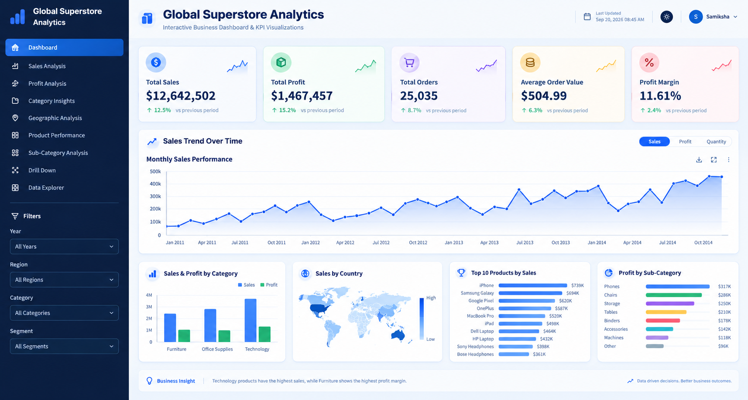
What Drives Revenue?
07
• Technology is the highest-sales category in the dashboard.
• Office Supplies provides a broad and significant sales contribution.
• Furniture contributes meaningful revenue and is important for profitability analysis.
• Top-sales products shown in the dashboard include iPhone, Samsung Galaxy, Google Pixel, OnePlus and MacBook Pro.
• Management implication: monitor high-contribution products for demand, inventory and promotion decisions.
Global Superstore Analytics | Executive Decision Report
September 2026

Slide 8
Profitability & Margin Analysis
08
• Overall profit is approximately $1.47M with an overall margin of 11.61%.
• Technology has the highest sales contribution, while Furniture shows the highest profit margin in the dashboard.
• Top profit sub-categories shown include Phones (~$317K), Chairs (~$286K), Storage (~$250K), Tables (~$210K) and Binders (~$178K).
• Key insight: high sales volume and high profitability are not necessarily concentrated in the same product groups.
Global Superstore Analytics | Executive Decision Report
September 2026

Slide 9
Geographic Performance
09
• The dataset covers sales across multiple countries and regions.
• Performance varies across markets, creating opportunities for targeted allocation of marketing and inventory resources.
• Country and regional views should be monitored alongside category and segment performance.
• Management implication: avoid applying identical commercial strategies across all markets.
Global Superstore Analytics | Executive Decision Report
September 2026

Slide 10
Product & Sub-Category Performance
10
• Top products by sales shown in the dashboard include iPhone (~$739K), Samsung Galaxy (~$694K), Google Pixel (~$620K), OnePlus (~$587K) and MacBook Pro (~$520K).
• Profit leaders include Phones, Chairs, Storage, Tables and Binders.
• Product-level analysis shows that the products generating the most revenue and the products generating the most profit should be managed using different performance criteria.
Global Superstore Analytics | Executive Decision Report
September 2026

Slide 11
Key Risk Areas & Opportunities
11
• RISK — Margin pressure: overall margin is 11.61%, so discount and pricing decisions require monitoring.
• RISK — Performance variation: monthly sales fluctuate considerably.
• RISK — Product concentration: a limited group of products contributes substantial sales.
• OPPORTUNITY — Margin optimization through discount/profit monitoring.
• OPPORTUNITY — Technology growth through targeted campaigns and inventory availability.
• OPPORTUNITY — Product portfolio optimization and continuous KPI monitoring.
Global Superstore Analytics | Executive Decision Report
September 2026

Slide 12
Recommendation 1 — Strengthen Margin Management
12
• Action: establish a margin monitoring framework using Discount %, Sales, Profit, Margin, Product, Sub-Category and Region.
• Phase 1: identify low-margin products and discount patterns.
• Phase 2: establish margin thresholds and review exceptions.
• Phase 3: monitor results monthly through the dashboard.
• Illustrative scenario: a 1 percentage-point margin improvement at current sales equals approximately $126,425 additional profit.
• Scenario only — not a guaranteed forecast.
Global Superstore Analytics | Executive Decision Report
September 2026

Slide 13
Recommendation 2 — Expand High-Performing Technology Revenue
13
• Evidence: Technology is the highest-sales category in the dashboard.
• Action: focus growth initiatives on high-performing technology products, cross-selling, bundles, targeted promotions and inventory availability.
• Illustrative scenario: a 5% increase on approximately $3.7M technology sales represents about $185K additional sales.
• At the current 11.61% overall margin, this is approximately $21.5K additional profit.
• Scenario only — actual results depend on implementation and realized margin.
Global Superstore Analytics | Executive Decision Report
September 2026

Slide 14
Recommendation 3 — Optimize Product & Order Value
14
• Current baseline: 25,035 orders and $504.99 average order value.
• Action: increase order value through bundles, complementary products, premium recommendations and targeted offers.
• Illustrative scenario: a 3% AOV increase raises AOV to about $520.14.
• Across 25,035 orders, this represents approximately $379K additional sales.
• At the current overall margin, the equivalent profit impact is approximately $44K.
• Scenario only — actual results depend on adoption and realized margin.
Global Superstore Analytics | Executive Decision Report
September 2026

Slide 15
ROI Scenarios & 90-Day Implementation Roadmap
15
1% MARGIN IMPROVEMENT
5% TECHNOLOGY GROWTH
3% AOV IMPROVEMENT
+$126K PROFIT
+$185K SALES
+$379K SALES
0–30 DAYS
31–60 DAYS
61–90 DAYS
DIAGNOSE
IMPLEMENT
OPTIMIZE
Baseline, low-margin products, discount patterns
Monitoring, campaigns, bundles, market reviews
Compare results, scale, adjust and review ROI
Final message: use the dashboard as a continuous decision-support system, not only as a reporting tool.
Global Superstore Analytics | Executive Decision Report
September 2026

