Slide 1



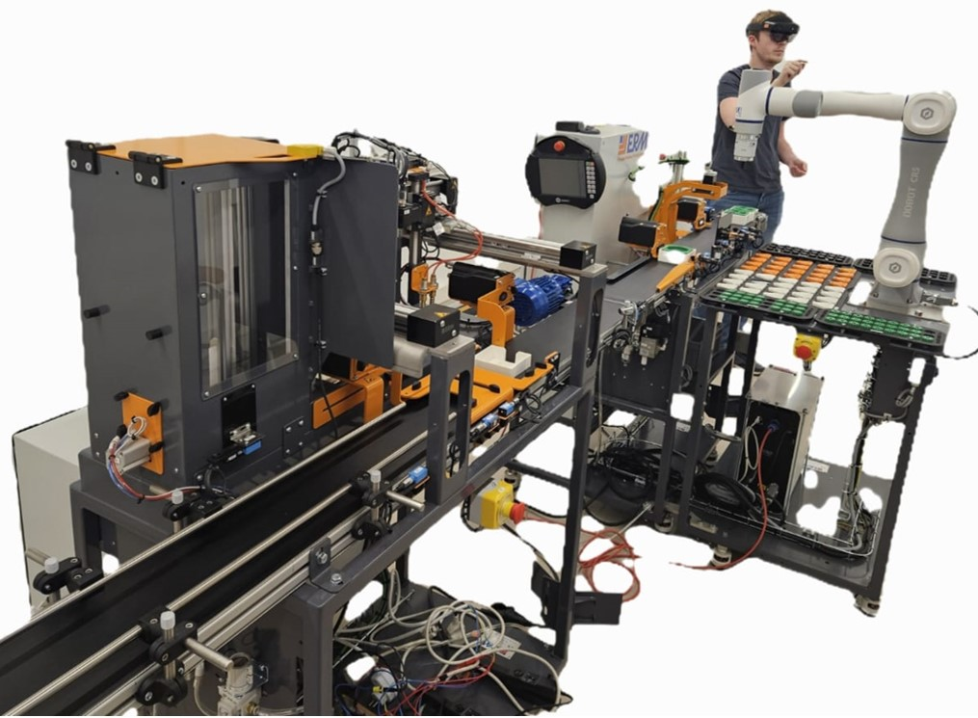
INTERNSHIP · EULER LABORATORY · ISAE-SUPMÉCA
Mechatronics Modelling
of an Entire Industry 5.0
Production Line
Intern: Ms. Samiksha Satre
Duration: 4 Months
Supervisor: Mr.Romain Delabeye
Period: February 2026 To June 2026
Location: Isae-supméca Paris, France
The ALIX line — ERMASMART (ERM Automatismes) · CR5 cobot under AR
Electronics & Telecommunication Engineering
N. K. Orchid College of Engineering & Technology, Solapur

Slide 2
INDEX
THE MISSION
THE SYSTEM
SPATIAL REPRESENTATION
WORKFLOW
MULTIPHYSICS MODELS
STATIONS
REAL-TIME EXPERIMENT ON THE ALIX LINE
VALIDATION
SCIENTIFIC HONESTY
SCIENTIFIC HONESTY
ENERGY ANALYSIS
SPATIAL LAYOUT & COUPLING ANALYSIS
DELIVERABLES
CONCLUSION
Euler Laboratory
ALIX · Industry 5.0 Digital Twin | Euler Laboratory, ISAE-Supméca
2

Slide 3
THE MISSION
From physical line to digital twin
The objective: build a unified process, mechatronic and multiphysics model of an entire Industry 5.0 production line — bridging physical processes, control logic and intelligent decision-making — as the foundation of a digital twin for reconfiguration and optimisation.
THE HOST
Euler Laboratory
ISAE-Supméca, Saint-Ouen · Paris
1
Analyse the line architecture & mechatronic subsystems
Theme — IS2M
Multiphysics & Mechatronic Systems Engineering. Studies the multidisciplinary design of complex systems: mechatronics, robotics, cyber-physical & production systems (CPS / CPPS), systems of systems.
2
Model each subsystem in Modelica (mech · electrical · thermal)
3
Integrate the production sequence & process logic
4
Export to FMUs and orchestrate from Python via FMI
5
Simulate the whole line end-to-end from one program
Application domains: aeronautics · automotive · naval · rail · energy · medical · Industry 4.0 / 5.0 production lines.
6
Identify parameters & validate against measurements
ALIX · Industry 5.0 Digital Twin | Euler Laboratory, ISAE-Supméca
3

Slide 4
THE SYSTEM
ALIX — the ERMASMART Industry 5.0 line
ALIX is the lab's ERMASMART line by ERM Automatismes (Carpentras, France) — a bench-top flexible line showcasing smart sensors, IO-Link, supervision, cobotics, vision & RFID traceability.
8445 mm
3-ph 400 V
S7-1200
30 s
line length
244 V phase · 50 Hz
Siemens PLC · TULIP
cadence / finished pot
The five stations (packaging mode)
ON10
DX10
CR5
XY10
VL10
›
›
›
›
Bin-picking cobot
2D vision feed-in
Dosing axis
fills pots
Capping cobot
6-DOF Dobot
Cartesian XYZ
packs into trays
Vertical magazine
finished-tray store
Continuous conveyor belt — runs through all five stations
Coloured = modelled in this project
ALIX · Industry 5.0 Digital Twin | Euler Laboratory, ISAE-Supméca
4

Slide 5
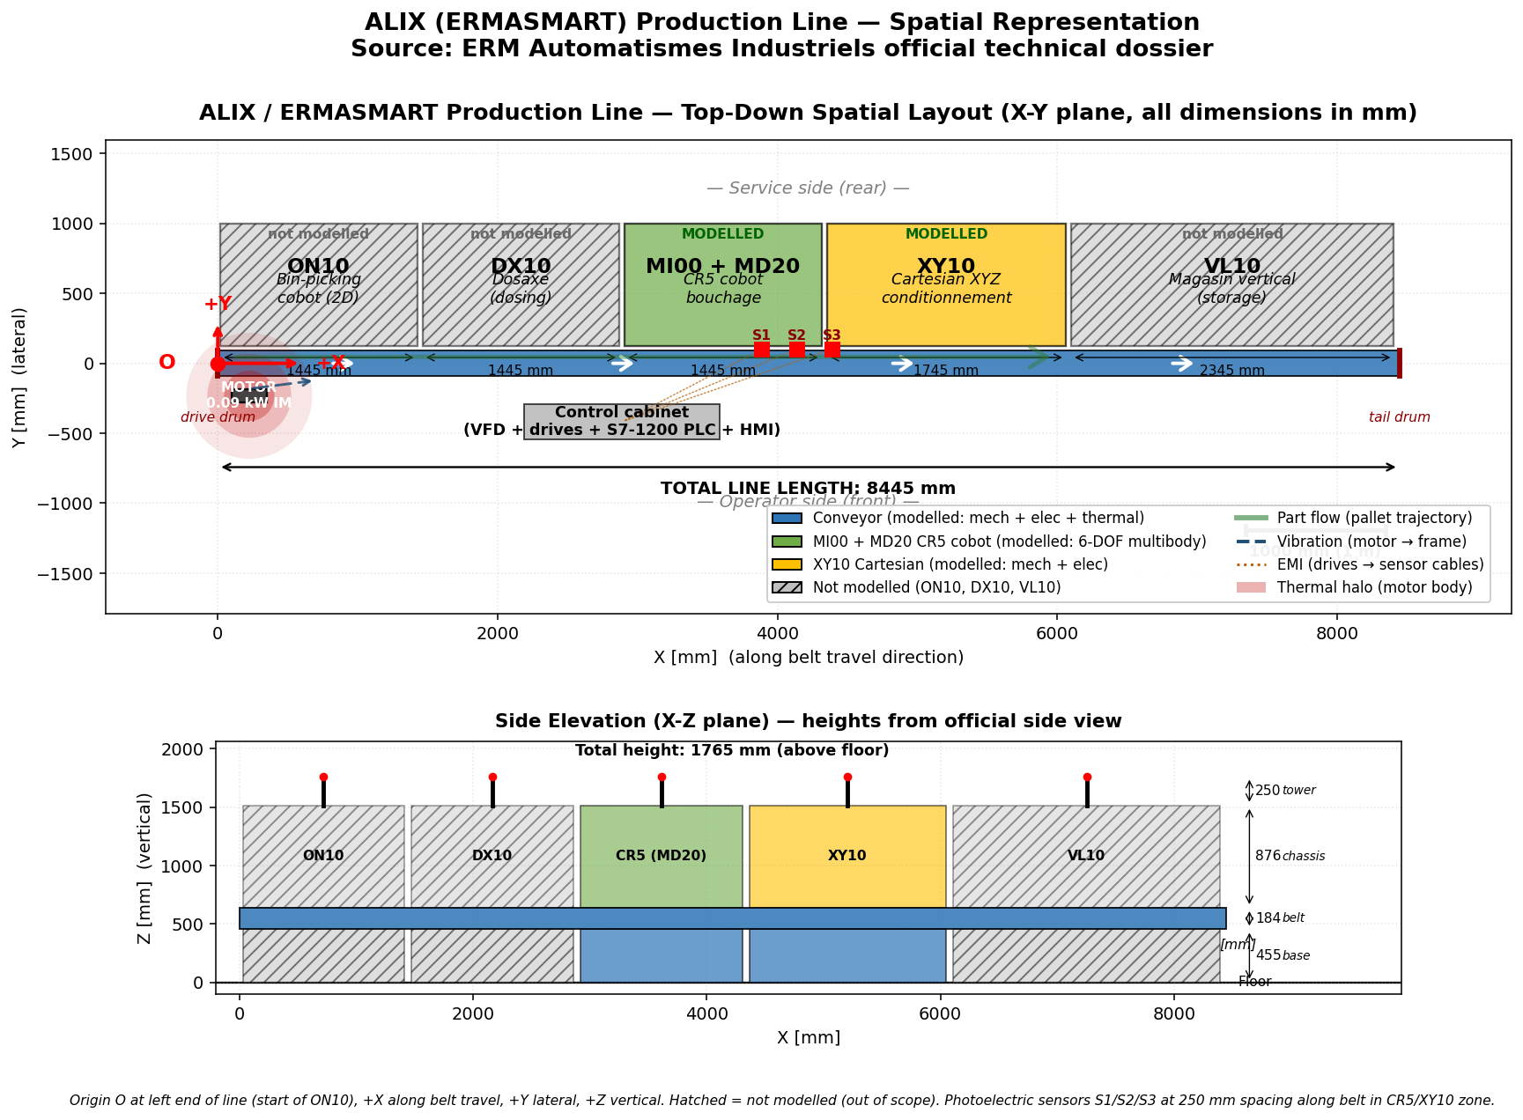
SPATIAL REPRESENTATION
5

Slide 6
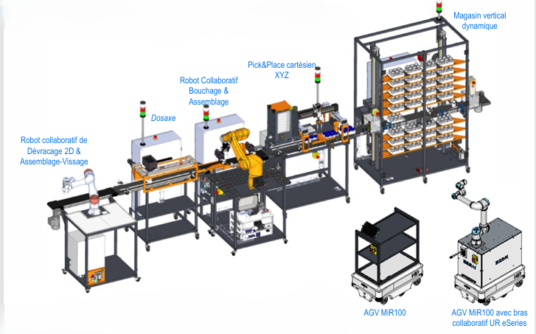
STATIONS
ALIX · Industry 5.0 Digital Twin | Euler Laboratory, ISAE-Supméca
6

Slide 7
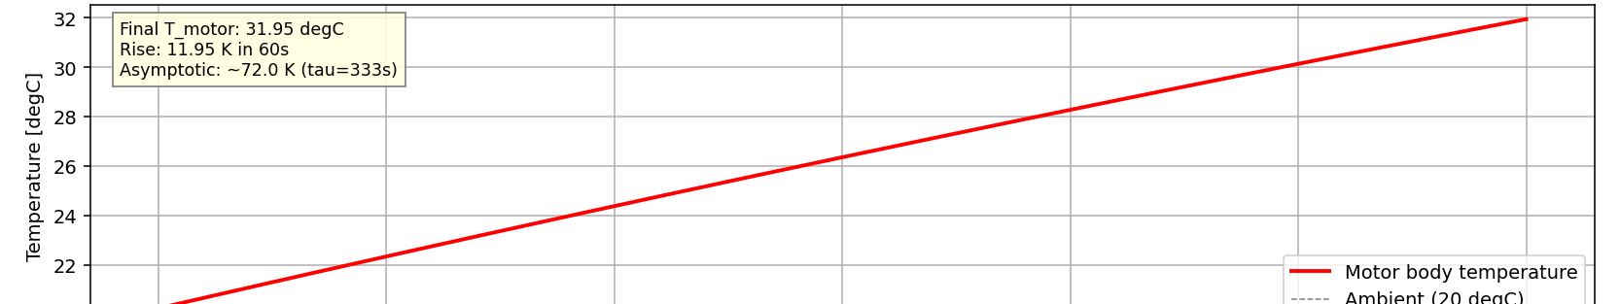
MULTIPHYSICS MODEL 1 · CONVEYOR
Electrical → mechanical → thermal chain
3-ph supply
244 V · 50 Hz
Induction
motor
Gearbox
i = 20
Drum +
belt load
→
→
→
Thermal branch: motor losses ≈ 108 W → body C = 500 J/K → conductance G = 1.5 W/K → ambient 20 °C
Key parameters
Thermal FMU — verified vs analytical
Stator / rotor R | 12 Ω / 8 Ω
Magnetising Lm | 0.45 H
Leakage Lσ | 0.025 H
Pole pairs | 2 (4-pole)
Gear ratio | 20
Heat capacity C | 500 J/K
Conductance G / τ | 1.5 W/K · 333 s
Steady-state prediction: 1499 rpm · 1.629 A RMS · 107.96 W
+11.95 K motor-body rise in 60 s — model vs analytical agreement 99.2%. P_elec matches the 3DEXPERIENCE reference to 0.0003 W.
ALIX · Industry 5.0 Digital Twin | Euler Laboratory, ISAE-Supméca
7

Slide 8
THREE SUBSYSTEMS
1.Conveyor Motor Model
Architecture diagram
Electrical
───────────────
3-phase 244 V
50 Hz supply
Mechanical
───────────────
Motor shaft
torque + ω
Thermal
───────────────
Body heat
capacity C
Stator + rotor
(squirrel cage)
Air-gap torque
equation
Conductance G
to ambient
Copper + iron losses
(heatPort)
Ambient 20 °C
ALIX · Industry 5.0 Digital Twin | Euler Laboratory, ISAE-Supméca
8

Slide 9
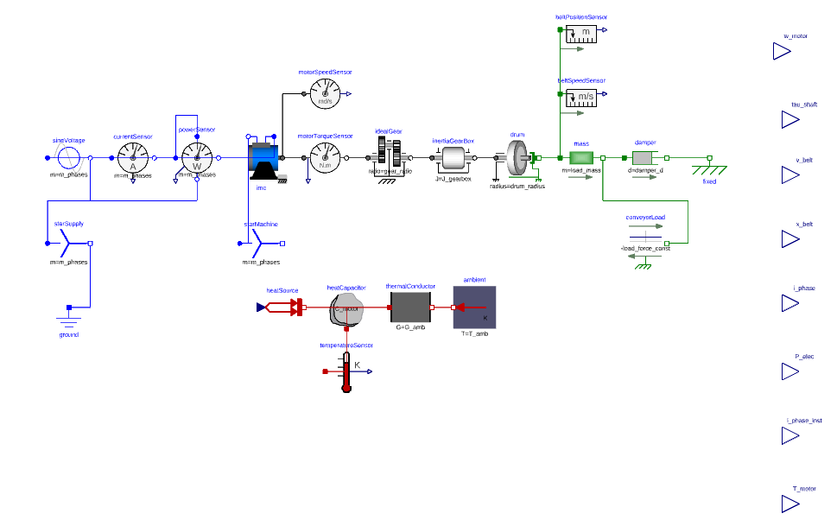
CONVEYOR MODEL
Fig No.1.Conveyor motor model
ALIX · Industry 5.0 Digital Twin | Euler Laboratory, ISAE-Supméca
9

Slide 10
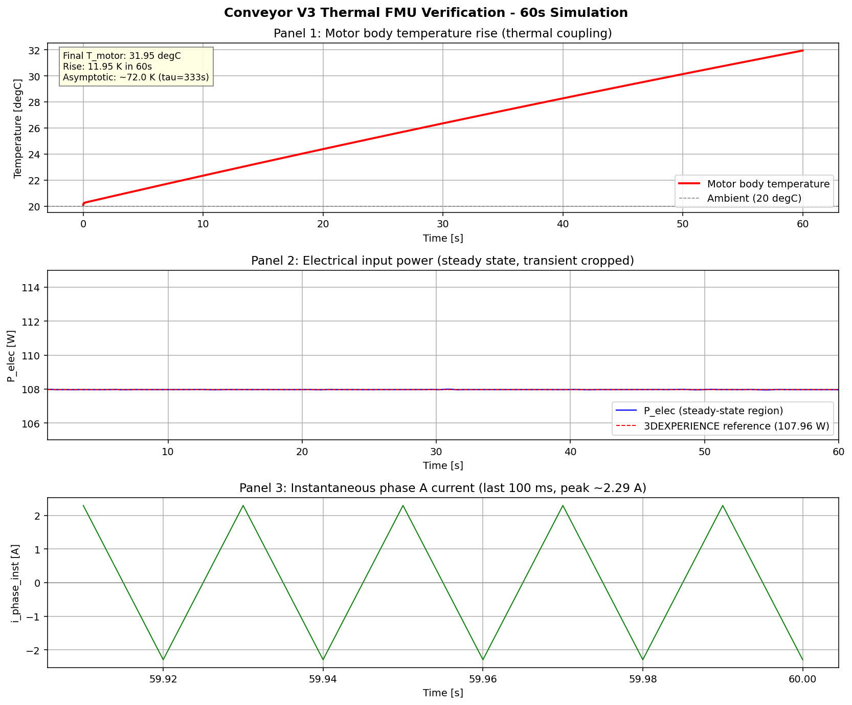
CONVEYOR FMU VALIDATION
Fig No.2.Conveyor motor model FMU Verification
ALIX · Industry 5.0 Digital Twin | Euler Laboratory, ISAE-Supméca
10

Slide 11
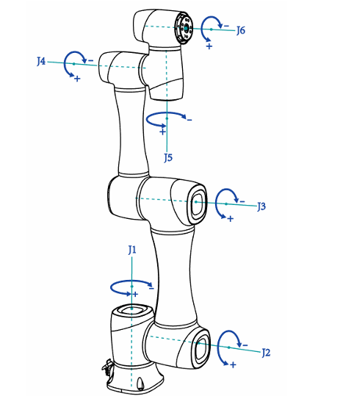
MODEL 2 · CR5 COBOT
A faithful 6-DOF multibody twin
Kinematic chain (Dobot CR5 axis convention)
J1
axis Z
—
J2
axis Y
—
J3
axis Y
—
J4
axis X
—
J5
axis Y
—
J6
axis Z
Geometry from the real robot
Per-link mass, COM and inertia extracted from the public CR5 CAD in 3DEXPERINCE; 6× Revolute + 6× BodyShape, Newton-Euler assembled automatically by the MultiBody library.
94.9%
Mass agreement
model 23.74 kg vs brochure 25 kg
Joint-2 gravity pendulum: period matches
CR5 Model
ALIX · Industry 5.0 Digital Twin | Euler Laboratory, ISAE-Supméca
11

Slide 12
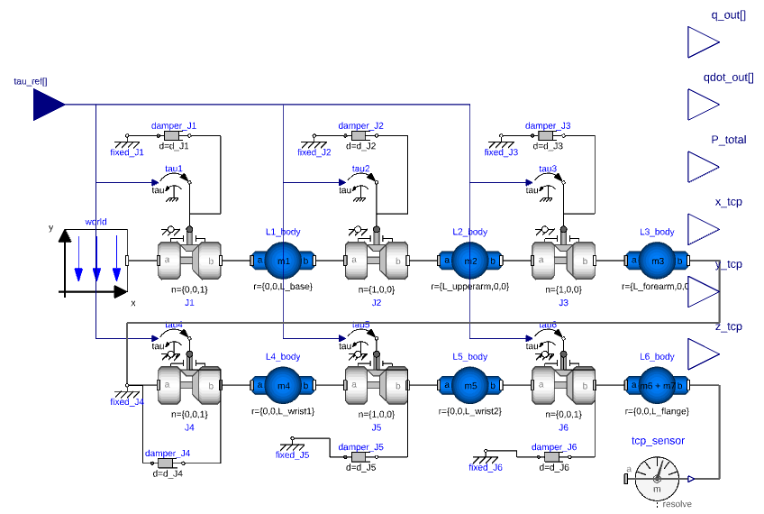
CR5 COBOT MODEL
Fig No.3. CR5 COBOT model
12

Slide 13
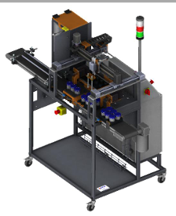
MODEL 3 · XY10 STATION
Cartesian gantry + vacuum gripper
Closed-loop drive (per axis · ×3 for X · Y · Z)
Position
command
PID
DC-equiv
voltage
R-L
winding
DC
machine
Lead-screw
(rot→lin)
Linear
stage
›
›
›
›
›
›
Position feedback closes the loop · vacuum gripper: Boolean command → switch → grip force
Honest abstraction: DC-equivalent steppers
Real steppers fire ±20 A in chopper mode; the FMU models a smooth ±3 A time-averaged drive. At line-orchestration level what matters is envelope, timing and energy — all captured. Chopper detail belongs to EMC studies, not digital-twin operation. A documented engineering choice, not an omission.
XY10 Station
13

Slide 14
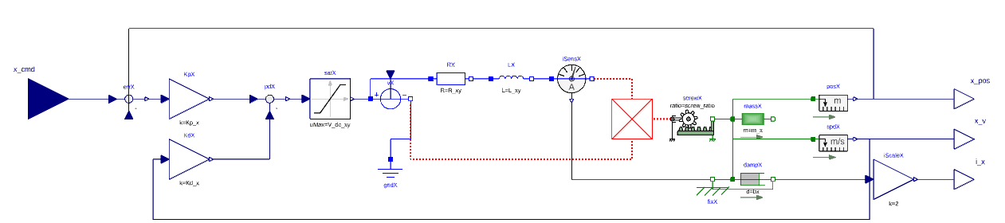
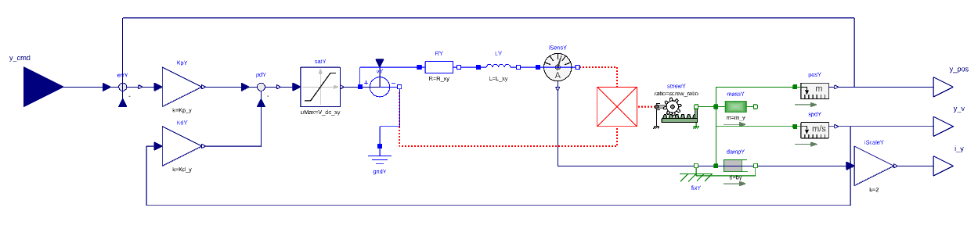
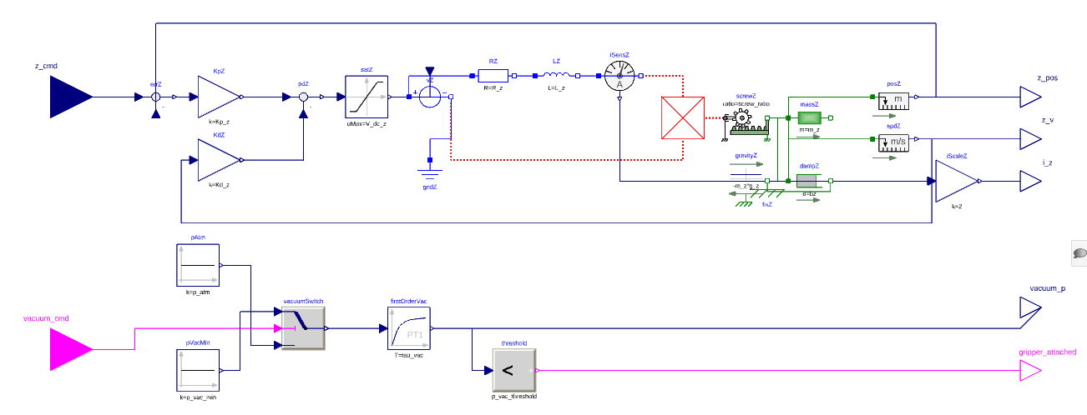
XY10 STATION MODEL
14

Slide 15
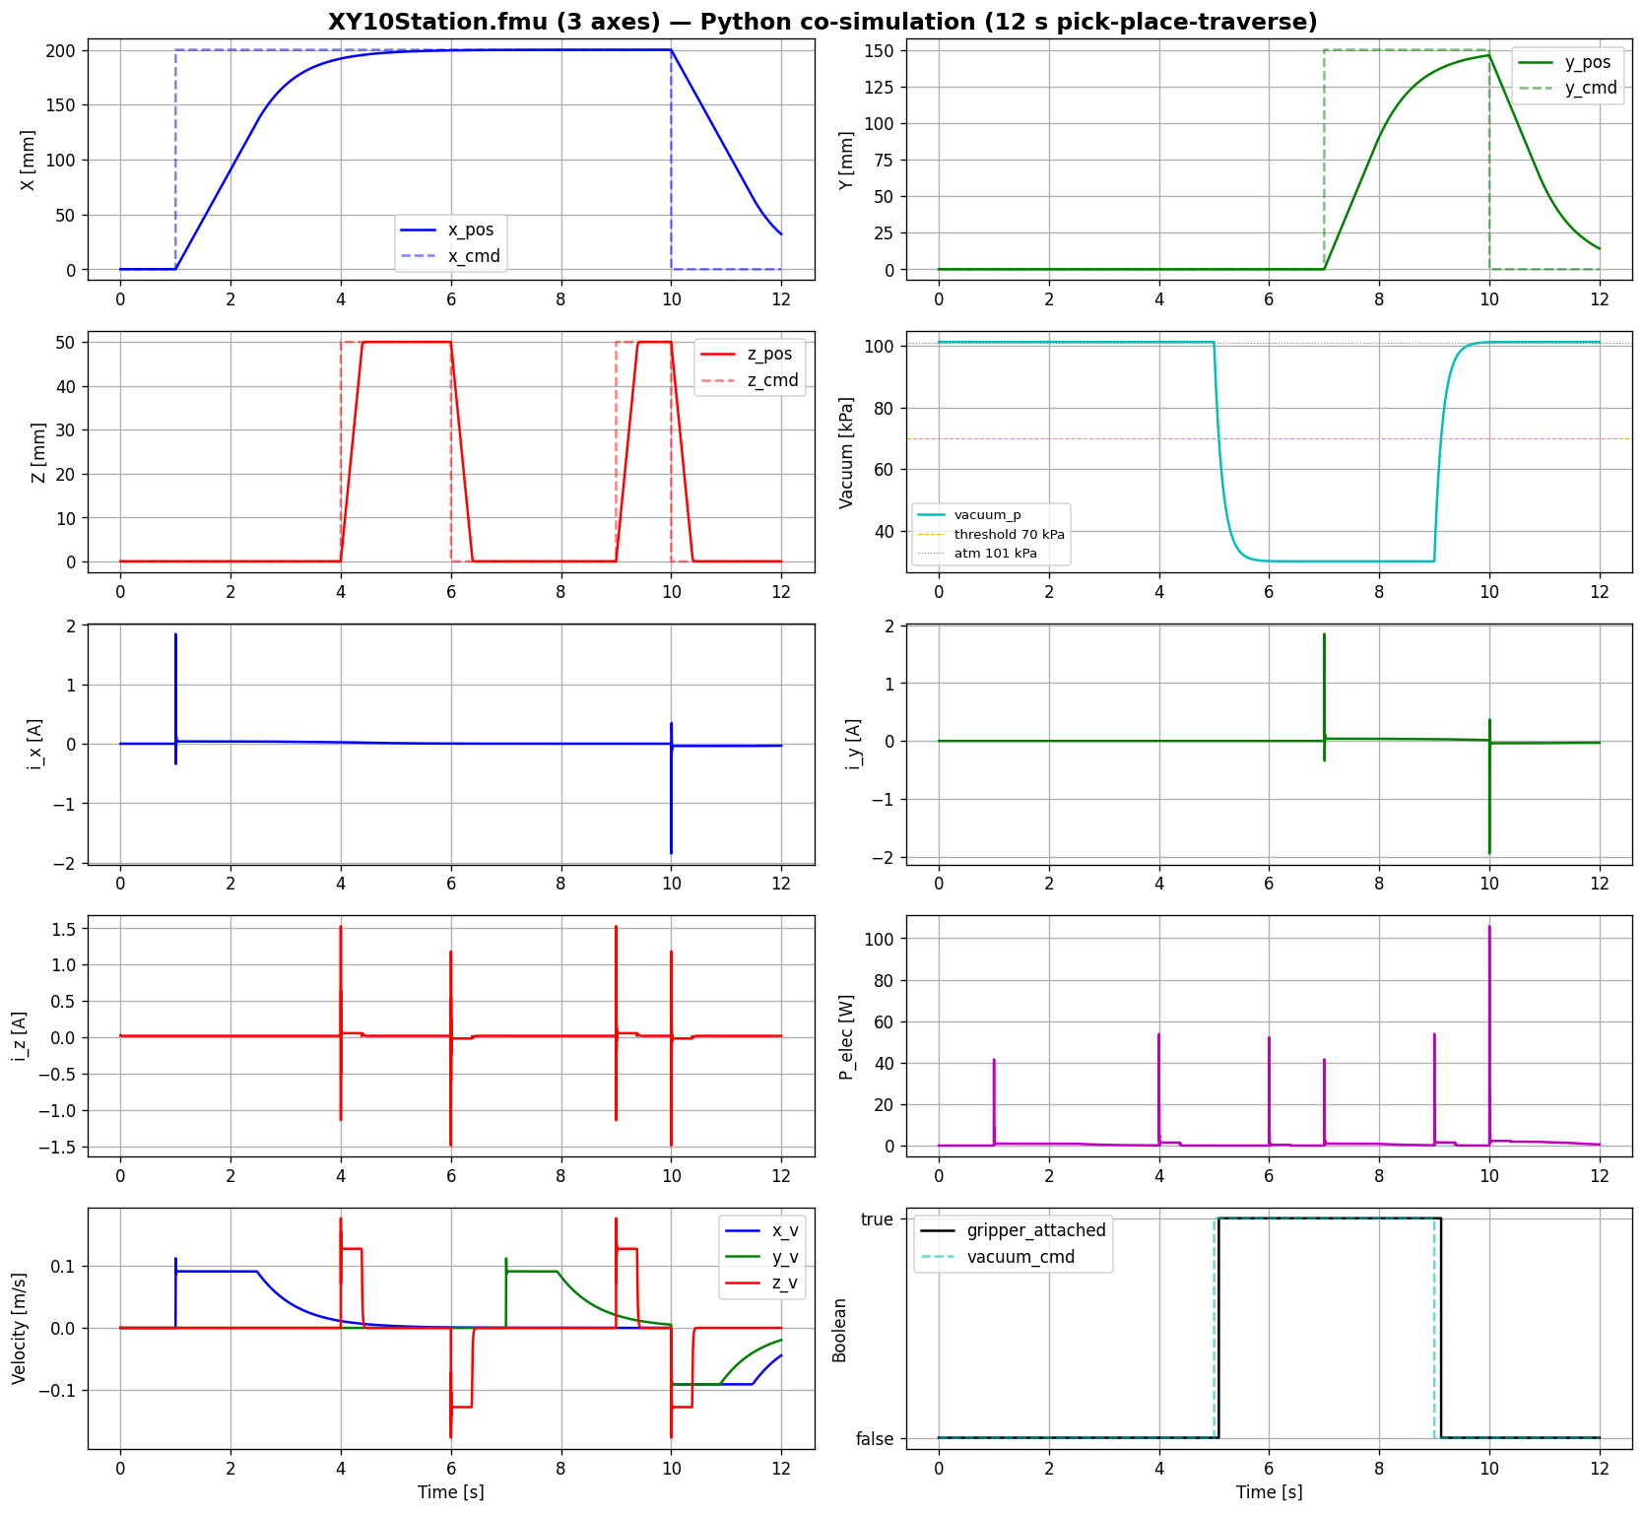
XY10 STATION FMU VALIDATION
15

Slide 16
WORKFLOW
1
Real-time experiment on the ALIX line
2
TDMS data acquisition
3
Multiphysics modelling in Dymola / 3DEXPERIENCE
4
5
Python orchestration
6
Two-stage validation + energy analysis
FMU export Each model exported as FMI 2.0 Co-Simulation FMU.
ALIX · Industry 5.0 Digital Twin | Euler Laboratory, ISAE-Supméca
16

Slide 17
REAL-TIME EXPERIMENT ON THE ALIX LINE
The experimental sequence:
t (s) | Action | Station
0 | Pot enters the line from the input magazine | (upstream)
5 | XY10 vacuum gripper picks the empty pot from the input tray | XY10
7 | XY10 places the pot onto the moving conveyor belt | XY10 → Conveyor
8 → 18 | Conveyor transports the pot along the line (0.196 m/s steady state) | Conveyor
18 | Pot arrives at the CR5 capping station, photoelectric sensor S2 triggers | Conveyor
19 | CR5 picks a cap from the cap dispenser | CR5
22 | CR5 places the cap on the pot, vision check confirms placement | CR5
24 | Conveyor restarts and carries the capped pot downstream | Conveyor
30 | Cycle complete — next pot enters | ---
ALIX · Industry 5.0 Digital Twin | Euler Laboratory, ISAE-Supméca
17

Slide 18
VALIDATION
Two stages — against reality and against itself
STAGE A — FMU vs real TDMS field data
STAGE B — FMU vs Dymola reference
Does the model match the world?
Supply voltage · conveyor current fundamental · motor temperature rise · XY10 burst envelope · CR5 mass — each compared against measurement.
Did the export stay faithful?
The exported FMU is replayed in Python and compared to the original Dymola run — catching any FMU-export bug. Result: essentially lossless (T_motor differs by 0.0001 K).
Signal-processing pipeline (Stage A)
1
2
3
4
5
6
7
Load TDMS
Apply ×200 / ×10 gains
200 ms steady window
Band-pass 40–60 Hz
FMU @ 50 kHz → decimate
Cross-correlation align
Compute 6 metrics
ALIX · Industry 5.0 Digital Twin | Euler Laboratory, ISAE-Supméca
18

Slide 19
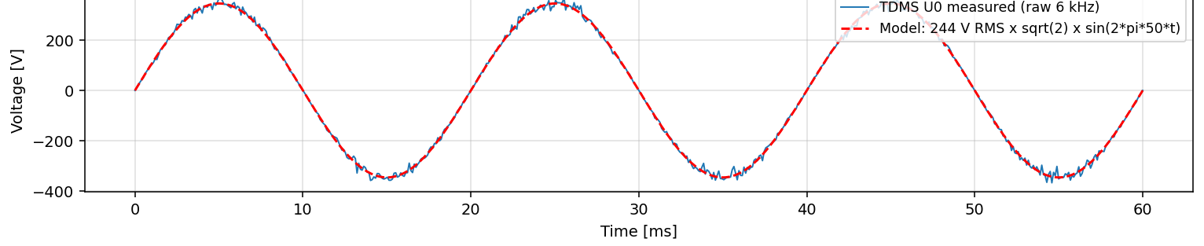
THE HEADLINE
The model matches the line
0.999
0.91
99.2%
94.9%
Voltage R²
Current R²
Thermal
CR5 mass
supply sinusoid · 99.8% peak
fundamental, phase-aligned
ΔT 11.86 K vs 11.95 K obs.
23.74 kg vs 25 kg brochure
Supply voltage — TDMS measured (blue) vs model sinusoid (red)
STAGE B — EXPORT IS LOSSLESS
T_motor
0.0001 K
> 99.99%
i_phase
0.00%
100%
P_elec
0.0003 W
> 99.99%
R² = 0.9987 · peak 345.6 V vs 345.1 V (99.8%) · phase shift negligible
The FMU faithfully reproduces the Dymola model — the toolchain itself introduces no error.
ALIX · Industry 5.0 Digital Twin | Euler Laboratory, ISAE-Supméca
19

Slide 20
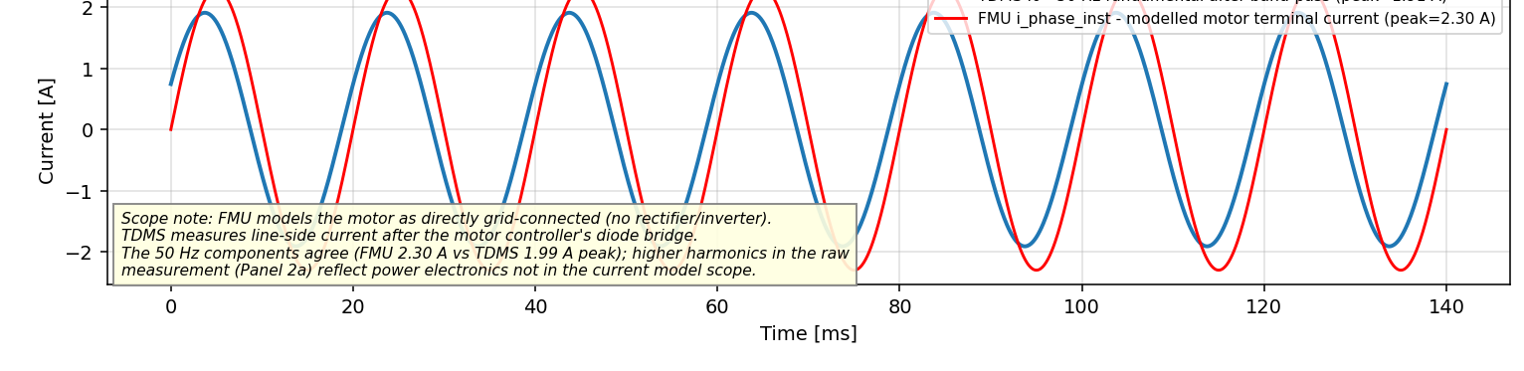
SCIENTIFIC HONESTY
Every residual is named and explained
Conveyor current — 50 Hz fundamental: TDMS band-passed (blue) vs FMU (red)
One root cause: the unmodelled drive-rectifier delay. The model is grid-connected, so the line current shows a 14% amplitude offset (FMU 2.30 A vs measured 1.91 A) and a 105° phase offset (−5.83 ms). Both are the same physical effect — power electronics deliberately outside the current model scope. Localised, named, physically explained.
The fix (Phase 2): calibrate Rs, Rr, Lm, Lσ in the Dymola 2026x identification UI → expected to cut the 14% residual to 3–5%. Calibrate on first.tdms, validate on four.tdms.
ALIX · Industry 5.0 Digital Twin | Euler Laboratory, ISAE-Supméca
20

Slide 21
ENERGY ANALYSIS
Where the line spends its power
Each FMU was run through a full 30-second cycle; instantaneous power was integrated (E = ∫P dt) per subsystem.
Per-cycle breakdown
Conveyor
3284 J · 108 W
90.1%
Sensors + PLC
240 J · 8 W
6.6%
90.1%
Pneumatic
121 J · 4 W
3.3%
XY10 steppers
≈ 0 J · ≈ 0 W
0.0%
Total line 3645 J · 121 W
Insight: the conveyor dominates by an order of magnitude because it runs continuously — making it the prime predictive-maintenance target. Its T_motor output is exposed by the model, directly supporting the Industry 5.0 sustainability pillar.
ALIX · Industry 5.0 Digital Twin | Euler Laboratory, ISAE-Supméca
21

Slide 22
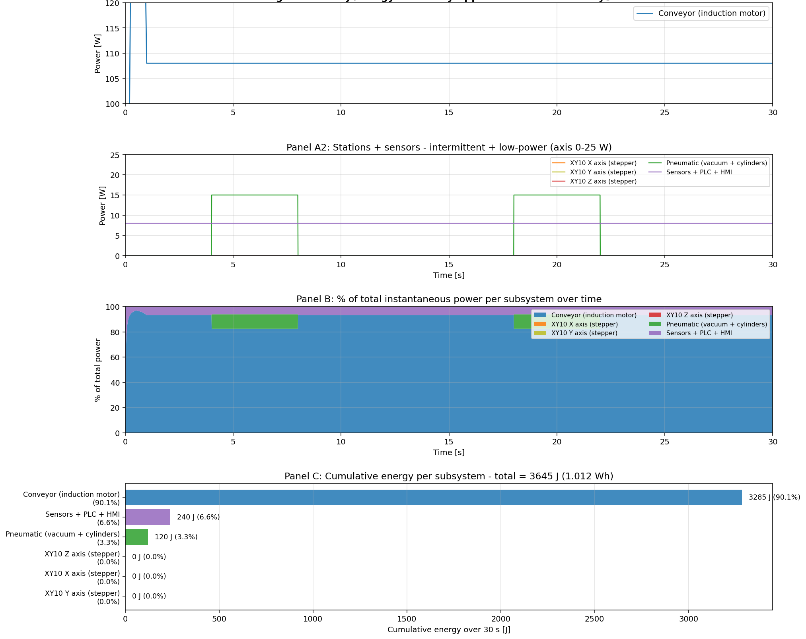
ENERGY ANALYSIS GRAPH
22

Slide 23
INTEGRATION
Spatial layout & coupling analysis
Spatial representation
Coupling matrix
A dimensionally-accurate 2D drawing of the full 8445 mm line — top-down and side elevation — with modelled stations coloured, out-of-scope stations greyed, and photoelectric sensors S1/S2/S3 at 250 mm spacing.
25 interactions catalogued across 8 subsystems — Supply, Cabinet, Conveyor motor & frame, CR5, XY10, Pneumatic, Sensors.
EL
electrical
MEC
mechanical
TH
thermal
EMI
interference
PF
part flow
ON10
DX10
CR5
XY10
VL10
Strong couplings — modelled
Cabinet ↔ Conveyor motor (electrical · FMU)
Conveyor motor ↔ body (thermal · FMU v3)
Pneumatic ↔ XY10 gripper (EL + MEC · FMU)
Belt ↔ CR5 / Belt ↔ XY10 (part flow · orchestration)
conveyor — 8445 mm
Max height 1765 mm (incl. signal towers) · cross-line depth 1765 mm.
ALIX · Industry 5.0 Digital Twin | Euler Laboratory, ISAE-Supméca
23

Slide 24
DELIVERABLES
10 of 10 delivered ·
Mechanical modelling
Electrical modelling
Thermal modelling
✓ Delivered
✓ Delivered
✓ Delivered
Spatial representation
Coupling analysis
FMU export
✓ Delivered
✓ Delivered
✓ Delivered
Python orchestration
End-to-end simulation
Validation vs measurements
✓ Delivered
✓ Delivered
✓ Delivered
Energy analysis
✓ Delivered
10 fully delivered. The two open items — sensitivity/observability and parameter identification — have their workflow and tooling (Dymola 2026x calibration UI) defined for Phase 2.
ALIX · Industry 5.0 Digital Twin | Euler Laboratory, ISAE-Supméca
24

Slide 25
CONCLUSION
A validated multiphysics digital model of the ALIX line — three subsystems, three physics domains — matching the real line to R² = 0.999 on voltage, 0.91 on current and 99.2% on thermal, with every residual physically explained.
1
2
Experimental Validation Confirms Model Reliability
3
Foundation for Industry 5.0 Optimization
Digital Twin Successfully Established
A complete multiphysics digital representation of the ALIX Industry 5.0 production line was successfully developed by integrating electrical, mechanical, and thermal models into a unified simulation framework.
Three major subsystems (Conveyor, CR5, XY10) were modelled and exported as FMI-compliant FMUs.
End-to-end production-line orchestration was achieved through Python.
The developed models demonstrated strong agreement with real industrial measurements, validating their suitability for engineering analysis and decision support.
Voltage prediction accuracy: R² = 0.999
Current prediction accuracy: R² = 0.91
Thermal prediction accuracy: 99.2%
FMU export fidelity exceeded 99.99%, confirming lossless integration between Dymola and Python.
Beyond simulation, the digital twin enables future predictive maintenance, energy optimization, and intelligent production-line reconfiguration.
Energy analysis identified the conveyor as the dominant consumer (90.1% of total energy usage).
Model architecture supports parameter identification, sensitivity analysis, and real-time monitoring.
Samiksha Satre · Euler Laboratory, ISAE-Supméca · github.com/samikshasatre/Mechatronics-modelling-of-entire-industry-5.0
ALIX · Industry 5.0 Digital Twin | Euler Laboratory, ISAE-Supméca
25

