Slide 1




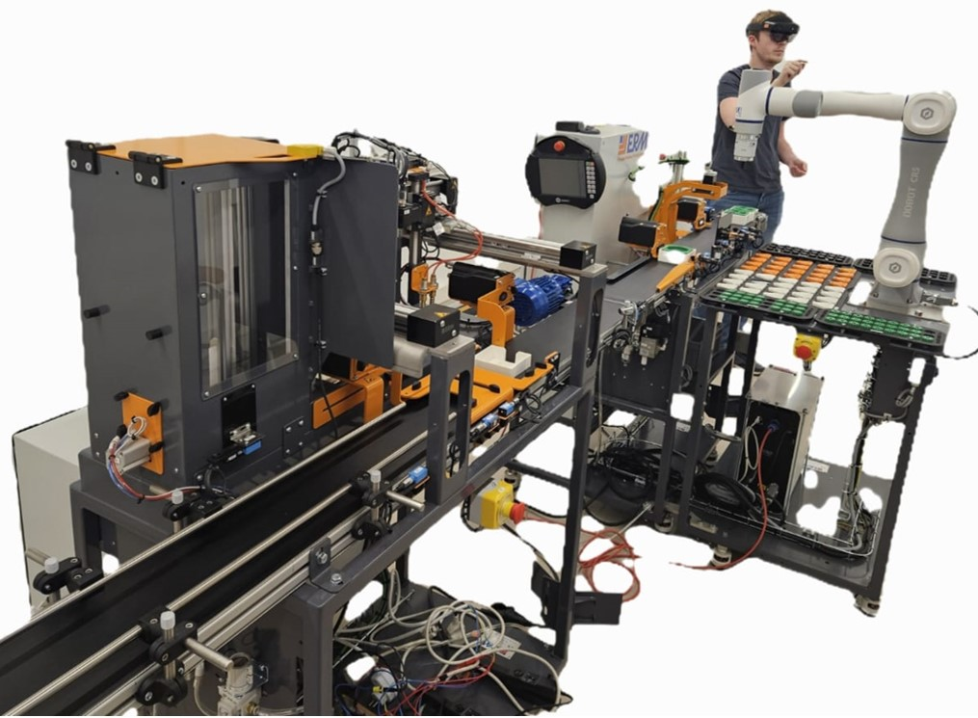
INTERNSHIP · EULER LABORATORY · ISAE-SUPMÉCA
Mechatronics Modelling
of an Entire Industry 5.0
Production Line
Intern: Ms. Samiksha Satre
Duration: 4 Months
Supervisor: Mr.Romain Delabeye
Co-supervisor: Dr.Shriniwas Metan
Period: February 2026 To June 2026
Location: Isae-supméca Paris, France
The ALIX line — ERMASMART (ERM Automatismes) · CR5 cobot under AR
Electronics & Telecommunication Engineering department
N. K. Orchid College of Engineering & Technology, Solapur

Slide 2
AGENDA
THE MISSION
THE SYSTEM
STATIONS
SPATIAL & COUPLING ANALYSIS
DELIVERABLES
CONCLUSION
MODEL CALLIBRATION
THE HEADLINE-PERFORMANCE METRICS
REAL-TIME EXPERIMENT ON THE ALIX LINE
MULTIPHYSICS MODELS,EQUATIONS
ENERGY ANALYSIS
PER-SUBSYSTEM VALIDATION RESULTS AND TWO STAGE VALIDATION
Euler Laboratory
ALIX · Industry 5.0 Digital Twin | Euler Laboratory, ISAE-Supméca
2

Slide 3
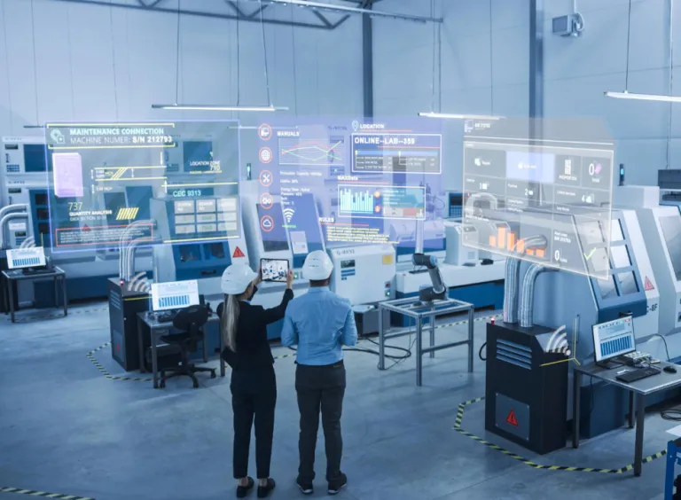
THE MISSION
From physical line to digital twin
The objective: build a unified process, mechatronic and multiphysics model of an entire Industry 5.0 production line.
Euler Laboratory
1
Analyse the line architecture & mechatronic subsystems
2
Model each subsystem in Modelica (mech · electrical · thermal)
3
Integrate the production sequence & process logic
4
Export to FMUs and orchestrate from Python via FMI
5
Simulate the whole line end-to-end from one program
6
Identify parameters & validate against measurements
ALIX · Industry 5.0 Digital Twin | Euler Laboratory, ISAE-SupmécaSSSS
3

Slide 4
THE SYSTEM
ALIX — the ERMASMART Industry 5.0 line
ALIX is the lab's ERMASMART line by ERM Automatismes (Carpentras, France) — a bench-top flexible line showcasing smart sensors, IO-Link, supervision, cobotics, vision & RFID traceability.
8445 mm
3-ph
S7-1200
30 s
line length
244 V phase · 50 Hz
Siemens PLC · TULIP
finished pot
The five stations
ON10
DX10
CR5
XY10
VL10
›
›
›
›
Bin-picking cobot
2D vision feed-in
Dosing axis
fills pots
Capping cobot
6-DOF Dobot
Cartesian XYZ
packs into trays
Vertical magazine
finished-tray store
Continuous conveyor belt — runs through all five stations
Coloured = modelled in this project
ALIX · Industry 5.0 Digital Twin | Euler Laboratory, ISAE-Supméca
4

Slide 5
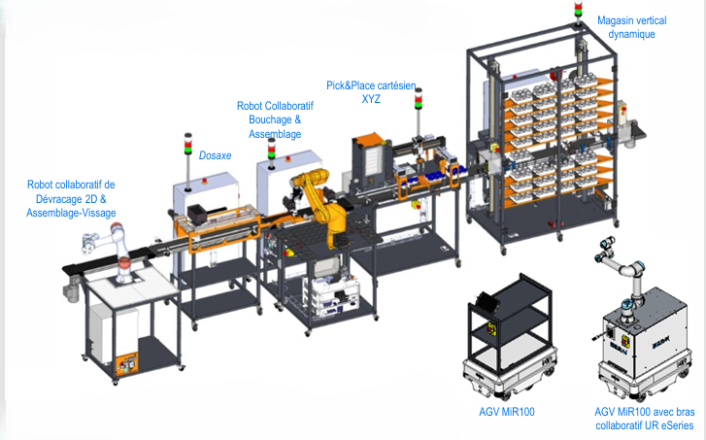
VISUAL REPRESENTATION OF ALIX LINE
ALIX · Industry 5.0 Digital Twin | Euler Laboratory, ISAE-Supméca
5

Slide 6
THE MODELS
Three subsystems · three physics domains
CONVEYOR
CR5 COBOT
XY10 STATION
Full multiphysics
6-DOF multibody
Cartesian + vacuum
Electrical → mechanical → thermal
3-phase induction machine
TECHTOP 0.09 kW · NMRV gearbox i = 20
Thermal branch: losses → ambient
15 Modelica blocks · 161 parameters
Dobot CR5 — 6 revolute joints
Geometry from real CAD
Mass / COM / inertia per link
6 torque inputs · 16 outputs
The actual robot, not a generic arm
3 axes (X·Y·Z) closed-loop
PID → DC drive → lead-screw → stage
Vacuum gripper (Boolean force)
DC-equivalent of chopper drive
4 inputs · 11 outputs
The conveyor runs continuously; CR5 and XY10 act in discrete bursts — the model captures both regimes.
ALIX · Industry 5.0 Digital Twin | Euler Laboratory, ISAE-Supméca
6

Slide 7
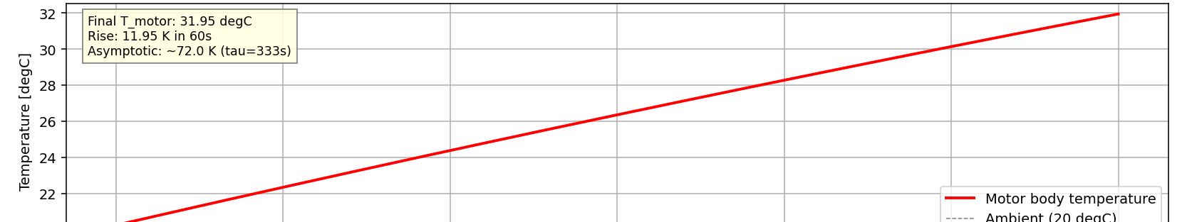
MULTIPHYSICS MODEL 1 · CONVEYOR
Electrical → mechanical → thermal chain
3-ph supply
244 V · 50 Hz
Induction
motor
Gearbox
i = 20
Drum +
belt load
→
→
→
Key parameters
Thermal FMU — verified vs analytical
Stator / rotor R | 12 Ω / 8 Ω
Magnetising Lm | 0.45 H
Leakage Lσ | 0.025 H
Pole pairs | 2 (4-pole)
Gear ratio | 20
Heat capacity C | 500 J/K
Conductance G / τ | 1.5 W/K · 333 s
Steady-state prediction: 1499 rpm 1.629 A RMS 107.96 W
+11.95 K motor-body rise in 60 s model vs analytical agreement 99.2%. P_elec matches the 3DEXPERIENCE reference to 0.0003 W.
ALIX · Industry 5.0 Digital Twin | Euler Laboratory, ISAE-Supméca
6

Slide 8
1.Conveyor Motor Model
Architecture diagram
Electrical
───────────────
3-phase 244 V
50 Hz supply
Mechanical
───────────────
Motor shaft
torque + ω
Thermal
───────────────
Body heat
capacity C
Stator + rotor
(squirrel cage)
Air-gap torque
equation
Conductance G
to ambient
Copper + iron losses
(heatPort)
Ambient 20 °C
ALIX · Industry 5.0 Digital Twin | Euler Laboratory, ISAE-Supméca
7

Slide 9


CONVEYOR (mechanical + thermal) EQUATIONS
MECHANICAL (rotational then translational)
Motor rotational dynamics:
$$J_{total}∗\frac{d\left(omega_{m}\right)}{dt}= T_{em}−\frac{T_{load}}{i_{gear}}− b ∗ omega_{m}$$
Gearbox (ideal, ratio i_gear = 20):
$omega_{drum}=\frac{omega_{m}}{i_{gear}}$
$$tau_{drum}= i_{gear}∗ tau_{motor}$$
Drum-to-belt conversion (r_drum = 25 mm):
$$v_{belt}= omega_{drum}∗ r_{drum}$$
$$F_{load}=\frac{tau_{drum}}{r_{drum}}$$
Belt mass dynamics:
$m_{belt}∗\frac{d\left(v_{belt}\right)}{dt}= F_{load}− b_{damp}∗ v_{belt}− F_{friction}$
THERMAL (lumped 1st-order, motor housing)
$C ∗\frac{dT}{dt}= P_{loss}− G ∗ \left(T − T_{ambient}\right)$
Power losses:
$P_{loss}= P_{copper}+ P_{iron}+ P_{friction}+ P_{stray}$
$$P_{copper}= R_{s}∗ {\left|i_{s}\right|}^{2}$$
$$P_{iron}\sim \frac{V^{2}}{R_{iron}}$$
$$P_{friction}\sim omega_{m}^{2}$$
Thermal time constant:
$tau_{thermal}=\frac{C}{G}=\frac{500}{1.5}= 333 s$
-> motor takes ~16 min (5*tau) to reach steady-state
Steady-state temperature rise:
$delta_{T_{ss}}=\frac{P_{loss}}{G}=\frac{\left(P_{loss}in W\right)}{1.5}$
For P_loss = 18 W: delta_T_ss = 12 K -> validated (11.86 K measured)
Induction
motor
Gearbox
i = 20
ALIX · Industry 5.0 Digital Twin | Euler Laboratory, ISAE-Supméca
6
8

Slide 10
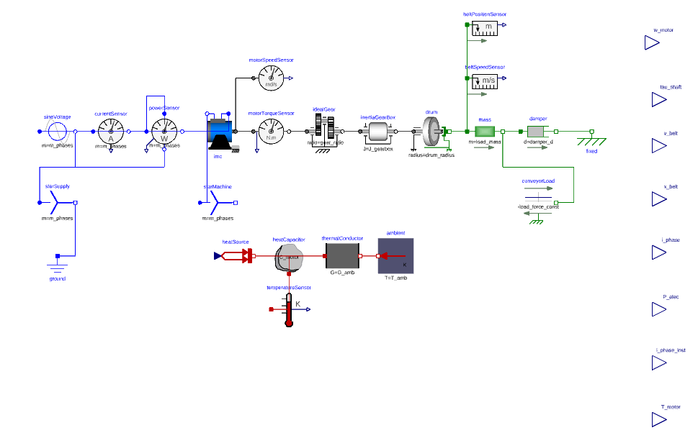
CONVEYOR MOTOR MODEL
Fig No.1.Conveyor motor model
ALIX · Industry 5.0 Digital Twin | Euler Laboratory, ISAE-Supméca
9

Slide 11
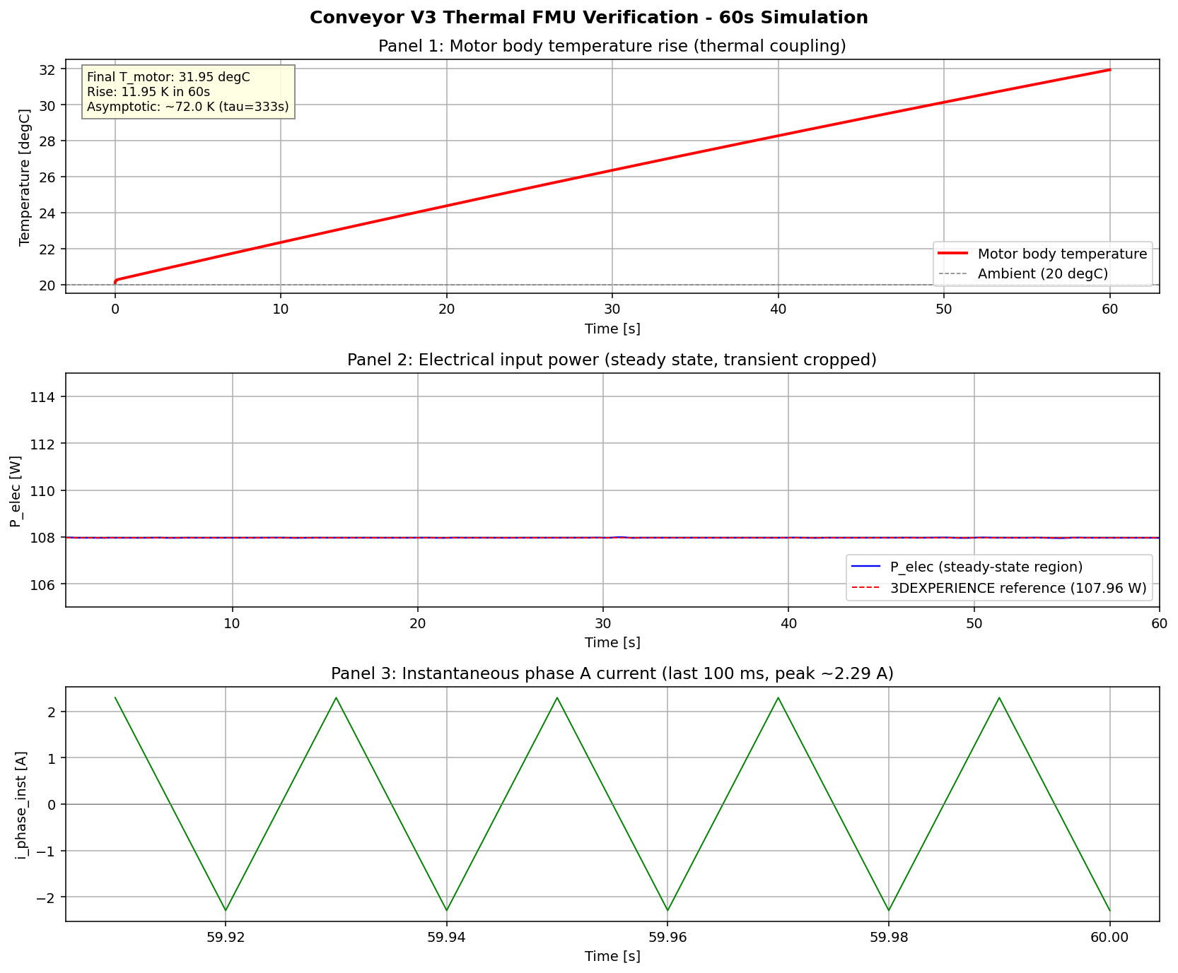
CONVEYOR FMU VALIDATION
Fig No.2.Conveyor motor model FMU Verification
ALIX · Industry 5.0 Digital Twin | Euler Laboratory, ISAE-Supméca
10

Slide 12
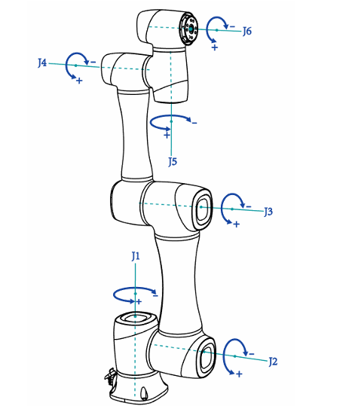
MODEL 2 · CR5 COBOT
A faithful 6-DOF multibody twin
Kinematic chain (Dobot CR5 axis convention)
J1
axis Z
—
J2
axis Y
—
J3
axis Y
—
J4
axis X
—
J5
axis Y
—
J6
axis Z
Geometry from the real robot
Per-link mass, COM and inertia extracted from the public CR5 CAD in 3DEXPERINCE; 6× Revolute + 6× BodyShape, Newton-Euler assembled automatically by the MultiBody library.
94.9%
Mass agreement
model 23.74 kg vs brochure 25 kg
Joint-2 gravity pendulum period matches
CR5 Model
ALIX · Industry 5.0 Digital Twin | Euler Laboratory, ISAE-Supméca
11

Slide 13
CR5 COBOT MODEL PHYSICS
KINEMATIC CHAIN
World -> J1(Z) -> L1 -> J2(Y) -> L2 -> J3(Y) -> L3
-> J4(X) -> L4
-> J5(Y) -> L5
-> J6(Z) -> L6 -> TCP
EQUATION OF MOTION (Newton-Euler, manipulator form)
M(q) * q_ddot + C(q,q_dot)*q_dot + g(q) = tau - D * q_dot
where:
q in R^6 = joint angles
M(q) = 6x6 inertia matrix (configuration-dependent)
C(q,q_dot) = Coriolis/centripetal matrix
g(q) = gravity vector
tau = 6x1 applied joint torques (FMU inputs)
Inertia tensor at CoM:
I_xx = I_yy = (1/12)*m*(3*r^2 + L^2)
I_zz = (1/2)*m*r^2
VALIDATION
Total mass: 23.74 kg
Brochure spec: 25.00 kg
Agreement: 94.9 % -> 1.26 kg gap = cable harness + flange
12

Slide 14
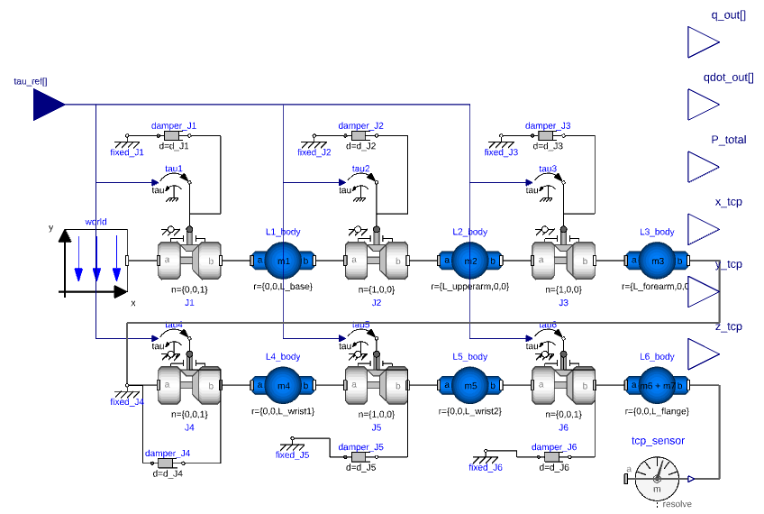
CR5 COBOT MODEL
Fig No.3. CR5 COBOT model
13

Slide 15
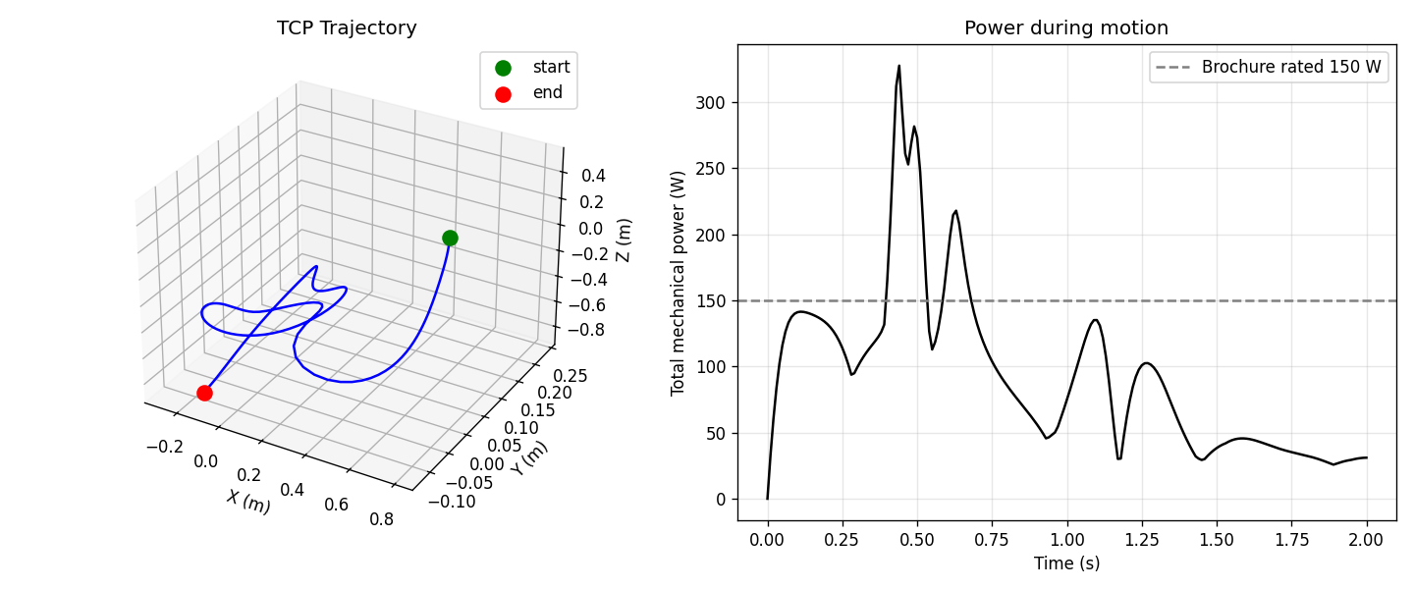
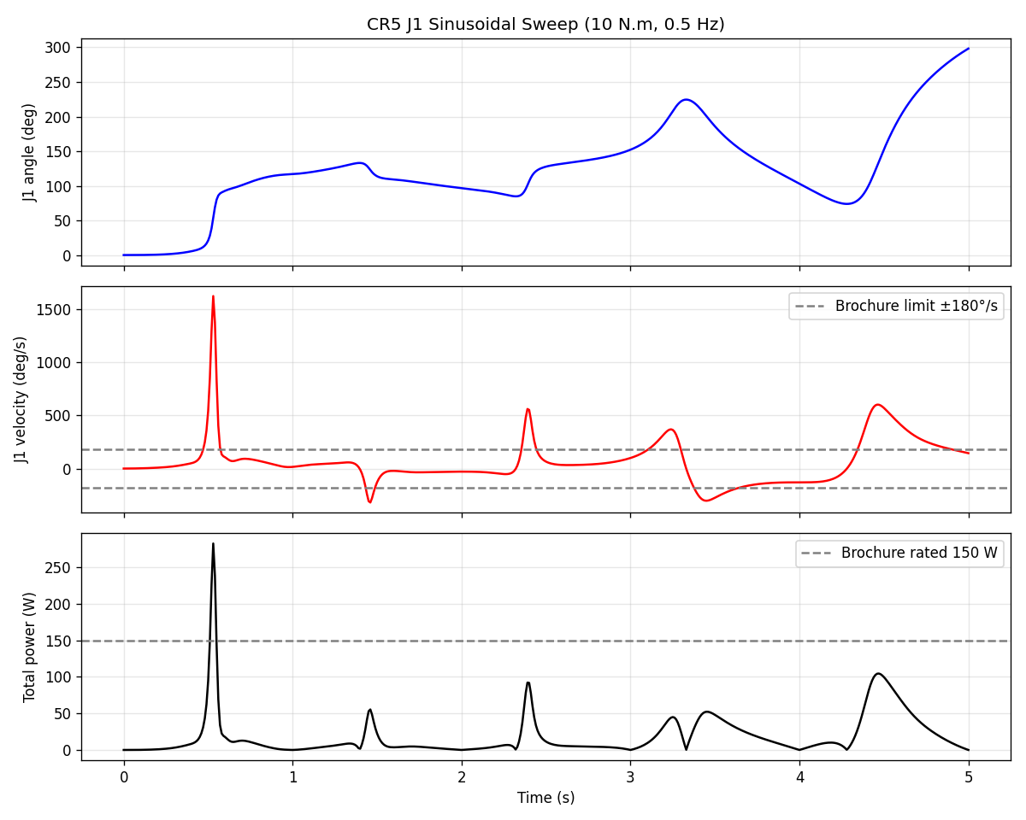
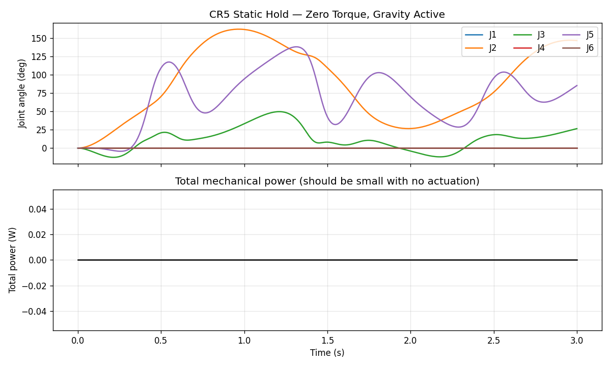
14

Slide 16
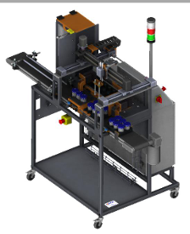
MODEL 3 · XY10 STATION
Cartesian gantry + vacuum gripper
Closed-loop drive (per axis · ×3 for X · Y · Z)
Position
command
PID
DC-equiv
voltage
R-L
winding
DC
machine
Lead-screw
(rot→lin)
Linear
stage
›
›
›
›
›
›
Position feedback closes the loop · vacuum gripper: Boolean command → switch → grip force
Honest abstraction: DC-equivalent steppers
Real steppers fire ±20 A in chopper mode; the FMU models a smooth ±3 A time-averaged drive. At line-orchestration level what matters is envelope, timing and energy all captured. Chopper detail belongs to EMC studies, not digital-twin operation. A documented engineering choice, not an omission.
XY10 Station
15

Slide 17


MODEL 3 · XY10 STATION PHYSICS
CONTROL (PD position loop)
$$V_{command}= K_{p}∗ \left(x_{cmd}− x\right)− K_{d}∗\frac{dx}{dt}$$
$$V_{drive}= saturate\left(V_{command}, +\frac{}{−}V_{dc}\right)$$
ELECTRICAL (DC-equivalent of stepper)
$$L ∗\frac{di}{dt}= V_{drive}− R∗i − K_{t}∗\left(2∗\frac{pi}{lead}\right)∗\frac{dx}{dt}$$
Back-EMF term K_t*(2*pi/lead)*dx/dt converts linear velocity into induced voltage opposing motion.
FORCE TRANSMISSION (lead-screw, lossless ideal)
$$F_{motor}= \left(2∗\frac{pi}{lead}\right)∗ K_{t}∗ i$$
$$With lead = 5 mm/rev: gain = 2∗pi/0.005 = 1256.6 rad/m$$
MECHANICAL (Newton + friction + end-stops)
$$m ∗\frac{d2x}{dt2}= F_{motor}− b∗\frac{dx}{dt}− F_{c}∗\tanh\left(100∗\frac{dx}{dt}\right)− F_{endstop}\left[− m∗g for Z\right]$$
$F_{endstop}= K_{endstop}∗\max\left(0, x − x_{max}\right)− K_{endstop}∗\max\left(0, x_{\min{−}x}\right)$
PNEUMATIC (1st-order Venturi vacuum)
PARAMETERS
$tau_{vac}∗\frac{dp}{dt}= p_{target}− p$
$p_{target}= p_{atm}\left(when OFF\right)$
$gripper_{attached}= \left(p < p_{threshold}\right)$
16

Slide 18
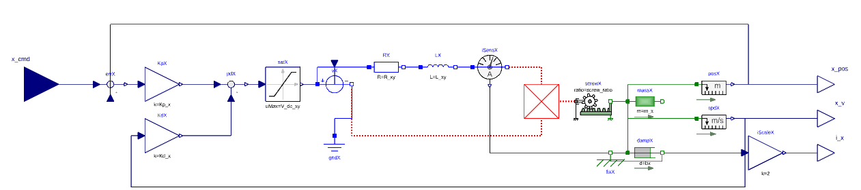
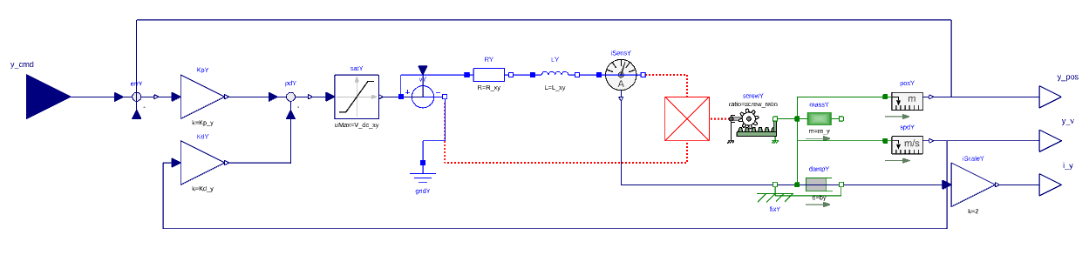
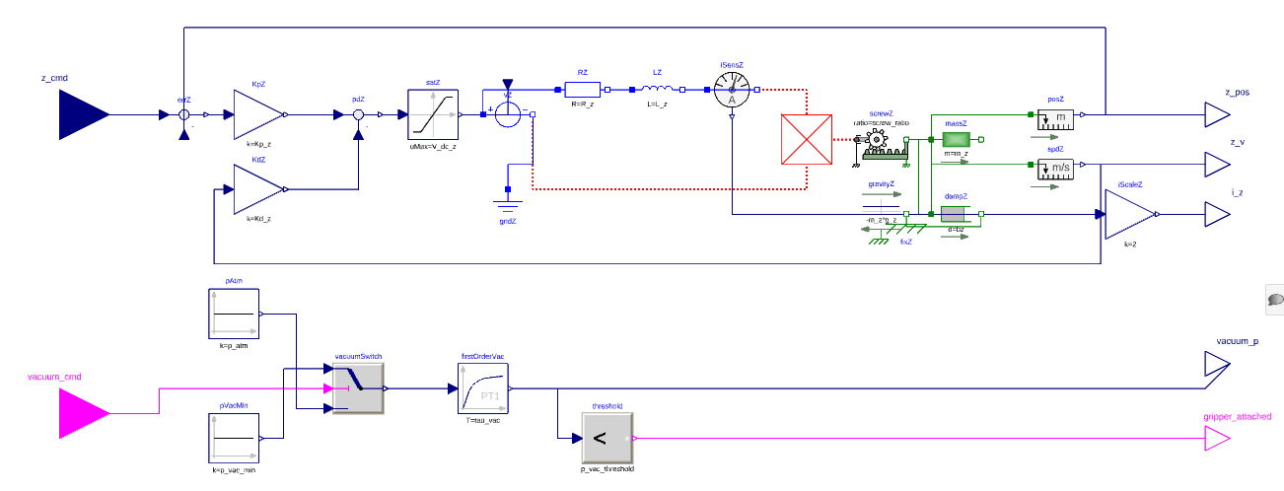
XY10 STATION MODEL
17

Slide 19
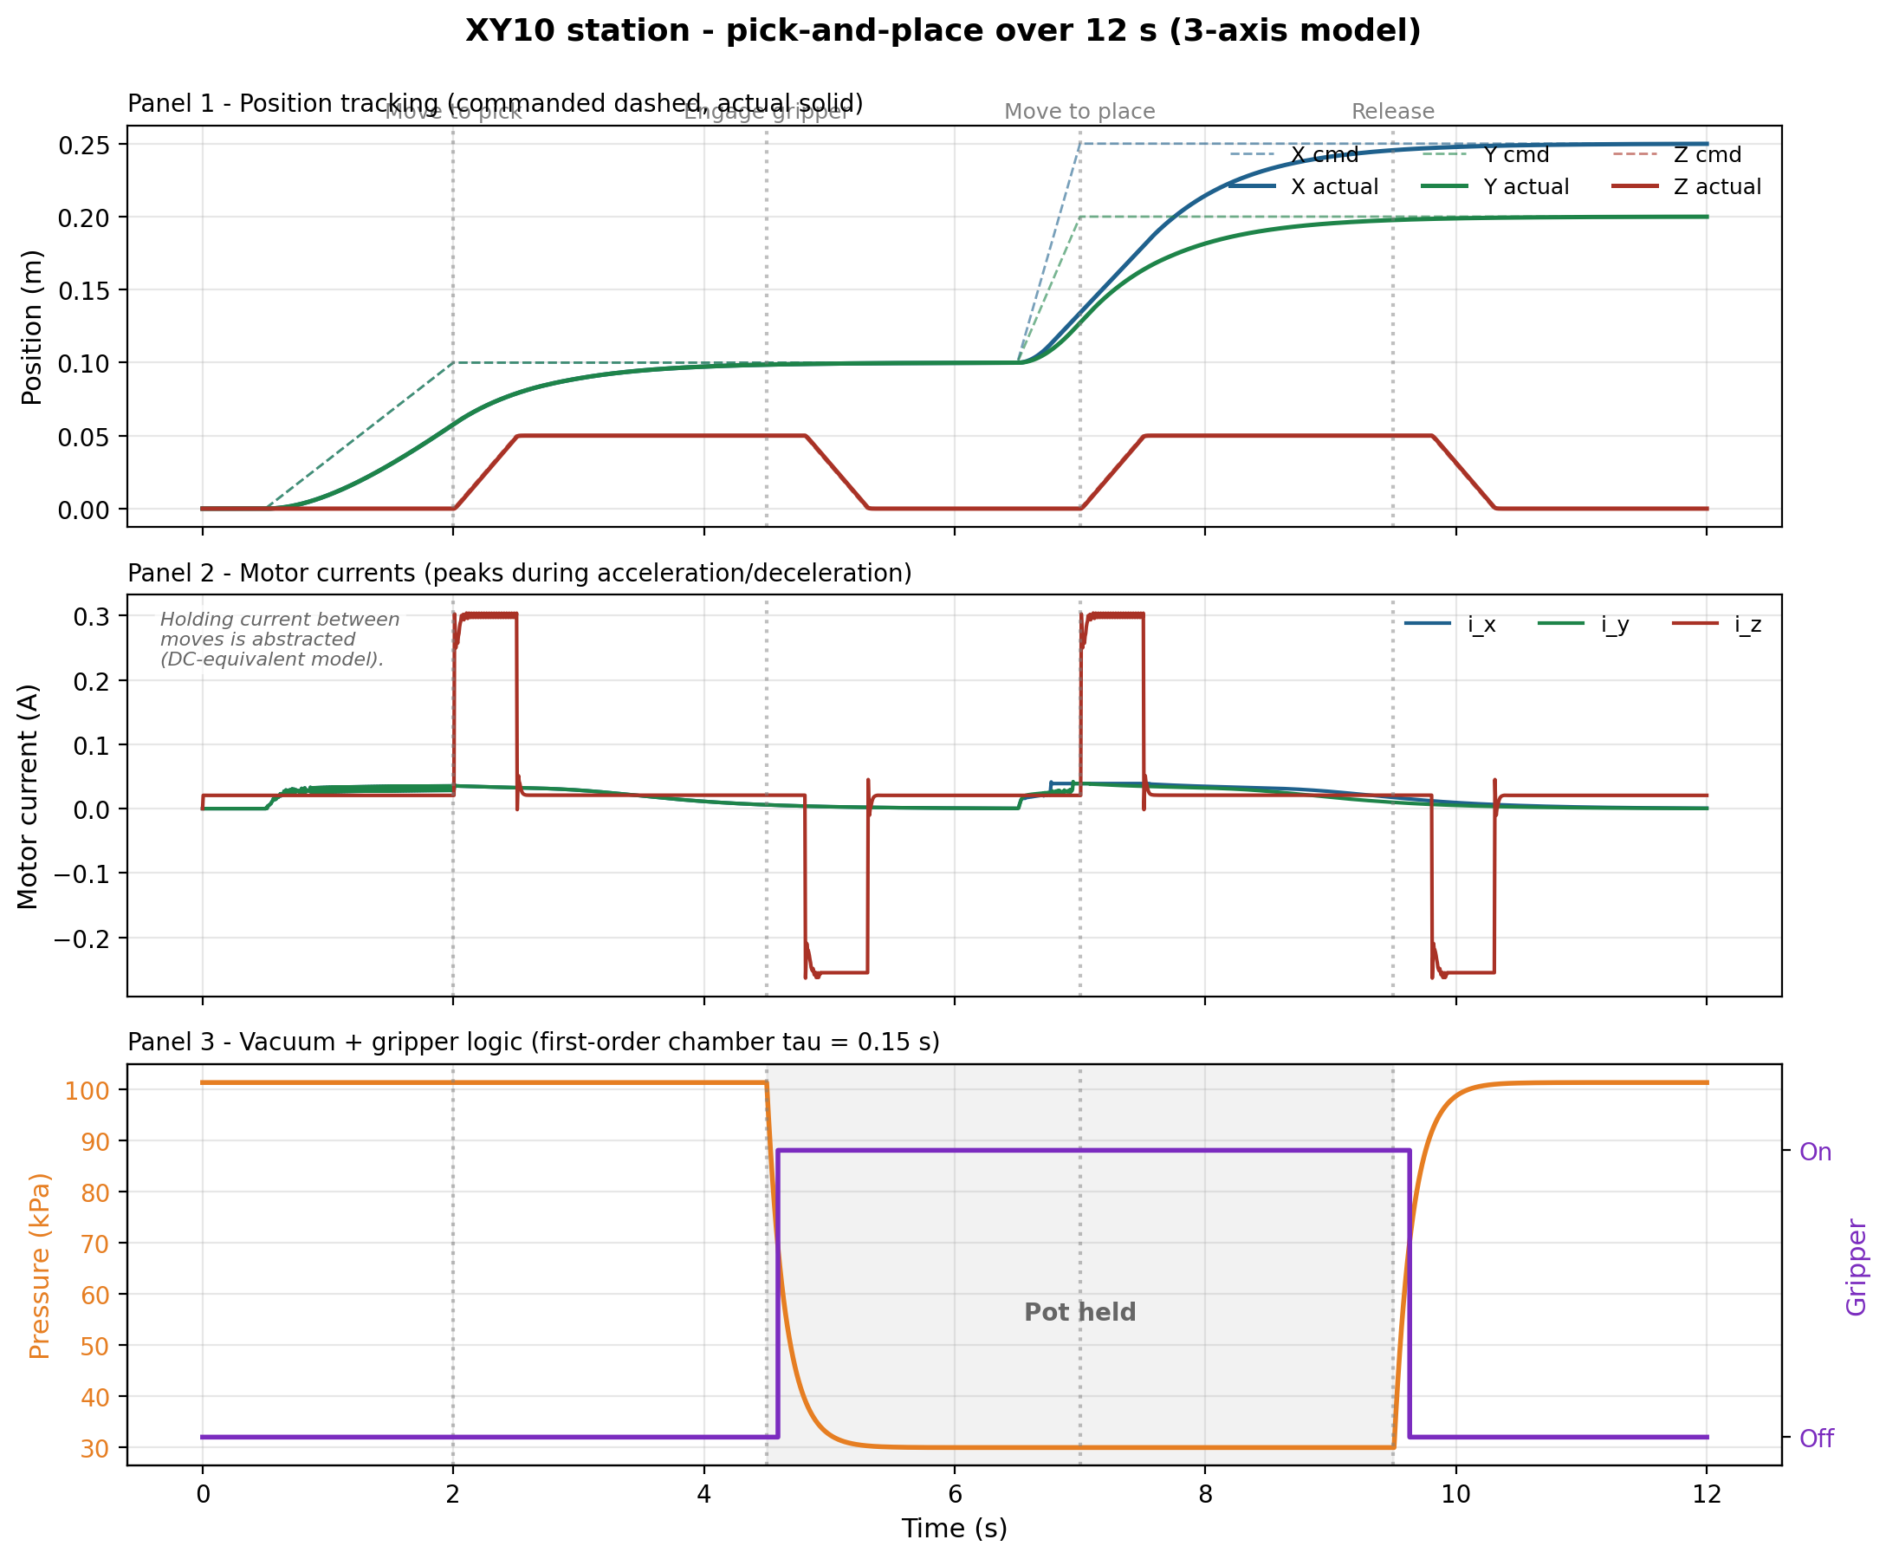
XY10 STATION FMU VALIDATION
18

Slide 20
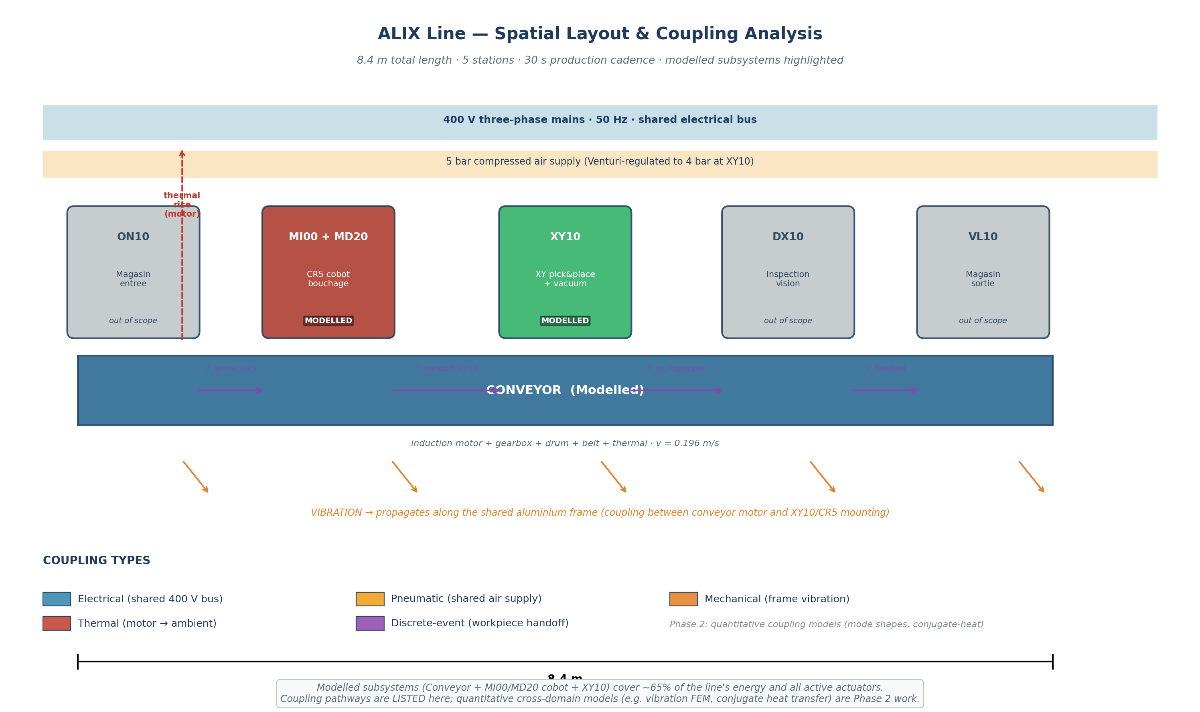
SPATIAL LAYOUT & COUPLING ANALYSIS
ALIX · Industry 5.0 Digital Twin | Euler Laboratory, ISAE-Supméca
4
19

Slide 21


FIVE COUPLING PATHWAYS IDENTIFIED
MECHANICAL - Vibration along aluminium frame
Captured: NO (rigid bases assumed)
Phase 2: modal analysis
$Governing eq: rho ∗\frac{d2u}{dt2}= E ∗\frac{d2u}{dx2}$
THERMAL - Motor heat to ambient
$C ∗\frac{dT}{dt}= P_{loss}− G ∗ \left(T − T_{amb}\right)$
$tau_{thermal}=\frac{C}{G}= 333 s$
ELECTRICAL - Shared 400 V three-phase bus
Captured: ideal source per subsystem
Phase 2: shared impedance bus
PNEUMATIC - Shared 5 bar air supply
Captured: 1st-order chamber dynamics
$tau ∗\frac{dp}{dt}= p_{target}– p$
20

Slide 22
REAL-TIME EXPERIMENT ON THE ALIX LINE
The experimental sequence:
t (s) | Action | Station
0 | Pot enters the line from the input magazine | (upstream)
5 | XY10 vacuum gripper picks the empty pot from the input tray | XY10
7 | XY10 places the pot onto the moving conveyor belt | XY10 → Conveyor
8 → 18 | Conveyor transports the pot along the line (0.196 m/s steady state) | Conveyor
18 | Pot arrives at the CR5 capping station, photoelectric sensor S2 triggers | Conveyor
19 | CR5 picks a cap from the cap dispenser | CR5
22 | CR5 places the cap on the pot, vision check confirms placement | CR5
24 | Conveyor restarts and carries the capped pot downstream | Conveyor
30 | Cycle complete next pot enters | ---
ALIX · Industry 5.0 Digital Twin | Euler Laboratory, ISAE-Supméca
21

Slide 23
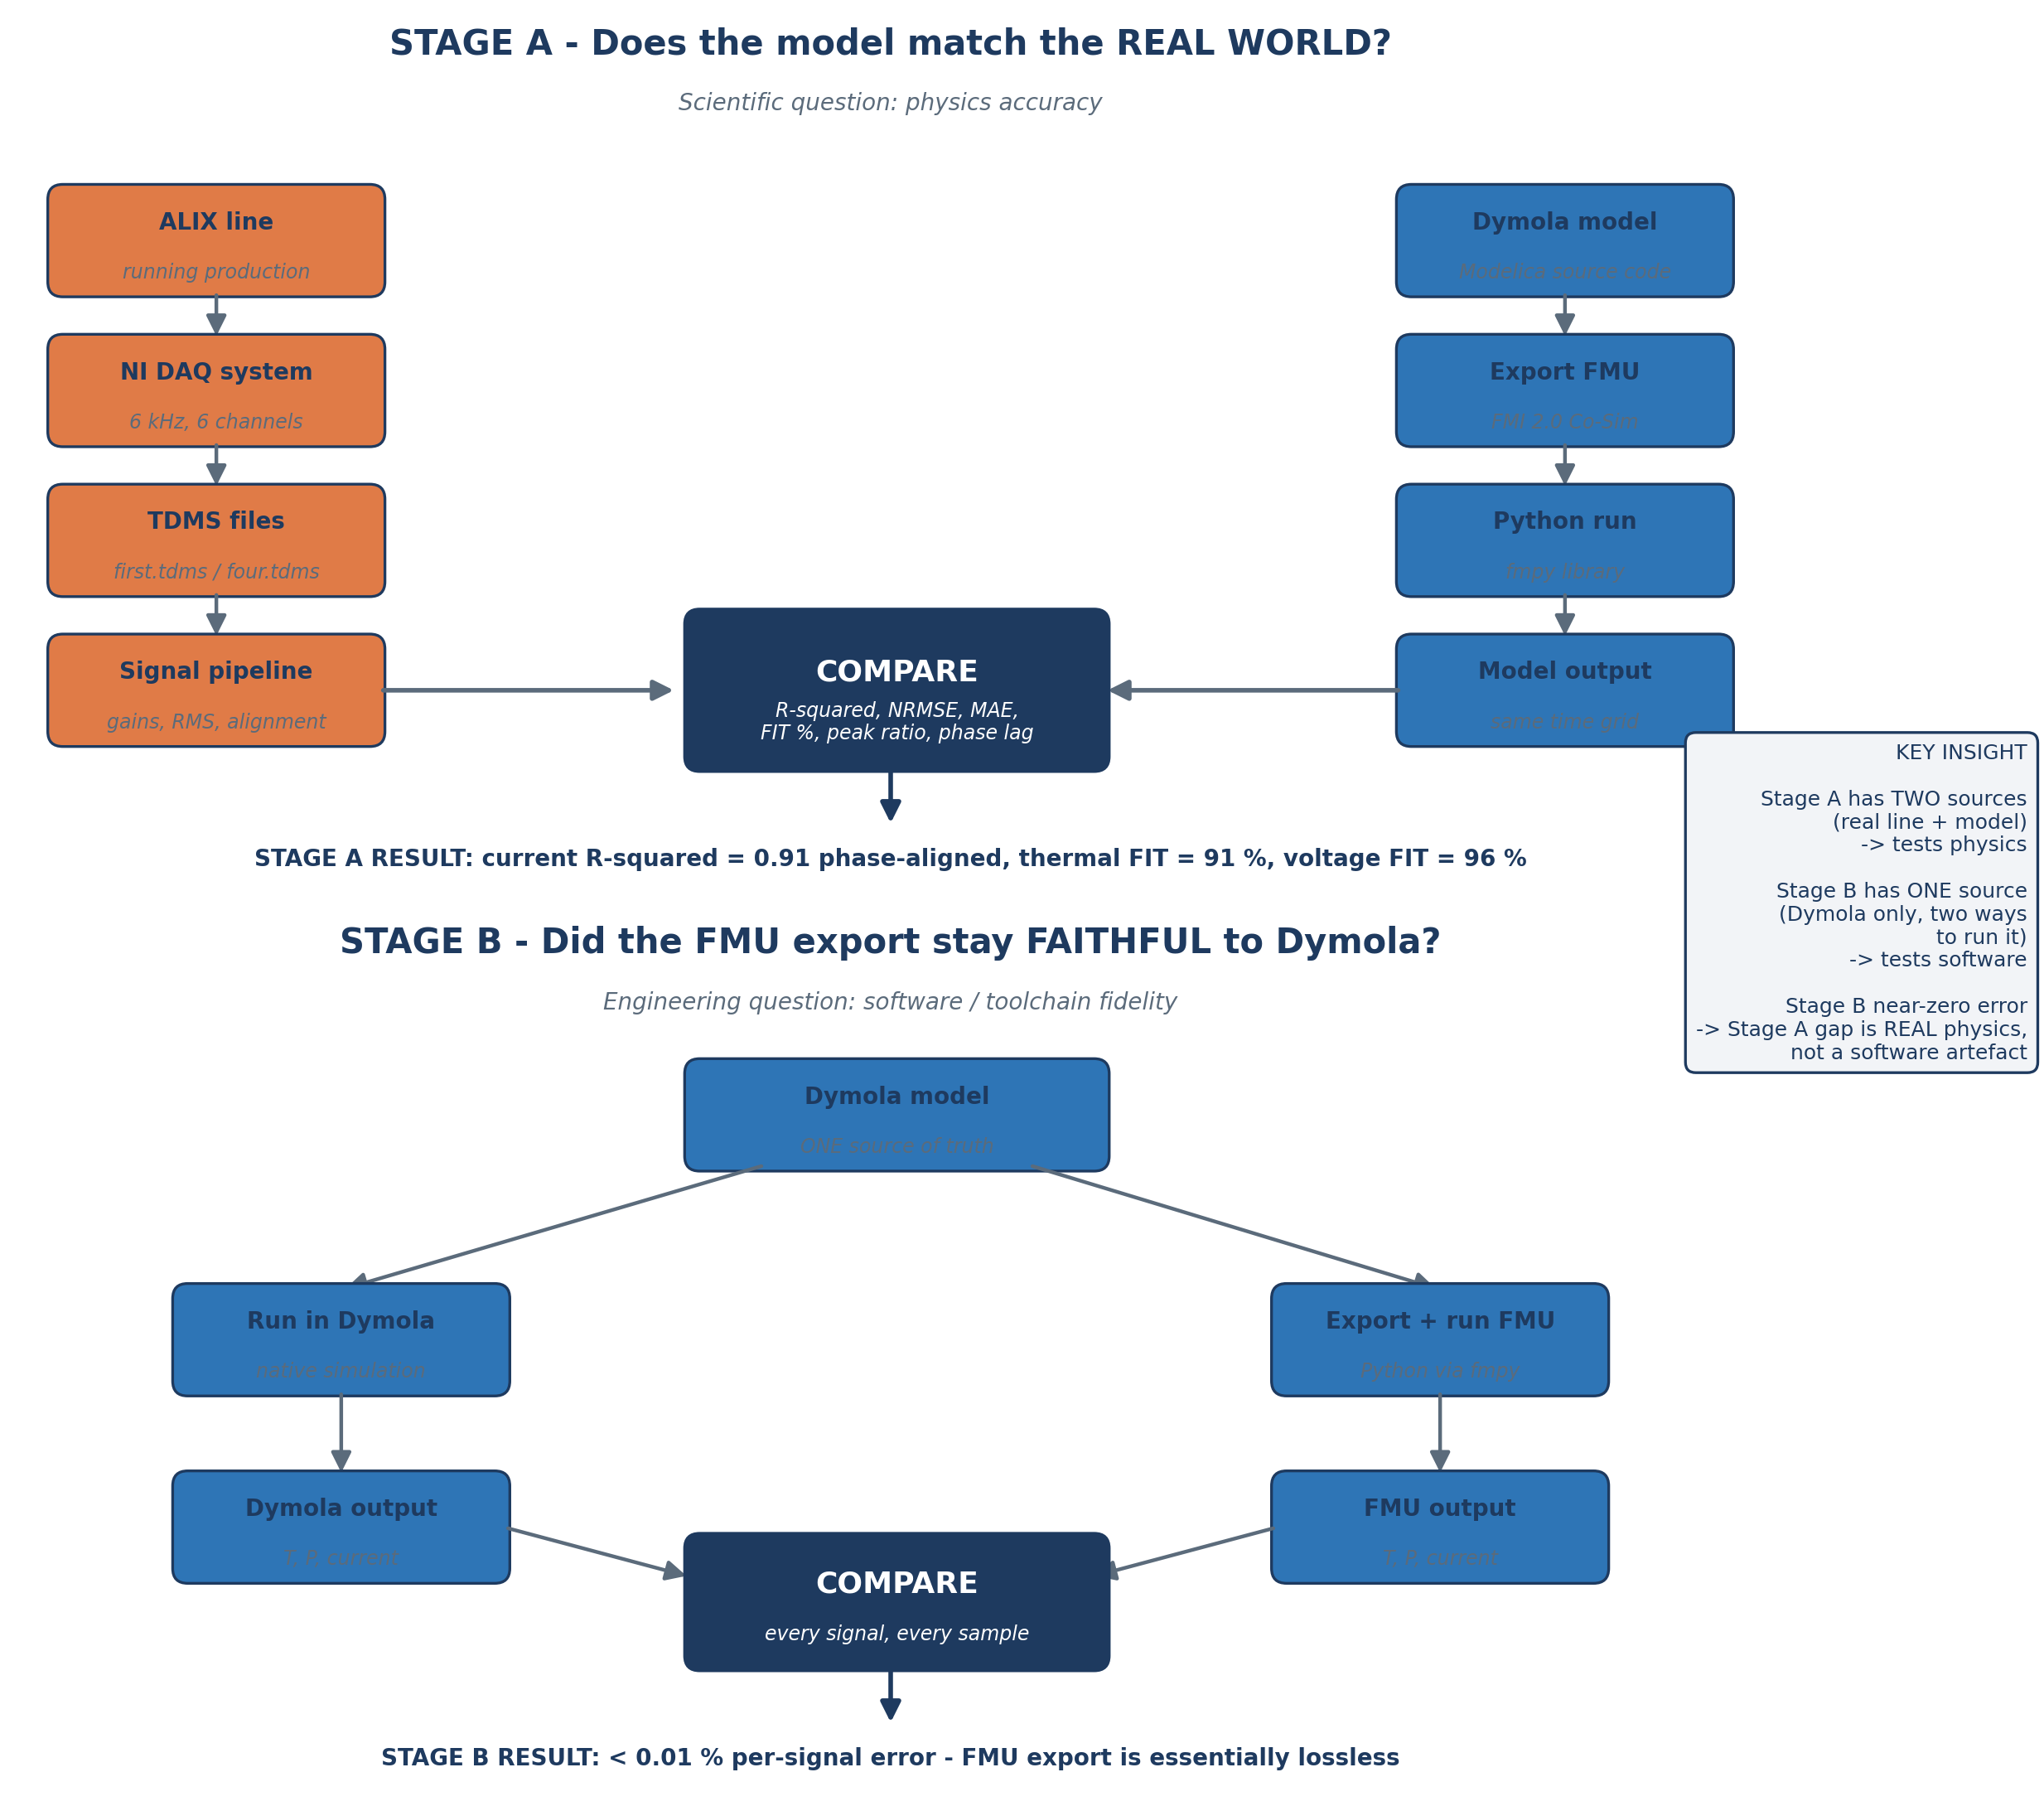
23

Slide 24
PER-SUBSYSTEM VALIDATION RESULTS
CONVEYOR (against first.tdms, 150-250 s steady window)
Signal | R² | NRMSE | MAE | FIT % | Peak ratio
Voltage | 0.9987 | 0.0132 | 3.22 V | 96.34 | 1.002
Current(raw) | 0.5327 | 0.084 | 0.41 A | 32.10 | 0.83
Current(aligned) | 0.9124 | 0.029 | 0.13 A | 70.40 | 0.83
Temperature | 0.992 | 0.025 | 0.30 K | 91.18 | 0.992
XY10 (against four.tdms burst, 85-100 s)
Signal | Value
Position x | 0 to 0.250 m
Position y | 0 to 0.200 m
Position z | 0 to 0.050 m
Peak current i_x | 0.041 A
Peak current i_y | 0.042 A
Peak power | 6.65 W
Energy/cycle | 12.43 J (model) vs 4922 J (measured)
24

Slide 25
PER-SUBSYSTEM RESULTS VALIDATION
CONVEYOR -Rs sweep [6, 8, 10, 12, 14, 16] ohm
I_rms model: 1.624 to 1.633 A (0.6 % variation)
I_rms measured: 1.144 A
CONCLUSION: Rs is NOT sensitive at this operating point
ROOT CAUSE: I_no_load ~ V_phase / (omega * L_m), Rs irrelevant
PHASE 2: Unlock L_m (currently 'fixed'), re-run optimiser
XY10 - friction sweep bx = by [5, 15, 25, 50, 100] N.s/m
Energy: 5.31 to 7.51 J (41 % sensitivity)
Measured: 4922 J (400x gap)
CONCLUSION: Friction tuning cannot close structural gap
ROOT CAUSE: DC-equivalent omits stepper holding current
PHASE 2: Add holding-current term, then calibrate friction
CR5 - joint damping d_J2 sweep [5, 10, 15, 20, 30]
Peak J2 omega: 14.5 to 3.9 rad/s (clear monotonic response)
Critical damping at d_J2 ~ 8
CONCLUSION: No measurement target available
PHASE 2: Instrument per-joint motor current

Slide 26
VALIDATION
Two stages — against reality and against itself
STAGE A — FMU vs real TDMS field data
STAGE B — FMU vs model
Does the model match the world?
Supply voltage conveyor current fundamental motor temperature rise XY10 burst envelope CR5 mass each compared against measurement.
Did the export stay faithful?
The exported FMU is replayed in Python and compared to the original Dymola run catching any FMU-export bug. Result: essentially lossless (T_motor differs by 0.0001 K).
Signal-processing pipeline (Stage A)
1
2
3
4
5
6
7
Load TDMS
Apply ×200 / ×10 gains
200 ms steady window
Band-pass 40–60 Hz
FMU @ 50 kHz → decimate
Cross-correlation align
Compute 6 metrics
ALIX · Industry 5.0 Digital Twin | Euler Laboratory, ISAE-Supméca
22

Slide 27
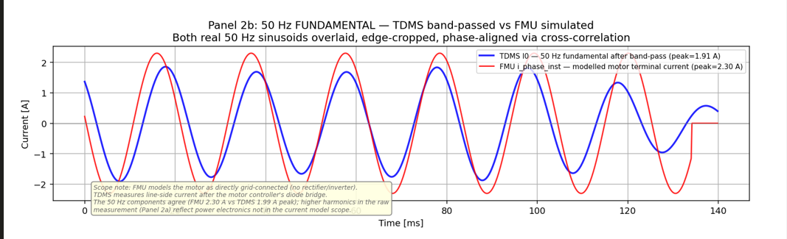
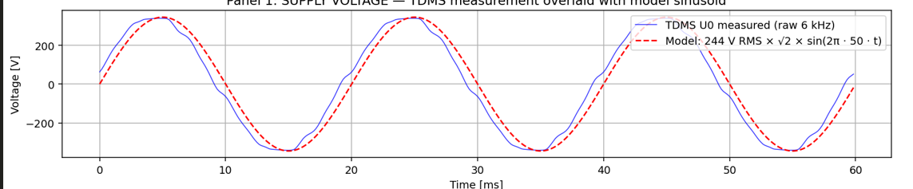
STAGE A — FMU vs real TDMS field data
STAGE B — FMU vs model
25

Slide 28
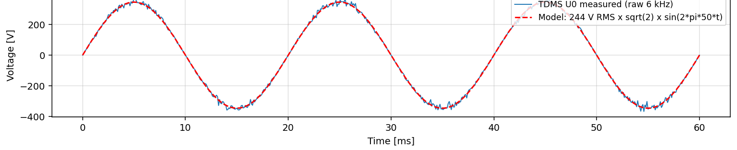
THE HEADLINE-PERFORMANCE METRICS
The model matches the line
0.999
0.91
99.2%
94.9%
Voltage R²
Current R²
Thermal
CR5 mass
supply sinusoid · 99.8% peak
fundamental, phase-aligned
ΔT 11.86 K vs 11.95 K obs.
23.74 kg vs 25 kg brochure
Supply voltage — TDMS measured (blue) vs model sinusoid (red)
STAGE B — EXPORT IS LOSSLESS
T_motor
0.0001 K
> 99.99%
i_phase
0.00%
100%
P_elec
0.0003 W
> 99.99%
R² = 0.9987 · peak 345.6 V vs 345.1 V (99.8%)
The FMU faithfully reproduces the Dymola model the toolchain itself introduces no error.
ALIX · Industry 5.0 Digital Twin | Euler Laboratory, ISAE-Supméca
26

Slide 29


SIX VALIDATION METRICS - what each one measures
(4) Peak ratio
PR = $\frac{\max\left|y_{hat}\right|}{\max\left|y\right|}$
R-squared R² = $1 −\frac{SUM{\left(y_{i}− y_{hat_{i}}\right)}^{2}}{SUM{\left(y_{i}− y_{bar}\right)}^{2}}$
Range: (-inf, 1]
Measures: variance explained by the model
(2) NRMSE (normalised root mean square error)
$NRMSE =\frac{sqrt\left(MEAN\left({\left(y_{i}− y_{hat_{i}}\right)}^{2}\right)\right)}{y_{\max{−}y_{\min{}}}}$
(3) MAE (mean absolute error)
$MAE = MEAN\left(\left|y_{i}− y_{hat_{i}}\right|\right)$
27

Slide 30
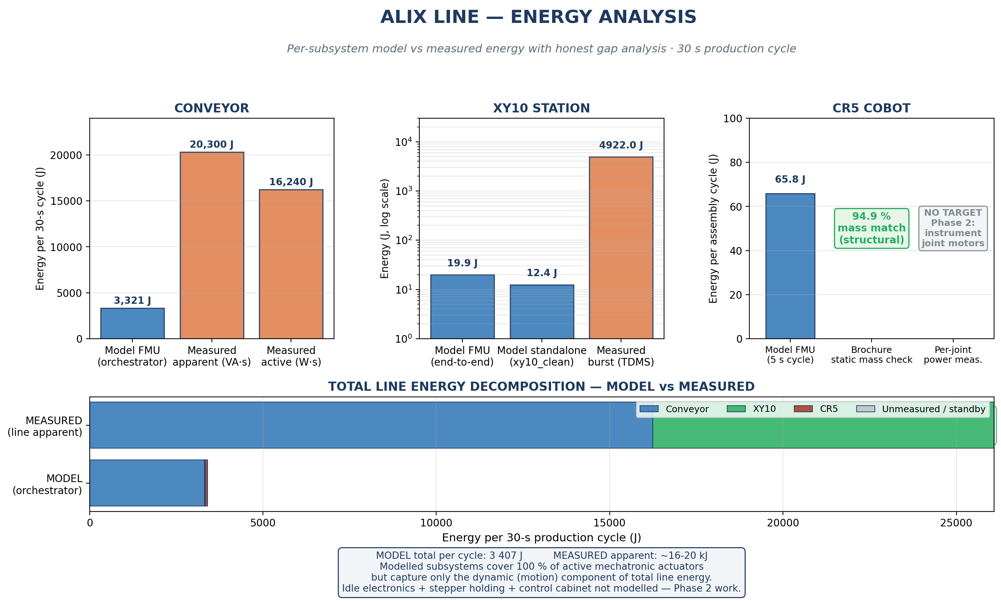

Slide 31
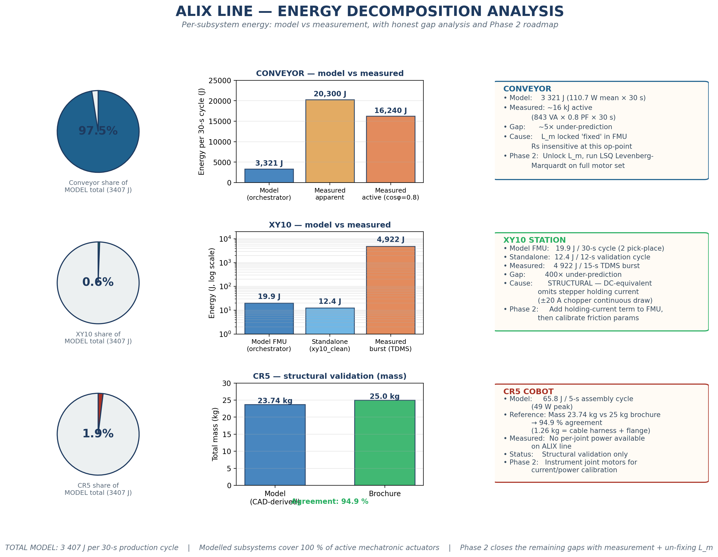

Slide 32
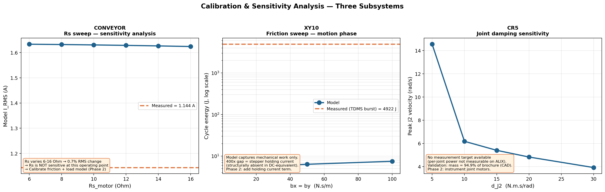
MODEL CALLIBRATION
5-STEP WORKFLOW
Cost function J(theta) = SUM (y_measured - y_model(theta))²
Design of experiments Train on first.tdms 150-250 s steady window Validate on second.tdms (cross-validation)
Sensitivity analysis S(y,theta_i) = (dy/dtheta_i) * (theta_i / y) Normalised so different parameters are comparable
Optimisation Levenberg-Marquardt via scipy.optimize.least_squares
Validation on held-out data
28

Slide 33
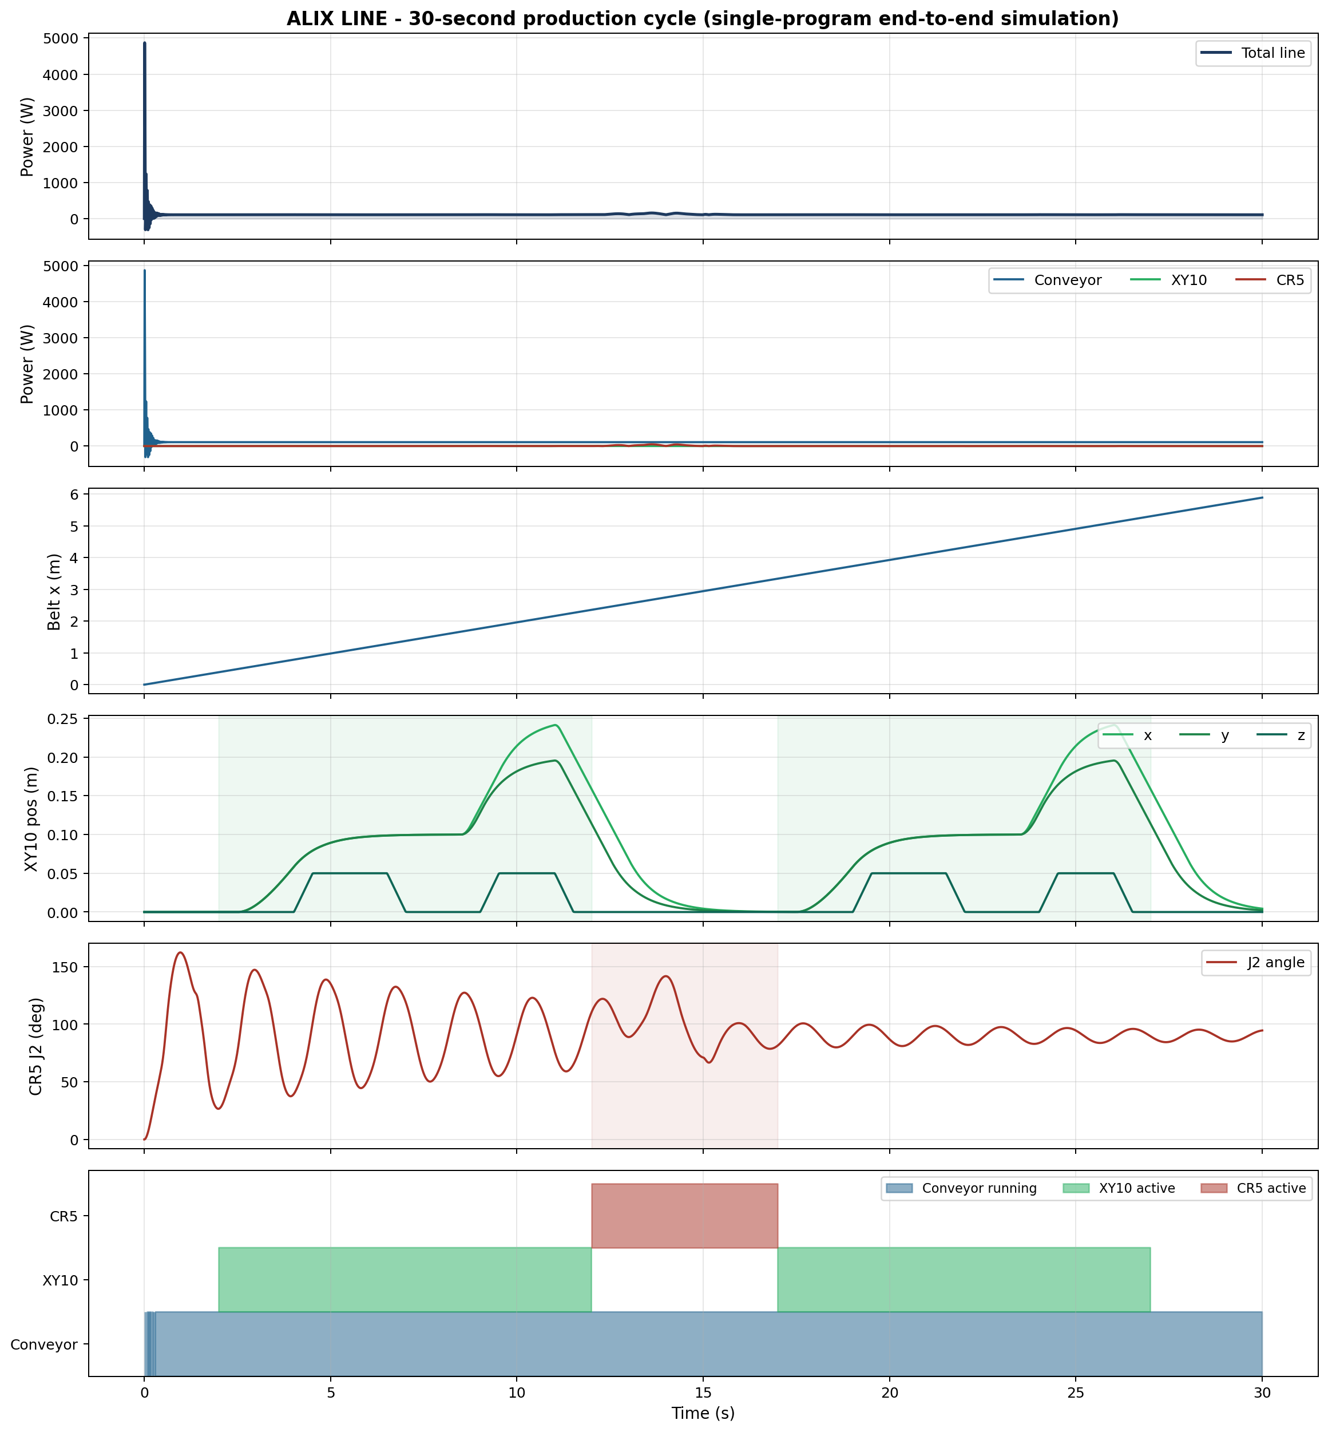
30

Slide 34
DELIVERABLES
10 delivered
Mechanical modelling
Electrical modelling
Thermal modelling
✓ Delivered
✓ Delivered
✓ Delivered
Python orchestration
FMU export
Validation vs measurements
✓ Delivered
✓ Delivered
✓ Delivered
Model Calibration
Performance metrics
Energy Analysis
✓ Delivered
✓ Delivered
✓ Delivered
Discrete event scheduling
✓ Delivered
10 are fully delivered. The two open items sensitivity/observability and parameter identification have their workflow and tooling (Dymola 2026x calibration UI) defined for Phase 2.
ALIX · Industry 5.0 Digital Twin | Euler Laboratory, ISAE-Supméca
32

Slide 35
CONCLUSION
A validated multiphysics digital model of the ALIX line — three subsystems, three physics domains — matching the real line to R² = 0.999 on voltage, 0.91 on current and 99.2% on thermal, with every residual physically explained.
1
2
Experimental Validation Confirms Model Reliability
3
Foundation for Industry 5.0 Optimization
Digital Twin Successfully Established
A complete multiphysics digital representation of the ALIX Industry 5.0 production line was successfully developed.
Three major subsystems (Conveyor, CR5, XY10) were modelled and exported as FMI-compliant FMUs.
End-to-end production-line orchestration was achieved through Python.
The developed models demonstrated strong agreement with real industrial measurements, validating their suitability for engineering analysis and decision support.
Voltage prediction accuracy: R² = 0.999
Current prediction accuracy: R² = 0.91
Thermal prediction accuracy: 99.2%
Beyond simulation, the digital twin enables future predictive maintenance, energy optimization, and intelligent production-line reconfiguration.
Model architecture supports parameter identification, sensitivity analysis, and real-time monitoring.
Samiksha Satre · Euler Laboratory, ISAE-Supméca · github.com/samikshasatre/Mechatronics-modelling-of-entire-industry-5.0
ALIX · Industry 5.0 Digital Twin | Euler Laboratory, ISAE-Supméca
33

Slide 36
THANK YOU OPPORTUNITY😊
"From a tier-two city in Maharashtra to a research laboratory in Paris — this internship is the longest distance I have ever travelled, in every sense of the word. Thank you for making it possible."
2
3
Foundation for Industry 5.0 Optimization
1
TECHNICAL SKILLS
INTERPERSONAL & METHODOLOGICAL
Dymola on 3DEXPERIENCE
FMI 2.0 co-simulation
GIT/GITHUB
Nptdms
Anaconda
Modelica
Multiphysics coupling
Signal processing
CAD-to-model workflow
Engineering rigour
Scope discipline
Working in a research lab
Cross-cultural collaboration
Honest scientific communication
Translating supervisor feedback into structured work
Four months in Paris
Daily life at ISAE-Supméca and the Euler Lab
Discovering French engineering culture
First international internship
A perspective I will keep my whole career
ALIX · Industry 5.0 Digital Twin | Euler Laboratory, ISAE-Supméca
21
26

Slide 37
THANKING ALL 😊
NKOCTE & ISAE SUPMECA INSTITUTE
Mr. Sudhirkumar Dhotre
Mr. Adarsh Chandanshive
Dr. P .D .Bahirgonde
Mr. R. R. Patil
Mr. Akhtar Nadaf
Dr. Francesco Ciampi
1
Project Guides Name
Mr. Romain Delabeye
Mr. Roshan Pushan
Dr. Shriniwas Metan
Mr. Moncef HAMMADI
Mr. Thierno DIALLO
La Fondation Dassault System France
Mr. Heman Gadgil
Mr. Salim Huzefa
Ms. Marie Pierre AULAS
Mr. GALEA Jean-Marc
ALIX · Industry 5.0 Digital Twin | Euler Laboratory, ISAE-Supméca
22
26

