Slide 1




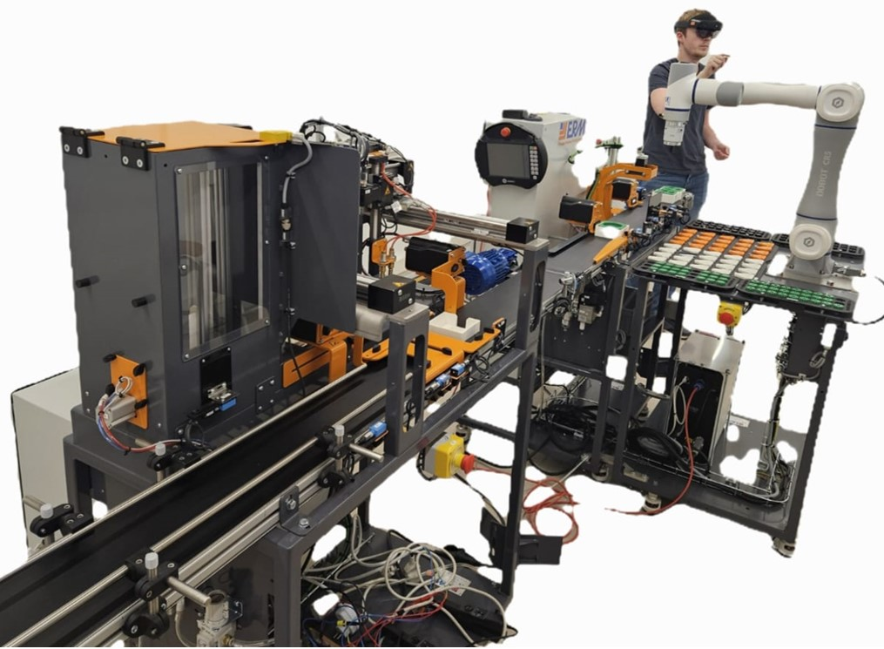
Intern: Ms. Samiksha Satre
Duration: 4 Months
Supervisor:Mr.Romain Delabeye
Period: February 2026 To June 2026
Location: Isae-supméca Paris, France

Slide 2
INDEX
THE MISSION
THE SYSTEM
MULTIPHYSICS MODELS
Spatial representation
Coupling analysis
FMU export
✓ Delivered
Python orchestration
End-to-end simulation
Validation vs measurements
✓ Delivered
Energy analysis
Sensitivity / observability
Parameter identification
◐ Foundation in place
ALIX · Industry 5.0 Digital Twin | Euler Laboratory, ISAE-Supméca
16

Slide 3
THE MISSION
From physical line to digital twin
The objective: build a unified process, mechatronic and multiphysics model of an entire Industry 5.0 production line — bridging physical processes, control logic and intelligent decision-making — as the foundation of a digital twin for reconfiguration and optimisation.
THE HOST
Euler Laboratory
ISAE-Supméca, Saint-Ouen · Paris
1
Analyse the line architecture & mechatronic subsystems
Theme — IS2M
Multiphysics & Mechatronic Systems Engineering. Studies the multidisciplinary design of complex systems: mechatronics, robotics, cyber-physical & production systems (CPS / CPPS), systems of systems.
2
Model each subsystem in Modelica (mech · electrical · thermal)
3
Integrate the production sequence & process logic
4
Export to FMUs and orchestrate from Python via FMI
5
Simulate the whole line end-to-end from one program
Application domains: aeronautics · automotive · naval · rail · energy · medical · Industry 4.0 / 5.0 production lines.
6
Identify parameters & validate against measurements
ALIX · Industry 5.0 Digital Twin | Euler Laboratory, ISAE-Supméca
2

Slide 4
THE SYSTEM
ALIX — the ERMASMART Industry 5.0 line
ALIX is the lab's ERMASMART line by ERM Automatismes (Carpentras, France) — a bench-top flexible line showcasing smart sensors, IO-Link, supervision, cobotics, vision & RFID traceability.
8445 mm
3-ph 400 V
S7-1200
30 s
line length
244 V phase · 50 Hz
Siemens PLC · TULIP
cadence / finished pot
The five stations (packaging mode)
ON10
DX10
CR5
XY10
VL10
›
›
›
›
Bin-picking cobot
2D vision feed-in
Dosing axis
fills pots
Capping cobot
6-DOF Dobot
Cartesian XYZ
packs into trays
Vertical magazine
finished-tray store
Continuous conveyor belt — runs through all five stations
Coloured = modelled in this project
ALIX · Industry 5.0 Digital T win | Euler Laboratory, ISAE-Supméca
3

Slide 5
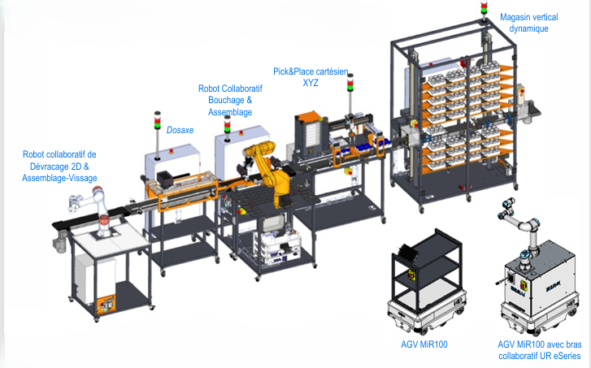

Slide 6
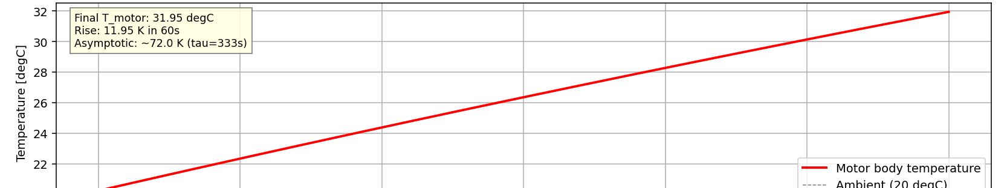
MULTIPHYSICS MODEL 1 · CONVEYOR
Electrical → mechanical → thermal chain
3-ph supply
244 V · 50 Hz
Induction
motor
Gearbox
i = 20
Drum +
belt load
→
→
→
Thermal branch: motor losses ≈ 108 W → body C = 500 J/K → conductance G = 1.5 W/K → ambient 20 °C
Key parameters
Thermal FMU — verified vs analytical
Stator / rotor R | 12 Ω / 8 Ω
Magnetising Lm | 0.45 H
Leakage Lσ | 0.025 H
Pole pairs | 2 (4-pole)
Gear ratio | 20
Heat capacity C | 500 J/K
Conductance G / τ | 1.5 W/K · 333 s
Steady-state prediction: 1499 rpm · 1.629 A RMS · 107.96 W
+11.95 K motor-body rise in 60 s — model vs analytical agreement 99.2%. P_elec matches the 3DEXPERIENCE reference to 0.0003 W.
ALIX · Industry 5.0 Digital Twin | Euler Laboratory, ISAE-Supméca
7

Slide 7
THREE SUBSYSTEMS
1.Conveyor Motor Model
Architecture diagram
Electrical
───────────────
3-phase 244 V
50 Hz supply
Mechanical
───────────────
Motor shaft
torque + ω
Thermal
───────────────
Body heat
capacity C
Stator + rotor
(squirrel cage)
Air-gap torque
equation
Conductance G
to ambient
Copper + iron losses
(heatPort)
Ambient 20 °C
ALIX · Industry 5.0 Digital Twin | Euler Laboratory, ISAE-Supméca
4

Slide 8
1.ELECTRICAL DOMAIN
Components used (Modelica blocks):
1 | Modelica.Electrical.Polyphase.Sources.SineVoltage
2 | Modelica.Electrical.Polyphase.Basic.Star
3 | Modelica.Electrical.Polyphase.Sensors.VoltageSensor
4 | Modelica.Electrical.Polyphase.Sensors.CurrentSensor
5 | Modelica.Magnetic.FundamentalWave.BasicMachines.InductionMachines.IM_SquirrelCage
6 | Modelica.Blocks.Math.Product
2.THERMAL DOMAIN
7 | Modelica.Thermal.HeatTransfer.Components.HeatCapacitor | Motor body thermal mass C = 500 J/K
8 | Modelica.Thermal.HeatTransfer.Components.ThermalConductor | Cooling to air G = 1.5 W/K
9 | Modelica.Thermal.HeatTransfer.Sources.FixedTemperature | Ambient at 293.15 K (20 °C)
10 | Modelica.Thermal.HeatTransfer.Sensors.TemperatureSensor | Motor body temperature T_motor

Slide 9
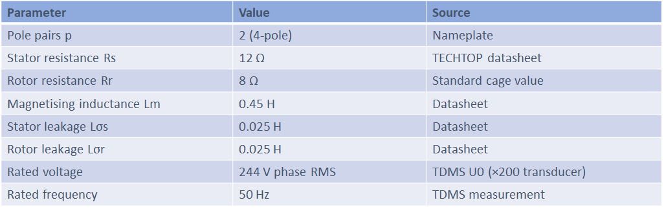
Motor parameters (TECHTOP 0.09 kW, 4-pole):
Thermal Parameters
Parameter | Value | Source
Heat capacity C | 500 J/K | Lumped-mass identification
Conductance G | 1.5 W/K | Cooling-test identification
Time constant τ = C/G | 333 s | Computed
Ambient T_amb | 293.15 K | Lab condition

Slide 10
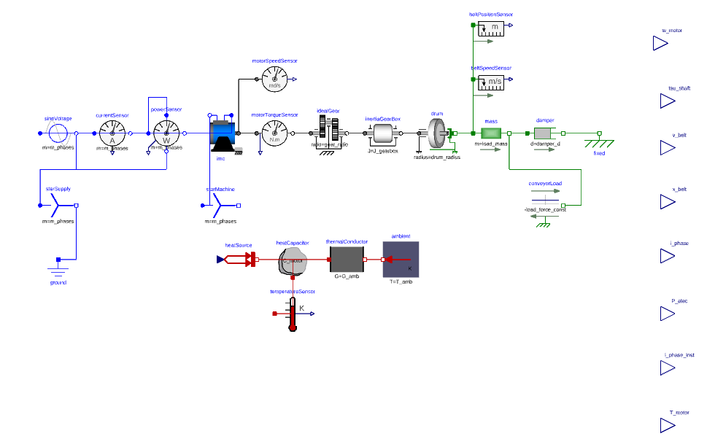
Fig No.1.Conveyor motor model

Slide 11
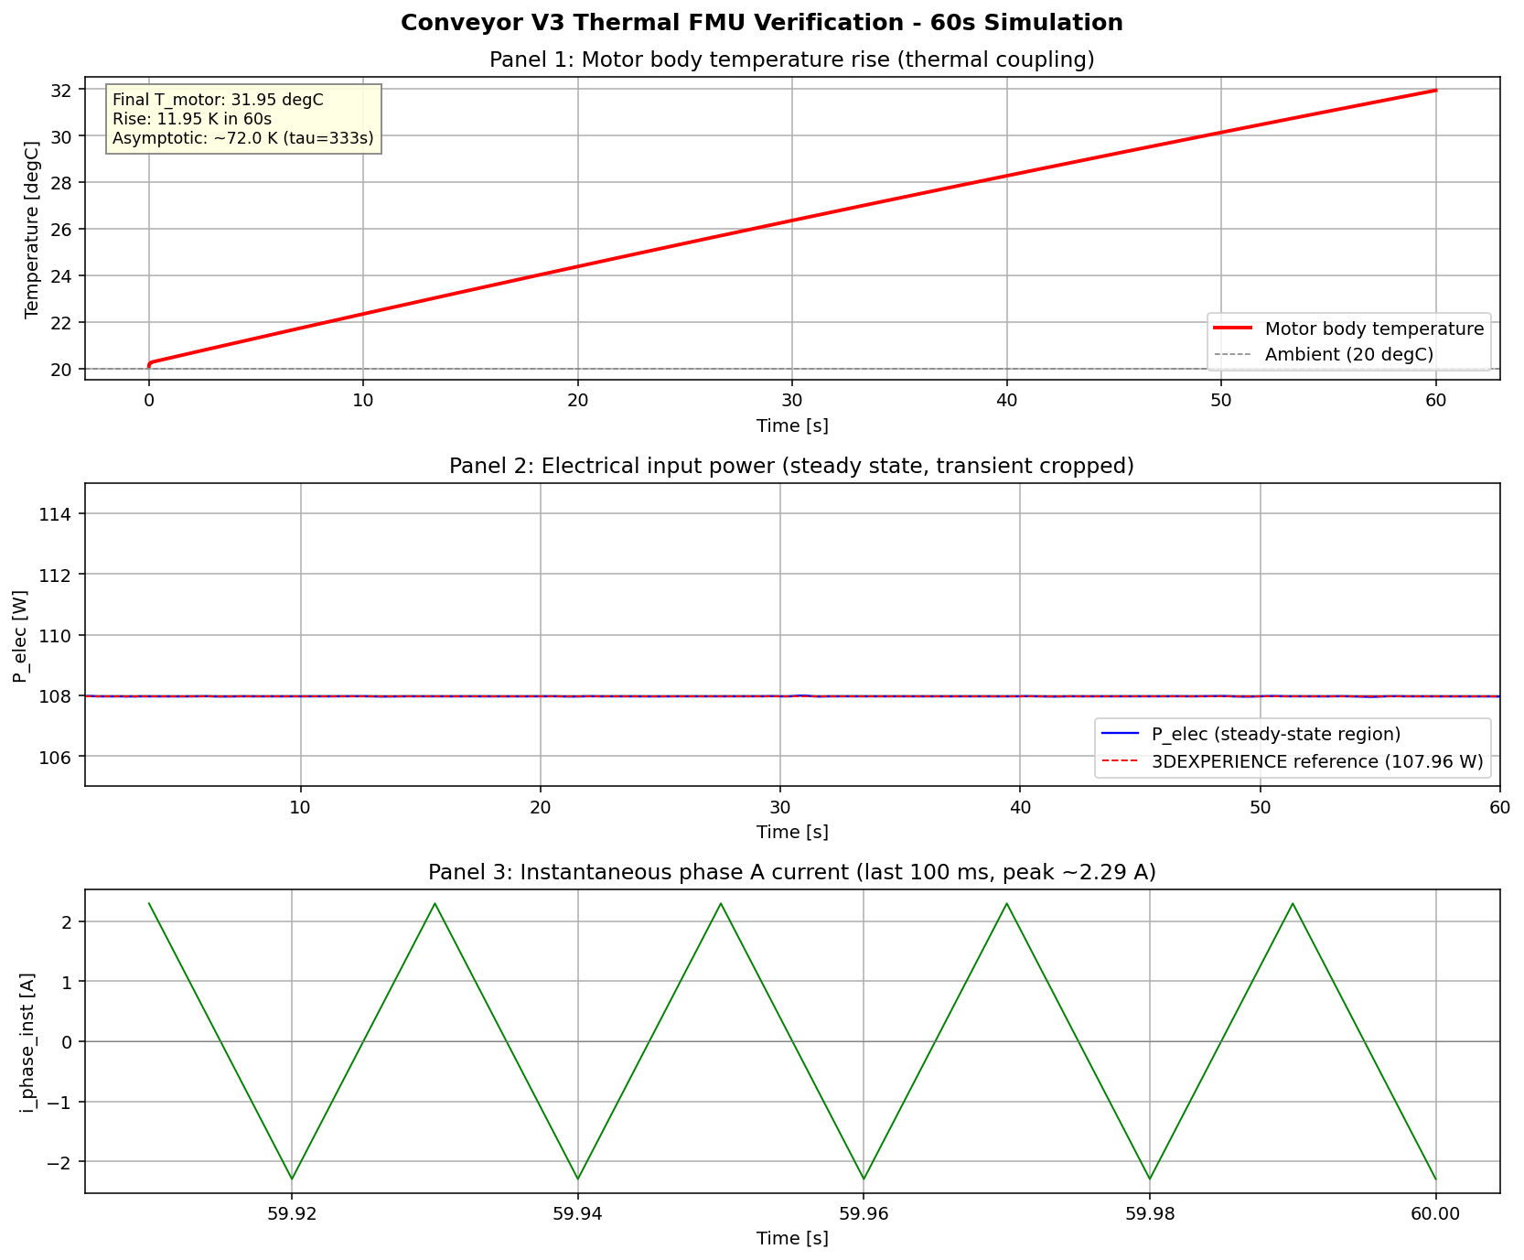

Slide 12
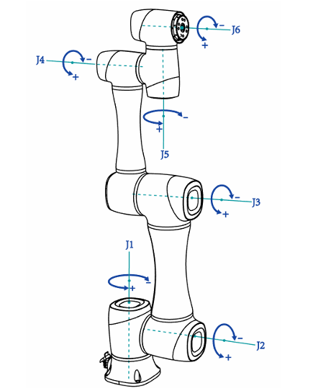
MODEL 2 · CR5 COBOT
A faithful 6-DOF multibody twin
Kinematic chain (Dobot CR5 axis convention)
J1
axis Z
—
J2
axis Y
—
J3
axis Y
—
J4
axis X
—
J5
axis Y
—
J6
axis Z
Geometry from the real robot
Per-link mass, COM and inertia extracted from the public CR5 CAD in FreeCAD; 6× Revolute + 6× BodyShape, Newton-Euler assembled automatically by the MultiBody library.
94.9%
Mass agreement
model 23.74 kg vs brochure 25 kg
Joint-2 gravity pendulum: period matches
CR5 Model
ALIX · Industry 5.0 Digital Twin | Euler Laboratory, ISAE-Supméca
8

Slide 13
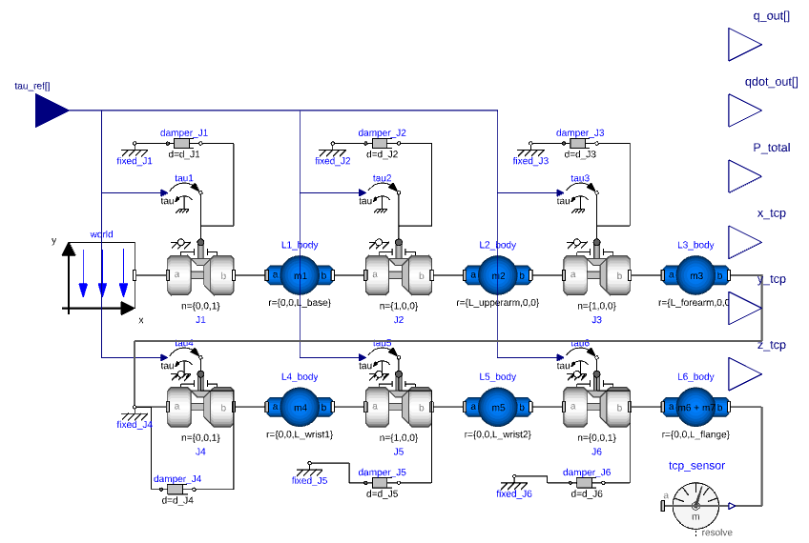
Fig No.3.CR5 model

Slide 14
MULTIPHYSICS-MODEL
Three subsystems -2. CR5 Cobot Model
Architecture diagram
Link1
(base)
J2(y)
Link2
(Upper)
J3
(Y)
J4
(X)
World (gravity)
J1
(z)
End-effector
J6
(Z)
Link 5
(Wrist)
J5
(Y)
Link 4
(Wrist Pitch)
Joint axis table (Dobot CR5 convention)
Joint | Rotation Axis | Function
J1 | Z | Base rotation (waist)
J2 | Y | Shoulder
J3 | Y | Elbow
J4 | X | Wrist roll
J5 | Y | Wrist pitch
J6 | Z | Wrist yaw (tool flange)
ALIX · Industry 5.0 Digital Twin | Euler Laboratory, ISAE-Supméca
4

Slide 15
Components used (Modelica blocks):
Sr.no | Block | Role
1 | Modelica.Mechanics.MultiBody.World | Global frame + gravity (9.81 m/s² along −Z)
2 | Modelica.Mechanics.MultiBody.Joints.Revolute × 6 | Six revolute joints, axes Z–Y–Y–X–Y–Z
3 | Modelica.Mechanics.MultiBody.Parts.BodyShape × 6 | Six links — each carrying mass, COM, inertia tensor
4 | Modelica.Mechanics.Rotational.Sources.Torque × 6 | Joint torque inputs (one per joint)
5 | Modelica.Mechanics.Rotational.Sensors.AngleSensor × 6 | Joint angles q1–q6
6 | Modelica.Mechanics.Rotational.Sensors.SpeedSensor × 6 | Joint velocities q̇1–q̇6
7 | Modelica.Mechanics.MultiBody.Sensors.AbsolutePosition | End-effector position in world frame
8 | Modelica.Mechanics.MultiBody.Sensors.AbsoluteAngles | End-effector orientation

Slide 16
Import the Dobot CR5 CAD assembly
Identify the six links in the assembly tree
For each link, open Tools → Measure → Measure Inertia
Set the material density
Read off the mass, centre of mass position
Export the values by copying them from the Properties panel.
Paste each link's values into the corresponding BodyShape block in the Dymola model
Repeat for all six links.
CAD extraction workflow in 3DEXPERIENCE Steps
Outcome of the extraction:
Quantity | Value
Total mass (sum of 6 links) | 23.74 kg
Manufacturer brochure value | 25 kg
Agreement | 94.9 %

Slide 17
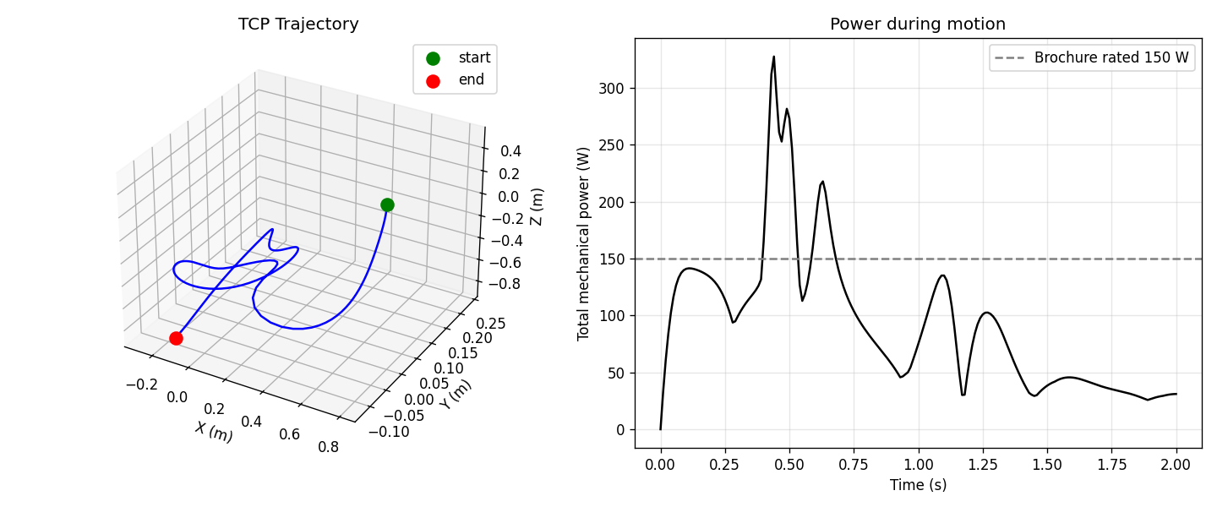
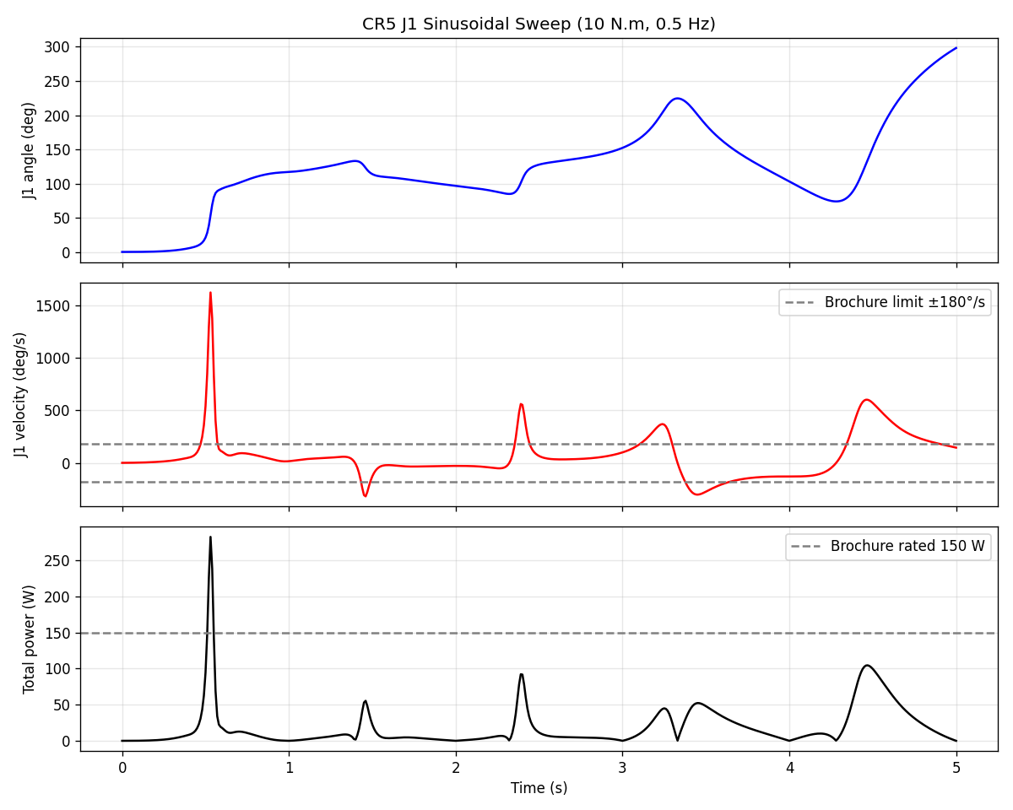
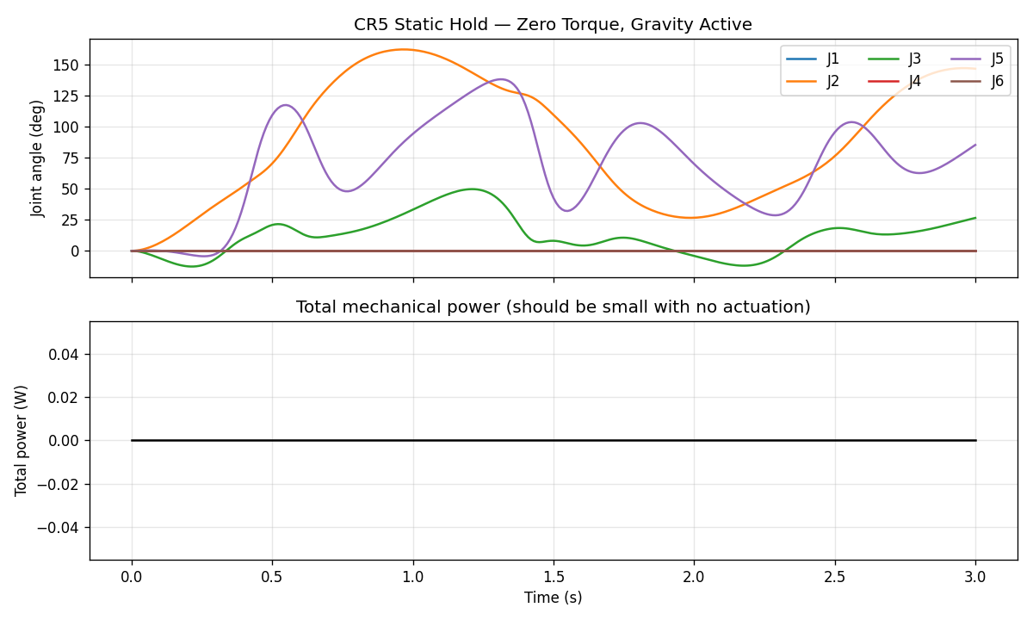

Slide 18
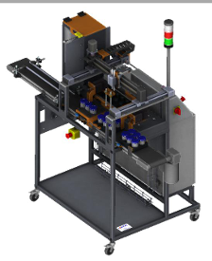
MODEL 3 · XY10 STATION
Cartesian gantry + vacuum gripper
Closed-loop drive (per axis · ×3 for X · Y · Z)
Position
command
PID
DC-equiv
voltage
R-L
winding
DC
machine
Lead-screw
(rot→lin)
Linear
stage
›
›
›
›
›
›
Position feedback closes the loop · vacuum gripper: Boolean command → switch → grip force
Honest abstraction: DC-equivalent steppers
Real steppers fire ±20 A in chopper mode; the FMU models a smooth ±3 A time-averaged drive. At line-orchestration level what matters is envelope, timing and energy — all captured. Chopper detail belongs to EMC studies, not digital-twin operation. A documented engineering choice, not an omission.
XY10 Station
ALIX · Industry 5.0 Digital Twin | Euler Laboratory, ISAE-Supméca
9

Slide 19
MULTIPHYSICS-MODEL
Three subsystems -3.XY10 Station Model
Architecture diagram
x_cmd
(input)
PID controller
DC drive
voltage
R-L winding
(electrical)
DC machine
(rotational)
Lead-screw
(IdealGearR2T)
Linear stage
(Mass)
(feedback to PID)
Position sensor
Vacuum branch
vacuum_cmd
(Boolean)
Switch
(logical)
F_vacuum
(output)
ALIX · Industry 5.0 Digital Twin | Euler Laboratory, ISAE-Supméca
4

Slide 20
Components used (Modelica blocks)
Sr.no | Block | Role
1 | Modelica.Blocks.Interfaces.RealInput | Position command x_cmd / y_cmd / z_cmd
2 | Modelica.Blocks.Continuous.PID | Position controller (closes the loop)
3 | Modelica.Electrical.Analog.Sources.SignalVoltage | DC-equivalent drive voltage source
4 | Modelica.Electrical.Analog.Basic.Resistor | Winding resistance R
5 | Modelica.Electrical.Analog.Basic.Inductor | Winding inductance L
6 | Modelica.Electrical.Analog.Sensors.CurrentSensor | Axis drive current i_x / i_y / i_z
7 | Modelica.Electrical.Machines.BasicMachines.DCMachines.DC_PermanentMagnet | DC-equivalent of the real stepper motor
8 | Modelica.Mechanics.Rotational.Components.IdealGearR2T | Lead-screw (rotation → linear motion)

Slide 21
9 | Modelica.Mechanics.Translational.Components.Mass | Linear stage carriage
10 | Modelica.Mechanics.Translational.Sensors.PositionSensor | Stage position output
11 | Modelica.Mechanics.Translational.Sensors.SpeedSensor | Stage velocity output
Vacuum gripper components
Sr.no | Block | Role
12 | Modelica.Blocks.Interfaces.BooleanInput | Vacuum on/off command vacuum_cmd
13 | Modelica.Blocks.Logical.Switch | Toggles between zero force and full grip
14 | Modelica.Blocks.Sources.Constant | Defines the full-grip force level
15 | Modelica.Blocks.Interfaces.RealOutput | Vacuum force output F_vacuum

Slide 22
AXIS PARAMETERS
Parameter | Value | Source
Lead-screw pitch | 5 mm/rev | ERM XY10 fiche
X-axis carriage mass | ≈ 2 kg | ERM specifications
Y-axis carriage mass | ≈ 3 kg | ERM specifications
Z-axis carriage mass | ≈ 1 kg | ERM specifications
Winding resistance R | Identified | TDMS no-load test
Winding inductance L | Identified | TDMS step response
Torque constant Kt | from rated stepper data | NEMA equivalent
Vacuum grip force | full-on value | ERM vacuum spec

Slide 23
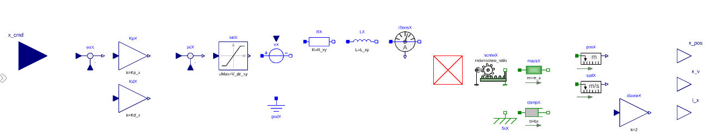
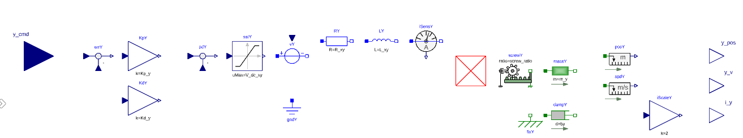
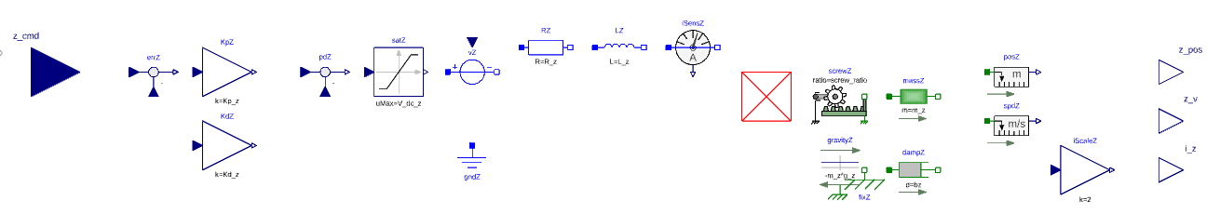

Slide 24
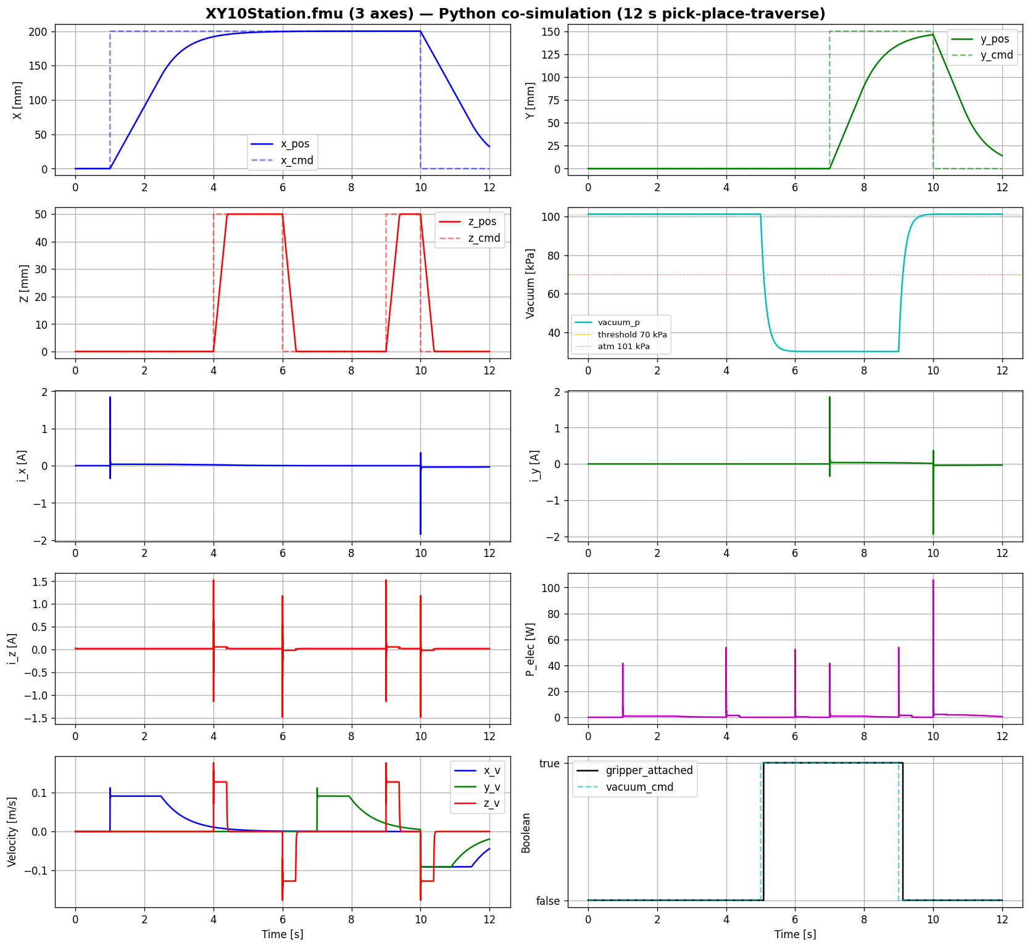

Slide 25
METHODOLOGY-TOOLS USED
1
Real-time experiment on the ALIX line
2
TDMS data acquisition
3
Multiphysics modelling in Dymola / 3DEXPERIENCE
4
5
Python orchestration
6
Two-stage validation + energy analysis
FMU export Each model exported as FMI 2.0 Co-Simulation FMU.

Slide 26
REAL-TIME EXPERIMENT ON THE ALIX LINE
The experimental sequence:
t (s) | Action | Station
0 | Pot enters the line from the input magazine | (upstream)
5 | XY10 vacuum gripper picks the empty pot from the input tray | XY10
7 | XY10 places the pot onto the moving conveyor belt | XY10 → Conveyor
8 → 18 | Conveyor transports the pot along the line (0.196 m/s steady state) | Conveyor
18 | Pot arrives at the CR5 capping station, photoelectric sensor S2 triggers | Conveyor
19 | CR5 picks a cap from the cap dispenser | CR5
22 | CR5 places the cap on the pot, vision check confirms placement | CR5
24 | Conveyor restarts and carries the capped pot downstream | Conveyor
30 | Cycle complete — next pot enters | ---

Slide 27
THE MODELS
Three subsystems · three physics domains
CONVEYOR
CR5 COBOT
XY10 STATION
Full multiphysics
6-DOF multibody
Cartesian + vacuum
Electrical → mechanical → thermal
3-phase induction machine
TECHTOP 0.09 kW · NMRV gearbox i = 20
Thermal branch: losses → ambient
15 Modelica blocks · 161 parameters
Dobot CR5 — 6 revolute joints
Geometry from real CAD
Mass / COM / inertia per link
6 torque inputs · 16 outputs
The actual robot, not a generic arm
3 axes (X·Y·Z) closed-loop
PID → DC drive → lead-screw → stage
Vacuum gripper (Boolean force)
DC-equivalent of chopper drive
4 inputs · 11 outputs
The conveyor runs continuously; CR5 and XY10 act in discrete bursts — the model captures both regimes.
ALIX · Industry 5.0 Digital Twin | Euler Laboratory, ISAE-Supméca
6

Slide 28
VALIDATION
Two stages — against reality and against itself
STAGE A — FMU vs real TDMS field data
STAGE B — FMU vs Dymola reference
Does the model match the world?
Supply voltage · conveyor current fundamental · motor temperature rise · XY10 burst envelope · CR5 mass — each compared against measurement.
Did the export stay faithful?
The exported FMU is replayed in Python and compared to the original Dymola run — catching any FMU-export bug. Result: essentially lossless (T_motor differs by 0.0001 K).
Signal-processing pipeline (Stage A)
1
2
3
4
5
6
7
Load TDMS
Apply ×200 / ×10 gains
200 ms steady window
Band-pass 40–60 Hz
FMU @ 50 kHz → decimate
Cross-correlation align
Compute 6 metrics
ALIX · Industry 5.0 Digital Twin | Euler Laboratory, ISAE-Supméca
11

Slide 29
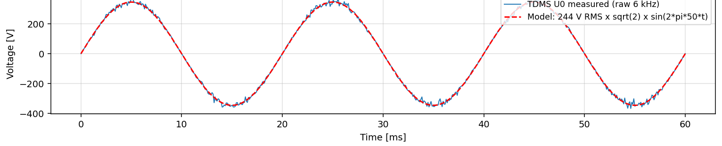
THE HEADLINE
The model matches the line
0.999
0.91
99.2%
94.9%
Voltage R²
Current R²
Thermal
CR5 mass
supply sinusoid · 99.8% peak
fundamental, phase-aligned
ΔT 11.86 K vs 11.95 K obs.
23.74 kg vs 25 kg brochure
Supply voltage — TDMS measured (blue) vs model sinusoid (red)
STAGE B — EXPORT IS LOSSLESS
T_motor
0.0001 K
> 99.99%
i_phase
0.00%
100%
P_elec
0.0003 W
> 99.99%
R² = 0.9987 · peak 345.6 V vs 345.1 V (99.8%) · phase shift negligible
The FMU faithfully reproduces the Dymola model — the toolchain itself introduces no error.

Slide 30
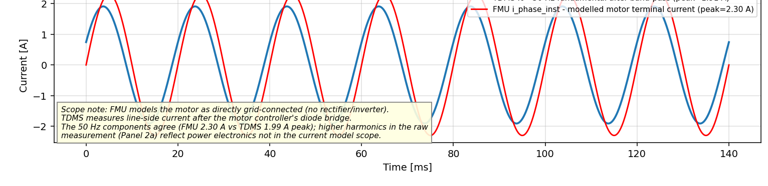
SCIENTIFIC HONESTY
Every residual is named and explained
Conveyor current — 50 Hz fundamental: TDMS band-passed (blue) vs FMU (red)
One root cause: the unmodelled drive-rectifier delay. The model is grid-connected, so the line current shows a 14% amplitude offset (FMU 2.30 A vs measured 1.91 A) and a 105° phase offset (−5.83 ms). Both are the same physical effect — power electronics deliberately outside the current model scope. Localised, named, physically explained.
The fix (Phase 2): calibrate Rs, Rr, Lm, Lσ in the Dymola 2026x identification UI → expected to cut the 14% residual to 3–5%. Calibrate on first.tdms, validate on four.tdms.
ALIX · Industry 5.0 Digital Twin | Euler Laboratory, ISAE-Supméca
13

Slide 31
ENERGY ANALYSIS
Where the line spends its power
Each FMU was run through a full 30-second cycle; instantaneous power was integrated (E = ∫P dt) per subsystem.
Per-cycle breakdown
Conveyor
3284 J · 108 W
90.1%
Sensors + PLC
240 J · 8 W
6.6%
90.1%
Pneumatic
121 J · 4 W
3.3%
XY10 steppers
≈ 0 J · ≈ 0 W
0.0%
Total line 3645 J · 121 W
Insight: the conveyor dominates by an order of magnitude because it runs continuously — making it the prime predictive-maintenance target. Its T_motor output is exposed by the model, directly supporting the Industry 5.0 sustainability pillar.
ALIX · Industry 5.0 Digital Twin | Euler Laboratory, ISAE-Supméca
14

Slide 32
REQUIREMENTS
10 of 12 delivered · 2 with foundation laid
Mechanical modelling
Electrical modelling
Thermal modelling
✓ Delivered
✓ Delivered
✓ Delivered
Spatial representation
Coupling analysis
FMU export
✓ Delivered
✓ Delivered
✓ Delivered
Python orchestration
End-to-end simulation
Validation vs measurements
✓ Delivered
✓ Delivered
✓ Delivered
Energy analysis
✓ Delivered
10 fully delivered. The two open items — sensitivity/observability and parameter identification — have their workflow and tooling (Dymola 2026x calibration UI) defined for Phase 2.
ALIX · Industry 5.0 Digital Twin | Euler Laboratory, ISAE-Supméca
16

Slide 33
IN ONE SENTENCE
A validated multiphysics digital model of the ALIX line — three subsystems, three physics domains — matching the real line to R² = 0.999 on voltage, 0.91 on current and 99.2% on thermal, with every residual physically explained.
1
2
3
Validated, not asserted
Honest by construction
Built to extend
Two-stage validation against real TDMS data and against the Dymola reference — numbers, not claims.
Scope = what could be measured. Every residual is named and traced to one physical cause.
Modelica · FMI · Python — a Dassault-native foundation ready for calibration, a shadow, and a full twin.
Samiksha Satre · Euler Laboratory, ISAE-Supméca · github.com/samikshasatre/Mechatronics-modelling-of-entire-industry-5.0

