Slide 1


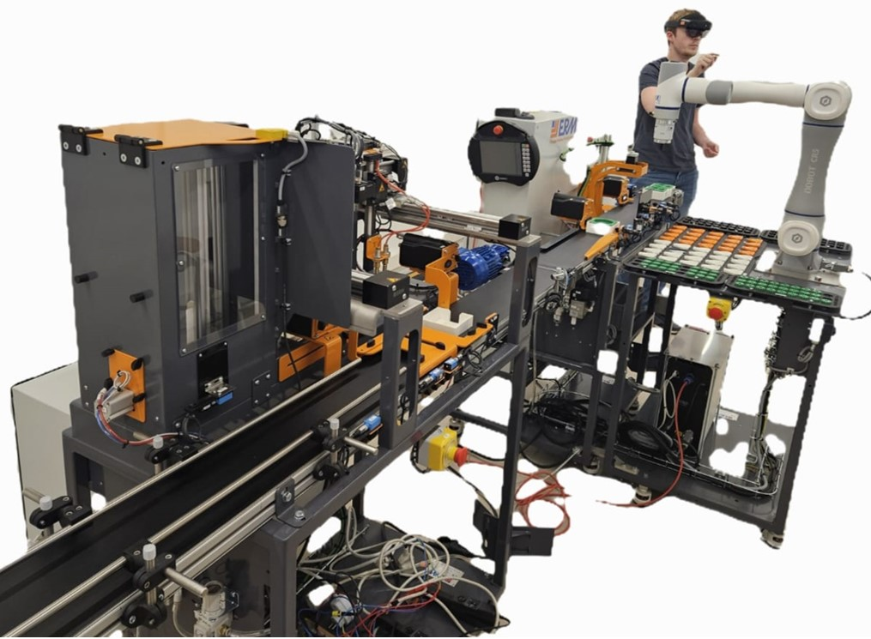
Intern: Ms. Samiksha Satre
Academic Level: Master’s Level (M1-M2)
Duration: 4 Months
Supervisor:Mr.Romain Delabeye
Period: February 2026 To June 2026
Location: Isae-supméca Paris, France
Under The Guidance Of
Dr Shrinivas S Metan
Mr.Romain Delabeye
Prof. Roshan Pushpan
1

Slide 2
Goal & expected outcome
Energy analysis
Model calibration
Model validation
Spatial representation and coupling matrix
Conclusion
references
Problem statement and objective
Introduction
Literature review
Specifications
Demo performed video
Tech stack
Multiphysics model ( conveyor,xy10,CR5)
FMU export
FMU vs actual specs
Groupe ISAE
|
ISAE-Supméca – Institut supérieur de mécanique de Paris
|
2

Slide 3

Problem statement and objective
Modern Industry 5.0 production lines are made of many connected machines — conveyors, robots, sensors, and vehicles — that all work together. Their movement (mechanical), power (electrical), and heat (thermal) behaviours are linked, but there is no single model that captures all of this and matches the real machine.
Without such a model, we cannot properly simulate the line, study its energy use, find its parameters, or build a digital twin that could later support smart decisions and learning.
This project solves that gap by building multiphysics models of the ALIX line's main subsystems in Modelica, turning them into FMUs, running the whole line from one Python program, and checking the models against real measurements.
Groupe ISAE
|
ISAE-Supméca – Institut supérieur de mécanique de Paris
|
3

Slide 4

Introduction
What is the project? This internship builds a digital twin of the ALIX production line at the Euler Laboratory, ISAE-Supméca. A digital twin is a simulation model that behaves like the real machine and can be tested on a computer instead of on the physical line.
Why multiphysics? Every machine on the line shows three kinds of behaviour at the same time — movement (mechanical), electricity (electrical), and heat (thermal). A multiphysics model captures all three together in one place.
How is it built? The models are written in Modelica (a language for physical systems), exported as FMUs (reusable simulation blocks), and run from Python using the FMI standard — so the entire line can be simulated from a single program.
How do we know it's correct? The models are checked against real measurements recorded from the running line (TDMS data), so the simulation is not just theory — it matches reality.
Groupe ISAE
|
ISAE-Supméca – Institut supérieur de mécanique de Paris
|
3

Slide 5
ALIX
ALIX is a bench-top Industry 5.0 production line at the Euler Laboratory — an ERMASMART line by ERM Automatismes Industriels (Carpentras, France).
Key facts (left column):
Total length 8445 mm · five integrated stations
Two operating modes: Conditionnement (packaging) and Assemblage (assembly)
A continuous conveyor carries pots/parts through all stations
Supply: 3-phase 400 V (244 V phase RMS), 50 Hz
Control: Siemens S7-1200 PLC + TULIP supervision
Photoelectric sensors detect parts and trigger each station
Groupe ISAE
|
ISAE-Supméca – Institut supérieur de mécanique de Paris
|
3

Slide 6
ALIX
ALIX is the Euler Laboratory's bench-top ERMASMART line by ERM Automatismes Industriels (Carpentras, France) — a flexible Industry 5.0 platform for packaging and assembly.
What it demonstrates (technologies): Smart sensors · IO-Link · supervision (TULIP) · cobotics · machine vision · RFID traceability · industrial automation (S7-1200 PLC)
Key facts:
Total length 8445 mm · five modular stations linked by a continuous conveyor
Supply: 3-phase 400 V (244 V phase RMS), 50 Hz
Flexible & reconfigurable — stations can be added, removed, or rearranged (e.g. it can run without the DX10 dosing unit; pots just stay empty)
Throughput: one finished pot every 30 s (packaging mode); one gear-train every 1 min (assembly mode)
Groupe ISAE
|
ISAE-Supméca – Institut supérieur de mécanique de Paris
|
3

Slide 7
OPERATING MODES
1
Conditionnement (packaging)
2
Assemblage (assembly)
Pot Supply ↓ 2D Depalletizing Robot (ON10) ↓ Granule Filling (DX10) ↓ Cap Placement (MI00 + MR10) ↓ Optional Personalization Cap ↓ Tray Packaging (XY10) ↓ Storage (VL10)
Reducer Base
↓
XY10 Positioning
↓
MI00 + MR10 Assembly Robot
↓
Install Lower Shaft
↓
Install Planet Gears
↓
Install Central Gear
↓
Vision Inspection
↓
ON10 Places and Screws Cover
↓
VL10 Storage
3
4
Groupe ISAE
|
ISAE-Supméca – Institut supérieur de mécanique de Paris
|
4

Slide 8
STATIONS
1
2
3
ON10
DX10
MI00 + MD20
2
Robot collaboratif de dévracage 2D
Dosaxe
Robot collaboratif de bouchage
(Dobot CR5)
Bin-pick pots from bulk and place on conveyor
Fill pots with a determined dose of granules
Place caps personalization covers
4
XY10
3
5
VL10
Robot cartésien XYZ de conditionnement
Magasin vertical
Pack capped pots into trays
Store packaged
Groupe ISAE
|
ISAE-Supméca – Institut supérieur de mécanique de Paris
|
4

Slide 9
stations
Each subsystem is exported as an FMU and orchestrated in Python following the FMI 2.0 standard.
1
Conveyor Motor
2
Robot Manipulator
FOCUS — current work
Dobot CR5 cobot
3-phase induction motor + Motovario NMRV 030 gearbox.
dq-frame dynamic model in Modelica.
6-DOF reduced to 3-DOF kinematic model for system-level simulation.
Payload 5 kg, reach 900 mm.
3
AGV Mobile Platform
4
Assembly Mechanism
ERMASMART / MiR100
ERMASMART XY10
Differential-drive motion model.
1.5 m/s forward, 100 kg payload, ±50 mm accuracy.
3-axis Cartesian pick-and-place with vacuum gripper.
Siemens S7-1200 PLC, IO-Link, RFID.
Groupe ISAE
|
ISAE-Supméca – Institut supérieur de mécanique de Paris
|
4

Slide 10
Modelling Process
01
02
03
04
System architecture
Parameter extraction
Mathematical modelling
Modelica behaviour
Define subsystems & interfaces
Datasheets & technical docs
Equations per subsystem
Implement in 3DEXPERIENCE
05
06
07
08
FMU export
Python co-simulation
Model Calibration
Experimental validation
Functional Mock-up Units
Orchestrate FMUs (FMI 2.0)
Calibrating the models
Verify with TDMS data
Groupe ISAE
|
ISAE-Supméca – Institut supérieur de mécanique de Paris
|
5

Slide 11
Conveyor motor — focus of this meeting
Modelling, parameters & first simulation results
Groupe ISAE
|
ISAE-Supméca – Institut supérieur de mécanique de Paris
|
6

Slide 12
Conveyor motor — specifications
Three-phase induction motor
Gearbox & belt drive
Power
0.09 kW
Gearbox model
Motovario NMRV 030
Voltage
230 / 400 V
Reduction ratio
20 : 1
Frequency
50 Hz
Output type
Worm-gear, hollow shaft
Rated speed
1400 RPM
Belt speed
0.15 – 0.22 m/s
Number of poles
4
Belt length
≈ 2.4 m
Phases
3
Load
Jars / trays / parts
Status: all parameters extracted from datasheets and verified against the physical motor on the ALIX line.
Groupe ISAE
|
ISAE-Supméca – Institut supérieur de mécanique de Paris
|
7

Slide 13
Conveyor motor — dq-frame mathematical model
Park transformation of the 3-phase quantities into a rotating dq reference frame — captures electromagnetic torque, flux linkage and mechanical dynamics.
Governing equations
Variables
Stator voltage (d-axis):
v_sd = R_s·i_sd + dψ_sd/dt − ω_s·ψ_sq
Stator voltage (q-axis):
v_sq = R_s·i_sq + dψ_sq/dt + ω_s·ψ_sd
Rotor voltage (squirrel-cage, v_rd = v_rq = 0):
0 = R_r·i_rd + dψ_rd/dt − (ω_s−ω_r)·ψ_rq
Electromagnetic torque:
T_em = (3/2)·p·(ψ_sd·i_sq − ψ_sq·i_sd)
Mechanical equation (with gearbox):
J·dω_m/dt = T_em − T_load/N − B·ω_m
v, i, ψ voltage, current, flux
R_s, R_r stator / rotor resistance
ω_s, ω_r synchronous / rotor speed
T_em electromagnetic torque
p pole pairs (= 2)
N gearbox ratio (= 20)
J, B inertia, viscous friction
Groupe ISAE
|
ISAE-Supméca – Institut supérieur de mécanique de Paris
|
8

Slide 14
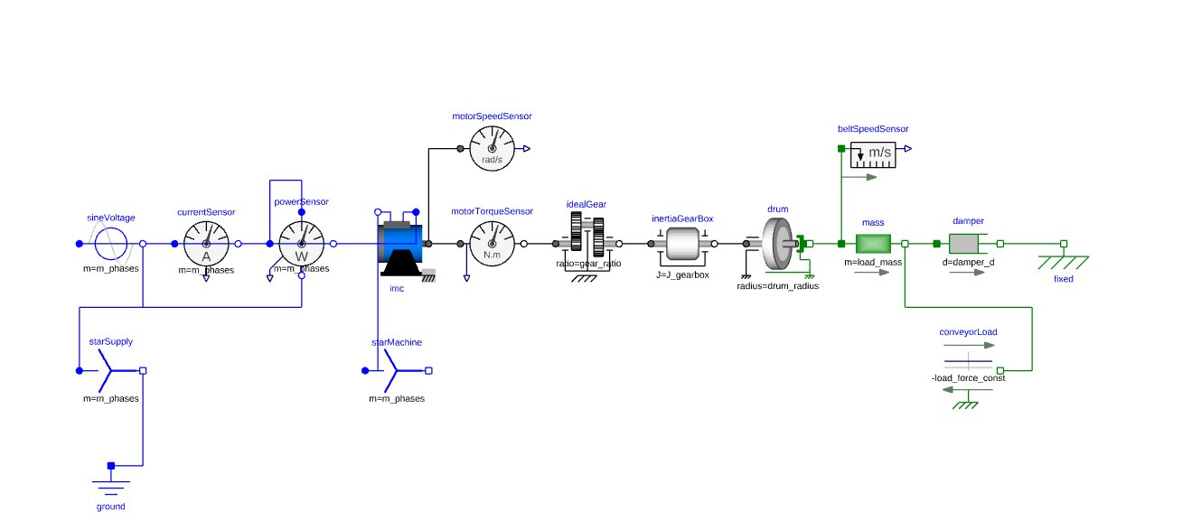
Conveyor motor — Modelica implementation in 3DEXPERIENCE
Behaviour-modelling diagram built in 3DEXPERIENCE — electrical chain (blue) and mechanical chain (green).
Components & sensors
Electrical chain
sineVoltage → currentSensor → powerSensor → IMC (m_phases = 3); starSupply, starMachine and ground complete the 3-phase circuit.
Mechanical chain
idealGear (ratio) → inertiaGearBox (J_gearbox) → drum (drum_radius) → belt mass → damper → fixed support.
Sensors
motorSpeedSensor (rad/s), motorTorqueSensor (N·m), beltSpeedSensor (m/s).
Load
conveyorLoad applies a constant resistive force −load_force_const on the belt mass.
3DEXPERIENCE Behaviour Modelling — conveyor motor + gearbox + belt load
Groupe ISAE
|
ISAE-Supméca – Institut supérieur de mécanique de Paris
|
9

Slide 15
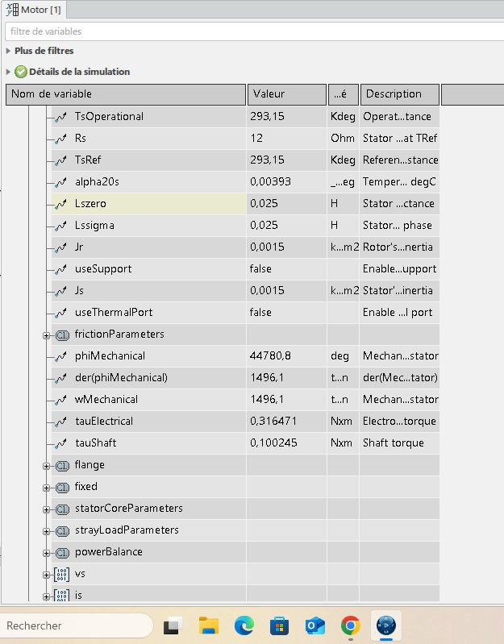
Conveyor motor — first simulation results
Simulation run on the 3DEXPERIENCE Modelica model — values read directly from the post-processing variable browser.
Input parameters
Simulation outputs
Rs
12 Ω
wMechanical
stator resistance
1496.1 RPM
Lssigma
0.025 H
stator stray ind.
Lszero
0.025 H
tauElectrical
zero-seq. ind.
0.316 N·m
Jr
0.0015 kg·m²
rotor inertia
tauShaft
Js
0.0015 kg·m²
0.100 N·m
stator inertia
TsRef
293.15 K
reference temp.
Steady-state near synchronous speed (1500 RPM) → very low slip, consistent with no-load run.
alpha20s
0.00393 / K
temp. coefficient
Groupe ISAE
|
ISAE-Supméca – Institut supérieur de mécanique de Paris
|
10

Slide 16
State of the art — research foundations
Each subsystem model is grounded in peer-reviewed literature on modelling, fault simulation and co-simulation.
Conveyor / induction motor
Dobot CR5 manipulator
dq-frame induction-motor models with electrical & mechanical fault simulation in Modelica (broken-bar, eccentricity, voltage unbalance).
Forward / inverse kinematics and Lagrangian dynamics for 6-DOF cobots; reduced-order 3-DOF surrogate for system simulation.
MiR100 AGV
FMI 2.0 co-simulation
Differential-drive kinematics; trajectory tracking via Model Predictive Control in factory-floor environments.
Master-slave orchestration of FMUs in Python; TDMS data acquisition for experimental validation of digital twins.
Groupe ISAE
|
ISAE-Supméca – Institut supérieur de mécanique de Paris
|
11

Slide 17
Conclusions & next steps
Achieved so far
Next steps
Digital-twin architecture defined for the four ALIX subsystems.
MBSE methodology validated with the supervisor (7-step pipeline).
All conveyor-motor parameters extracted and cross-checked.
dq-frame mathematical model derived and implemented in Modelica / 3DEXPERIENCE.
First simulation reproduces near-synchronous steady state: wMechanical ≈ 1496 RPM (slip < 0.3%).
Electrical torque tauElectrical ≈ 0.316 N·m, shaft torque tauShaft ≈ 0.100 N·m at no-load.
FMU 2.0 export of the conveyor model successfully tested in a Python wrapper.
Acquire experimental TDMS data on the real conveyor for validation.
Tune gearbox efficiency & friction parameters from measurements.
Inject electrical/mechanical faults (broken bar, voltage unbalance) for fault-simulation studies.
Start Subsystem 2 — Dobot CR5 kinematic / dynamic model.
Define interface variables between conveyor and XY10 station for the conditioning mode.
Prepare a first end-to-end Python co-simulation prototype with two FMUs.
Groupe ISAE
|
ISAE-Supméca – Institut supérieur de mécanique de Paris
|
12

Slide 18
Action plan — updated planning
Today
Feb
Mar
Apr
May
Jun
Jul
Aug
State of the art & literature
System architecture & MBSE plan
Conveyor motor — modelling & FMU
TDMS data acquisition & validation
Dobot CR5 — kinematic / dynamic model
MiR100 AGV — motion model
XY10 assembly — Cartesian model
End-to-end co-simulation prototype
Final report & defence
Done
In progress
Planned
Groupe ISAE
|
ISAE-Supméca – Institut supérieur de mécanique de Paris
|
13

Slide 19
isae
ISAE-Supméca
GROUPE
supméca
Institut supérieur de mécanique de Paris
3 rue Fernand Hainaut 93407 Saint-Ouen Cedex
Tél. 01 49 45 29 00 – www.isae-supmeca.fr
ISAE
Ministère de l'Enseignement supérieur
et de la Recherche

