Slide 1
The Online Car Sale
        Smrutiswagatika Muduli
        Mamalini Behera
        Snehamayee Bahalia
        Debasis Rout
        Subhasmita Panda
        Soumya Ranjan Jena

Slide 2
Major Players in Online Cars
Lead Generators
  Autoweb.com
  Cars.com
  Carclub.com
Direct Sellers
  AutoNationDirect.com
  CarsDirect.com
  CarOrder.com
  DriveOff.com
  Greenlight.com
Hybrid
  Autobytel.com

Slide 3
BASICS
Lead Generator
  Pass on customer inquiries to dealers and offer Internet training to sales staff
  Select car, pick options, dealer price comparisons, dealer recommendations
Direct Seller
  Consumers can buy and sell directly from their computer
  Login, select car, financing options, arrange delivery or pickup
Hybrid
  Lead Generator and “Click & Buy” option
  Allows Research and Dealer Recommendations, Research and Direct Purchase, or Click & Buy

Slide 4
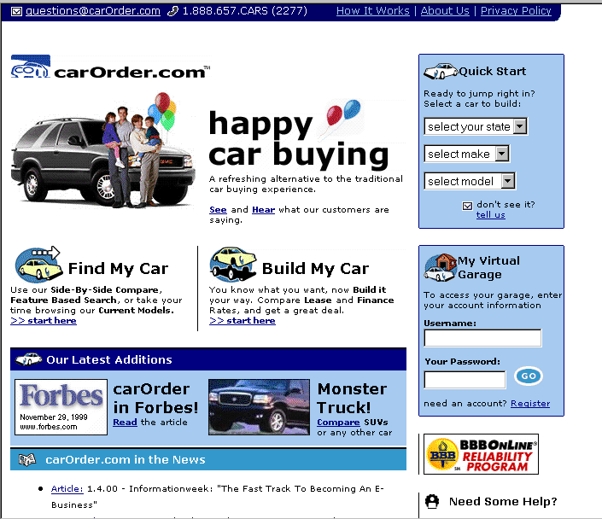
A Sample Front Page – carOrder.com

Slide 5
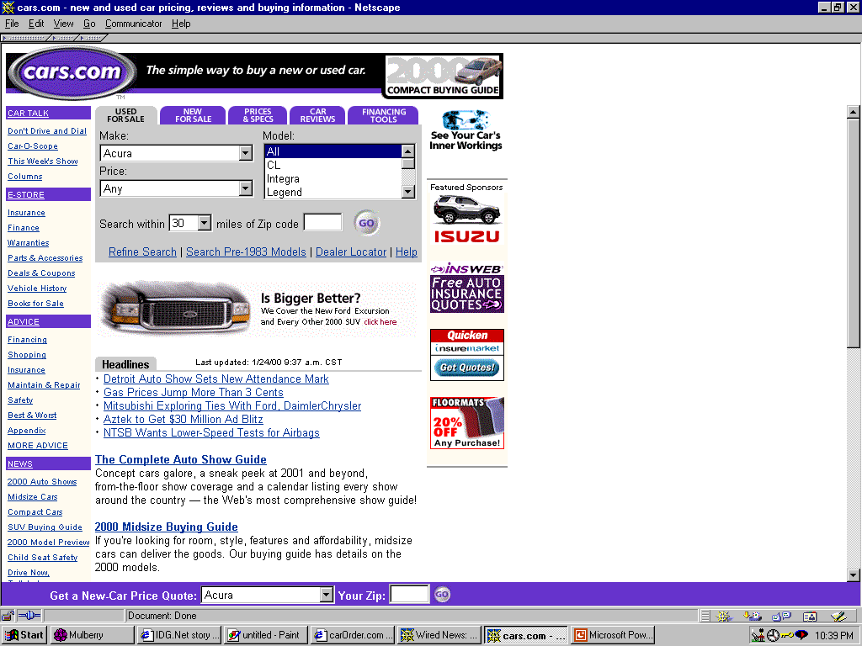
Lead Generator - Sample Front Page

Slide 6
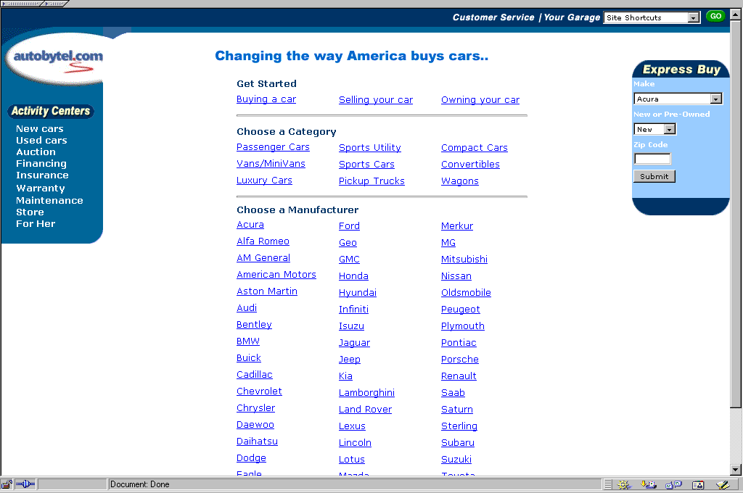
Hybrid - Sample Front Page

Slide 7
CUSTOMERS
Buyers/Sellers
Leisure/Sporty customers
First time buyers
Repeat customers
Business people
Price sensitive people
The CARSALE .com race for a fraction of the 2014 $350 billion auto market could have profitable awards.
2.7% of new vehicles sold via internet in 2016 , increasing to 5% in 2018.

Slide 8
ATTRACTING CUSTOMERS
Discounts
Additional features/maintenance
Referral (word of mouth)
Online research library (Autobytel)
Weekly auto market reports (Autobytel, Autoweb)
Financing online (Autoweb – through peoplefirst.com)
Blue book value of used cars

Slide 9
VALUE ADDED
Reminder emails for oil change/maintenance
Special discounts on services/parts
Service car anywhere
Home delivery
Free and convenient delivery service
Place advertisements to sell cars
Saves time
Free mailing lists
Search process easier

Slide 10
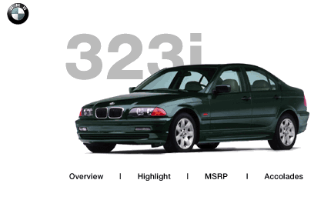
PRICE COMPARISON BMW 323I
bmwusa.com $29,485
CarOrder.com $25,425
CarDirect $26,976
Carsale.net $24,770

Slide 11
LEGAL IMPEDIMENTS & PRICING STRATEGIES
In TX, lobbyists have caused the tightening of franchise laws to further restrict efforts to sell cars without dealers. CarsDirect and Autobytel cannot sell in TX.
Lead Generators originally placed their businesses on dealers’ ignorance of the internet.
Possible shift from MSRP to cost-plus pricing. Consumers are well informed of wholesale price.

Slide 12
TRYING THE PRODUCT
Promotions
  Free maintenance
  Build your own car (Free customization)
  Free Delivery
  Free Research
  Convenience of Virtual Customization

Slide 13
RETAINING CUSTOMERS
First time customers into repeat customers
Referrals
Strong customer relationships throughout process (research, buying and servicing)
On maintenance plan, customers are committed to an ongoing relationship
Near instantaneous price quotes
Bypassing dealer sales personnel

Slide 14
THANK YOU FOR YOUR ATTENTION

Slide 15
ANY QUERIES???

