Slide 1




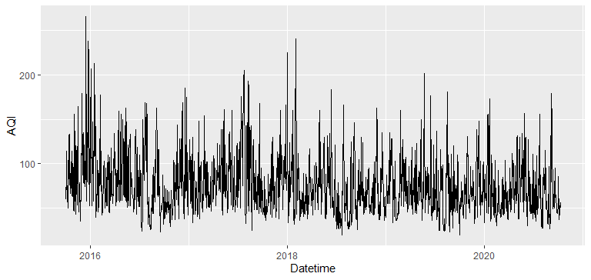
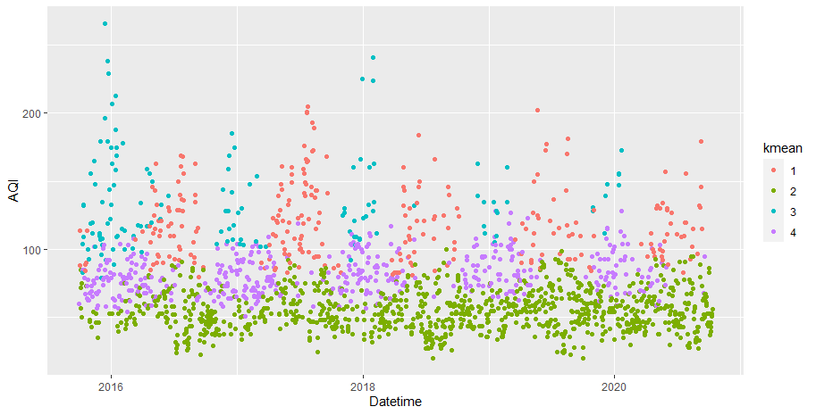
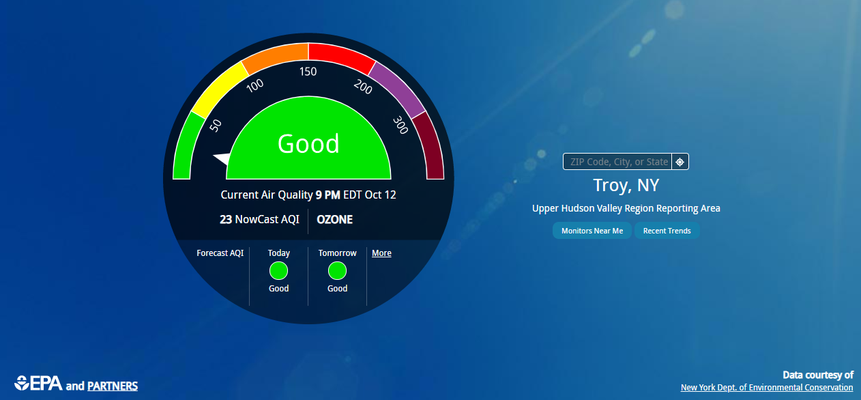
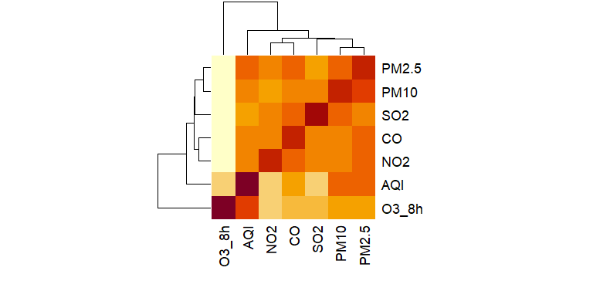
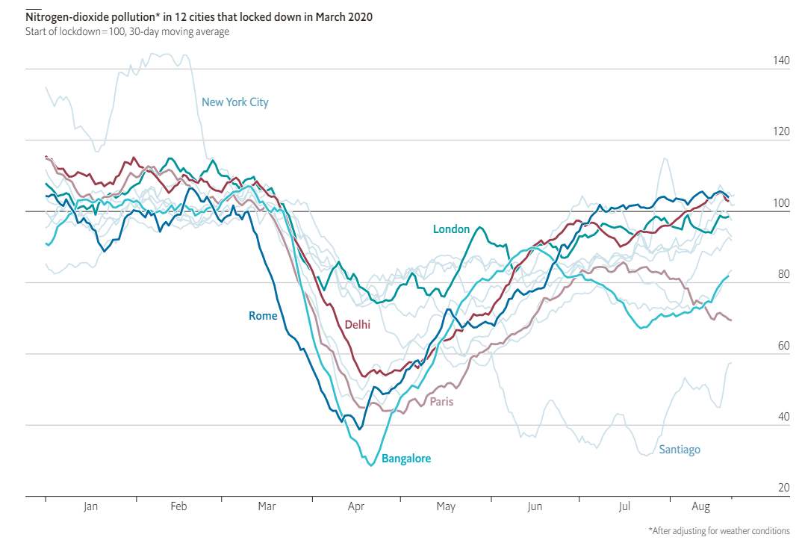
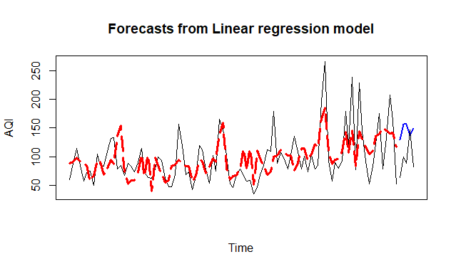
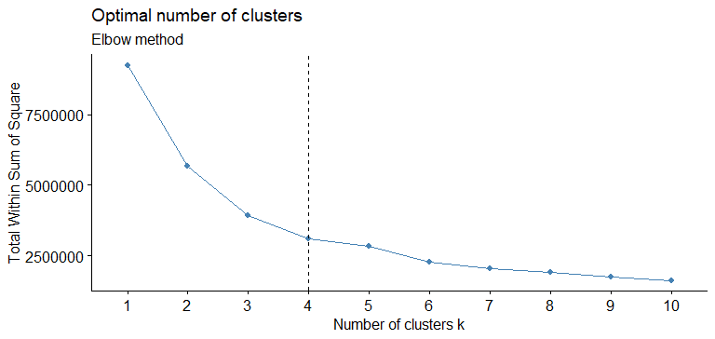
What we can do to protect air quality and ourselves and how
Yihui Yang^{1 (yangy34@rpi.edu)}, (¹Rensselaer Polytechnic Institute 110 8th St., Troy, NY, 12180 United States)
Abstract
Air quality has a strong correlation with people’s health. If people live in a place with bad air quality, he or she might suffer from breathing system damage, lung problems, even cancer. To help ordinary people to prevent these tragedies from happening, both government and third-party organizations have established a series of policies to regulate the related industries and set up metrics to monitor the air quality.
Here is the website provided by EPA and partners to show the current air quality data. The raw data as indicated at the right-bottom of the graph below is due to the courtesy of the New York Dept. of Environmental Conservation.
From the trend above, I can draw some brief conclusions. For example, AQI is a seasonal index. The peaks usually happened at the end of each year and the beginning of the next year. It also seems that AQI is getting low, which means the air quality is getting better recently. However, it still needs several hypothesis tests to confirm it.
Models
It will provide a better look when aggregating the data by pollutants within each group.
Heatmap can visualize the correlation within the data. After filtering out the DateTime column, here is the heatmap.
For group 1, from the graph, it seems that this phenomenon usually happens in the mid of the year. Commonly, during those days, ozone is quite high compared with the rest of the year.
For group 2, in terms of AQI data, the green dots which are located below the 100-line indicate that people can enjoy really good air quality during those days.
For group 3, the days are heavily polluted. AQI, PM2.5, PM10, SO2, CO, and NO2 are all high. These dots usually appear from the end of a year to the beginning of the next year.
For group 4, these days are not too bad, but people still need to take care of themselves when going out.
Overall, the green dots are becoming more and more frequent these years. The relevant parties, on the other hand, can spend more time to figure out what leads to group 1 caused by ground-level ozone and group 3 caused by AQI, PM2.5, PM10, SO2, CO, and NO2.
A widely-used indicator is AQI – Air Quality Index. AQI is based on the five main pollutants -- ground-level ozone(O3), particle pollution (PM2.5 and PM10), carbon monoxide(CO), sulfur dioxide(CO2) and nitrogen dioxide(NO2). When calculating the AQI, scientists will calculate the IAQI number of each pollutant, and set the AQI with the highest AQI data.
Surprisingly, ground-level ozone has a strong correlation with AQI. The second strongest indicator is PM2.5. PM2.5 and PM10 are strongly correlated with each other.
Since the majority of the data are numeric, I can use kmean to classify the data and find the pattern accordingly.
Firstly, I used the elbow method to find the optimal number of clusters.
Covid-19 is undoubtedly a worldwide issue this year. Meanwhile, due to the lockdown, the air quality of some cities getting better after March. I want to find the data and use a hypothesis test to make sure that the drop in AQI is significant.
Data cleaning and overview
To accomplish the goals above, I pick the data from aqistudy.cn. The timeframe I picked is from 10/01/2015 to 10/10/2020.
Blackline is the actual data. The Red and dash line is the train forecasts and the blue line is the validation forecasts. Apparently, the prediction results have some overlap with the actual data. Even if sometimes, there is a huge gap between the prediction and the actual results, the model can still predict the trend.
So, the number of clusters is 4.
Then, choose 4 as the k number, I conduct kmean function in R. I plotted the results with ggplot. The graph below clearly indicates that there are some patterns regarding DateTime.
The first column is the DateTime.
API: official Air Quality Index of that day
PM2.5: official PM2.5 concentration(μg/m3).
PM10: official PM10 concentration(μg/m3).
SO2: official SO2 concentration(μg/m3).
CO: official CO concentration(mg/m3).
NO2: official NO2 concentration(μg/m3).
O3_8h: official ozone concentration(μg/m3) in 8 hours.
Conclusion
Respectively, the average AQI in 2016 is 80.82. The average AQI in 2017 is 83.63. The average AQI in 2018 is 70.13. The average AQI in 2019 is 72.62. From the model and analysis above, the air quality is not going worse at least. From 2017 to 2018, air quality actually improved significantly.
Ground-level ozone has a strong statistical relationship with AQI data, and the PM2.5 is the second strongest factor.
Comparing with the same time in 2019, the limitation of human moving contributes to air quality improvement. Last year, from January to April, the average AQI was 74, but this year the number is down to 67.5. Meanwhile, the difference is significant statistically.
The air pollution during summertime(red dots) is usually caused by ground-level ozone. Ground-level ozone is created by NOX and VOC[5]. This process happens much easier and faster in a hot atmosphere, which explains why red dots appear more frequently during the mid of the year. In water, however, the weather is cold. The transmission of pollutants is slower than usual, so the majority of heavily polluted days are caused by particles and gas emitted by vehicles.
The model I choose is based on a linear model which considers seasonal and trend effect. The R2 is more than 0.4. When it comes to models with real-life problems, R2 around 0.4 is acceptable.
Acknowledgments:
Yihui Yang is a graduate student from Rensselaer Polytechnic Institute, Lally School of Business.

