Slide 1
SIMPLE
Team 9
Subhradeep Biswas (sbiswa24)
Prashansa(pprasha2)
Muhammad Sami(msami2)

Slide 2
Basic features of language….
Integer Type
Boolean Type
Looping
All Arithmetic operations (+, -, *, /,%)
Precedence

Slide 3
Extra Features of Language(Extra Credits)
Nested Loops
Functions
Recursion
Conditional expressions
Boolean expression

Slide 4
Language Control Flow
Program File
Lexical Analysis
Parse
Intermediate Code
Execution
Output

Slide 5
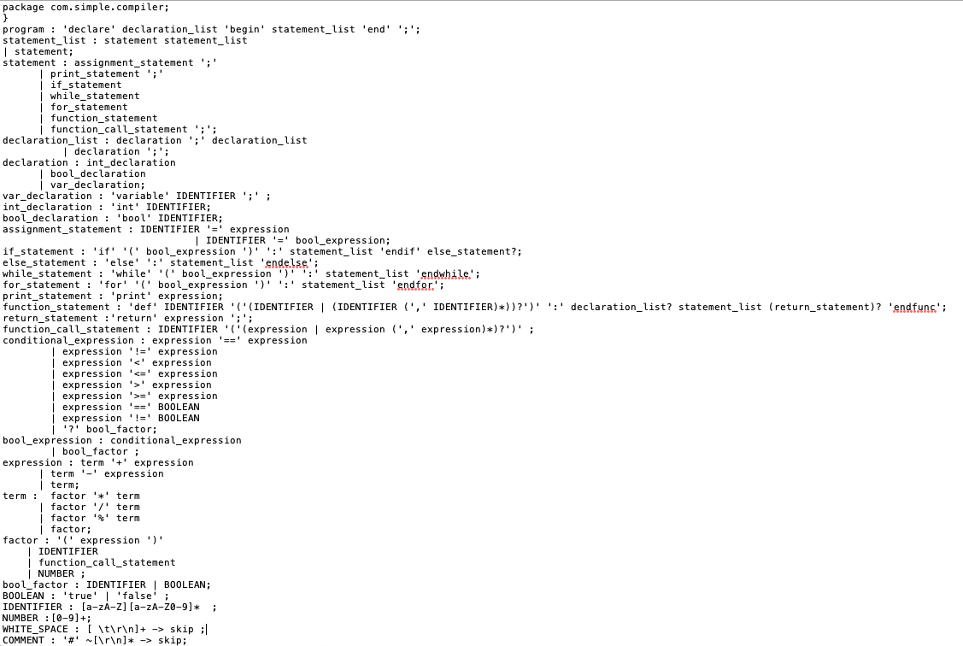
Grammer

Slide 6
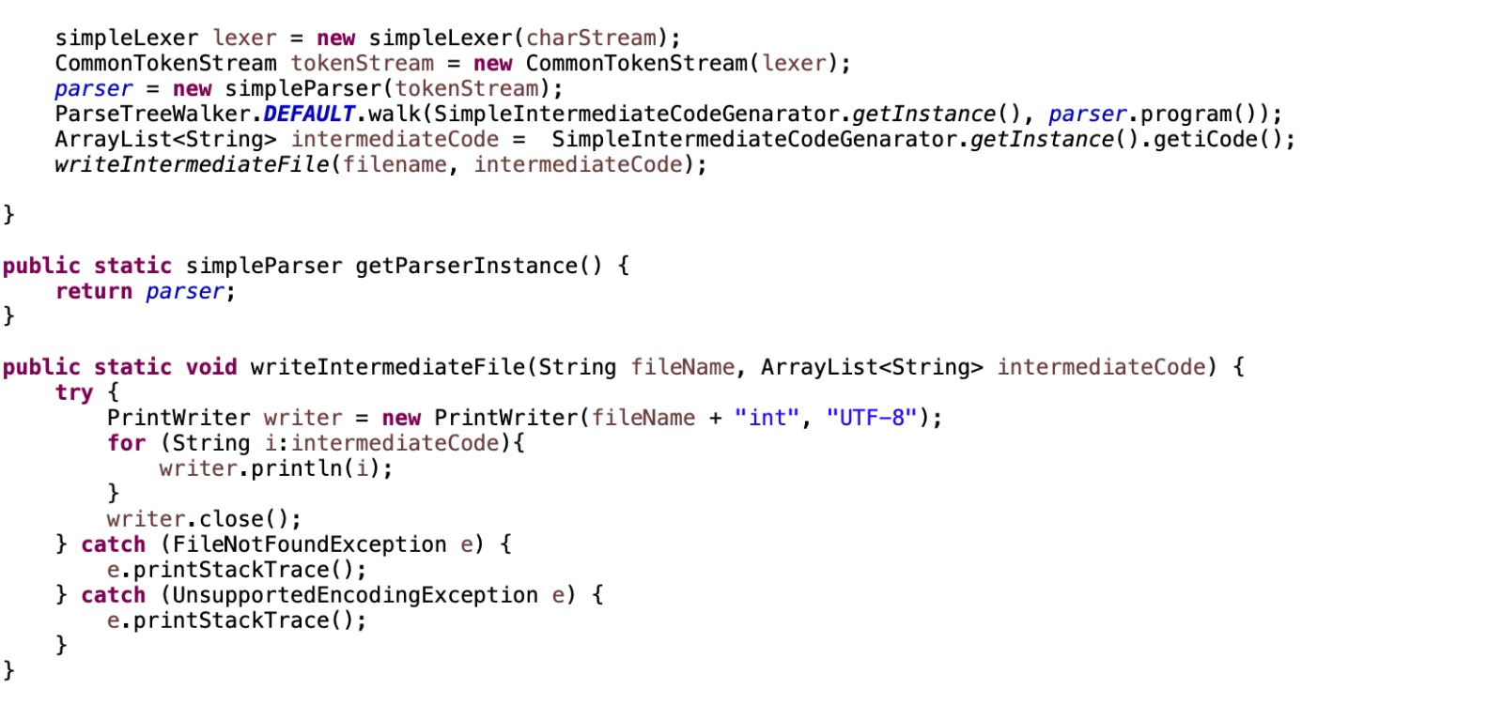
Compiler

Slide 7
Syntactical Structure
DECL
Int a;
Int b;
Begin
a = 1;
b = 2;
Print a;
Print b;
End;

Slide 8
Sample Programs
Addition
Functions
Precedence
Recursion

Slide 9
Code and Intermediate Code Addition
CODE | Intermediate Code
declare int a; int b; int c; begin a = 8; b = 2; c = a + b; print c; | INT a INT b INT c PUSH 8 ASSIGNMENT a PUSH 2 ASSIGNMENT b LOAD a LOAD b ADDITION ASSIGNMENT c LOAD c PRINT

Slide 10
Compiling and Execution Addition

Slide 11
Code and Intermediate Code Function
Code | Intermediate Code
int a; int b; int c; int d; int z; begin a = 1; b = 2; c = 3; d = 4; z = 0; print MUL(c,d); print MUL(a,b); def MUL (x,y): z = x * y; return z; endfunc | INT a INT b INT c INT d INT z PUSH 1 ASSIGNMENT a PUSH 2 ASSIGNMENT b PUSH 3 ASSIGNMENT c PUSH 4 ASSIGNMENT d PUSH 0 ASSIGNMENT z LOAD c LOAD d | FUNCTION CALL_MUL PRINT LOAD a LOAD b FUNCTION CALL_MUL PRINT FUNCTION DECLARE_MUL FUNCTION_PARAM #MULx #MULy LOAD #MULx LOAD #MULy MULTIPLY ASSIGNMENT #MULz LOAD #MULz RETURN FUNCTION END_MUL

Slide 12
Compiling and Execution Function

Slide 13
Code and Intermediate Code Precedence
Code | Intermediate Code
int n; int b; int c; int d; int z; begin a = 1; b = 2; c = 3; d = 4; z = 0; z = a + b - c * d; print z; | INT n INT b INT c INT d INT z PUSH 1 ASSIGNMENT a PUSH 2 ASSIGNMENT b PUSH 3 ASSIGNMENT c PUSH 4 ASSIGNMENT d PUSH 0 | ASSIGNMENT z LOAD a LOAD b LOAD c LOAD d MULTIPLY SUBTRACTION ADDITION ASSIGNMENT z LOAD z PRINT

Slide 14
Compiling and Execution Precedence

Slide 15
Code and Intermediate Code Recursion
Code | Intermediate Code
declare int n; begin n = 50; countBackwards(n); def countBackwards(n): if (n>0): print n; n = n-1; countBackwards(n); endif endfunc | INT n PUSH 50 ASSIGNMENT n LOAD n FUNCTION CALL_countBackwards FUNCTION DECLARE_countBackwards FUNCTION_PARAM #countBackwardsn IF_1 LOAD #countBackwardsn PUSH 0 GREATER_THAN CONDITION_END | LOAD #countBackwardsn PRINT LOAD #countBackwardsn PUSH 1 SUBTRACTION ASSIGNMENT #countBackwardsn LOAD #countBackwardsn FUNCTION CALL_countBackwards END IF_1 FUNCTION END_countBackwards

Slide 16
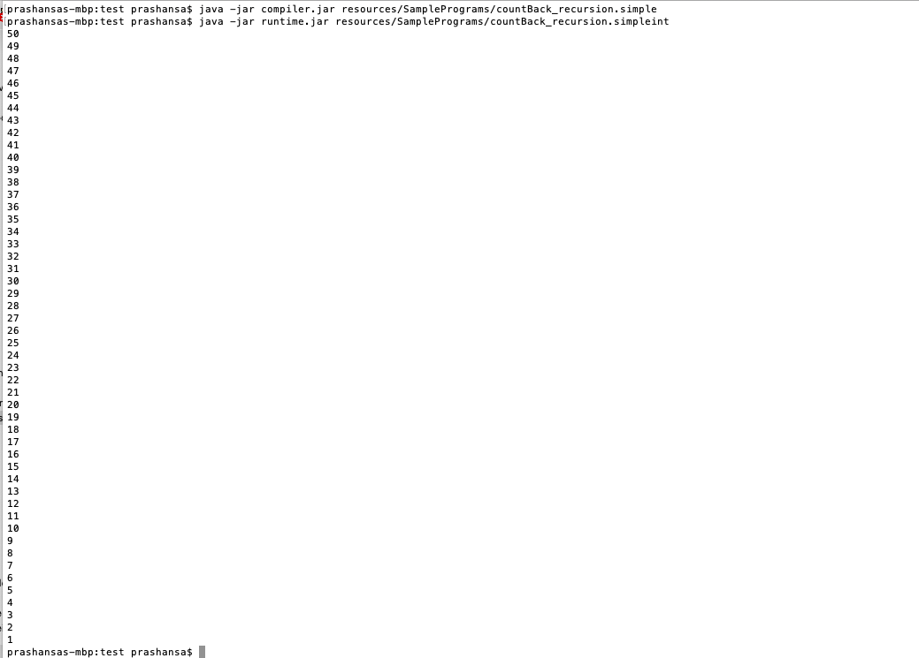
Compiling and Execution Recursion

Slide 17
Future Work
Other Data Types such as Float, Double, Char, String etc can be implemented.
Collective data types such as Array, Linked list, Hash maps, trees and Graphs can be implemented to try complex algorithms.
Object Oriented Programming concepts could be implemented to incorporate concepts like inheritance, Polymorphism etc

Slide 18


