Slide 1
CSE- 4128
Coin Detection Using
Template Matching
Presented To -
Dr. Sk Masudul Ahsan
Professor
CSE, KUET
Dipannita Biswas
Lecturer
CSE, KUET
Presented By -
Samin Saiara
Roll: 1907078
4th year, 1st term
Khulna University of Engineering & Technology

Slide 2
Outline
Objectives
Introduction
Theory
Methodology
Result
Conclusion
References

Slide 3
Objectives
To identify and classify different types of coins based on visual characteristics
To know about the basics behind coin detection
To implement a image processing methodology to detect and label coins for an input image
To evaluate the effectiveness of template matching in coin detection

Slide 4
Introduction
Template matching is a reliable method for coin detection
Rotated templates to match different orientation of coins
Candidate images for coins extracted from input image
Centroid calculation and circular ROI(Region of Interest) is used calculate to match candidate
Sliding a template over an image and computing similarity scores to identify matches

Slide 5
Methodology

Slide 6
Methodology- Paper 1(Cont’d)
Feature representation using word2vec
Word
Embeddings
Feature Embeddings
Character N-gram vectors
Max pooling
layer
Softmax layer
Figure 1:Flowchart of paper 1

Slide 7
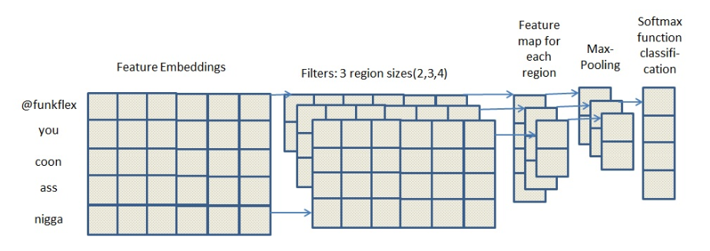
Methodology- Paper 1(Cont’d)
Figure 2:CNN methodology

Slide 8
Result

Slide 9
Conclusion
Template matching showed effectiveness in identifying coins
Rotating the templates allow us to detect coin in any orientation
Main challenge was differnent lighting, complex background, noisy image etc
Keeping the conditions in mind, it detected 2tk and 5tk coins properly

Slide 10
References
Lecture Slides
https://dev.to/tinazhouhui/coin-detection-discovering-opencv-with-python-1ka1
https://stackoverflow.com/questions/32692010/template-matching-for-coins-with-opencv
https://shrishailsgajbhar.github.io/post/OpenCV-OpenCV-Basic-Project-1
https://answers.opencv.org/question/4192/opencv-python-recognizing-and-identify-coins/

Slide 11
THANK YOU

