Slide 1










Heart Disease Prediction Model

Slide 2


Team : BotBuilders
Member : 01
Member : 02
Name : Mohammad Abrar Yasir
ID : C213002
Section : 6AM
Name : Shadman Yaser
ID : C213030
Section : 6AM

Slide 3
Segments
01
Introduction
04
Result
Problem
Statement
02
05
Conclusion
03
Methodology

Slide 4

Introduction
Heart Disease Prediction Model
Heart disease remains one of the leading causes of mortality worldwide, accounting for millions of deaths each year. Early detection and accurate prediction of heart disease can significantly improve patient outcomes and reduce healthcare costs. In recent years, machine learning (ML) has emerged as a powerful tool for analyzing complex medical data and providing predictive insights. This project focuses on leveraging machine learning techniques to develop a predictive model for heart disease, aiming to assist healthcare professionals in identifying high-risk individuals early and accurately.

Slide 5

01
02
Complexity of Data
Heart disease is influenced by numerous factors including age, gender, lifestyle, and various medical conditions. The multifaceted nature of these risk factors makes accurate prediction difficult.
Resource Intensive
Comprehensive cardiovascular assessments require significant medical resources and time, which can be a burden on healthcare systems.
Problem Statements
03
04
Accuracy and Reliability
Traditional diagnostic methods may not always provide the desired accuracy. False positives and negatives can lead to unnecessary treatments or missed diagnoses.
Interpretability
The lack of interpretability in some machine
learning models used for heart disease prediction poses challenges for healthcare professionals in understanding the underlying reasons behind predictions, potentially hindering clinical decision-
making and patient care.

Slide 6
Methodology
Naïve Bayes 02
Naïve Bayes calculates the probability of each class given a feature vector by multiplying the individual probabilities of each feature assuming independence, then selects the class with the highest probability.
₀₁ Logistic Regression
Logistic regression is a statistical method used for binary classification that models the probability of a binary outcome based on one or more predictor variables.
AIgorithms
Support Vector Classifier 04
Support Vector Classification (SVC) works by finding the hyperplane that best separates the classes in the feature space, maximizing the margin between the closest points of the classes (support vectors).
03 K-NeighborsClassifier
The k-Nearest Neighbors (k-NN) algorithm classifies a data point based on the majority class of its 'k' closest neighbors in the feature space.
05 Adaboost
AdaBoost, or Adaptive Boosting, combines multiple weak classifiers to create a strong classifier by sequentially training each weak classifier to correct the errors of its predecessors, emphasizing misclassified instances in each iteration.

Slide 7
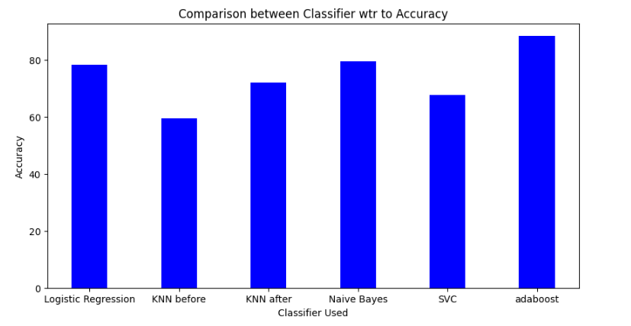


Result
Logistic Regression
Accuracy : 78.210
Naïve Bayes
Accuracy : 79
K-NeighborsClassifier
Accuracy : 71.984
Support Vector Cla_{s}s_{s}sifier
Accuracy : 67.704
Adaboost
Accuracy : 89

Slide 8
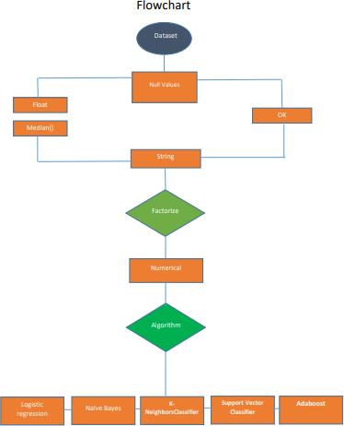

Slide 9

Conclusion
Enhanced Predictive Healthcare
Improved Healthcare
Decision-Making
By leveraging patient data and advanced algorithms, the model aids healthcare professionals in making more informed and timely decisions, ultimately improving patient outcomes.
Accuracy and Efficiency
The machine learning model developed in this project demonstrates significant accuracy and efficiency in predicting heart disease, providing a valuable tool for early diagnosis and intervention.

Slide 10
Thank You

