Slide 1
Face Recognition Implementation using VGG-16
Slides by:
Samin Hamidi, Atefeh Moradan

Slide 2
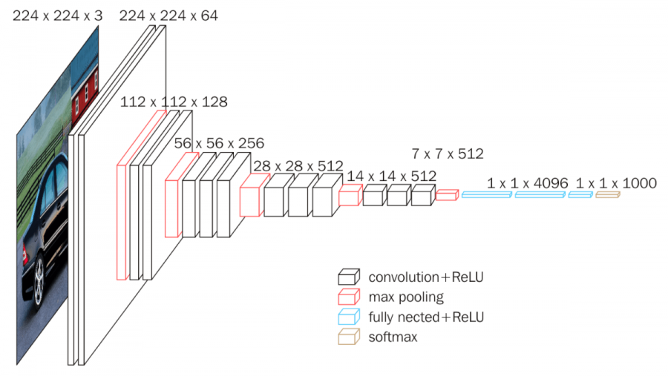
VGG16 Architecture

Slide 3
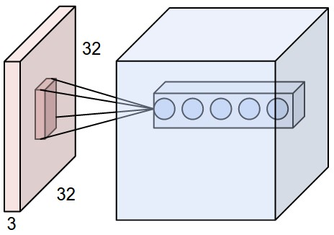
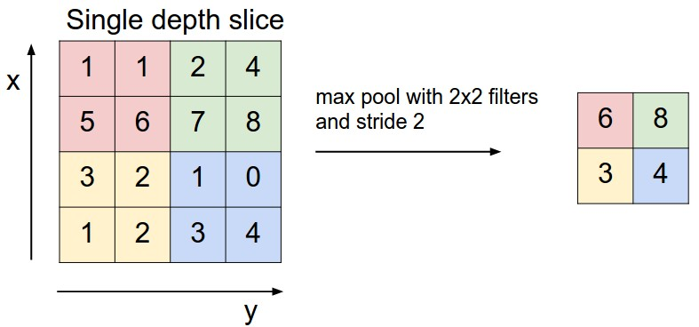
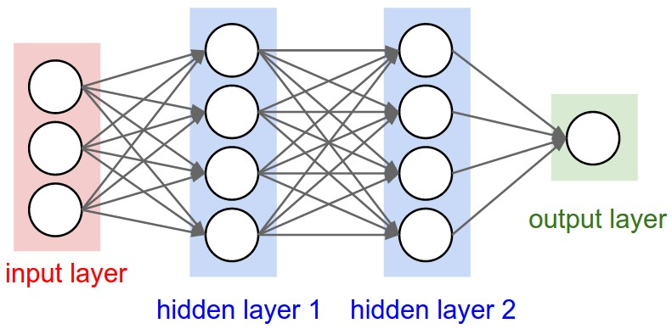
ConvNet Architecture
Convolutional
Pooling
FC

Slide 4
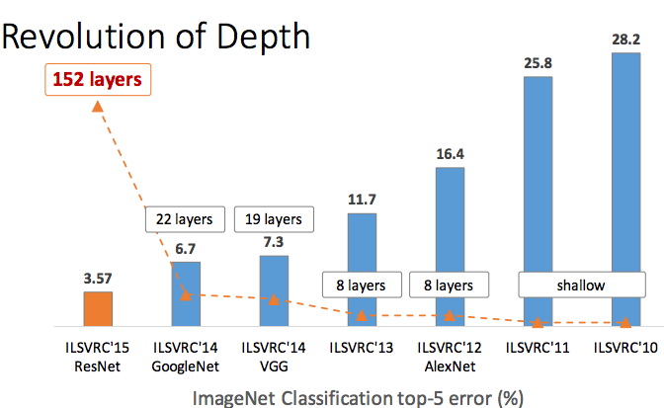
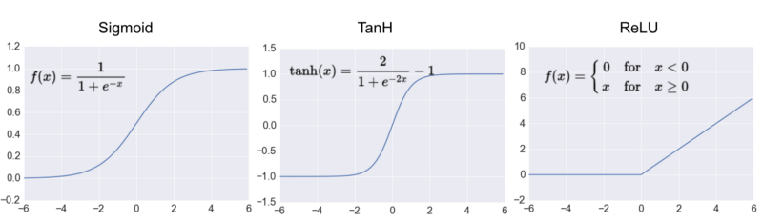
Why VGG16?
Pros:
Uniform Architecture
Classification Error
Pre-Trained Weights
Activation Function
Cons:
140M parameters
Running Time

Slide 5
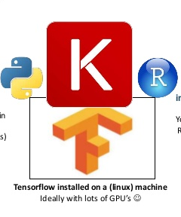
Implementation
Possible libraries:
Cafe (C++)
Tourch (Lua)
Theano (Python)
Tensorflow (Python)

Slide 6
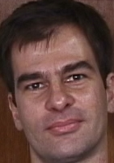
Implementation(pre-processing)
Resizing
224*224*3
train_X = train_X.astype('float32’)
test_X = test_X.astype('float32')
train_X = train_X / 255.
test_X = test_X / 255.
Normalization

Slide 7
Fit the data on Model
model = Sequential([
Conv2D(64, (3, 3), input_shape=input_shape, padding='same', activation='relu'),
Conv2D(64, (3, 3), activation='relu', padding='same'),
MaxPooling2D(pool_size=(2, 2), strides=(2, 2)),
Conv2D(128, (3, 3), activation='relu', padding='same'),
Conv2D(128, (3, 3), activation='relu', padding='same', ),
MaxPooling2D(pool_size=(2, 2), strides=(2, 2)),
Conv2D(256, (3, 3), activation='relu', padding='same', ),
Conv2D(256, (3, 3), activation='relu', padding='same', ),
Conv2D(256, (3, 3), activation='relu', padding='same', ),
MaxPooling2D(pool_size=(2, 2), strides=(2, 2)),
Conv2D(512, (3, 3), activation='relu', padding='same', ),
Conv2D(512, (3, 3), activation='relu', padding='same', ),
Conv2D(512, (3, 3), activation='relu', padding='same', ),
MaxPooling2D(pool_size=(2, 2), strides=(2, 2)),
Conv2D(512, (3, 3), activation='relu', padding='same', ),
Conv2D(512, (3, 3), activation='relu', padding='same', ),
Conv2D(512, (3, 3), activation='relu', padding='same', ),
MaxPooling2D(pool_size=(2, 2), strides=(2, 2)),
Flatten(),
Dense(4096, activation='relu'),
Dense(4096, activation='relu'),
Dense(4, activation='softmax')
])

Slide 8
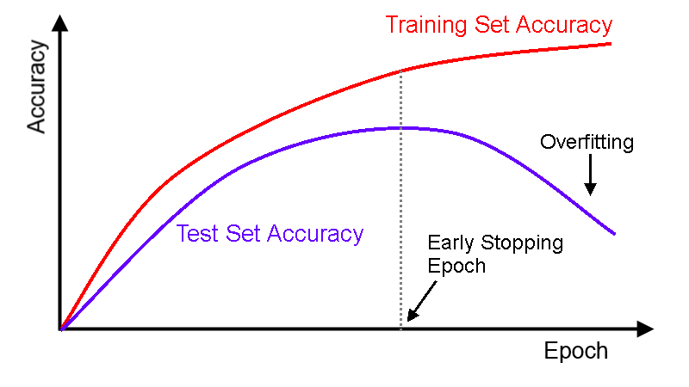
Fit the data on Model(cont)
model.fit(x_train, y_train, epochs=3, steps_per_epoch=9)

Slide 9
Evaluation
scores = model.evaluate(x_test, y_test, verbose=0)
 | Atefeh | Samin | Luigi
Atefeh | TA1 | FA2 | FA3
Samin | FS1 | TS2 | FS3
Luigi | FZ1 | FZ2 | TZ3
Accuracy(TA1+TS2+TZ3)/(total)
Accuracy=0.25

Slide 10

Technicalities
How to run large dataset:
1.CPU
2.Gpu(2G)
3.Docker(on Gpu or Cpu)

Slide 11
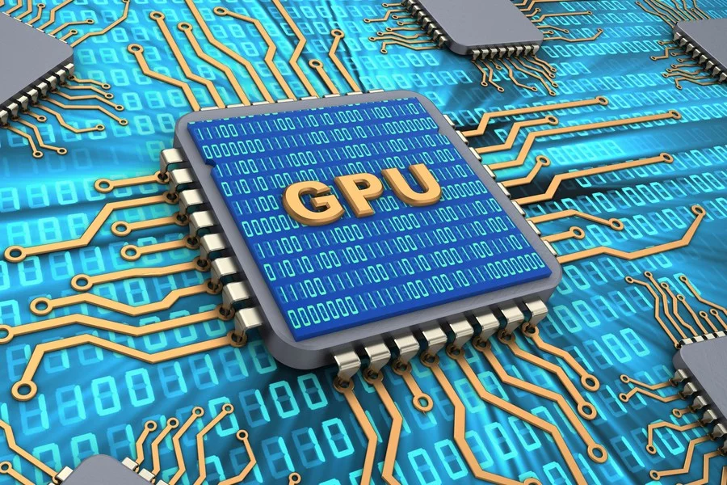
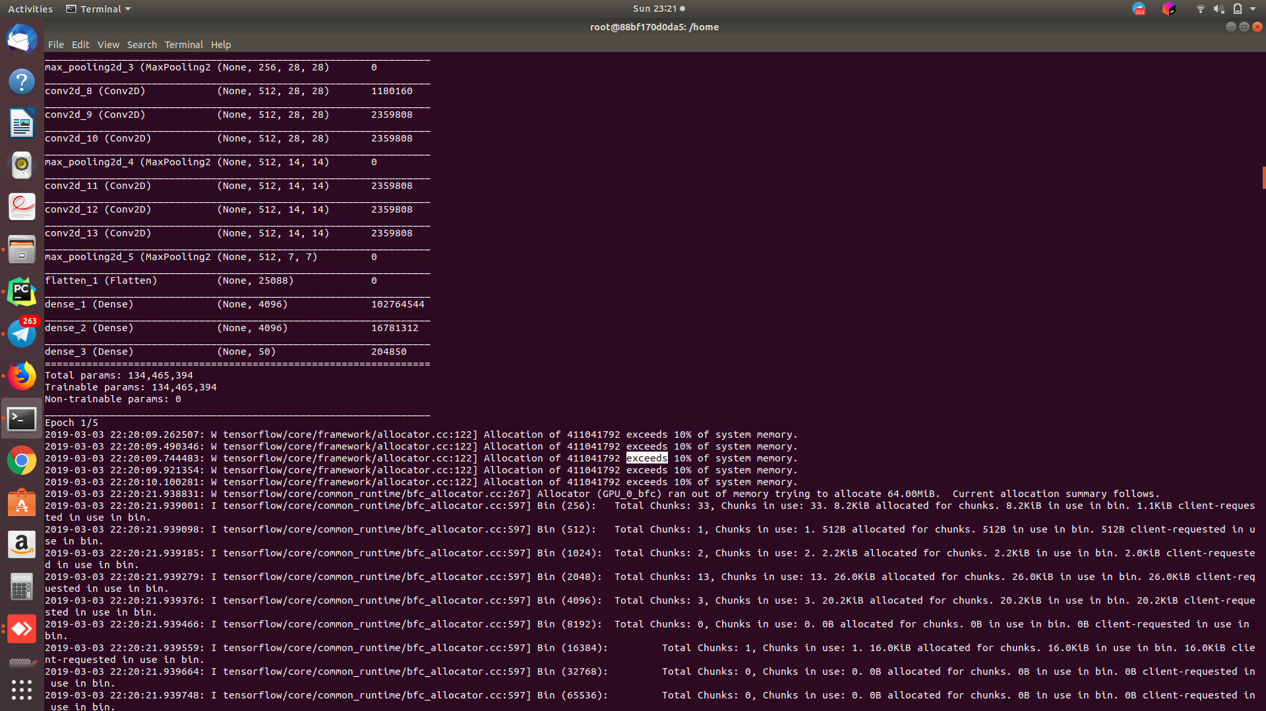
Technicalities!

