Slide 1
IBM University Engagement Project Submission
“Exploring the Power of Agentic AI with IBM Granite and LangFlow”

Slide 2
Project Title –Intelligent Shopping Agent
Domain of Project – e-commerce
Student Name | Recent Passport Photo | Email ID | Mobile number [WhatsApp]
Shaikh Saminabano Ayyub |  | saminashaikh1310@gmail.com | 9834580841

Slide 3
Problem Statement -
Problem Statement : Intelligent Shopping Agent
The Challenge
Shoppers today face an overload of product options, scattered reviews, and dynamic pricing across e-commerce platforms. Finding the right product that balances price, quality, and personal preferences is time-consuming and frustrating. Traditional recommendation systems often fail to capture real-time trends, personalized needs, or contextual factors like urgency, budget, or sustainability. The challenge is not just to recommend products but to act as a smart shopping companion that helps buyers make informed and confident decisions.
The Objective
Build an agentic AI shopping assistant that provides intelligent, personalized, and real-time support. The solution should:
Fuse Multisource Data: Aggregate product details, reviews, ratings, and price comparisons across multiple e-commerce sites into unified insights.
Enable Multimodal Search: Allow users to input voice queries, images (e.g., a photo of a product), or text descriptions to find best-matching products.
Create a Predictive & Agentic Layer: Suggest purchase timing (e.g., discounts, seasonal offers), recommend alternatives, and alert users about price drops or fake reviews.
Visualize Smart Shopping Pulse: Provide a dashboard summarizing comparisons, sustainability scores, trending products, and personalized shopping lists.

Slide 4
Cloud Platform: IBM Cloud
Agent Orchestration: IBM watsonx Orchestrate
AI Services: IBM watsonx.ai
Integrations: E-commerce APIs, product catalogs, and recommendation services
Technology Used

Slide 5
Proposed Solution -
The Intelligent Shopping Agent, built using IBM Cloud and IBM watsonx Orchestrate, serves as an AI-powered shopping assistant that helps users discover, compare, and select the most suitable products from multiple e-commerce websites through a conversational interface.
The agent collects user preferences such as product category, budget, brand preferences, desired features, and purchase purpose. It then analyzes product information from various online marketplaces and generates personalized recommendations based on user requirements.

Slide 6

Architecture blueprint

Slide 7

Role of Agentic AI in the solution
The Intelligent Shopping Agent is an AI-powered assistant designed to help users find, compare, and select the best products from multiple e-commerce platforms. It gathers user preferences such as product category, budget, brand choices, desired features, and purchase purpose, then analyzes available products to provide personalized recommendations. The agent compares products based on price, specifications, ratings, and reviews, helping users identify the most suitable option for their needs. It also suggests alternatives across different price ranges and explains the reasoning behind its recommendations. By offering a conversational and intelligent shopping experience, the agent simplifies product discovery, saves time, and enables users to make informed purchasing decisions with confidence.

Slide 8
Technology Used
-IBM Watsonx Orchestrate
IBM Grainte model - for eg – ibm-granite-3-2-8b – For natural language understanding, reasoning, and personalization
IBM Cloud – It provides the infrastructure to build, deploy, and scale the Nutrition Agent efficiently. IBM Cloud enables a reliable, secure, and scalable environment for deploying the Nutrition Agent.
IBM Watsonx.ai - For model deployment, embeddings, and AI governance

Slide 9
Novelty and Uniqueness
The Intelligent Shopping Agent stands out by combining AI-powered personalization, cross-platform product comparison, and conversational assistance into a single solution. Unlike traditional e-commerce search tools that operate within a single marketplace, this agent analyzes products from multiple online shopping platforms and provides unbiased recommendations tailored to individual user preferences, budget, and requirements. Using IBM Cloud and IBM watsonx Orchestrate, the agent understands natural language queries, automatically gathers shopping requirements, compares product features, prices, ratings, and reviews, and explains the reasoning behind its recommendations. Its ability to deliver personalized, real-time decision support through an interactive conversational interface reduces the effort required for product research and enables users to make faster and more informed purchasing decisions. This integration of AI-driven insights, intelligent orchestration, and multi-platform product discovery creates a unique and seamless shopping experience.

Slide 10
Git Hub Link
Github URL –https://github.com/saminasha/Intelligent-Shopping-Agent/tree/main
·
·
·

Slide 11
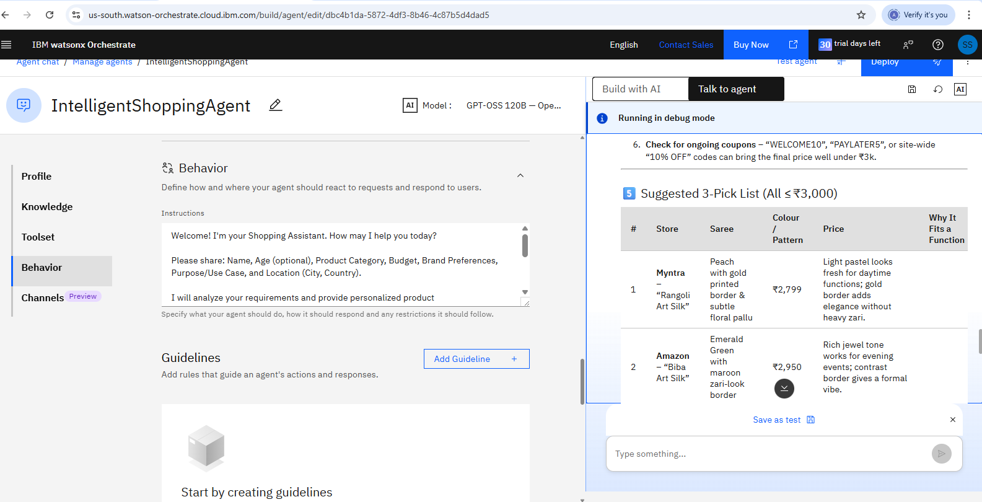
Result

Slide 12
Future Scope
The Intelligent Shopping Agent has significant potential for future enhancement by expanding its capabilities and integrations. The agent can be improved by connecting with more e-commerce platforms to provide a wider range of product options and real-time price comparisons. Future versions can include AI-based price prediction, discount alerts, personalized shopping profiles, and advanced review analysis to help users make better decisions. Voice-based assistance, multilingual support, and smarter recommendations based on user preferences and shopping history can further improve the user experience. The agent can also integrate features like wishlist management, virtual product visualization, and automated shopping assistance, making it a more intelligent, efficient, and personalized shopping solution.
·
·
·

Slide 13


