Slide 1
WELCOME

Slide 2
INVISIBYTE:
‘Invisible message,
Invisible security’
Presented by: Samrudhi. Naik
UUCMS: U02KF22S0038

Slide 3
contents
Introduction
Objectives
System Analysis
Input of the Project
Output of the Project
Logic Process
ER Diagram
Tools
Client Details
Limitations
Future Enhancement

Slide 4
INTRODUCTION:
Invisibyte is a website used to hiding information within another medium, such as image or text. In a way that makes the data should be hidden and undetectable to an observer. Where secret information is encoded into the Least significant bits of an image’s pixel values. It also includes encryption and decryption for enhanced security, making the hidden messages more secure.

Slide 5
objectives
Develop a secure web based platform for hiding and retrieving secret messages in digital media.
Implement encryption techniques to enhance data security.
Support multiple file formats such as PNG, JPEG for images.
Design a user friendly interface for easy encoding and decoding of messages.
Implement authentication mechanism to prevent unauthorized access.

Slide 6
system analysis
Existing system
Proposed system
Uses basic Least significant bit technique, which is easily detectable.
No encryption, making the hidden messages vulnerable to hacking.
Manual encoding and decoding process.
No user authentication system, allowing unauthorized access.
Implements LSB with encryption for higher security.
Provides a user friendly GUI/ web interface for easy encoding and decoding.
Implements real time hiding and execution for secure communications.
User authentication added to prevent unauthorized access.

Slide 7
input of the project
Cover image: images in which the secret message will be hidden.
Secret message: The message or data that needs to be hidden inside the image.
Encryption key: Used for encrypting the secret message before embedding into the image.
Stego Image: The images that contains the hidden message.

Slide 8
output of the project
Stego Images: The modified image that contains the secret message inside.
Success message: These messages helps users understand the status.
Encryption confirmation: If the message was encrypted, a success message confirms encryption.
Extracted secret message: Display the recovered secret message from the image.

Slide 9
logic process
Generate
User authentication
Output
(Image/text)
User uploads image
INVISIBYTE
Encryption/Decryption
Secret message
Encoding/ Decoding

Slide 10
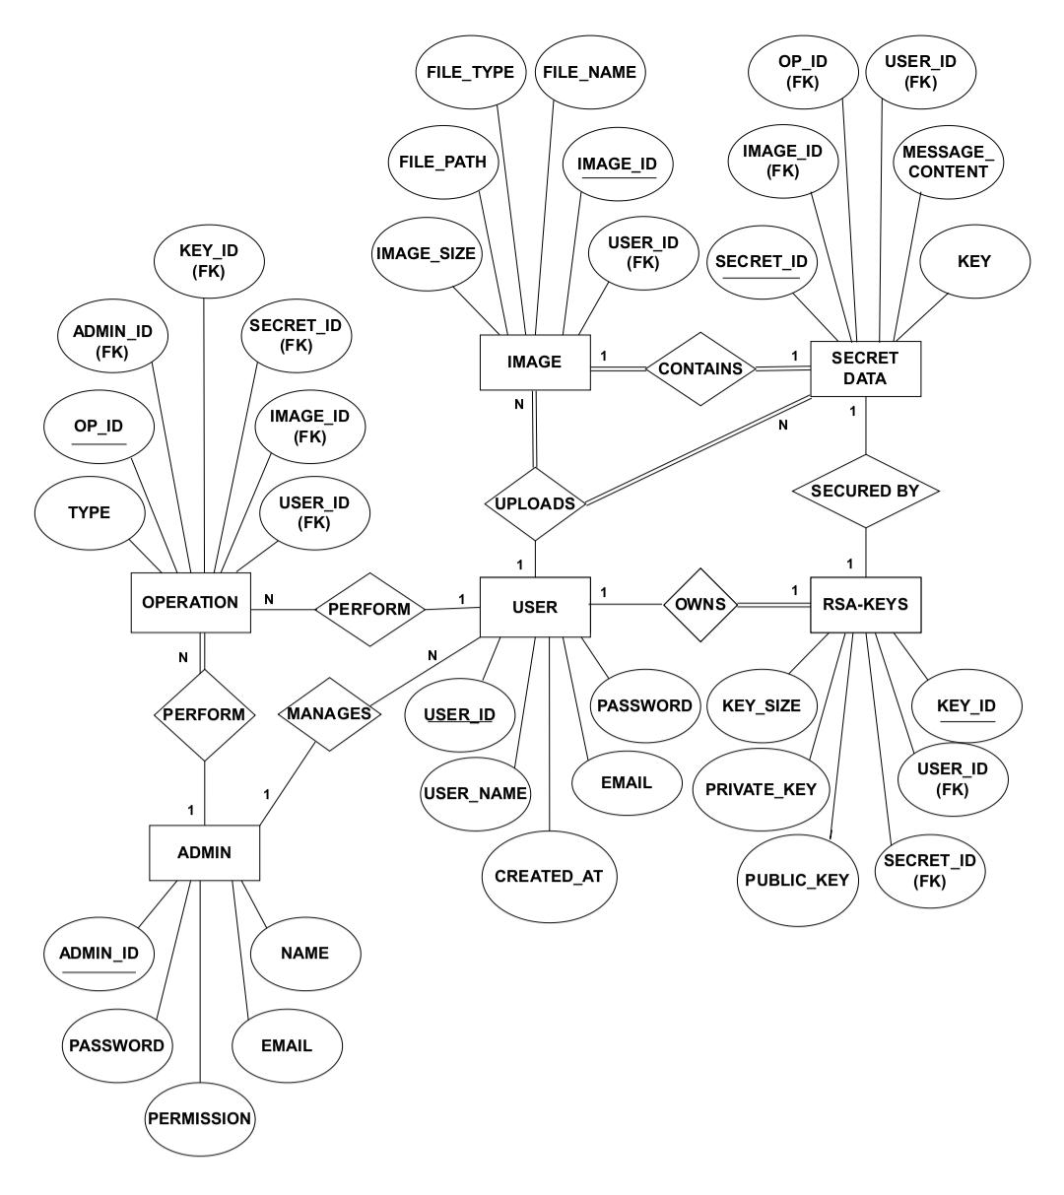
Er diagram

Slide 11
tools
Hardware Tools:
Processor intel i3 & above
RAM 4Gb & above
Storage 20Gb & above
Software Tools:
Operating system Window 10 or above
Front end HTML, CSS, Javascript
Backend Python
Database MySQL
Libraries PILLOW/PIL, RSA

Slide 12
client details
Name : Siddhi. Kharade
Mobile No : 8722568366

Slide 13
limitations:
Limited Data Capacity
Lossy Compression Issues
Security risk without encryption
Performance issues with large files

Slide 14
future enhancement
Enhanced security with advanced encryption
Cloud based steganography
Steganography in audios & videos

Slide 15
Any question??

Slide 16
Thank you!!

