Slide 1
Network Denial of Service Detection Using SDN
Group- 02
Group Members:
Bimal Bhattarai
Himangshu Das
Samin Yasar
Ranjeet Singh

Slide 2
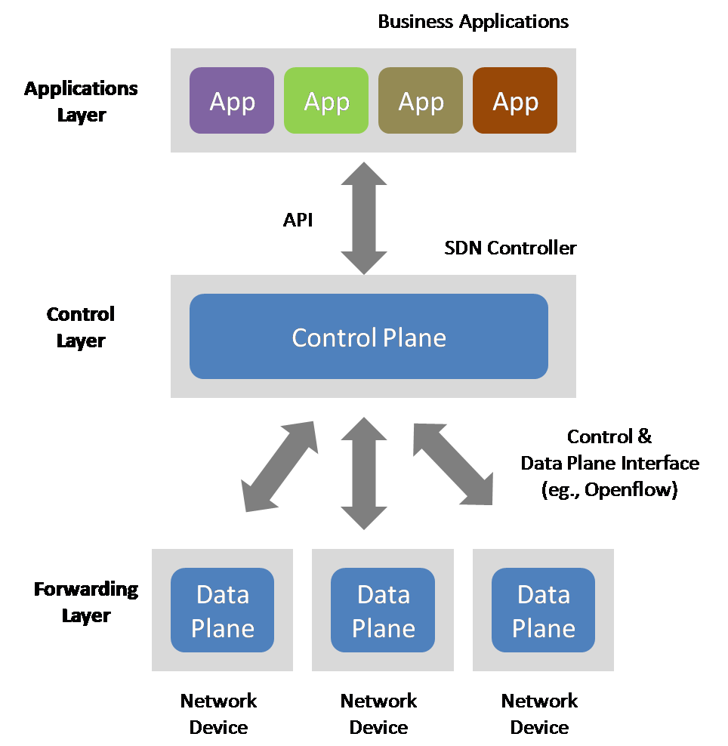
What is SDN?
Software-Defined Network is a 3-layer architecture e.g., application layer, control layer & forwarding layer.
Provides a framework for centralized network management system.
Programmable UI to develop various network management tools to manage the network.
Cloud services are exploding, and big organizations and enterprise network administrators are migrating to the SDN-based network implementations
These virtual technologies provide predictability, manageability and good quality of service.

Slide 3
Description of the Layers of SDN
Application Layer:
This is the topmost layer in the SDN.
In this layer the applications are developed to monitor, control, and create apps related to network functionalities.
Control Layer:
This is the layer in which responsible for controlling the entire network, giving visibility of the network, and tracking the network resources to those who manage it.
Determines how and where packets are forwarded in the below layer.
Forwarding Layer:
This layer is used forward packets to other devices that is present in its data plane and if not present, it sends a query to the control layer to update its data plane and forwards it to the desired destination.

Slide 4
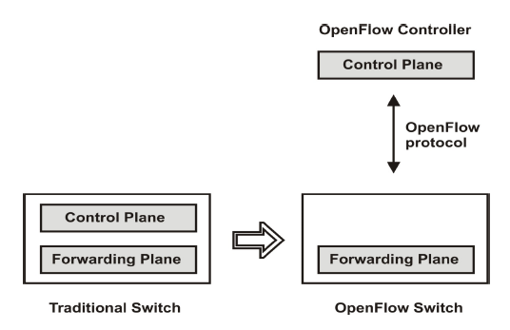
SDN vs Traditional Networks
SDN | Traditional Network
1. Virtual Network approach with a centralized control. | 1. Conventional networking approach with distributed control.
2. The control plane and data plane are separated. | 2. The control and data plane are mounted on the same device.
3. Easy and automatic configs can be done using central controller. Easy to program as per need. | 3. Manual configs need to be done on each device. So, it takes much more time. Difficult to program again and replace existing programs.
4. Easy to troubleshoot and report errors as it is a centralized controller, and the cost is also less. | 4. Difficult to troubleshoot and report errors due to its distributed control.

Slide 5
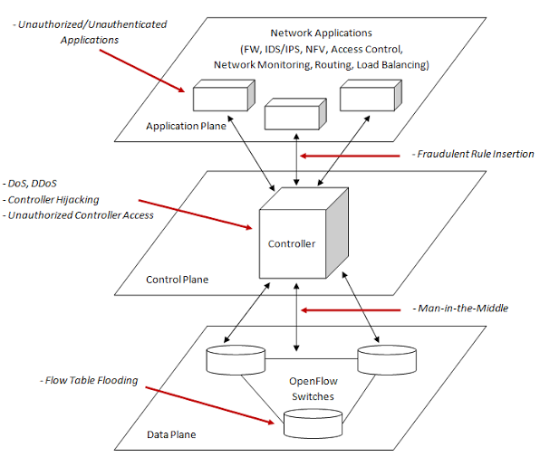
Threats Related to SDN
As SDN is new and there are various attack surfaces the threat actors can exploit.
The programmability part of SDNs make them more defenseless against various malicious code endeavors and assaults.
Southbound interface of a SDN can be the focus of various Denial of Service and side channel attacks.
Design mistakes in SDN can lead to further attacks from threat actors and hamper service than conventional systems.

Slide 6
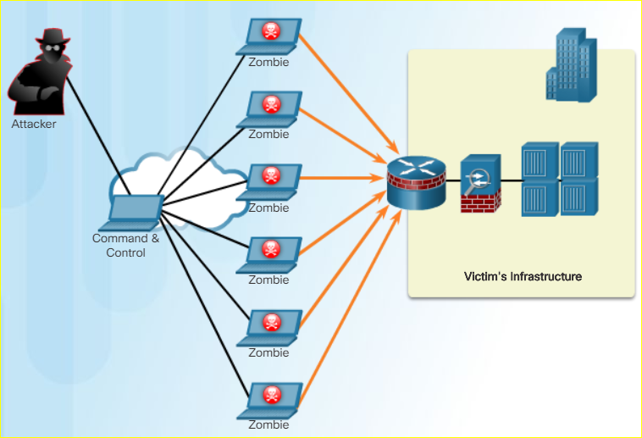
DDoS Attacks
A DDoS attack is larger version of a DoS attack that originates from multiple sources.
An attacker builds botnets or zombie hosts. The command and control (CnC) communicates with zombies over covert channels like IRC, P2P, DNS, HTTPS.
Botnets or zombie hosts continue to scan and infect more targets to create more botnets.
When ready the attacker through CnC instructs the zombies or botnets to carry out DDoS attack on the target host.

Slide 7
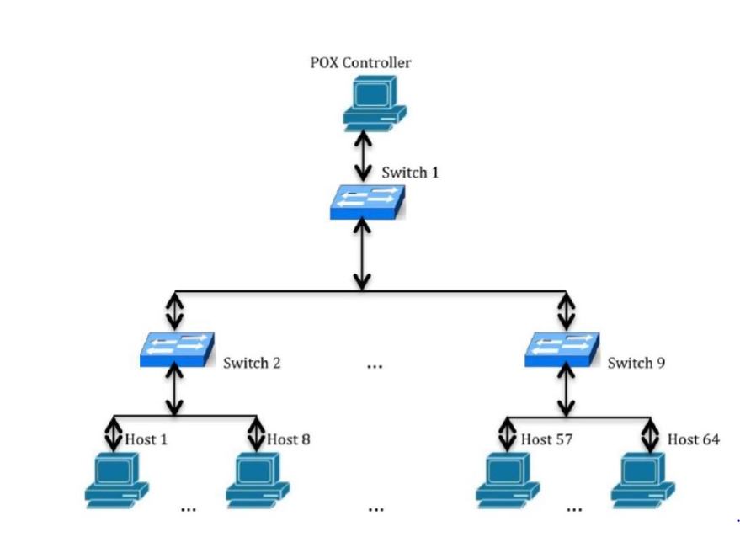
Components Used to Simulate Environment
Mininet:
Mininet was used to create our network topology with n switches.
It is simple network emulation tool used for SDN. Using Mininet the deployment of large topologies can be done with limited resources on a single virtual machine
It provides with an extensible python API, which enables for easy network creation and simulations

Slide 8
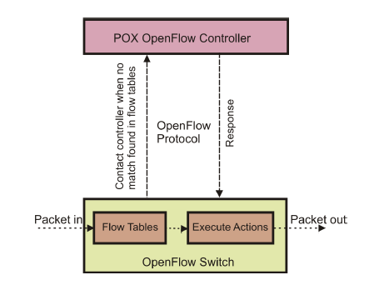
Components Used to Simulate Environment (Contd.)
POX:
This comes built-in with Mininet and provides a framework in SDN for connecting with switches using OpenFlow. This SDN controller instructs the switches as to what actions they should do through the southbound API. This is the brain of the SDN network.
It sends out specially-crafted LLDP messages out of the OpenFlow switches so that it discover other switches within the network topology.
It also manages the Flow Tables in switches. If the Packet in coming in the OpenFlow switch matches the Flow tables it forwarded to execute the action according to the flow.
If now flow found, then it is forwarded out to the controller as a Packet_in message and controller responds with the required action.

Slide 9
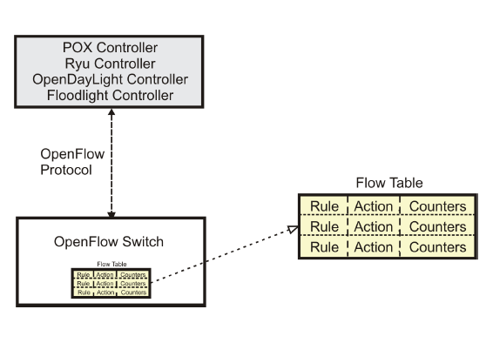
Components Used to Simulate Environment (Contd.)
OpenFlow:
This is a secure communication protocol within the SDN, which assists SDN controller in determining the path network across switches.
It helps in connection of the two main entities the OpenFlow switch, which implements the forwarding plane and the controller, which implements the control plane.
This helps in managing complex traffic due to parting of control plane and forwarding plane. It consists
This allows switches from multiple vendors to be remotely managed using a common protocol.

Slide 10
Components Used to Simulate Environment (Contd.)
Scapy:
It is a python-based library that will be used to generate traffic to and from the SDN controller.
This is an excellent tool for decoding packets from a wide variety of protocols, send packets over the network, simulate attacks, capture packets and much more.
VMware:
We used VMWare workstation to create our virtual environment for simulation.

Slide 11
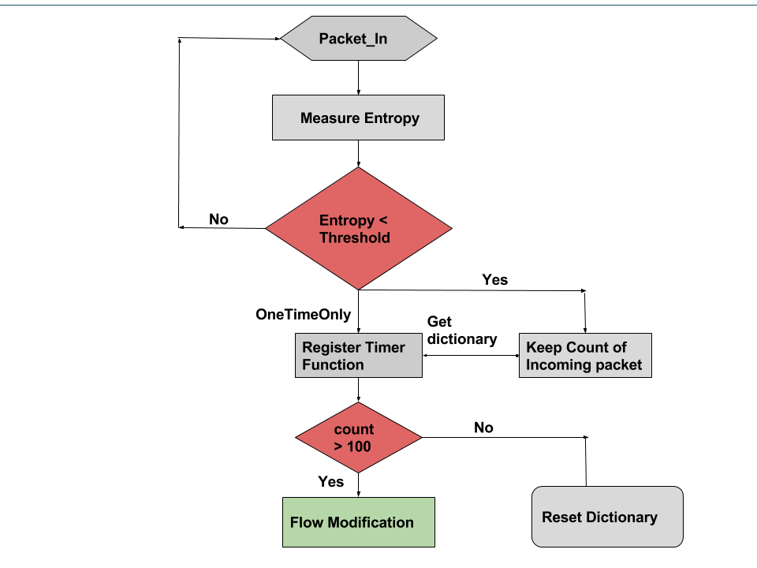
Early Detection of DDoS attack Using Entropy
Our goal is to detect the DDoS attack happening in SDN early and the theme behind our detection is using Entropy, which is the measure of disorderliness in a system.
When there is a DDoS attack happening in a system there is a sudden decrease of randomness that will decrease the system’s entropy from an accepted range.
Our project will use the SDN controller for early DDoS attack detection and the early detection mechanism should be lightweight and high response.
This high response time will help regain the control of the controller early when an attack is happening.

Slide 12


What is Entropy?
Entropy can be defined as a number that gives you an idea of how random an outcome will be based on the probability values of each of the possible outcomes in a situation.
$$H(X)=\sum_{i=0}^{n−1}{P_{i} \log_{2} × \frac{1}{p_{i}}}$$
Entropy will be maximum when all outcomes are equally likely. Any time we move away from equally likely outcomes then then the entropy must go down. Therefore, the entropy of variable X is the sum over all possible outcomes of i of X, of the product of the probability of outcome i times the log of the inverse of the probability of i.
Base Entropy is defined as the average entropy for the target IP address when there is no DDOS attack in place. The purpose of this is to define a normal scenario. We will use threshold 50.

Slide 13
Test Cases for Simulation
Test Cases | Description
1 | First, we will create a topology and test the connectivity between the nodes using the ping command
2 | Second, we will launch POX controller in order to make a connection between nodes and again check the connectivity.
3. | Third, we will generate a normal traffic on our SDN network to find threshold for usual traffic behavior
3 | Fourth, after generating random normal traffic we will be able to see a list of values for entropy and find the threshold
4 | Finally, we will simulate the attack on the target host, and we will see a large decrease in the value of entropy from the normal threshold, which means a decrease in the randomness. This will typically mean that an attack is happening on the target host.
We identified the following test cases for the detection on DDoS attack.

Slide 14

Demo
Video demo of our simulation

