Slide 1

AI AGENT TRACK / CASE STUDY 1
CaseZero
Bank disputes resolved in minutes, governed end to end.
AXIOM BY CASEZERO
TENCENT CLOUD x UTM HACKATHON 2026
Notes:
Timing: 0:00-0:25
Open by stating the chosen challenge exactly. CaseZero is a governed banking-dispute operating system for a five-person, non-technical complaints team. The promise is simple: one complaint can reach a verified, compliant outcome in minutes without giving a model authority over money.
[Sources]
- Tencent Cloud x UTM Hackathon Handbook, AI Agent Track, Case Study 1.
- OpenAI-generated hero artwork saved in submission/assets/generated/casezero-hero.png.

Slide 2

REAL-WORLD SCENARIO INSIGHT
The clock starts
before anyone
understands the case.
1.8M
retail + SME customers
90 MIN
manual handling per case
11%
regulatory deadlines missed
BNM / FMOS: 5-20 working days
Notes:
Timing: 0:25-1:05
The bank serves 1.8 million customers, yet each dispute takes about 90 minutes across multiple departments and eleven percent of deadlines are missed. The challenge is not to add another chatbot. It is to compress investigation, verification, financial resolution and customer communication while preserving five-to-twenty-working-day regulation.
[Sources]
- Tencent Cloud x UTM Hackathon Handbook, Case Study 1 introduction and challenge.
- OpenAI-generated transformation artwork saved in submission/assets/generated/90-to-5-transformation.png.

Slide 3
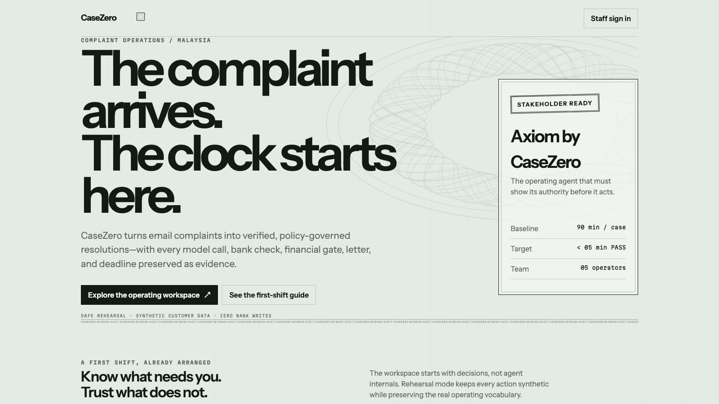
CASEZERO / SOLUTION
03
One email becomes one governed outcome.
INTAKE
VERIFY
RESOLVE
COMMUNICATE
Every transition carries evidence, an owner and a chained receipt.
Notes:
Timing: 1:05-1:45
CaseZero turns a raw email and PDF into one continuous case. Intake protects and extracts it. Verification checks bank and CRM evidence. Resolution can post only after a deterministic gate. Communication inserts mandatory disclosures by code. The operator sees the same story in a first-shift guide rather than learning an engineering pipeline.
[Sources]
- CaseZero production interface screenshot, submission/assets/ui/01-home.png.
- CaseZero README and API implementation.

Slide 4

AI INNOVATION / 30 POINTS
Six agents propose. One kernel decides.
Parallel specialist agents
Typed model proposals
Deterministic authority gates
Axiom exposes every action before it runs
MODELS PROPOSE / THE KERNEL DISPOSES
Notes:
Timing: 1:45-2:25
The innovation is the boundary between intelligence and authority. Six agents handle intake, classification, evidence, resolution, communication and SLA supervision in parallel. They return typed proposals. Axiom lets a business operator ask for work in natural language, but shows the capability, authority, effect and gates before execution. The deterministic kernel owns every financial and compliance decision.
[Sources]
- CaseZero api/agents and api/kernel implementation.
- OpenAI-generated agent artwork saved in submission/assets/generated/six-agents-one-kernel.png.

Slide 5
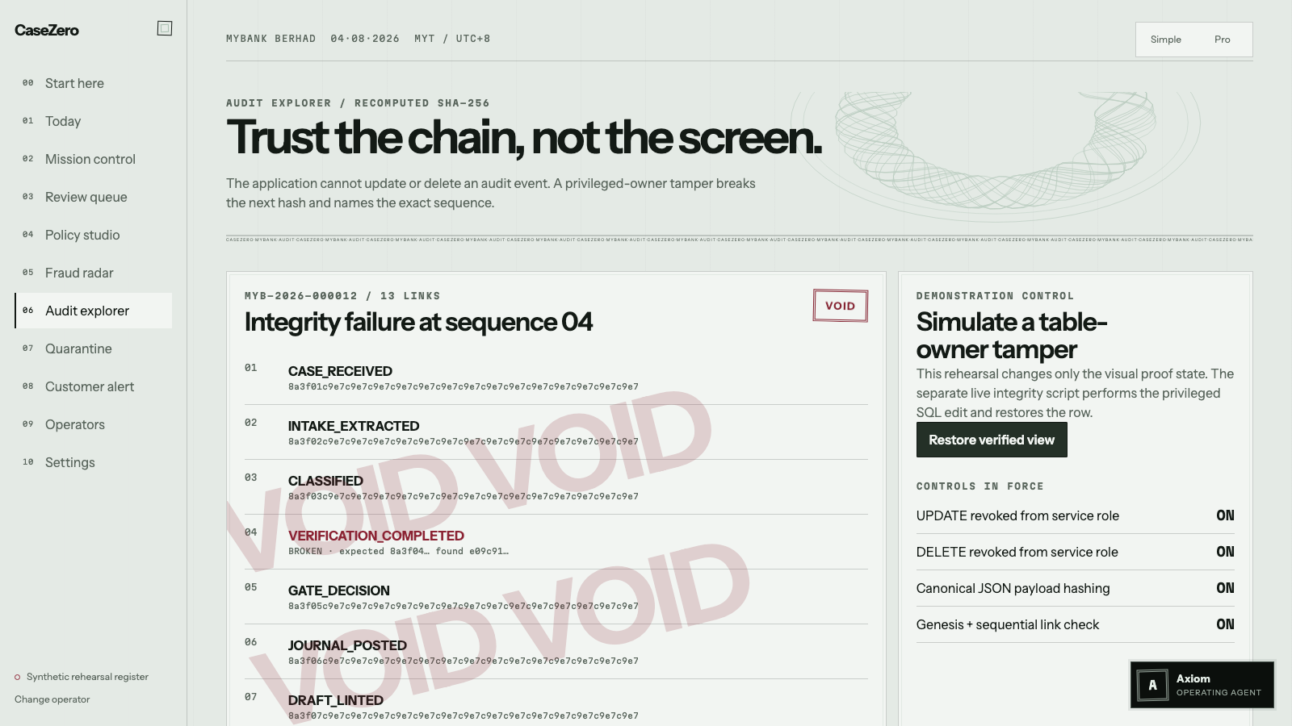
CASEZERO / TECHNICAL EXCELLENCE / 20 POINTS
05
The model cannot move money.
01
MCP evidence must return PASS
02
Ticket binds case, amount and expiry
03
Double-entry journal must balance
04
Hash chain names the altered event
Notes:
Timing: 2:25-3:05
Here is the control argument. Core banking and CRM are real MCP tool boundaries. A PASS result is necessary but not sufficient: the kernel also mints a signed ticket bound to the case, action, amount and expiry. The server rejects forged or stretched tickets. A posting must balance double entry. Every event extends one chain, and the audit screen names the exact sequence if a privileged row is altered.
[Sources]
- CaseZero MCP smoke, agent smoke and database integrity outputs.
- CaseZero audit screenshot, submission/assets/ui/05-audit-proof.png.

Slide 6
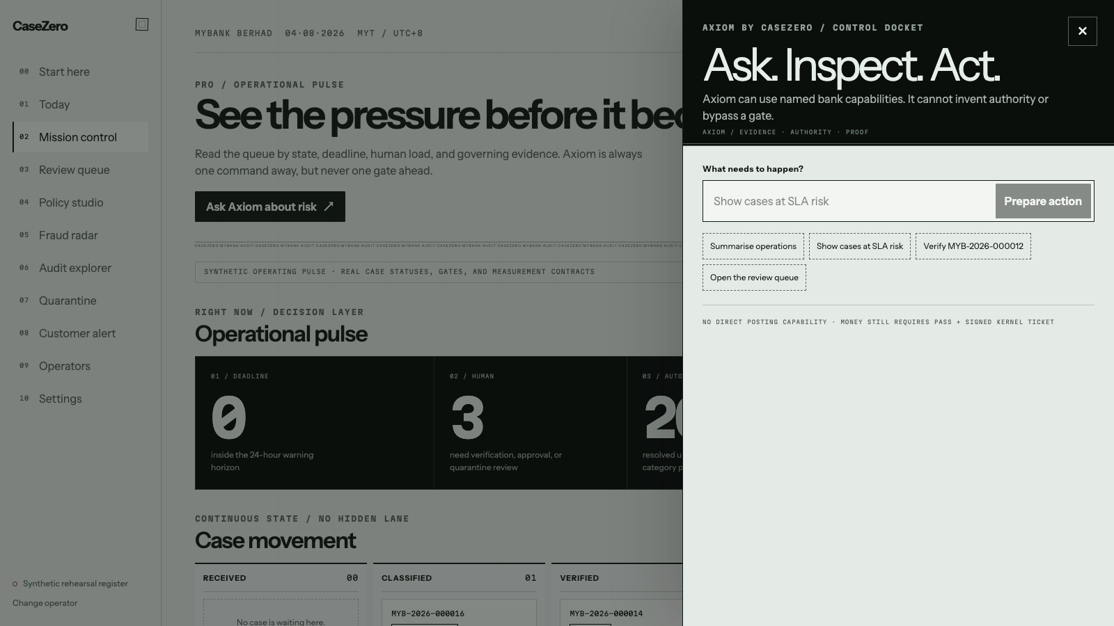
USER EXPERIENCE + DEMO / 25 POINTS
Ask. Inspect authority. Then act.
Axiom is an action docket - not a chatbot that hides side effects.
Notes:
Timing: 3:05-3:45
The demo should pause here. The operator asks for cases at SLA risk. Axiom does not instantly claim success. It displays the selected capability, the required role, whether anything changes, and the controls still in force. Read-only work can complete immediately. Invitations and settings changes require an eligible role, explicit confirmation, server-side re-planning and a receipt.
[Sources]
- CaseZero Axiom production interface screenshot, submission/assets/ui/03-axiom.png.
- CaseZero api/agents/wajar.py capability planner; legacy filename retained for migration compatibility.

Slide 7
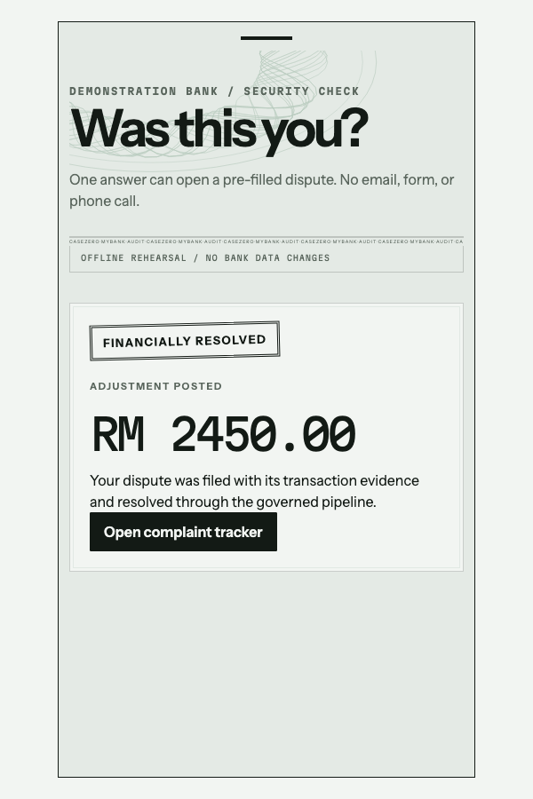
CASEZERO / CUSTOMER OUTCOME
07
The customer sees the outcome, not the machinery.
RM 2,450
returned after PASS verification
plain-language case tracker
FMOS referral rights preserved
Notes:
Timing: 3:45-4:20
The customer gets a calm, current record rather than the internal pipeline. This proactive example identifies a transaction, opens a pre-filled dispute and returns RM2,450 only after PASS verification. The tracker explains what happened in plain language and preserves the FMOS right to refer an eligible dissatisfied claim within six months.
[Sources]
- Tencent Cloud x UTM Hackathon Handbook, compliant customer communication requirement.
- CaseZero customer outcome screenshot, submission/assets/ui/06-customer-outcome-crop.png.

Slide 8
RELEASE EVIDENCE
Measured, not merely demonstrated.
95.90%
98.97%
5 / 5
465
category accuracy
urgency accuracy
attacks blocked
backend tests
p50 2.616s / p95 4.626s / RM0.001025 per case / 0 npm vulnerabilities
195 clean cases + 5 injection attacks / persisted live-model evaluation
Notes:
Timing: 4:20-5:00
The latest persisted production-model run classified 95.90 percent of the clean cases, assigned urgency at 98.97 percent and blocked all five injection attacks with zero clean false positives. Median model latency was 2.616 seconds and measured model cost was about one-tenth of a sen per case. The release now has 465 backend tests, eleven browser journeys and no npm vulnerabilities.
[Sources]
- CaseZero evals/latest.json and SUBMISSION.md measured results.
- CaseZero 4 August 2026 release test output.

Slide 9
BUSINESS VALUE + VIABILITY / 25 POINTS
The first
controlled rollout
covers 57% of
dispute volume.
35% unauthorised transactions
+ 22% billing errors
90 min -> under 5 min
SHADOW MODE -> COMPLIANCE SIGN-OFF -> THRESHOLDED AUTOMATION
Notes:
Timing: 5:00-5:40
Commercial rollout starts with unauthorised transactions and billing errors, which together represent fifty-seven percent of the stated mix. We do not switch on every automation. The bank begins in shadow mode, validates evidence and letters, receives Compliance sign-off, and then enables thresholded automation with the kill switch visible in Settings. The stretch target is under five minutes instead of ninety.
[Sources]
- Tencent Cloud x UTM Hackathon Handbook, Case Study 1 category mix and stretch target.
- CaseZero rollout plan and OpenAI-generated transformation artwork.

Slide 10
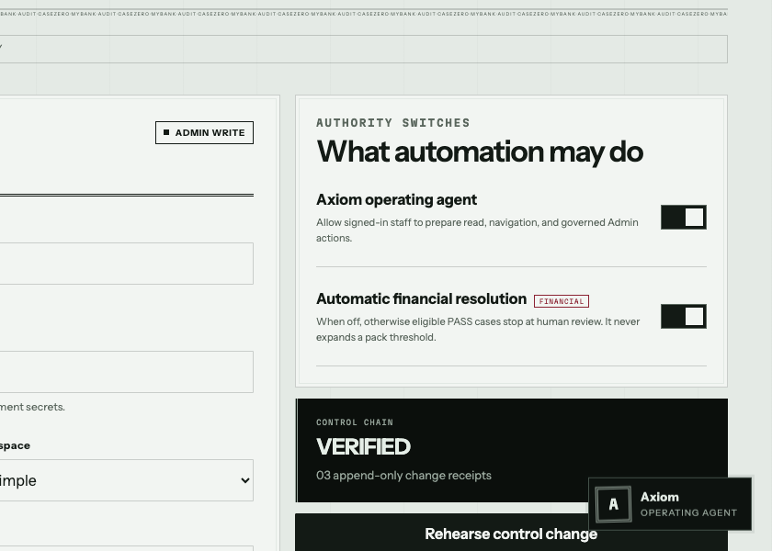
CONTROLLED ROLLOUT
Ready for a synthetic pilot today.
Four bank handoffs unlock live rollout:
CORE + CRM CREDENTIALS
COMPLAINT MAILBOX
COMPLIANCE SIGN-OFF
FIRST ADMIN IDENTITY
casezero-alpha.vercel.app
CASEZERO / AXIOM / CASE STUDY 1
Notes:
Timing: 5:40-6:20 + 20s reflection
CaseZero is live now for stakeholder onboarding, safe rehearsal and a synthetic-data pilot. A real bank rollout needs four controlled handoffs: core and CRM credentials, the complaints mailbox, Compliance sign-off, and the first Admin identity. Our build lesson is to let CodeBuddy accelerate implementation while tests and deterministic gates remain the authority. The public link is on screen. Close by inviting the judges to run the safe rehearsal.
[Sources]
- CaseZero production deployment and Control Register screenshot.
- Tencent Cloud x UTM Hackathon Handbook, demo-video reflection requirement.

