Slide 1
CASEZERO / DEMO DAY
Bank complaints resolved in minutes — governed end to end.
ONE
COMPLAINT
SIX
One customer complaint becomes one visible decision that the operator, customer and auditor can all understand.
SPECIALISTS
+ one human-visible gate
AXIOM BY CASEZERO
01
Notes:
Timing: 0:00–0:10 (10 seconds).
Say: ‘CaseZero resolves bank complaints in minutes, while keeping every decision visible and governed from end to end.’
This is the company purpose. Do not list features yet.
[Sources]
- Hackathon Demo Day Guideline supplied by the user, 12 Aug 2026.
- submission/01-project-copy/PROJECT_DESCRIPTION.md
- Sequoia Capital — company purpose should be one declarative sentence.

Slide 2
PROBLEM STATEMENT
A complaint takes 90 minutes because the evidence keeps changing hands.
90
01 Inbox
↓
02 Complaints
↓
03 Investigation
minutes
↓
04 Compliance
Case-study baseline for one complaint moving across multiple departments.
↓
05 Finance
↓
06 Customer reply
The failure is not one slow person. It is ownership drift between desks.
AXIOM BY CASEZERO
02
Notes:
Timing: 0:10–0:30 (20 seconds).
Say: ‘The case-study baseline is 90 minutes. The customer repeats the same story while evidence and ownership move through six desks.’
Keep this slide to the problem only. Do not reveal the solution until slide 4.
[Sources]
- submission/01-project-copy/PROJECT_DESCRIPTION.md — 90-minute baseline.
- api/agents/roster.py — human desks represented by the workflow.

Slide 3
WHY IT MATTERS
When ownership drifts, customer delay becomes regulatory risk.
11%
1.8M
The customer sees
silence
of regulatory deadlines
missed today
retail and SME
customers in the case study
The bank sees
exposure
A faster answer only counts if the bank can explain who acted, what evidence they used, and why money moved.
AXIOM BY CASEZERO
03
Notes:
Timing: 0:30–0:50 (20 seconds).
Say: ‘Eleven percent of deadlines are missed across a 1.8-million-customer bank. The customer experiences silence; the bank carries regulatory exposure.’
These are case-study inputs, not measured product results.
[Sources]
- submission/01-project-copy/PROJECT_DESCRIPTION.md — case-study bank and deadline miss rate.
- submission/01-project-copy/RUBRIC_MAP.md — Impact & Relevance.

Slide 4
SOLUTION
CaseZero turns one complaint into one visible, governed outcome.
01
02
03
04
Customer writes
Specialists act
Rules decide
Everyone sees proof
→
→
→
Their own email and PDF
Six narrow responsibilities
Authority, deadline and money
Customer, operator, auditor
The product is the chain of responsibility—not a chatbot added to a dashboard.
AXIOM BY CASEZERO
04
Notes:
Timing: 0:50–1:10 (20 seconds).
Say: ‘CaseZero keeps the customer’s story, the specialist work, the bank rules and the final proof in one visible journey.’
This is the thirty-second product explanation required by the judges.
[Sources]
- submission/01-project-copy/PROJECT_DESCRIPTION.md — comprehensive solution design.
- Y Combinator — state clearly what the product does and for whom.

Slide 5
WHY THIS SOLUTION
AI can read the mess. It should not own the irreversible decision.
01
02
03
Narrow roles
Deterministic authority
Human exception lane
One responsibility per agent makes mistakes visible.
Code—not model wording—owns deadlines and money.
Uncertainty becomes a review task, never a guess.
Why now: modern models can interpret messy language and documents; governed software can keep their authority bounded.
AXIOM BY CASEZERO
05
Notes:
Timing: 1:10–1:35 (25 seconds).
Say: ‘We designed the system around a simple belief: AI is excellent at interpretation, but irreversible bank decisions need deterministic authority and a visible human exception lane.’
This slide answers ‘why this design’ and ‘why now’ without implementation jargon.
[Sources]
- api/agents/roster.py — narrow seats and explicit zero-model roles.
- api/kernel/gates.py and api/agents/resolver.py — deterministic authority and signed tickets.
- Sequoia Capital — solution, uniqueness and why now.

Slide 6
THE AGENT TEAM
Six specialists divide the work so no single brain owns the case.
01
GEMINI
02
GEMINI
03
NO MODEL
Intake
Classifier
Verifier
Reads email + PDF; extracts the claim.
Chooses 1 of 7 categories + confidence.
Checks CRM + core-banking evidence.
RULE · Quarantine harmful instructions first.
RULE · Low confidence goes to a human.
RULE · PASS, FAIL or MANUAL_REVIEW only.
04
NO MODEL
05
GROQ
06
NO MODEL
Resolver
Communicator
Supervisor
Posts a reversal or credit.
Drafts the customer response.
Watches every open-case deadline.
RULE · No signed ticket means no posting.
RULE · Kernel inserts required wording.
RULE · Escalates only; cannot move money.
Compliance Kernel sits between them all: no model, no persuasion, only policy.
AXIOM BY CASEZERO
06
Notes:
Timing: 1:35–2:05 (30 seconds).
Walk left to right and pair each job with its rule: Intake reads but quarantines attacks; Classifier labels but routes low confidence to a person; Verifier checks facts but cannot invent a fourth verdict; Resolver posts only with a signed ticket; Communicator drafts while the kernel controls mandatory wording; Supervisor escalates but cannot move money.
Call out the brain labels. Only Intake, Classifier and Communicator use a model. The three roles closest to evidence, money and supervision deliberately use no model.
[Sources]
- api/agents/roster.py — canonical seats, roles and brain routing.
- Production proof MYB-2026-000057 — Intake/Classifier Gemini 2.5 Flash; Communicator Llama 3.3 70B via Groq.

Slide 7
THE AI BRAIN
Models propose. The kernel decides. A human handles uncertainty.
SAFE + KNOWN
MODEL BRAINS
COMPLIANCE KERNEL
→
MESSY INPUT
signed action
→
Gemini reads + classifies
Groq drafts the reply
→
deadline · limits · ticket
mandatory wording
email + PDF
→
UNCERTAIN / OVER LIMIT
human decision
Human enters for low confidence, incomplete or contradictory bank evidence, approval limits, or dual control.
AXIOM BY CASEZERO
07
Notes:
Timing: 2:05–2:30 (25 seconds).
Say: ‘The models produce bounded proposals. The kernel checks policy. A safe, known case can proceed with a signed action; uncertainty becomes a human decision.’
Point to the human branch and name the four triggers shown at the bottom.
[Sources]
- api/agents/classifier.py — confidence floor routes to a human.
- api/agents/verifier.py — PASS, FAIL or MANUAL_REVIEW.
- api/kernel/gates.py and api/agents/resolver.py — limits, dual control and signed tickets.

Slide 8
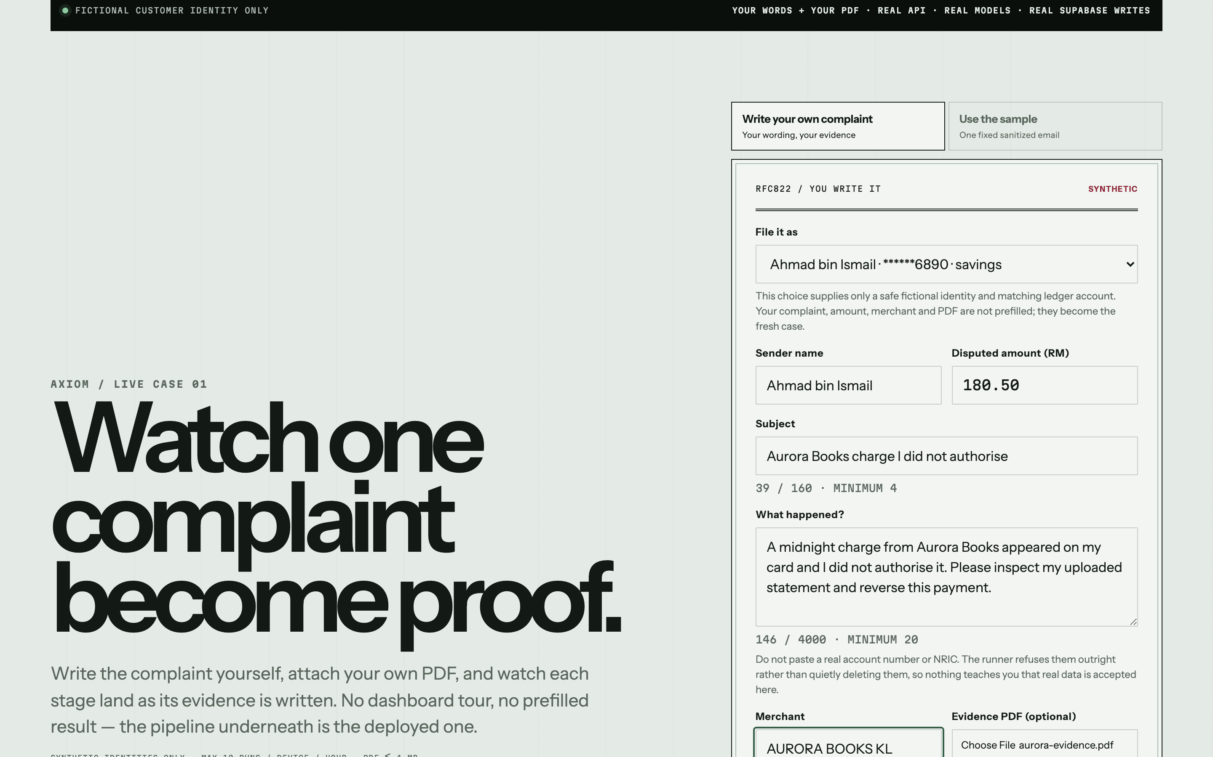
LIVE DEMO · VISITOR INPUT
The complaint and PDF come from the visitor—not from seeded text.
Only the identity is fictional
The visitor controls the subject, complaint words, amount, merchant and evidence PDF.
LIVE DEMO CUE
Type → attach → run
The first result block returns the exact subject, claim, PDF filename, read method and body fingerprint.
AXIOM BY CASEZERO
08
Notes:
Timing: 2:30–3:15 (45 seconds).
Live cue: open https://casezero-alpha.vercel.app/live. Select a fictional identity, type a short complaint, enter the amount and merchant, attach a PDF, then run it.
Say: ‘The identity is fictional for privacy. Everything that describes the complaint is mine.’
While processing, transition to the Boardroom: ‘Now watch each specialist earn the next handoff.’
[Sources]
- dashboard/app/live/page.tsx — composer and truth boundary.
- dashboard/e2e/live.spec.ts — visitor subject, body and PDF assertions.
- submission/assets/deck/pitch-composer.png — current production composer capture.

Slide 9
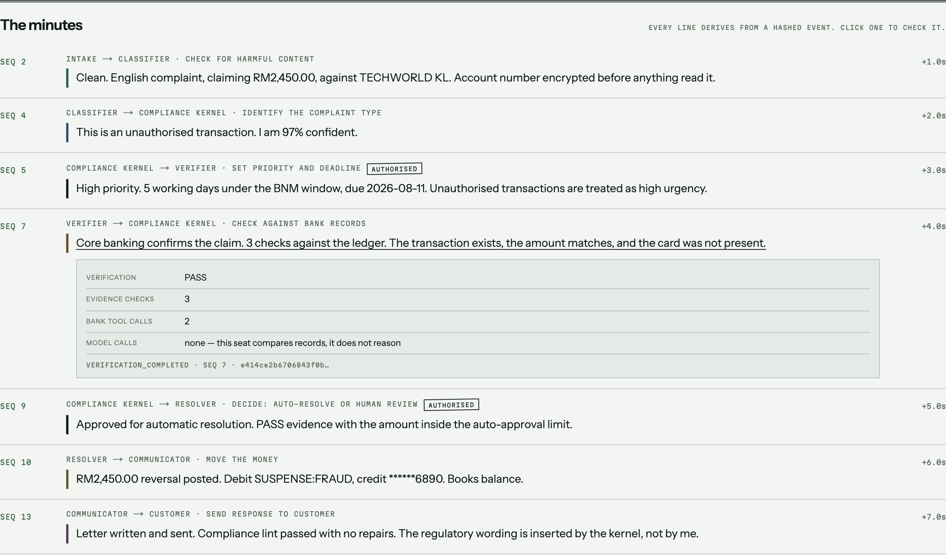
PRODUCT IN ACTION
Each agent speaks only from evidence already written to the chain.
01
02
03
04
05
06
Intake
Classifier
Kernel
Verifier
Resolver
Communicator
Click any spoken line → see event number, facts and hash.
AXIOM BY CASEZERO
09
Notes:
Timing: 3:15–3:40 (25 seconds).
Say: ‘This is not a generated story. The Boardroom renders the event chain as a conversation. If a stage has no event, that agent stays silent.’
Open one handoff receipt in the live demo and show sequence number, evidence facts and hash.
[Sources]
- api/agents/handoff.py — every sentence is assembled from recorded events only.
- submission/assets/deck/receipt-open.png — product capture.
- submission/01-project-copy/RUBRIC_MAP.md — Demo & Storytelling and Technical Execution.

Slide 10
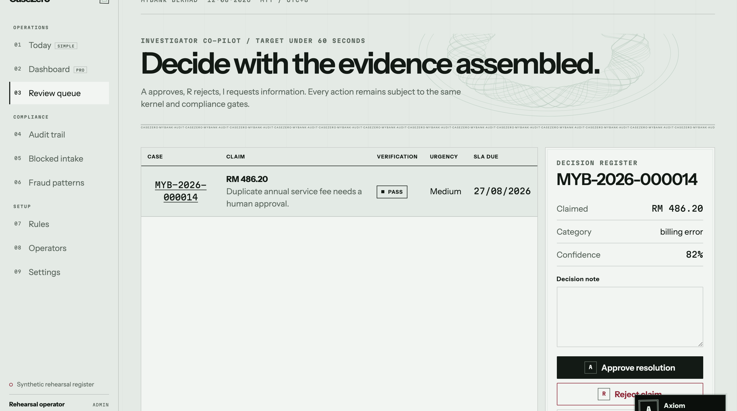
HUMAN-IN-THE-LOOP
The human is not a fallback screen. They are the decision owner for exceptions.
The system assembles
evidence · category · confidence · deadline · bank result
The person decides
Approve
Reject
Request information
Every choice re-enters the same kernel gates and remains on the audit trail.
AXIOM BY CASEZERO
10
Notes:
Timing: 3:40–4:10 (30 seconds).
Say: ‘Here is the person. CaseZero brings them the evidence and a clear choice. They can approve, reject or request information. The person owns the exception; the kernel still enforces the rules.’
Human triggers: low confidence, bank evidence that cannot settle the claim, high amount, or dual-control policy.
[Sources]
- dashboard/app/review/page.tsx — human decision workspace.
- api/review.py and api/main.py — governed human review decision.
- submission/assets/deck/human-review.png — current production rehearsal capture.

Slide 11
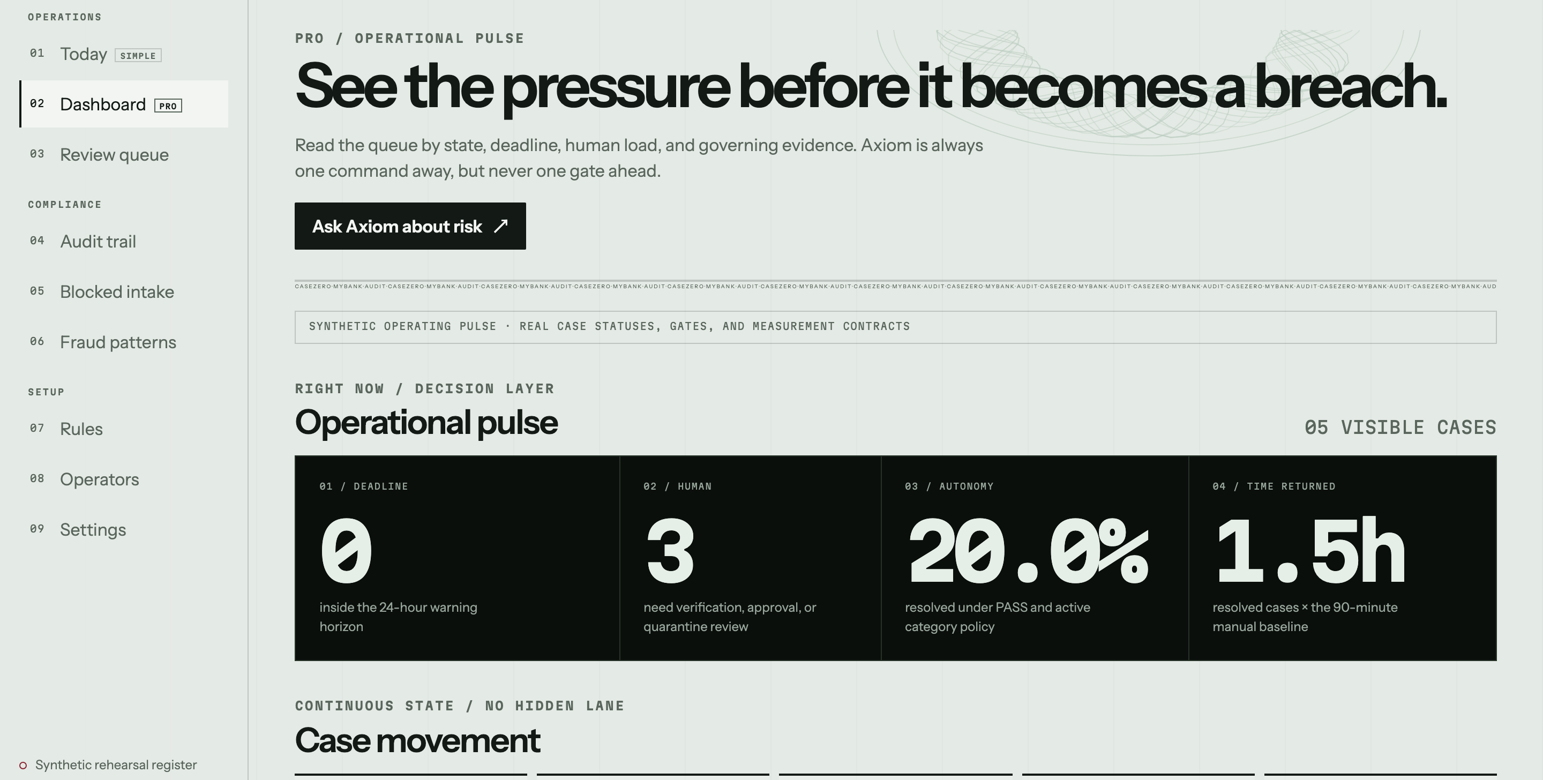
BUSINESS VALIDITY
The business case is measurable staff time plus a controlled path to rollout.
57%
unauthorised transactions + billing errors
in the case study
NOW
Synthetic pilot
NEXT
Staff-reviewed rollout
THEN
Bank integration
AXIOM BY CASEZERO
11
Notes:
Timing: 4:10–4:35 (25 seconds).
Say: ‘Mission Control measures deadline risk, human load, safe autonomy and time returned. We start with two high-volume dispute types—57% of the stated volume—then move from synthetic pilot to staff-reviewed rollout and only then bank integration.’
Label 57% as a case-study rollout figure, not production adoption.
[Sources]
- submission/01-project-copy/PROJECT_DESCRIPTION.md — 57% first-rollout scope and rollout prerequisites.
- submission/assets/deck/mission-control.png — current production rehearsal capture.
- dashboard/app/pro/page.tsx — operational metrics and Axiom entry point.

Slide 12
PRODUCTION PROOF · 12 AUG 2026
One fresh visitor-written case proves the full chain works.
20.1s
14
3 + 3
RM180.50
fresh live case
valid event links
model + bank calls
balanced posting
VISITOR INPUT RECEIPT
Their subject · their claim · their PDF · exact body fingerprint
VERIFIED LIVE
AXIOM BY CASEZERO
12
Notes:
Timing: 4:35–4:50 (15 seconds).
Say: ‘The latest visitor-written production case completed in 20.1 seconds with 14 valid links, three model calls, three bank-tool calls and a balanced RM180.50 posting.’
This slide proves the run. Do not mix it with the ask; advance to the conclusion.
[Sources]
- Production proof MYB-2026-000057, token eqr5YdEUctbiGPU2rODXyZoTLA1j1_F8C1drO2X018w.
- Production verification recorded 12 Aug 2026: COMMUNICATED, PASS, 20,108 ms, 14 valid links, balanced posting.
- Live URL: https://casezero-alpha.vercel.app/live

Slide 13
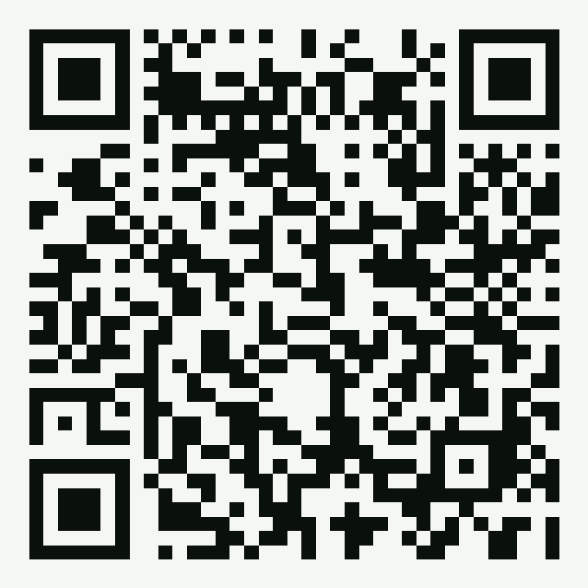
CONCLUSION
Cancel six handoffs. Keep six governed specialists ready 24/7.
BEFORE · SIX DESKS
AFTER · ONE GOVERNED CHAIN
TEST IT LIVE
01 Inbox
01
Intake
02
Classifier
02 Complaints
reads + screens
labels + confidence
03 Investigation
03
Verifier
04
Resolver
checks bank facts
ticketed action only
04 Compliance
05
Communicator
06
Supervisor
05 Finance
customer answer
deadline escalation
Write your own complaint + PDF
06 Customer reply
90-minute baseline · ownership drifts
Kernel rule: deadlines · confidence · limits · signed tickets
casezero-alpha.vercel.app
/live
20.1s
14
24/7
1
fresh verified run
valid event links
intake readiness
human exception lane
AXIOM BY CASEZERO
13
Notes:
Timing: 4:50–5:00 (10 seconds).
Say: ‘Cancel the six handoffs, not the people. Six governed specialists are ready whenever a complaint arrives, while one visible human lane owns every exception. Scan the code and test it with your own words and PDF.’
Point left to the struck-through desk sequence, then right to the governed chain and QR. Stop after the invitation.
24/7 means intake readiness at the deployed endpoint. It does not claim uninterrupted autonomous bank operations; production availability still depends on bank-owned hosting, integrations and controls.
[Sources]
- submission/01-project-copy/PROJECT_DESCRIPTION.md — 90-minute case-study baseline and production boundary.
- api/agents/roster.py — six specialist roles, kernel obligations and human-desk mapping.
- Production proof MYB-2026-000057 — 20.1 seconds and 14 valid event links.
- Live URL encoded in submission/assets/deck/casezero-live-qr.png: https://casezero-alpha.vercel.app/live

Slide 14
THE ASK
REFERENCE · PREVIOUS CLOSE
Approve a staff-reviewed pilot for unauthorised transactions and billing errors.
01
02
03
Synthetic cases
→
Staff-reviewed pilot
→
Bank integration
Prove safety and measurement
Humans own every exception
Connect only after approval
Models propose. Rules decide. Humans own exceptions.
casezero-alpha.vercel.app/live
READY FOR A CONTROLLED PILOT
AXIOM BY CASEZERO
14
Notes:
Reference only. This is the previous conclusion preserved at the user’s request and is not part of the timed five-minute run.
If this version is selected later, say: ‘Our ask is simple: approve a staff-reviewed pilot for unauthorised transactions and billing errors. Models propose, rules decide, and humans own exceptions.’
[Sources]
- submission/01-project-copy/PROJECT_DESCRIPTION.md — controlled rollout path and first two dispute types.
- submission/01-project-copy/RUBRIC_MAP.md — feasibility, responsible AI and overall quality.
- Live URL: https://casezero-alpha.vercel.app/live

Slide 15
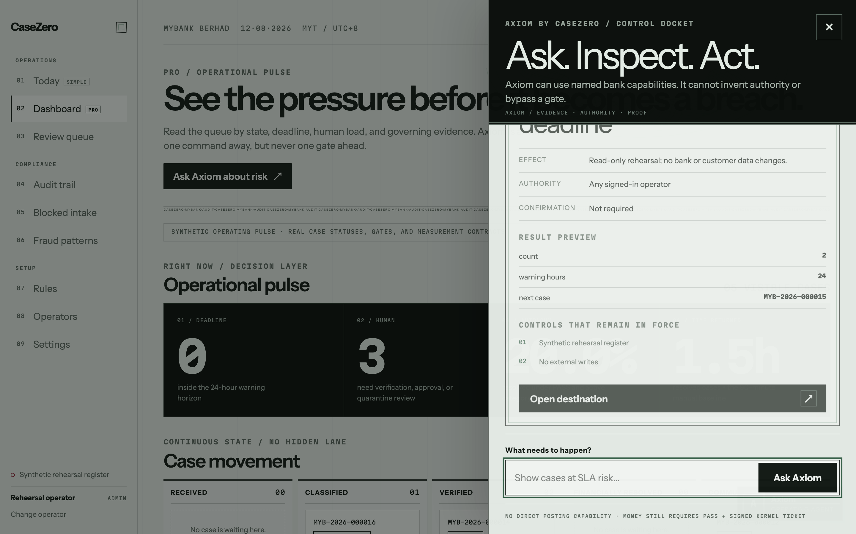
APPENDIX · AXIOM OPERATING AGENT
NOT PART OF THE FIVE-MINUTE RUN
Natural language helps the human operate—without inventing authority.
Axiom may
summarise
navigate
prepare an action
Axiom may not
grant itself a role
bypass confirmation
post without a ticket
AXIOM BY CASEZERO · APPENDIX / Q&A
15
Notes:
Q&A only. Use when asked how staff interact with CaseZero beyond one complaint.
Answer: ‘Axiom converts plain-language requests into an allowlisted docket that shows effect, authority, confirmation and gates before execution.’
[Sources]
- api/agents/wajar.py — closed capability registry and governed dockets.
- submission/assets/deck/axiom-risk-docket.png — current production rehearsal capture.

Slide 16
APPENDIX · AGENTS AND AI
NOT PART OF THE FIVE-MINUTE RUN
Likely questions about the six agents and their brains
Why six agents instead of one?
Which agents use AI?
Each agent owns one narrow responsibility. That makes failures inspectable and prevents one model from controlling the full case.
Intake and Classifier use Gemini; Communicator uses Groq. Verifier, Resolver and Supervisor deliberately make no model call.
Can you change a model?
What does the Compliance Kernel do?
Yes. Brain routing is separate from policy and authority, so a model can be evaluated or replaced without changing the financial gate.
It calculates deadlines, checks confidence and evidence, enforces limits, mints signed tickets and inserts mandatory customer wording.
AXIOM BY CASEZERO · APPENDIX / Q&A
16
Notes:
Q&A only. Do not present this slide in the timed five-minute run.
Start with the one-sentence answer shown. Add technical detail only if the judge asks a follow-up.
Questions: Why six agents instead of one? | Which agents use AI? | Can you change a model? | What does the Compliance Kernel do?
[Sources]
- submission/01-project-copy/PROJECT_DESCRIPTION.md
- submission/01-project-copy/RUBRIC_MAP.md
- api/agents/roster.py, api/agents/classifier.py, api/agents/verifier.py and api/agents/resolver.py
- dashboard/e2e/live.spec.ts and dashboard/e2e/boardroom.spec.ts

Slide 17
APPENDIX · HUMAN AND RESPONSIBLE AI
NOT PART OF THE FIVE-MINUTE RUN
Likely questions about people, safety and ethics
Exactly when does a human enter?
Can a human override everything?
Low confidence, incomplete or contradictory evidence, an amount above the automatic limit, dual control, or any explicit refusal.
An authorized person can decide an exception, but the reason is recorded and the action must still pass the same kernel and role checks.
What if the PDF contains an attack?
What if the AI is wrong?
Suspicious instructions are blocked before the first model call. The case is quarantined with an explanation instead of silently continuing.
Its output is only a proposal. Bank evidence and deterministic rules can contradict it, and uncertainty routes to a person rather than money movement.
AXIOM BY CASEZERO · APPENDIX / Q&A
17
Notes:
Q&A only. Do not present this slide in the timed five-minute run.
Start with the one-sentence answer shown. Add technical detail only if the judge asks a follow-up.
Questions: Exactly when does a human enter? | Can a human override everything? | What if the PDF contains an attack? | What if the AI is wrong?
[Sources]
- submission/01-project-copy/PROJECT_DESCRIPTION.md
- submission/01-project-copy/RUBRIC_MAP.md
- api/agents/roster.py, api/agents/classifier.py, api/agents/verifier.py and api/agents/resolver.py
- dashboard/e2e/live.spec.ts and dashboard/e2e/boardroom.spec.ts

Slide 18
APPENDIX · BUSINESS AND FEASIBILITY
NOT PART OF THE FIVE-MINUTE RUN
Likely questions about value, rollout and adoption
Who pays and why?
Is 20 seconds realistic?
A bank complaints operation pays to reduce handling time and deadline risk while preserving review, audit and existing control ownership.
It is the measured synthetic production run time, not a promise for every real case. Network, evidence and human review can make cases longer.
How would rollout start?
What still belongs to the bank?
Synthetic cases first, then a staff-reviewed pilot for two high-volume categories, then controlled integration after compliance and security approval.
Core and CRM credentials, mailbox transport, operator identities, approval limits, policy ownership, compliance sign-off and production security.
AXIOM BY CASEZERO · APPENDIX / Q&A
18
Notes:
Q&A only. Do not present this slide in the timed five-minute run.
Start with the one-sentence answer shown. Add technical detail only if the judge asks a follow-up.
Questions: Who pays and why? | Is 20 seconds realistic? | How would rollout start? | What still belongs to the bank?
[Sources]
- submission/01-project-copy/PROJECT_DESCRIPTION.md
- submission/01-project-copy/RUBRIC_MAP.md
- api/agents/roster.py, api/agents/classifier.py, api/agents/verifier.py and api/agents/resolver.py
- dashboard/e2e/live.spec.ts and dashboard/e2e/boardroom.spec.ts

Slide 19
APPENDIX · PRODUCT, PROOF AND UX
NOT PART OF THE FIVE-MINUTE RUN
Likely questions about the demo and technical proof
Is the complaint prefilled?
How do you prove one result?
No. Only the demo identity is fictional. Subject, words, amount, merchant and PDF come from the visitor and appear in the input receipt.
The result includes the visitor-input receipt, agent handoffs, model and bank-tool receipts, balanced journal and a recomputed event chain.
How is it tested?
Is the interface accessible?
The release gate passes 504 backend tests, 29 browser journeys, type checking, production build, slide/PDF rendering and dependency audit.
The live path supports keyboard use, visible focus, reduced motion, readable refusal states and zero horizontal overflow at 390 pixels.
AXIOM BY CASEZERO · APPENDIX / Q&A
19
Notes:
Q&A only. Do not present this slide in the timed five-minute run.
Start with the one-sentence answer shown. Add technical detail only if the judge asks a follow-up.
Questions: Is the complaint prefilled? | How do you prove one result? | How is it tested? | Is the interface accessible?
[Sources]
- submission/01-project-copy/PROJECT_DESCRIPTION.md
- submission/01-project-copy/RUBRIC_MAP.md
- api/agents/roster.py, api/agents/classifier.py, api/agents/verifier.py and api/agents/resolver.py
- dashboard/e2e/live.spec.ts and dashboard/e2e/boardroom.spec.ts

