Slide 1
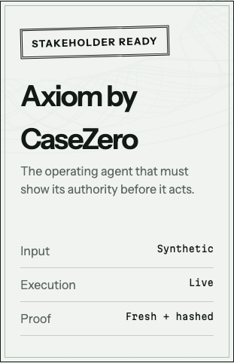
CASE STUDY 1 / BANKING DISPUTE AUTOMATION
Axiom
One complaint.
One governed outcome.
LIVE NOW · PROVABLE END TO END
casezero-alpha.vercel.app
Notes:
Open by naming Case Study 1 exactly. Axiom is a governed banking-dispute operating agent: it can use AI for interpretation, but it must prove authority before any financial action.
[Sources]
- Tencent Cloud x UTM Hackathon Handbook, page 4.
- First-party production capture: https://casezero-alpha.vercel.app

Slide 2
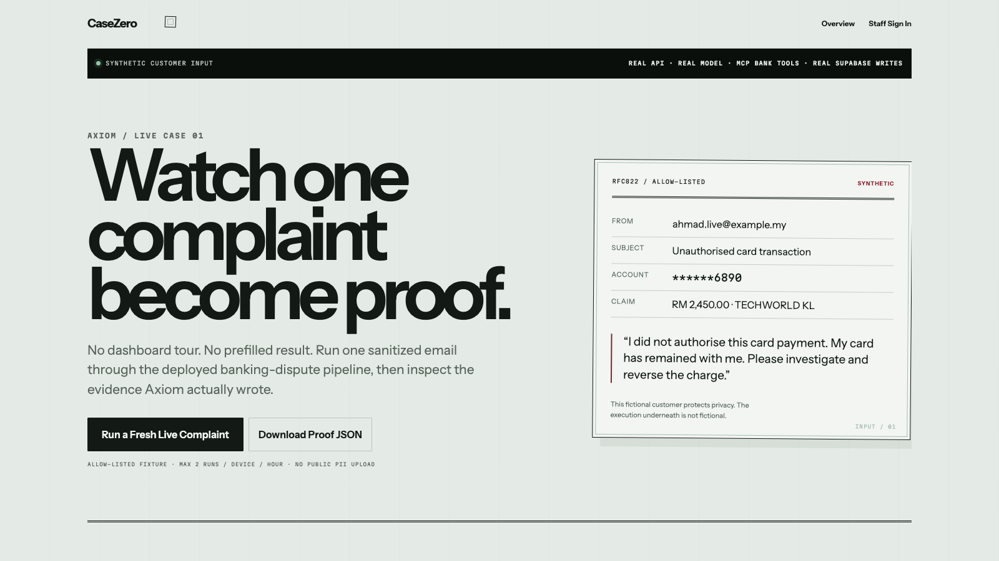
THE BANK'S STARTING POINT
Time is lost before evidence is assembled.
1.8M
retail + SME customers
90 MIN
manual handling per case
11%
regulatory deadlines missed
BNM / FMOS · 5-20 WORKING DAYS
Notes:
The handbook gives us the bank's baseline: 1.8 million customers, 90 minutes of manual handling per case, and roughly 11 percent of regulatory deadlines missed.
[Sources]
- Tencent Cloud x UTM Hackathon Handbook, Case Study 1 introduction, page 4.
- First-party Axiom production capture.

Slide 3
AXIOM / LIVE PRODUCT
03
A fresh complaint becomes a public proof.
SANITIZED INPUT
LIVE EXECUTION
SIGNED OUTCOME
SHAREABLE PROOF
No prefilled success. No silent fallback.
Notes:
The public path deliberately starts with an allow-listed synthetic customer. The execution beneath it is live: FastAPI, Gemini, MCP bank tools, Supabase writes, journal posting, and hash verification. That boundary protects customer PII without faking the run.
[Sources]
- First-party production capture and persisted live endpoint at https://casezero-alpha.vercel.app/live
- Tencent Cloud x UTM Hackathon Handbook, security and auditability requirements, page 5.

Slide 4
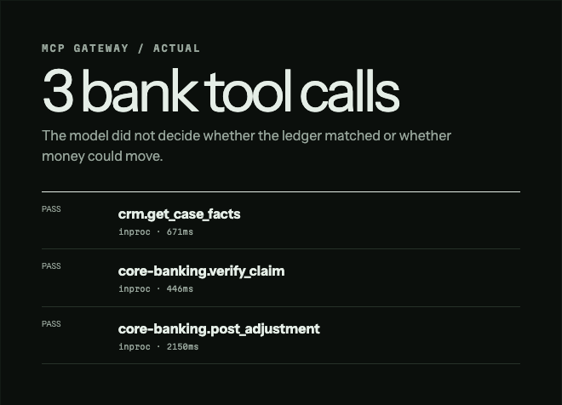
AI INNOVATION / AUTHORITY DESIGN
AI proposes.
Policy decides.
Intake extracts + encrypts
Classifier assigns category + SLA
Verifier calls CRM + core tools
Deterministic gate owns POST
MODELS WRITE PROPOSALS / CODE OWNS AUTHORITY
Notes:
Axiom uses specialist agents where probabilistic reasoning helps, then crosses into deterministic code for policy, authorization, and financial posting. The image is the actual telemetry from the deployed case: three metered Gemini calls and three MCP bank-tool calls.
[Sources]
- Persisted production proof for MYB-2026-000028.
- CaseZero api/agents and api/kernel implementation.

Slide 5
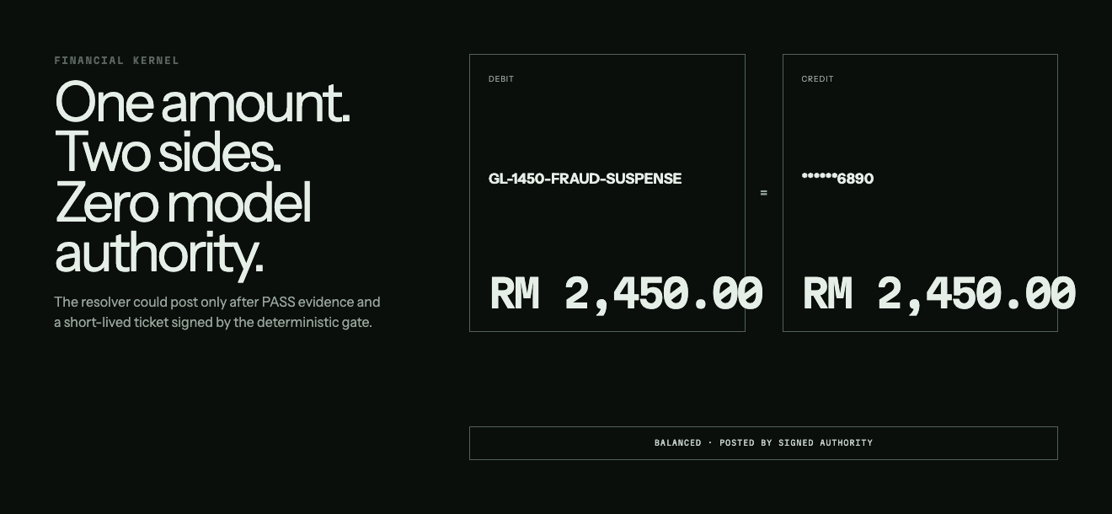
AXIOM / FINANCIAL CONTROL
05
A verified model result still cannot move money.
01
Bank evidence returns PASS
02
Ticket binds case, amount + expiry
03
Debit equals credit: RM 2,450
04
13-link chain verifies the write
Notes:
PASS is necessary, but not sufficient. The kernel also requires a short-lived signed ticket, a balanced journal, and an unbroken event chain. The displayed RM 2,450 entry is the actual posting returned by the production run.
[Sources]
- Persisted production proof for MYB-2026-000028.
- CaseZero resolver, kernel ticket, journal, and hash-chain implementation.

Slide 6
USER EXPERIENCE / ONE CLEAR FIRST ACTION
One click starts a fresh production case.
Synthetic customer. Real API, model, MCP tools + Supabase.
Notes:
The redesigned public experience has one first action. It does not ask a judge to choose a mode or tour a dashboard. It starts with one sanitized complaint, waits for production, and shows only returned evidence.
[Sources]
- First-party production capture: https://casezero-alpha.vercel.app/live

Slide 7
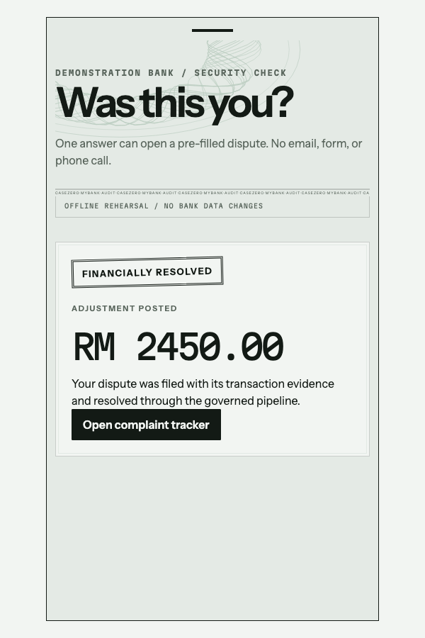
AXIOM / CUSTOMER COMMUNICATION
07
The customer receives a resolution - not agent internals.
RM 2,450
COMMUNICATED · PASS · POSTED
plain-language case record
FMOS notice when required
Notes:
The external experience is intentionally calmer than the operator proof. A pre-approved communication is linted, authorized, and released with the final state and applicable redress information. The displayed customer is a sanctioned fixture; the status behavior is implemented.
[Sources]
- Tencent Cloud x UTM Hackathon Handbook, compliant customer communication requirement, page 5.
- First-party CaseZero customer-outcome capture.

Slide 8
RELEASE EVIDENCE / VERIFIED 04 AUG 2026
Measured at the system boundary.
24.59s
3 / 3
3 / 3
13 / 13
fresh production run
metered model calls
MCP bank tool calls
hash links valid
466 BACKEND TESTS / 14 BROWSER JOURNEYS / 0 HIGH-SEVERITY NPM VULNERABILITIES
MYB-2026-000028 · COMMUNICATED · PASS · POSTED · BALANCED
Notes:
This is the release we just exercised in production. It completed in 24.59 seconds with three metered model calls, three MCP bank-tool calls, thirteen valid chain links, and a balanced journal. The full local release gate is 466 backend tests and 14 browser journeys.
[Sources]
- Persisted production proof for MYB-2026-000028.
- CaseZero 4 August 2026 backend, browser, build, and npm-audit results.

Slide 9
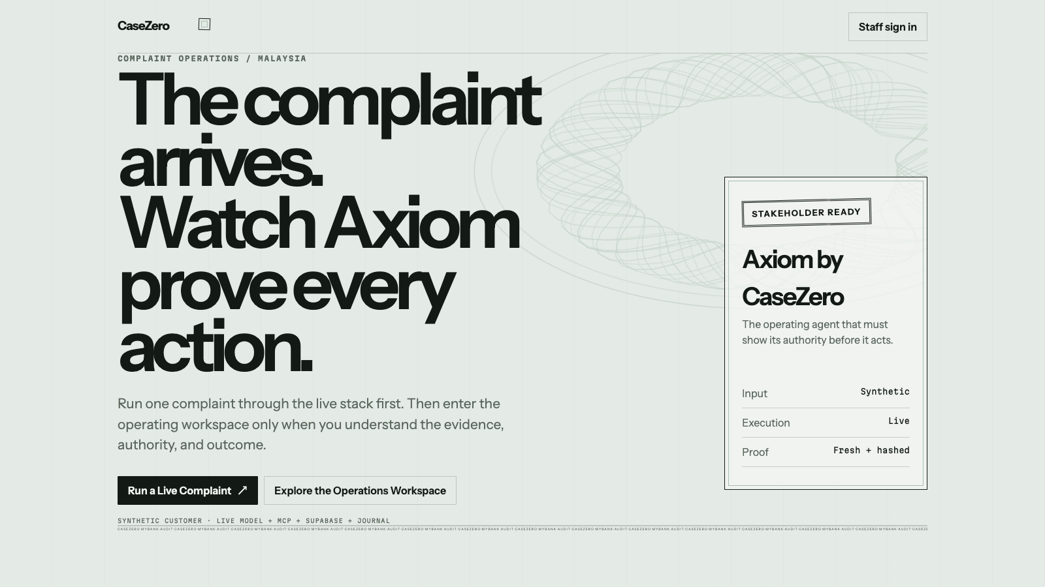
CONTROLLED VALUE / FIRST ROLLOUT
Start where 57% of dispute volume already sits.
35% unauthorised transactions
+ 22% billing errors
DEMO CASE · 90 MIN → 24.59 SEC
SHADOW MODE → COMPLIANCE SIGN-OFF → THRESHOLDED POSTING
Notes:
The first controlled rollout targets the two highest-volume categories, which together account for 57 percent of the handbook's stated mix. The 24.59-second figure is this live demonstration case, not a promised production average. A bank should prove its own target in shadow mode before enabling thresholded posting.
[Sources]
- Tencent Cloud x UTM Hackathon Handbook, Case Study 1 category mix and under-five-minute stretch target, page 4.
- Persisted production proof for MYB-2026-000028.

Slide 10
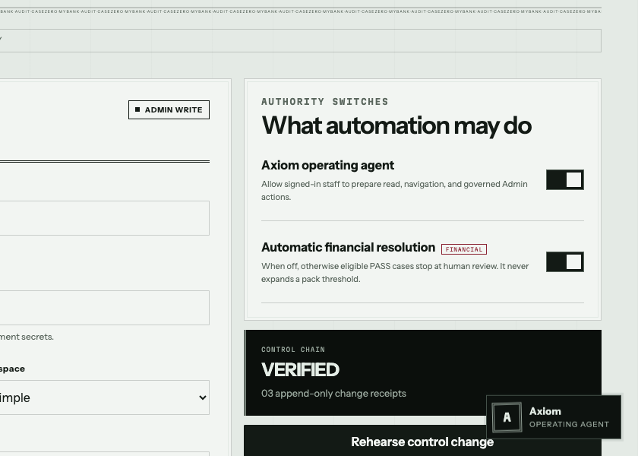
BANK STAKEHOLDER HANDOFF
The system is live.
Your inputs make it bank-ready.
Connect the controlled boundaries:
01 CORE + CRM ENDPOINTS
02 MAILBOX + SEND AUTHORITY
03 COMPLIANCE PACK + THRESHOLDS
04 ADMIN USERS + SLA WORKER
casezero-alpha.vercel.app
AXIOM / CASE STUDY 1 / SAFE INPUT · PRODUCTION BEHAVIOR
Notes:
Close with the decision boundary. The public system is live today with safe synthetic input. A real bank rollout needs bank-owned core and CRM endpoints, complaint-mailbox send authority, the approved compliance pack and thresholds, and named administrators plus an always-on SLA worker.
[Sources]
- CaseZero production deployment and stakeholder deployment guide.
- First-party Axiom settings capture.

