Slide 1

Solita.
AWS Lambda

Slide 2

AWS Lambda git clone https://github.com/samion/aws-lambda.git
Sami Nieminen
sami.nieminen@solita.fi
Solita Oy

Slide 3
Contents
AWS Lambda
Other AWS tools used in this exercise
Accounts & Roles
AWS Web Console
Exercise part 1: Analysing file metadata from S3
Exercise part 2: Writing analysis result to DynamoDB
Demo: Analyze large log file using EMR

Slide 4
Lambda comes from the Lambda Calculus and refers to anonymous functions in programming.

Slide 5
AWS Lambda is a compute service that runs your code in response to events and automatically manages the compute resources for you

Slide 6
AWS Lambda
Currently supports Javascript syntax using AWS NodeJS SDK
About all of the AWS services usable from Lambda
Suitable for building micro services, triggered by various AWS services
Lambda function can be triggered from S3 event, DynamoDB stream or Kinesis at the moment
It’s like bash, where you can call various unix-commands and pipe them together
Price is based on max amount of RAM and duration of the function call

Slide 7
Other AWS tools used in this exercise

Slide 8
S3 – Simple Storage System
Redundant, scalable object storage
Buckets are object (file) containers
Can serve static web content (usually using CloudFront in front)
Can set object lifecycle, e.g. archiving to Glacier or deletion after defined time
Can set triggers for object events
Price based on used storage space

Slide 9
DynamoDB – NoSQL database
Scalable (read and write performance defined per table)
Document and key-value data models
Price is based on the user defined read and write performance values

Slide 10
EMR – Elastic MapReduce
Hadoop as a service
Price based on amount and type of cluster nodes

Slide 11
Accounts & Roles

Slide 12
Accounts
Accounts created per user
Rights limited to services used in this exercise
S3 bucket name must match: fi.solita.lambda.<account_username>.*

Slide 13
Roles
invocationrole: assumed by S3 when triggering the Lambda function
right to call the Lambda
executionrole: assumed by Lambda when it is executing
right to call used AWS services
emr-instance-role: assumed by the Hadoop instances
emr-service-role: assumed by the Elastic MapReduce

Slide 14
AWS Web Console

Slide 15
AWS Web Console
https://739080850666.signin.aws.amazon.com/console

Slide 16
Exercise

Slide 17
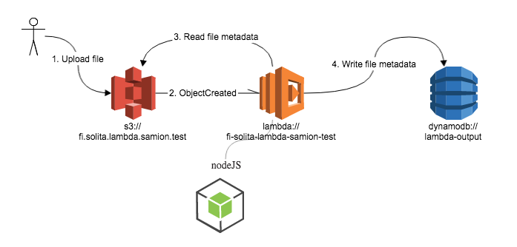

Slide 18
Exercise part 1: Analyzing file metadata from S3

Slide 19
1. Creating a Lambda function
AWS Web Console -> Services -> Compute -> Lambda
Create a Lambda function
Name: fi-solita-lambda-<user>-test
Description: Lambda testing
Code entry type: Edit code inline
Code template: S3 Get Object
Handler name: handler
Role name: executionrole
Use defaults for advanced settings
Create Lambda function
See the Function ARN, such as: arn:aws:lambda:eu-west-1:739080850666:function:fi-solita-lambda-samion-test, needed on next phase

Slide 20
2. Creating an S3 bucket and trigger for Lambda function
AWS Web Console -> Services -> Storage & Content Delivery -> S3
Create Bucket
Bucket Name: ‘fi.solita.lambda.<user>.test
Region: Ireland
No logging
Create
Click on the bucket name and select Properties

Slide 21
Create trigger for the Lambda function under Events
Name: BucketEventToLambda
Events: ObjectCreated
Send To: Lambda function
Lambda function ARN: <the one from step 1>, e.g. arn:aws:lambda:eu-west-1:739080850666:function:fi-solita-lambda-samion-test
Invocation role ARN: arn:aws:iam::739080850666:role/invocationrole

Slide 22
Testing
Upload test-input.txt to your bucket
Follow the CloudWatch log files, link available from the Lambda function list page

Slide 23
Exercise part 2: Writing the metadata to DynamoDB

Slide 24
DynamoDB usage
File lambda-exercise-part2.js contains DynamoDB usage example
Change username samion to your own

Slide 25
Demo – analyze log file using EMR

Slide 26
Source and output
Source is a plain text log file which contains device state change events
Aim is to collect the state change events and calculate sums of state changes per device
Output is json with device name and state change count

Slide 27
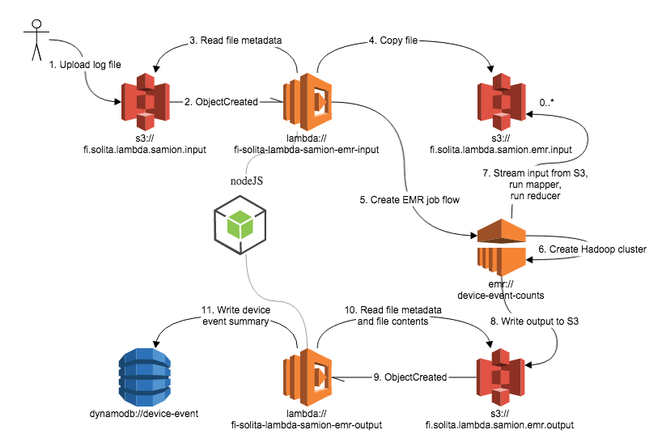

Slide 28
Lambda - input
This lambda function is triggered by incoming log file in input bucket
It copies the log file to EMR input bucket
It creates and runs a job flow using Elastic MapReduce, i.e. a Hadoop cluster

Slide 29
MapReduce
mapper.js
Reads through the input log file, skips unrelated lines and creates a map from device names to device state change events
reducer.js
Reads through state change events of one device and counts them, writes json with device name and count

Slide 30
Lambda - output
This lambda function is triggered by the Elastic MapReduce output, being written to another bucket
It reads the output file and writes the device names and counts to DynamoDB either item by item or using batches

Slide 31
Documentation
Lambda: http://aws.amazon.com/lambda
Lambda Developer Guide: http://docs.aws.amazon.com/lambda/latest/dg/lambda-dg.pdf
Lambda blogs: https://aws.amazon.com/blogs/compute/category/aws-lambda/
S3: http://aws.amazon.com/s3
DynamoDB: http://aws.amazon.com/dynamodb
EMR:
Node.js SDK: http://aws.amazon.com/sdk-for-node-js
Node.js Streaming EMR: http://blogs.aws.amazon.com/bigdata/post/TxVX5RCSD785H6/Node-js-Streaming-MapReduce-with-Amazon-EMR

Slide 32
Kiitos.
Sami Nieminen
sami.nieminen@solita.fi
Solita Oy

