Slide 1
Enrollment &
Outcome Intelligence
Midwest Universities
90 public universities · 6 Midwest states · 2019–2024
Enrollment trends · Retention rates · 6-year graduation outcomes
Prepared by:
Samip Thakuri
DATA SOURCE: IPEDS / NCES
TOOLS: PYTHON · SQL · POWER BI

Slide 2
EXECUTIVE SUMMARY
Five Key Findings at a Glance
What the data reveals about Midwest public universities, 2019–2024
1
Iowa leads, Oklahoma lags
4
Size drives outcomes
Iowa averages 72.6% graduation rate — 37.5 points above Oklahoma, the region's lowest performer. Every top-10 institution has retention above 85%.
Large universities achieve 65.8% grad rates vs 39.6% at small institutions — a 26-point gap driven by student support resources, not class size.
2
Missouri in enrollment crisis
5
Retention predicts everything
4 Missouri institutions lost 36–53% of students since 2019. Missouri Western declined 53.3% — the steepest fall in the region.
Every top-10 institution retains 85%+ of students. Retention is the single strongest leading indicator of 6-year graduation success.
3
COVID resilience — outcomes held
Enrollment dropped 7.8% during COVID but graduation rates actually improved (44.9→45.8%). The region absorbed the shock without outcome collapse.
Samip Thakuri · CEDBR, Wichita State University · 2025

Slide 3
METHODOLOGY
Research Design & Data Pipeline
From raw IPEDS files to interactive dashboard — a fully reproducible analytical workflow
STUDY SCOPE
ANALYTICAL PIPELINE
90
Public 4-year universities analyzed
01 ETL
Python + Pandas — load 18 IPEDS CSVs, filter, merge → SQLite
6
Midwest states (KS, MO, NE, OK, IA, CO)
02 SQL EDA
DBeaver — 6 business questions with documented findings
6
Years of panel data (2019–2024)
03 Modeling
Linear regression + Random Forest — graduation rate drivers
18
IPEDS raw CSV files downloaded
04 Dashboard
Power BI — 3-page interactive dashboard, published publicly
3
IPEDS surveys: HD + EF-D + GR
05 Report
Research brief + PowerPoint executive summary
6
Business questions answered via SQL
Samip Thakuri · CEDBR, Wichita State University · 2025

Slide 4
FINDING 1
Which universities lead on graduation rates?
Top 10 Midwest public universities by 6-year graduation rate (2024)
87.5%
Top grad rate — Air Force Academy
CO · Rural · 7:1 student-faculty ratio
85%+
Retention in ALL top 10 institutions
Retention is the universal predictor
3 of 10
Top institutions are in Colorado
Iowa leads by state avg at 72.6%
Insight: Every top-10 institution retains over 85% of students. Size and location vary — but keeping students is what drives graduation.
Samip Thakuri · CEDBR, Wichita State University · 2025

Slide 5
FINDING 2
Enrollment Crisis: Who is losing students?
State-level trends and the institutions hit hardest (2019–2024)
TOP 5 ENROLLMENT DECLINERS
1
Missouri Western State
-53.3%
MO
2
Harris-Stowe State Univ.
-42.4%
MO
3
Lincoln University
-39.4%
MO
4
Fort Hays State Univ.
-38.9%
KS
5
Peru State College
-38.6%
NE
Nebraska is the only state where enrollment has not recovered to pre-COVID levels — outcomes are declining with it.
4 of 5 hardest-hit institutions are in Missouri
Samip Thakuri

Slide 6
FINDING 3
COVID-19 Impact: Did outcomes recover?
Comparing enrollment, retention, and graduation rates across three periods
Pre-COVID (2019)
COVID Years (2020–21)
Post-COVID (2022–24)
2,652
2,445
2,627
Avg Enrollment
Avg Enrollment
Avg Enrollment
72.0%
71.3%
71.8%
Avg Retention Rate
Avg Retention Rate
Avg Retention Rate
44.9%
45.8%
45.8%
Avg 6-Yr Grad Rate
Avg 6-Yr Grad Rate
Avg 6-Yr Grad Rate
Key insight: Enrollment dropped 7.8% during COVID but has recovered. Graduation rates actually IMPROVED during COVID — students who stayed enrolled completed at higher rates.
Samip Thakuri

Slide 7
FINDING 4 & 5
Size and Retention: The Hidden Drivers
How institution size and retention rates determine graduation outcomes
RETENTION BY STATE (2024)
IA
86.7%
Range: 82–90%
KS
77.1%
Range: 68–86%
MO
75.7%
Range: 54–100%
NE
73.8%
Range: 63–86%
CO
69.9%
Range: 0–100%
OK
66.9%
Range: 54–90%
Large universities outperform small ones by 26pp on grad rate — not because of lower student-faculty ratios, but because of stronger student support infrastructure.
Samip Thakuri

Slide 8
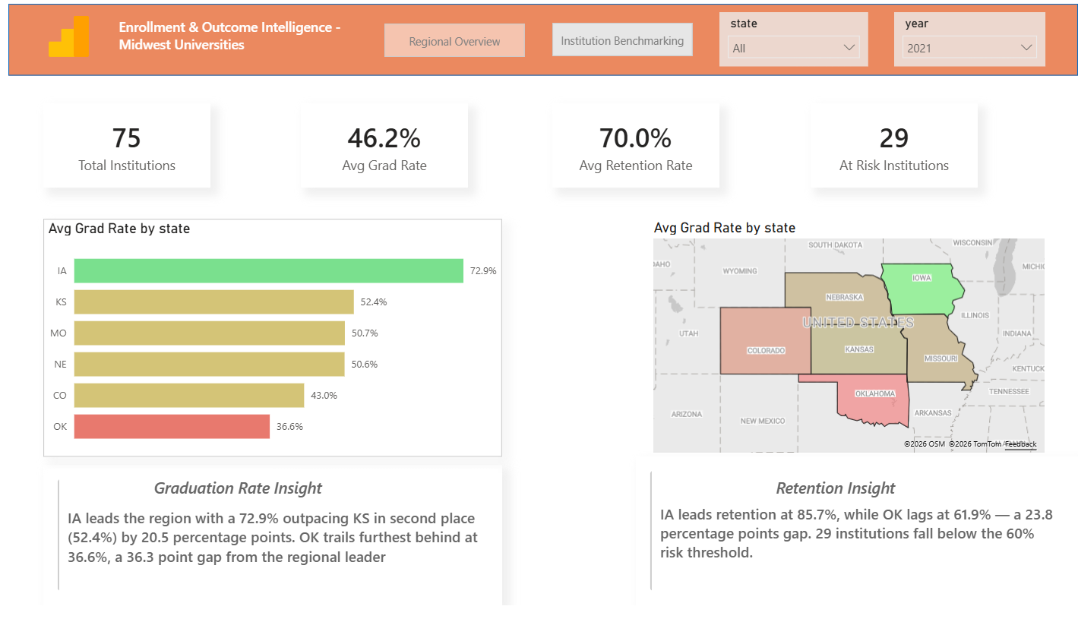
DASHBOARD SHOWCASE
Page 1 — Regional Overview

Slide 9
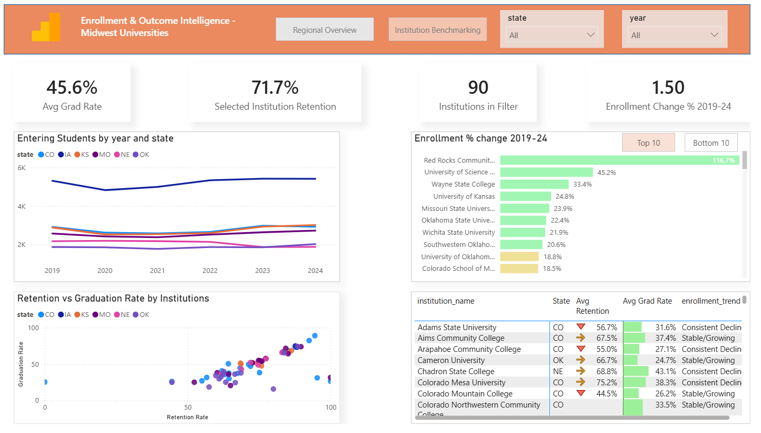
DASHBOARD SHOWCASE
Page 2 — Enrollment Trends

Slide 10
RECOMMENDATIONS
Policy Recommendations
Four actionable interventions based on the analysis findings
1
Invest in student retention infrastructure
2
Urgent intervention for Missouri institutions
Every top-10 institution retains 85%+ of students. States with below-average retention (OK 66.9%, CO 69.9%) should prioritize advising, mental health, and financial aid retention programs — not just recruitment.
Missouri Western, Harris-Stowe, and Lincoln University have lost 40–53% of students. State policy must address this structural decline — through mergers, program realignment, or targeted emergency funding.
3
Support small institution capacity building
4
Address Nebraska's enrollment trajectory
Small institutions (under 5,000 students) achieve only 39.6% grad rates vs 65.8% for large universities. Resource-sharing partnerships and shared services models could close the gap significantly.
Nebraska is the only state where post-COVID enrollment has not recovered. A statewide enrollment strategy targeting adult learners and workforce-aligned programs is needed before decline becomes irreversible.
Samip Thakuri

Slide 11
Key Takeaways
Retention drives graduation
Every institution in the top 10 retains 85%+ of students. Fix retention first — graduation follows.
Missouri needs intervention now
4 institutions lost 36–53% of entering students since 2019. This is structural, not a COVID artifact.
COVID resilience is real
Enrollment recovered. Graduation rates improved during COVID. The region proved it can adapt under pressure.
Iowa is the regional benchmark
Consistent across all metrics — 72.6% grad rate, 86.7% retention, zero at-risk institutions.
Size gap is a resource gap
26-point graduation rate gap between large and small universities reflects unequal resources, not student quality.
Data: IPEDS / NCES (2019–2024) · Tools: Python · SQL · Power BI · Samip Thakuri

