Slide 1

Watering Hole Attack
Gandaki University
Department of Science and Technology
Shishir N. Chhetri
2081/03/17

Slide 2
Contents
Introduction
Pictorial explanation
Types
Examples
Prevention

Slide 3
1. Introduction
A watering hole attack is a type of cyber attack where an attacker compromises a website or network that is commonly used by a specific group of people, such as a company or industry.
The attacker then uses this compromised site to distribute malware or spread malicious content to the visitors of the site.

Slide 4
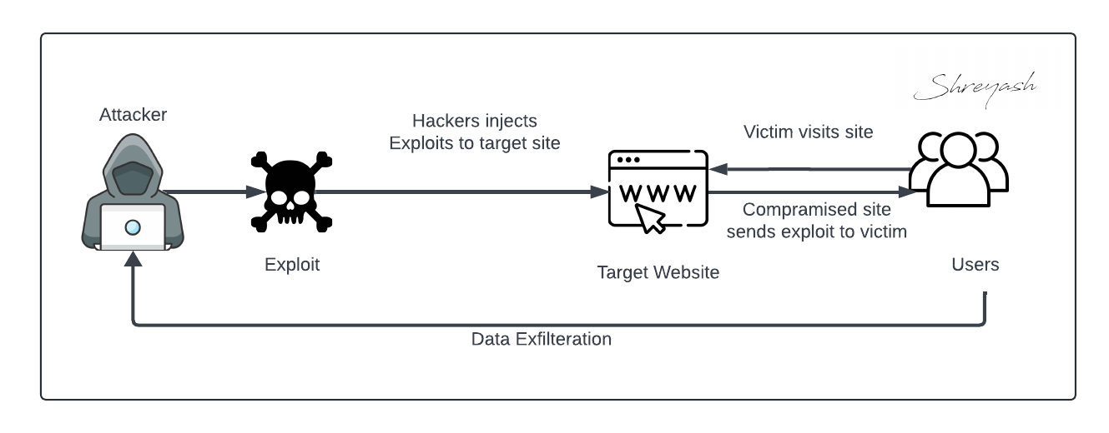
Pictorial explanation

Slide 5
Types of Watering hole attack
Web Based :-Attackers compromise a website to infect visitors.
Network-based Watering Hole: Attackers compromise a network or VPN to infect devices connected to it.

Slide 6
Examples
2011: Google's Gmail was hacked through a watering hole attack on a Chinese human rights group's website.
2013: A watering hole attack on a popular Korean-language blog infected visitors with malware.

Slide 7
Prevention
Keep software up-to-date: Ensure all software, including browsers and plugins, is updated with the latest security patches.
Use strong passwords: Use unique, complex passwords for all accounts.
Be cautious when clicking on links: Avoid clicking on suspicious links or downloading attachments from unfamiliar websites.
Use antivirus software: Install and regularly update antivirus software to detect and remove malware.
Implement network segmentation: Segment networks to prevent lateral movement in case of an attack.

Slide 8


