Slide 1


Slide 2
CHAPTER 14
Basics of Functional Dependencies and Normalization for Relational Databases
Slide 14- 2

Slide 3
Chapter Outline
1 Informal Design Guidelines for Relational Databases
  1.1 Semantics of the Relation Attributes
  1.2 Redundant Information in Tuples and Update Anomalies
  1.3 Null Values in Tuples
  1.4 Spurious Tuples
2 Functional Dependencies (FDs)
  2.1 Definition of Functional Dependency
Slide 14- <number>

Slide 4
Chapter Outline
3 Normal Forms Based on Primary Keys
  3.1 Normalization of Relations
  3.2 Practical Use of Normal Forms
  3.3 Definitions of Keys and Attributes Participating in Keys
  3.4 First Normal Form
  3.5 Second Normal Form
  3.6 Third Normal Form
4 General Normal Form Definitions for 2NF and 3NF (For Multiple Candidate Keys)
5 BCNF (Boyce-Codd Normal Form)
Slide 14- <number>

Slide 5
Chapter Outline
6 Multivalued Dependency and Fourth Normal Form
7 Join Dependencies and Fifth Normal Form
Slide 14- <number>

Slide 6
1. Informal Design Guidelines for Relational Databases (1)
What is relational database design?
  The grouping of attributes to form "good" relation schemas
Two levels of relation schemas
  The logical "user view" level
  The storage "base relation" level
Design is concerned mainly with base relations
What are the criteria for "good" base relations?
Slide 14- <number>

Slide 7
Informal Design Guidelines for Relational Databases (2)
We first discuss informal guidelines for good relational design
Then we discuss formal concepts of functional dependencies and normal forms
  - 1NF (First Normal Form)
  - 2NF (Second Normal Form)
  - 3NF (Third Normal Form)
  - BCNF (Boyce-Codd Normal Form)
Additional types of dependencies, further normal forms, relational design algorithms by synthesis are discussed in Chapter 15
Slide 14- <number>

Slide 8
1.1 Semantics of the Relational Attributes must be clear
GUIDELINE 1: Informally, each tuple in a relation should represent one entity or relationship instance. (Applies to individual relations and their attributes).
  Attributes of different entities (EMPLOYEEs, DEPARTMENTs, PROJECTs) should not be mixed in the same relation
  Only foreign keys should be used to refer to other entities
  Entity and relationship attributes should be kept apart as much as possible.
Bottom Line: Design a schema that can be explained easily relation by relation. The semantics of attributes should be easy to interpret.
Slide 14- <number>

Slide 9
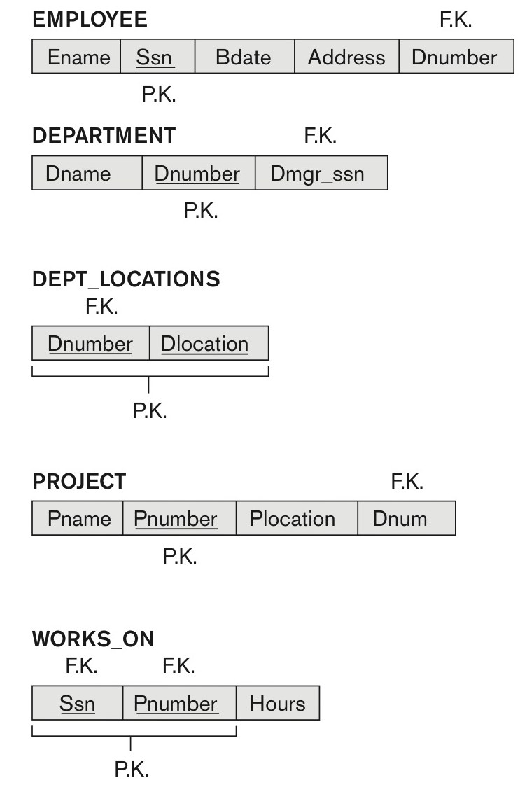
Figure 14.1 A simplified COMPANY relational database schema
Figure 14.1 A simplified COMPANY relational database schema.
Slide 14- <number>

Slide 10
1.2 Redundant Information in Tuples and Update Anomalies
Information is stored redundantly
  Wastes storage
  Causes problems with update anomalies
    Insertion anomalies
    Deletion anomalies
    Modification anomalies
Slide 14- <number>

Slide 11
EXAMPLE OF AN UPDATE ANOMALY
Consider the relation:
  EMP_PROJ(Emp#, Proj#, Ename, Pname, No_hours)
Update Anomaly:
  Changing the name of project number P1 from “Billing” to “Customer-Accounting” may cause this update to be made for all 100 employees working on project P1.
Slide 14- <number>

Slide 12
EXAMPLE OF AN INSERT ANOMALY
Consider the relation:
  EMP_PROJ(Emp#, Proj#, Ename, Pname, No_hours)
Insert Anomaly:
  Cannot insert a project unless an employee is assigned to it.
Conversely
  Cannot insert an employee unless he/she is assigned to a project.
Slide 14- <number>

Slide 13
EXAMPLE OF A DELETE ANOMALY
Consider the relation:
  EMP_PROJ(Emp#, Proj#, Ename, Pname, No_hours)
Delete Anomaly:
  When a project is deleted, it will result in deleting all the employees who work on that project.
  Alternately, if an employee is the sole employee on a project, deleting that employee would result in deleting the corresponding project.
Slide 14- <number>

Slide 14
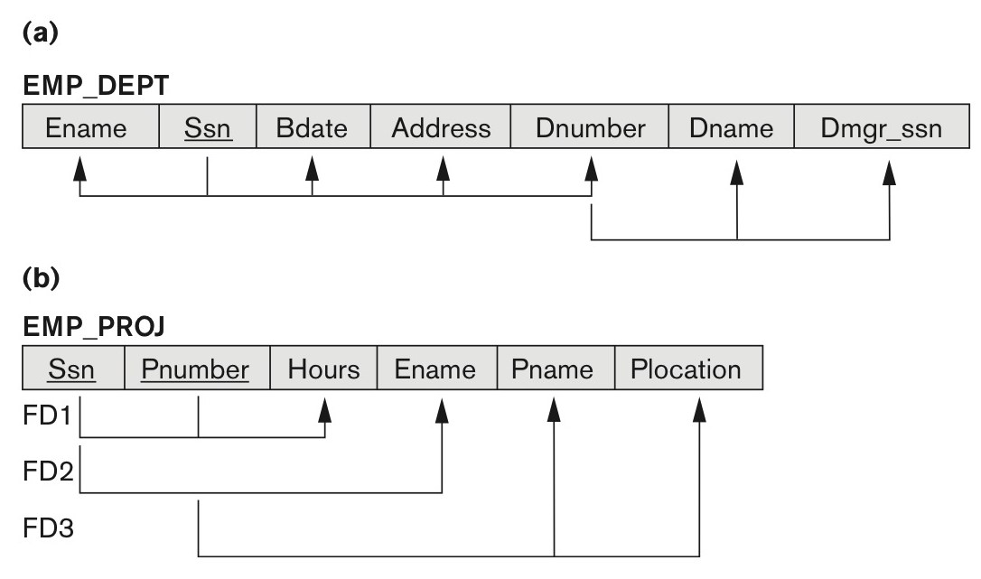
Figure 14.3 Two relation schemas suffering from update anomalies
Figure 14.3
Two relation schemas suffering from update anomalies. (a) EMP_DEPT and (b) EMP_PROJ.
Slide 14- <number>

Slide 15
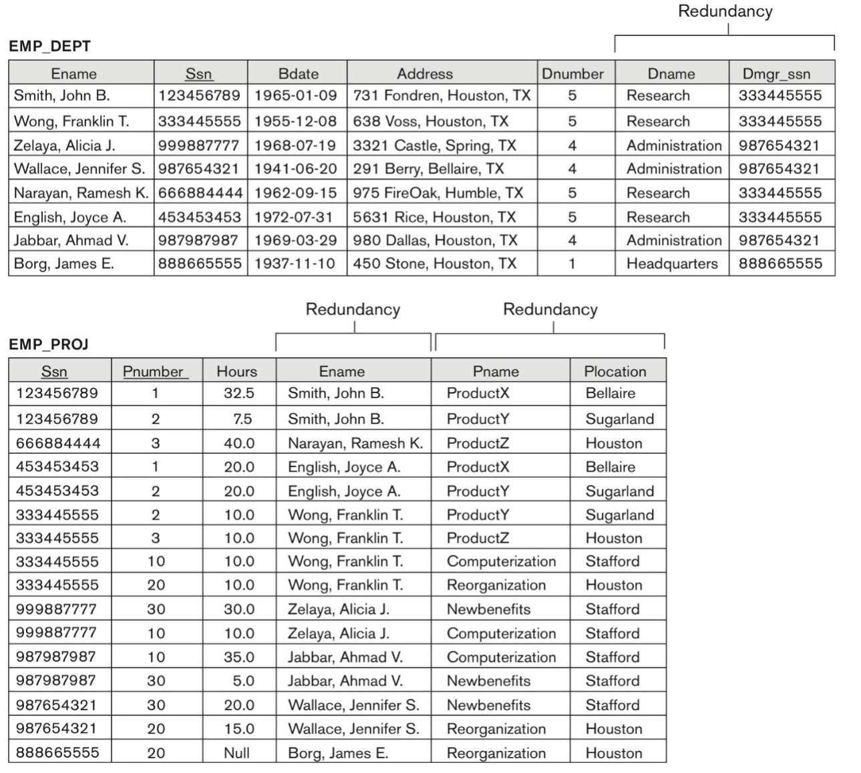
Figure 14.4 Sample states for EMP_DEPT and EMP_PROJ
Figure 14.4
Sample states for EMP_DEPT and EMP_PROJ resulting from applying NATURAL JOIN to the relations in Figure 14.2. These may be stored as base relations for performance reasons.
Slide 14- <number>

Slide 16
Guideline for Redundant Information in Tuples and Update Anomalies
GUIDELINE 2:
  Design a schema that does not suffer from the insertion, deletion and update anomalies.
  If there are any anomalies present, then note them clearly and make sure that the programs that update the database will operate correctly
Slide 14- <number>

Slide 17
1.3 Null Values in Tuples
GUIDELINE 3:
  Relations should be designed such that their tuples will have as few NULL values as possible
  Attributes that are NULL frequently could be placed in separate relations (with the primary key)
Reasons for nulls:
  Attribute not applicable or invalid
  Attribute value unknown (may exist)
  Value known to exist, but unavailable
Slide 14- <number>

Slide 18
1.4 Generation of Spurious Tuples – avoid at any cost
Bad designs for a relational database may result in erroneous results for certain JOIN operations
The "lossless join" property is used to guarantee meaningful results for join operations
GUIDELINE 4:
  The relations should be designed to satisfy the lossless join condition.
  No spurious tuples should be generated by doing a natural-join of any relations.
Slide 14- <number>

Slide 19
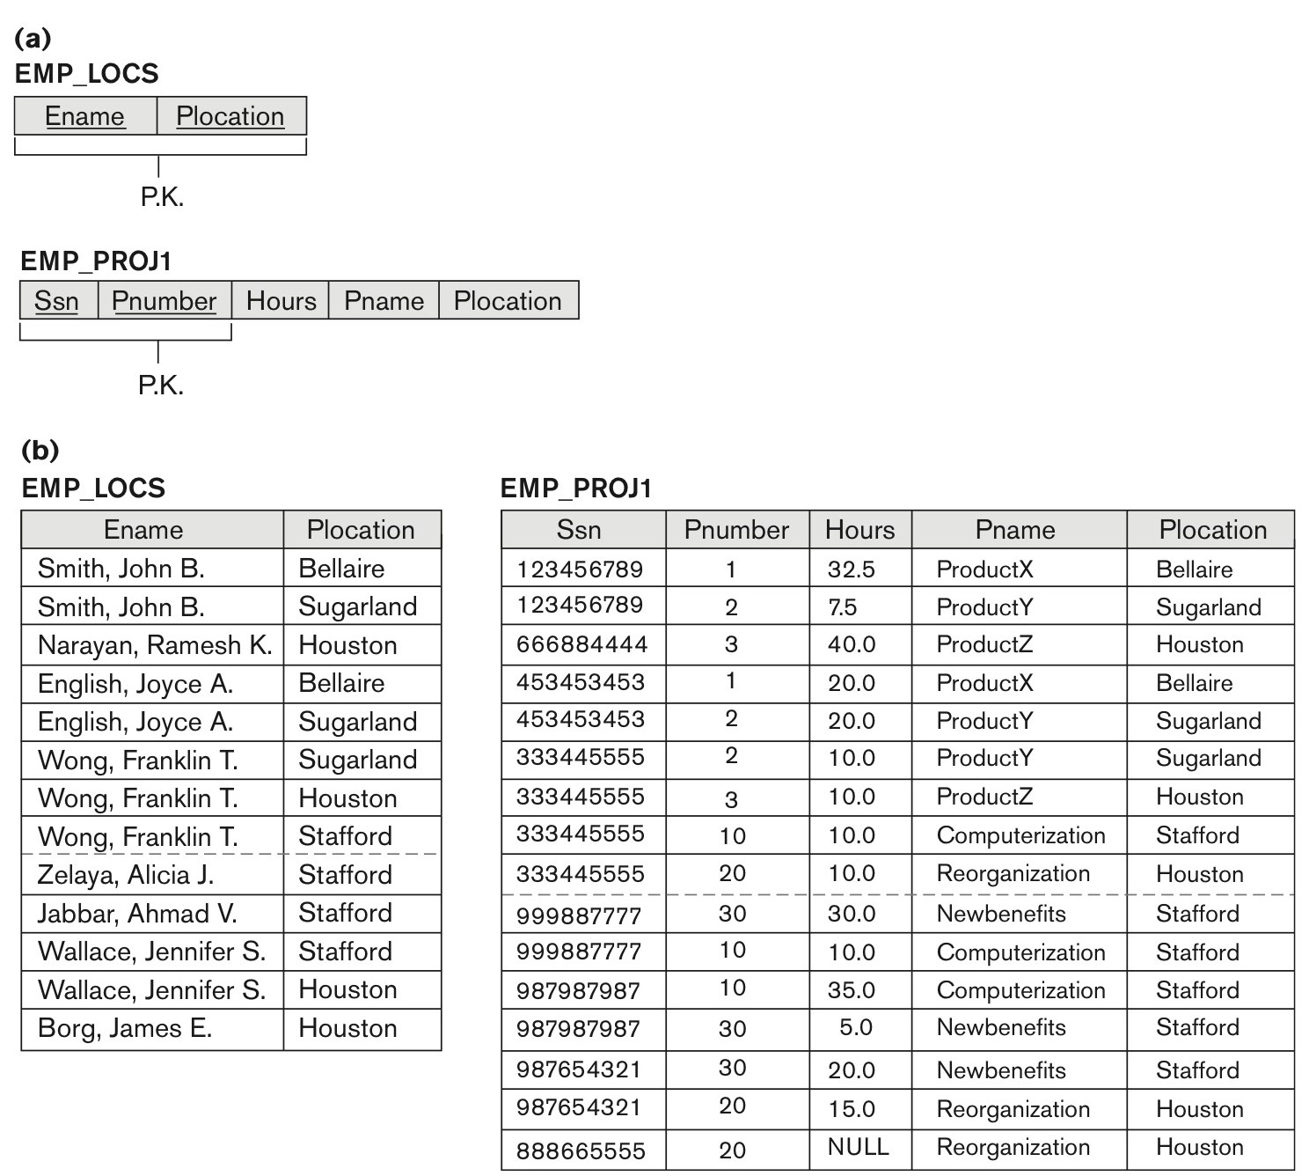
1.4 Generation of Spurious Tuples – avoid at any cost (contd.)
Slide 14- <number>

Slide 20
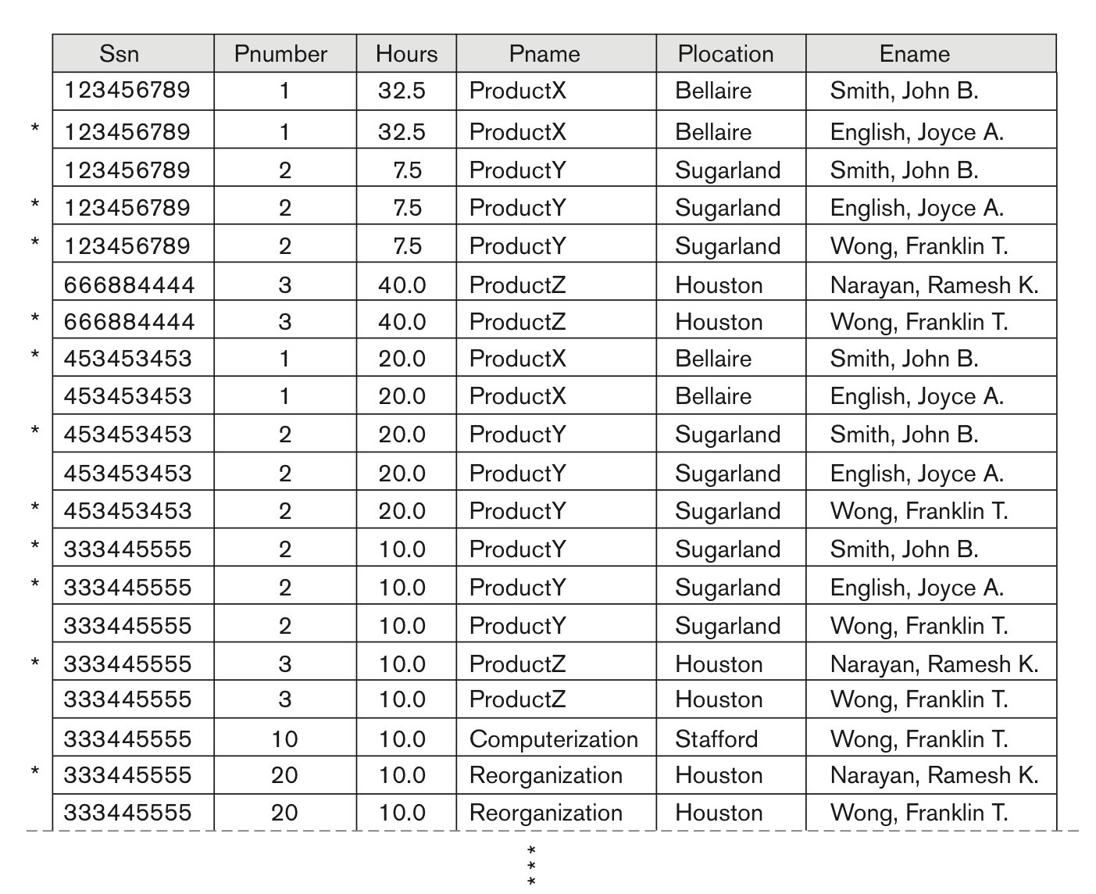
1.4 Generation of Spurious Tuples – avoid at any cost (contd.)
Slide 14- <number>

Slide 21
Spurious Tuples
There are two important properties of decompositions:
  Non-additive or losslessness of the corresponding join
  Preservation of the functional dependencies.
Note that:
  Property (a) is extremely important and cannot be sacrificed.
  Property (b) is less stringent and may be sacrificed. (See Chapter 15).
Slide 14- <number>

Slide 22
2. Functional Dependencies
Functional dependencies (FDs)
  Are used to specify formal measures of the "goodness" of relational designs
  And keys are used to define normal forms for relations
  Are constraints that are derived from the meaning and interrelationships of the data attributes
A set of attributes X functionally determines a set of attributes Y if the value of X determines a unique value for Y
Slide 14- <number>

Slide 23
2.1 Defining Functional Dependencies
X  Y holds if whenever two tuples have the same value for X, they must have the same value for Y
  For any two tuples t1 and t2 in any relation instance r(R): If t1[X]=t2[X], then t1[Y]=t2[Y]
X  Y in R specifies a constraint on all relation instances r(R)
Written as X  Y; can be displayed graphically on a relation schema as in Figures. ( denoted by the arrow: ).
FDs are derived from the real-world constraints on the attributes
Slide 14- <number>

Slide 24
Examples of FD constraints (1)
Social security number determines employee name
  SSN  ENAME
Project number determines project name and location
  PNUMBER  {PNAME, PLOCATION}
Employee ssn and project number determines the hours per week that the employee works on the project
  {SSN, PNUMBER}  HOURS
Slide 14- <number>

Slide 25
Examples of FD constraints (2)
An FD is a property of the attributes in the schema R
The constraint must hold on every relation instance r(R)
If K is a key of R, then K functionally determines all attributes in R
  (since we never have two distinct tuples with t1[K]=t2[K])
Slide 14- <number>

Slide 26
Defining FDs from instances
Note that in order to define the FDs, we need to understand the meaning of the attributes involved and the relationship between them.
An FD is a property of the attributes in the schema R
Given the instance (population) of a relation, all we can conclude is that an FD may exist between certain attributes.
What we can definitely conclude is – that certain FDs do not exist because there are tuples that show a violation of those dependencies.
Slide 14- <number>

Slide 27
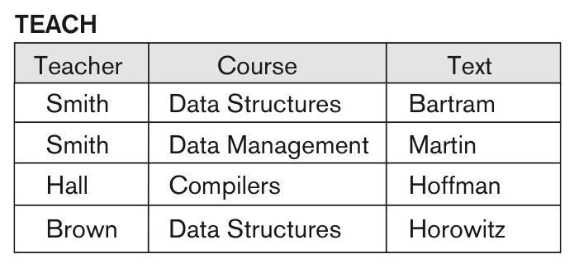
Figure 14.7 Ruling Out FDs
Note that given the state of the TEACH relation, we can say that the FD: Text → Course may exist. However, the FDs Teacher → Course, Teacher → Text and
Couse → Text are ruled out.
Slide 14- <number>

Slide 28
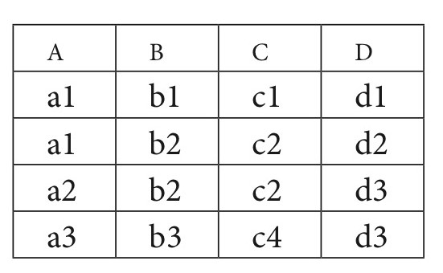
Figure 14.8 What FDs may exist?
A relation R(A, B, C, D) with its extension.
Which FDs may exist in this relation?
Slide 14- <number>
Notes:
YES: B->C, C->B, {A,B}->C, {A,B}->D, {C,D}->B
NO: A->B, B->A, D->C

Slide 29
3 Normal Forms Based on Primary Keys
3.1 Normalization of Relations
3.2 Practical Use of Normal Forms
3.3 Definitions of Keys and Attributes Participating in Keys
3.4 First Normal Form
3.5 Second Normal Form
3.6 Third Normal Form
Slide 14- <number>

Slide 30
3.1 Normalization of Relations (1)
Normalization:
  The process of decomposing unsatisfactory "bad" relations by breaking up their attributes into smaller relations
Normal form:
  Condition using keys and FDs of a relation to certify whether a relation schema is in a particular normal form
Slide 14- <number>

Slide 31
Normalization of Relations (2)
2NF, 3NF, BCNF
  based on keys and FDs of a relation schema
4NF
  based on keys, multi-valued dependencies : MVDs;
5NF
  based on keys, join dependencies : JDs
Additional properties may be needed to ensure a good relational design (lossless join, dependency preservation; see Chapter 15)
Slide 14- <number>

Slide 32
3.2 Practical Use of Normal Forms
Normalization is carried out in practice so that the resulting designs are of high quality and meet the desirable properties
The practical utility of these normal forms (4NF and 5NF) becomes questionable when the constraints on which they are based are hard to understand or to detect
The database designers need not normalize to the highest possible normal form
  2NF is also ok for performance reasons
  usually up to 3NF and BCNF. 4NF rarely used in practice.
Slide 14- <number>

Slide 33
3.3 Definitions of Keys and Attributes Participating in Keys (1)
A superkey of a relation schema R = {A1, A2, ...., An} is a set of attributes S subset-of R with the property that no two tuples t1 and t2 in any legal relation state r of R will have t1[S] = t2[S]
A key K is a superkey with the additional property that removal of any attribute from K will cause K not to be a superkey any more.
Slide 14- <number>

Slide 34
Definitions of Keys and Attributes Participating in Keys (2)
If a relation schema has more than one key, each is called a candidate key.
  One of the candidate keys is arbitrarily designated to be the primary key, and the others are called secondary keys.
A Prime attribute must be a member of some candidate key
A Nonprime attribute is not a prime attribute—that is, it is not a member of any candidate key.
Slide 14- <number>

Slide 35
3.4 First Normal Form
Considered to be part of the formal definition of a relation in the basic (flat) relation model
Disallows
  composite attributes
  multivalued attributes
  nested relations; attributes whose values for an individual tuple are non-atomic
The only attribute values permitted by 1NF are single atomic values
Most RDBMSs allow only those relations to be defined that are in First Normal Form
Slide 14- <number>

Slide 36
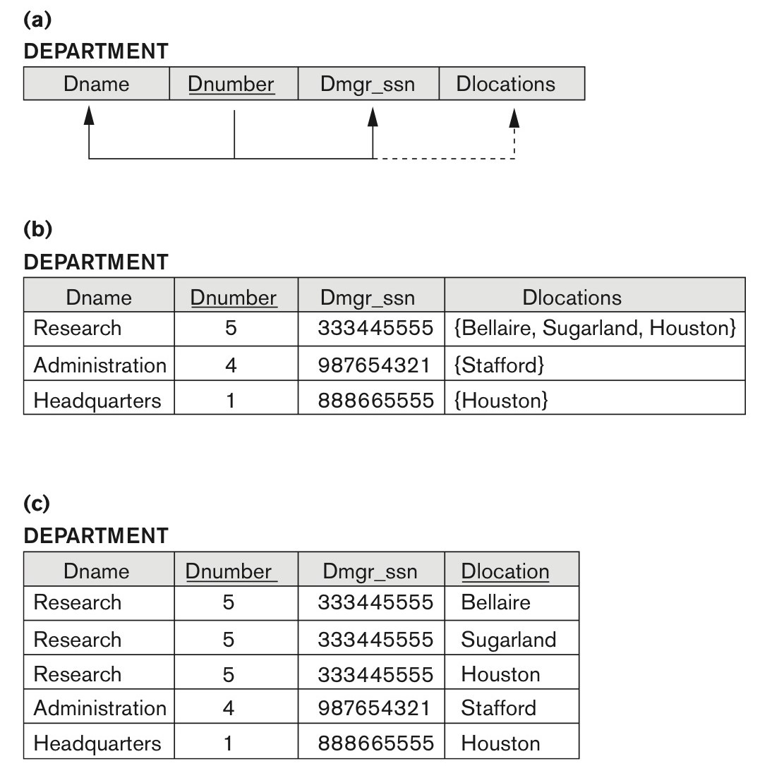
Figure 14.9 Normalization into 1NF
Figure 14.9
Normalization into 1NF. (a) A relation schema that is not in 1NF. (b) Sample state of relation DEPARTMENT. (c) 1NF version of the same relation with redundancy.
Slide 14- <number>

Slide 37

Figure 14.10 Normalizing nested relations into 1NF
Figure 14.10
Normalizing nested relations into 1NF. (a) Schema of the EMP_PROJ relation with a nested relation attribute PROJS. (b) Sample extension of the EMP_PROJ relation showing nested relations within each tuple. (c) Decomposition of EMP_PROJ into relations EMP_PROJ1 and EMP_PROJ2 by propagating the primary key.
Slide 14- <number>

Slide 38
3.5 Second Normal Form (1)
Uses the concepts of FDs, primary key
Definitions
  Prime attribute: An attribute that is member of the primary key K
  Full functional dependency: a FD Y -> Z where removal of any attribute from Y means the FD does not hold any more
Examples:
  {SSN, PNUMBER} -> HOURS is a full FD since neither SSN -> HOURS nor PNUMBER -> HOURS hold
  {SSN, PNUMBER} -> ENAME is not a full FD (it is called a partial dependency ) since SSN -> ENAME also holds
Slide 14- <number>

Slide 39
Second Normal Form (2)
A relation schema R is in second normal form (2NF) if every non-prime attribute A in R is fully functionally dependent on the primary key (FFD)
R can be decomposed into 2NF relations via the process of 2NF normalization or “second normalization”
Slide 14- <number>

Slide 40
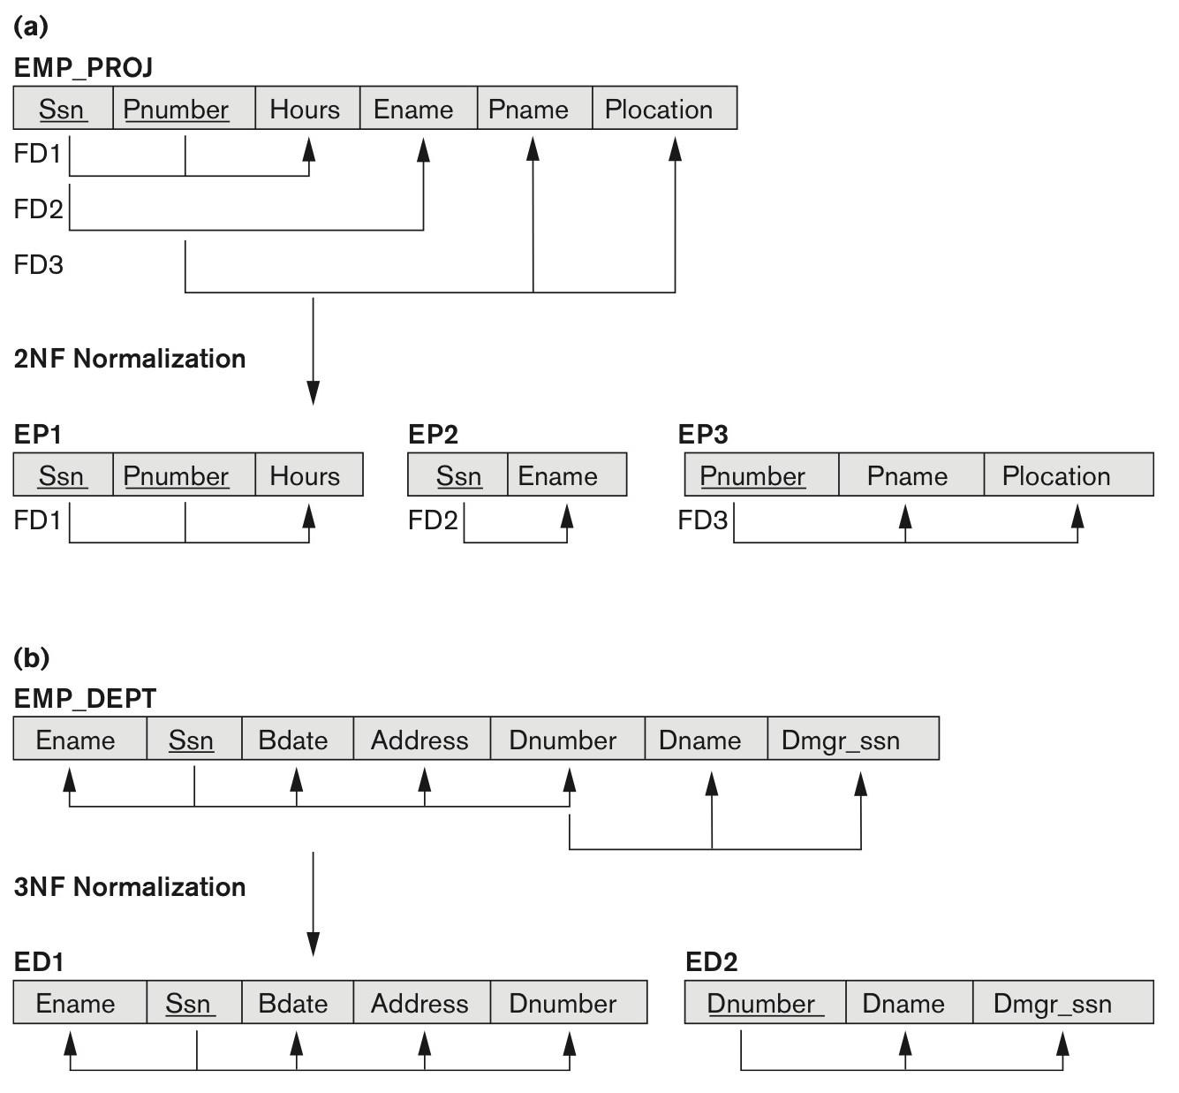
Figure 14.11 Normalizing into 2NF and 3NF
Figure 14.11
Normalizing into 2NF and 3NF. (a) Normalizing EMP_PROJ into 2NF relations. (b) Normalizing EMP_DEPT into 3NF relations.
Slide 14- <number>

Slide 41
3.6 Third Normal Form (1)
Definition:
  Transitive functional dependency: a FD X -> Z that can be derived from two FDs X -> Y and Y -> Z
Examples:
  SSN -> DMGRSSN is a transitive FD
    Since SSN -> DNUMBER and DNUMBER -> DMGRSSN hold
  SSN -> ENAME is non-transitive
    Since there is no set of attributes X where SSN -> X and X -> ENAME
Slide 14- <number>

Slide 42
Third Normal Form (2)
A relation schema R is in third normal form (3NF) if it is in 2NF and no non-prime attribute A in R is transitively dependent on the primary key
R can be decomposed into 3NF relations via the process of 3NF normalization
Slide 14- <number>
Notes:
NOTE:
In X -> Y and Y -> Z, with X as the primary key, we consider this a problem only if Y is not a candidate key.
When Y is a candidate key, there is no problem with the transitive dependency .
E.g., Consider EMP (SSN, Emp#, Salary ).
Here, SSN -> Emp# -> Salary and Emp# is a candidate key.

Slide 43
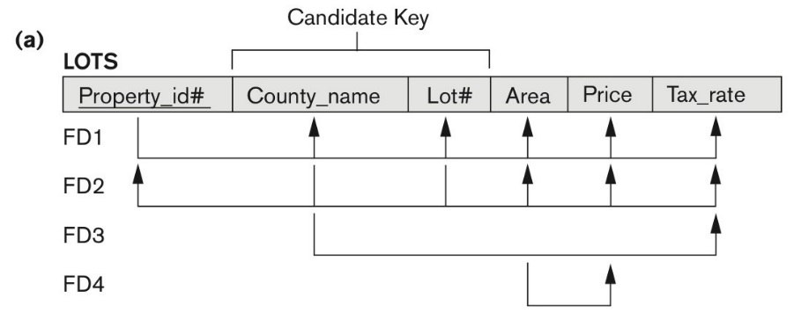
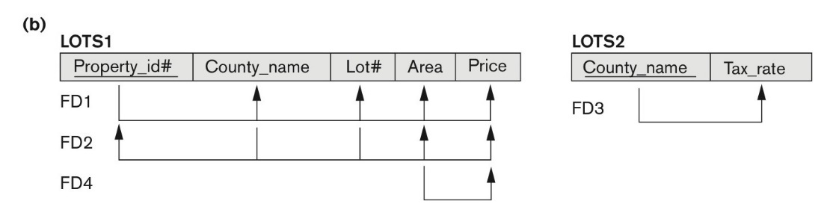
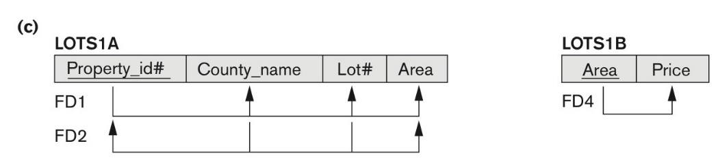
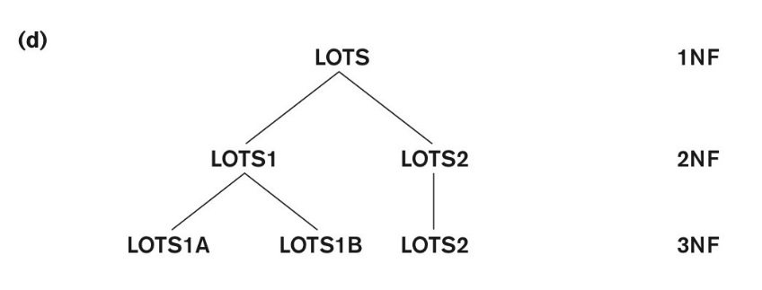
Figure 14.12 Normalization into 2NF and 3NF
Figure 14.12 Normalization into 2NF and 3NF. (a) The LOTS relation with its functional dependencies FD1 through FD4.
(b) Decomposing into the 2NF relations LOTS1 and LOTS2. (c) Decomposing LOTS1 into the 3NF relations LOTS1A and LOTS1B. (d) Progressive normalization of LOTS into a 3NF design.
Slide 14- <number>

Slide 44
Normal Forms Defined Informally
1st normal form
  All attributes depend on the key
2nd normal form
  All attributes depend on the whole key
3rd normal form
  All attributes depend on nothing but the key
Slide 14- <number>

Slide 45
4. General Normal Form Definitions (For Multiple Keys) (1)
The above definitions consider the primary key only
The following more general definitions take into account relations with multiple candidate keys
Any attribute involved in a candidate key is a prime attribute
All other attributes are called non-prime attributes.
Slide 14- <number>

Slide 46
4.1 General Definition of 2NF (For Multiple Candidate Keys)
A relation schema R is in second normal form (2NF) if every non-prime attribute A in R is fully functionally dependent on every key of R
In Figure 14.12 the FD
County_name → Tax_rate violates 2NF.
So second normalization converts LOTS into
LOTS1 (Property_id#, County_name, Lot#, Area, Price)
LOTS2 ( County_name, Tax_rate)
Slide 14- <number>

Slide 47
4.2 General Definition of Third Normal Form
Definition:
  Superkey of relation schema R - a set of attributes S of R that contains a key of R
  A relation schema R is in third normal form (3NF) if whenever a FD X → A holds in R, then either:
    (a) X is a superkey of R, or
    (b) A is a prime attribute of R
LOTS1 relation violates 3NF because
Area→Price ; Area is not a superkey and Price is not a prime attribute in LOTS1. (see Figure 14.12).
Slide 14- <number>

Slide 48
4.3 Interpreting the General Definition of Third Normal Form
Consider the 2 conditions in the Definition of 3NF:
  A relation schema R is in third normal form (3NF) if whenever a FD X → A holds in R, then either:
    (a) X is a superkey of R, or
    (b) A is a prime attribute of R
Condition (a) catches two types of violations :
- one, where a prime attribute functionally determines a non-prime attribute. This catches 2NF violations due to non-full functional dependencies.
-second, where a non-prime attribute functionally determines a non-prime attribute. This catches 3NF violations due to a transitive dependency.
Slide 14- <number>

Slide 49
4.3 Interpreting the General Definition of Third Normal Form (2)
ALTERNATIVE DEFINITION of 3NF: We can restate the definition as:
  A relation schema R is in third normal form (3NF) if every non-prime attribute in R meets both of these conditions:
  It is fully functionally dependent on every key of R
  It is non-transitively dependent on every key of R
  Note that stated this way, a relation in 3NF also meets the requirements for 2NF.
The condition (b) from the last slide takes care of the dependencies that “slip through” (are allowable to) 3NF but are “caught by” BCNF which we discuss next.
Slide 14- <number>

Slide 50
5. BCNF (Boyce-Codd Normal Form)
A relation schema R is in Boyce-Codd Normal Form (BCNF) if whenever an FD X → A holds in R, then X is a superkey of R
Each normal form is strictly stronger than the previous one
  Every 2NF relation is in 1NF
  Every 3NF relation is in 2NF
  Every BCNF relation is in 3NF
There exist relations that are in 3NF but not in BCNF
Hence BCNF is considered a stronger form of 3NF
The goal is to have each relation in BCNF (or 3NF)
Slide 14- <number>

Slide 51
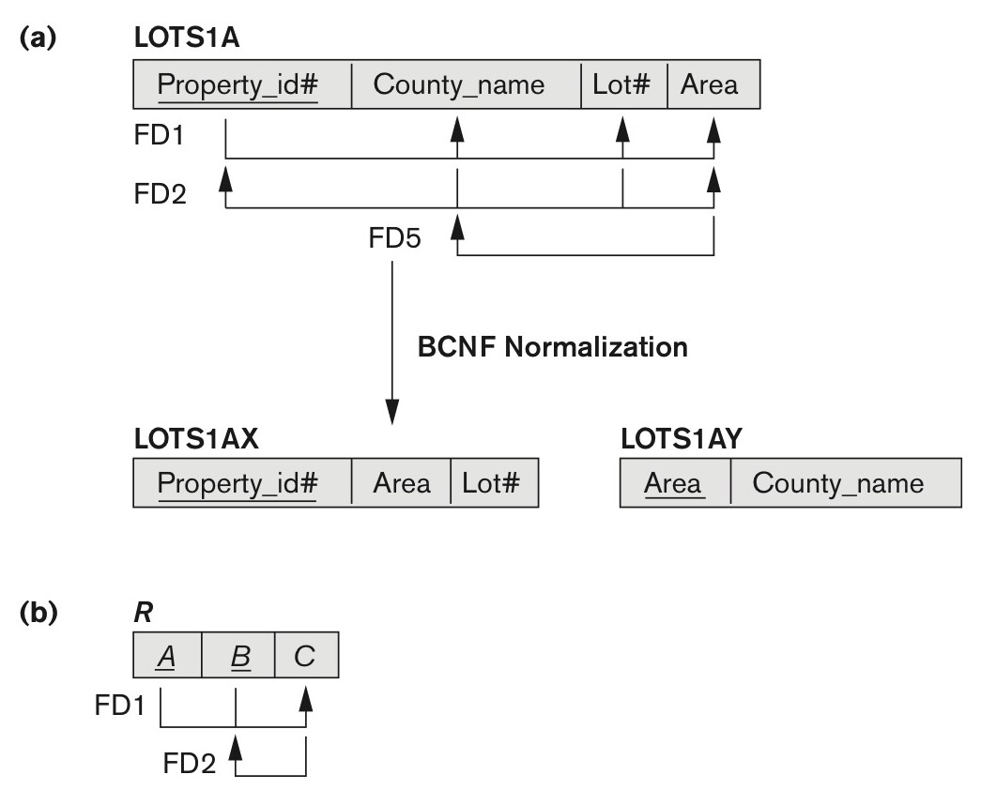
Figure 14.13 Boyce-Codd normal form
Figure 14.13
Boyce-Codd normal form. (a) BCNF normalization of LOTS1A with the functional dependency FD2 being lost in the decomposition. (b) A schematic relation with FDs; it is in 3NF, but not in BCNF due to the f.d. C → B.
Slide 14- <number>

Slide 52

Figure 14.14 A relation TEACH that is in 3NF but not in BCNF
Figure 14.14
A relation TEACH that is in 3NF but not BCNF.
Slide 14- <number>

Slide 53
Achieving the BCNF by Decomposition (1)
Two FDs exist in the relation TEACH:
  fd1: { student, course} → instructor
  fd2: instructor → course
{student, course} is a candidate key for this relation and that the dependencies shown follow the pattern in Figure 14.13 (b).
  So this relation is in 3NF but not in BCNF
A relation NOT in BCNF should be decomposed so as to meet this property, while possibly forgoing the preservation of all functional dependencies in the decomposed relations.
  (See Algorithm 15.3)
Slide 14- <number>

Slide 54
Achieving the BCNF by Decomposition (2)
Three possible decompositions for relation TEACH
  D1: {student, instructor} and {student, course}
  D2: {course, instructor } and {course, student}
  D3: {instructor, course } and {instructor, student} ✓
All three decompositions will lose fd1.
  We have to settle for sacrificing the functional dependency preservation. But we cannot sacrifice the non-additivity property after decomposition.
Out of the above three, only the 3rd decomposition will not generate spurious tuples after join.(and hence has the non-additivity property).
A test to determine whether a binary decomposition (decomposition into two relations) is non-additive (lossless) is discussed under Property NJB on the next slide. We then show how the third decomposition above meets the property.
Slide 14- <number>

Slide 55
Test for checking non-additivity of Binary Relational Decompositions
Testing Binary Decompositions for Lossless Join (Non-additive Join) Property
  Binary Decomposition: Decomposition of a relation R into two relations.
  PROPERTY NJB (non-additive join test for binary decompositions): A decomposition D = {R1, R2} of R has the lossless join property with respect to a set of functional dependencies F on R if and only if either
    The f.d. ((R1 ∩ R2)  (R1- R2)) is in F⁺, or
    The f.d. ((R1 ∩ R2)  (R2 - R1)) is in F⁺.
Slide 14- <number>

Slide 56
Test for checking non-additivity of Binary Relational Decompositions
If you apply the NJB test to the 3 decompositions of the TEACH relation:
D1 gives Student  Instructor or Student  Course, none of which is true.
D2 gives Course  Instructor or Course  Student, none of which is true.
However, in D3 we get Instructor  Course or Instructor  Student.
Since Instructor  Course is indeed true, the NJB property is satisfied and D3 is determined as a non-additive (good) decomposition.
Slide 14- <number>

Slide 57
General Procedure for achieving BCNF when a relation fails BCNF
Here we make use the algorithm from Chapter 15 (Algorithm 15.5):
Let R be the relation not in BCNF, let X be a subset-of R, and let X → A be the FD that causes a violation of BCNF. Then R may be decomposed into two relations:
(i) R –A and (ii) X υ A.
If either R –A or X υ A is not in BCNF, repeat the process.
Note that the f.d. that violated BCNF in TEACH was Instructor →Course. Hence its BCNF decomposition would be :
(TEACH – Course) and (Instructor υ Course), which gives
the relations: (Instructor, Student) and (Instructor, Course) that we obtained before in decomposition D3.
Slide 14- 57
Notes:
TEACH is a relation

Slide 58
5. Multivalued Dependencies and Fourth Normal Form (1)
Definition:
A multivalued dependency (MVD) X —>> Y specified on relation schema R, where X and Y are both subsets of R, specifies the following constraint on any relation state r of R: If two tuples t₁ and t₂ exist in r such that t₁[X] = t₂[X], then two tuples t₃ and t₄ should also exist in r with the following properties, where we use Z to denote (R 2 (X υ Y)):
  t₃[X] = t₄[X] = t₁[X] = t₂[X].
  t₃[Y] = t₁[Y] and t₄[Y] = t₂[Y].
  t₃[Z] = t₂[Z] and t₄[Z] = t₁[Z].
An MVD X —>> Y in R is called a trivial MVD if (a) Y is a subset of X, or (b) X υ Y = R.
Slide 14- 58

Slide 59
Multivalued Dependencies and Fourth Normal Form (3)
Definition:
A relation schema R is in 4NF with respect to a set of dependencies F (that includes functional dependencies and multivalued dependencies) if, for every nontrivial multivalued dependency X —>> Y in F⁺, X is a superkey for R.
  Note: F⁺ is the (complete) set of all dependencies (functional or multivalued) that will hold in every relation state r of R that satisfies F. It is also called the closure of F.
Slide 14- 59

Slide 60
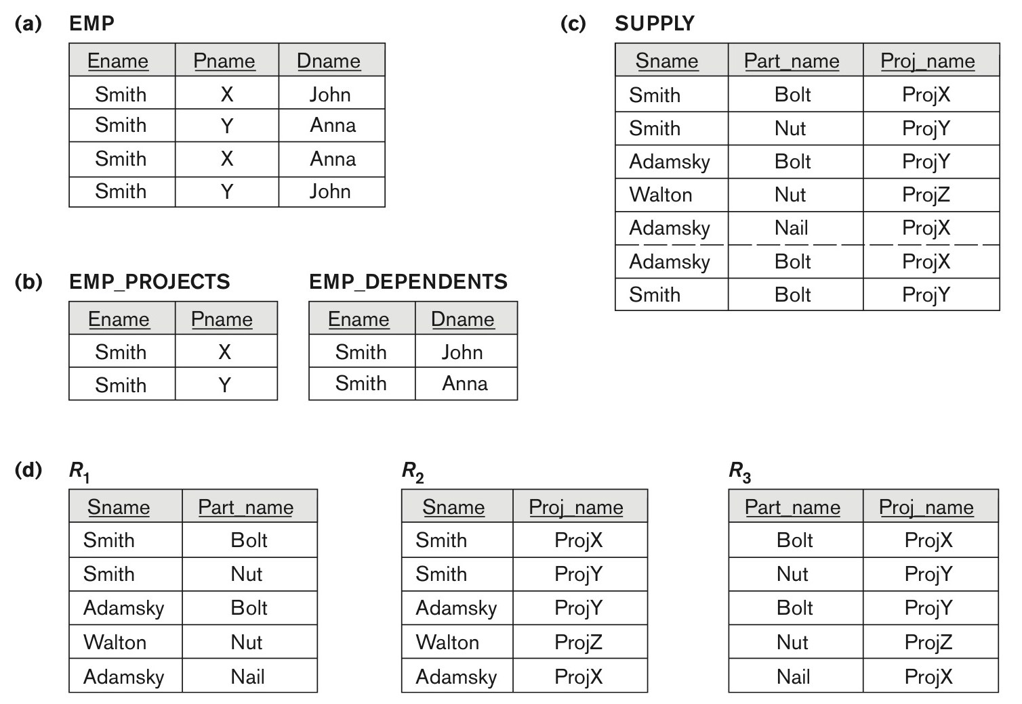
Figure 14.15 Fourth and fifth normal forms.
Figure 14.15
Fourth and fifth normal forms. (a) The EMP relation with two MVDs: Ename –>> Pname and Ename –>> Dname. (b) Decomposing the EMP relation into two 4NF relations EMP_PROJECTS and EMP_DEPENDENTS. (c) The relation SUPPLY with no MVDs is in 4NF but not in 5NF if it has the JD(R1, R2, R3). (d) Decomposing the relation SUPPLY into the 5NF relations R1, R2, R3.
Slide 14- <number>

Slide 61
6. Join Dependencies and Fifth Normal Form (1)
Definition:
A join dependency (JD), denoted by JD(R₁, R₂, ..., R_{n}), specified on relation schema R, specifies a constraint on the states r of R.
  The constraint states that every legal state r of R should have a non-additive join decomposition into R₁, R₂, ..., R_{n}; that is, for every such r we have
  * (π_{R1}(r), π_{R2}(r), ..., π_{Rn}(r)) = r
Note: an MVD is a special case of a JD where n = 2.
A join dependency JD(R₁, R₂, ..., R_{n}), specified on relation schema R, is a trivial JD if one of the relation schemas R_{i} in JD(R₁, R₂, ..., R_{n}) is equal to R.
Slide 14- <number>

Slide 62
Join Dependencies and Fifth Normal Form (2)
Definition:
A relation schema R is in fifth normal form (5NF) (or Project-Join Normal Form (PJNF)) with respect to a set F of functional, multivalued, and join dependencies if,
  for every nontrivial join dependency JD(R₁, R₂, ..., R_{n}) in F⁺ (that is, implied by F),
    every R_{i} is a superkey of R.
Discovering join dependencies in practical databases with hundreds of relations is next to impossible. Therefore, 5NF is rarely used in practice.
Slide 14- <number>

Slide 63
Chapter Summary
Informal Design Guidelines for Relational Databases
Functional Dependencies (FDs)
Normal Forms (1NF, 2NF, 3NF)Based on Primary Keys
General Normal Form Definitions of 2NF and 3NF (For Multiple Keys)
BCNF (Boyce-Codd Normal Form)
Fourth and Fifth Normal Forms
Slide 14- <number>

