Slide 1
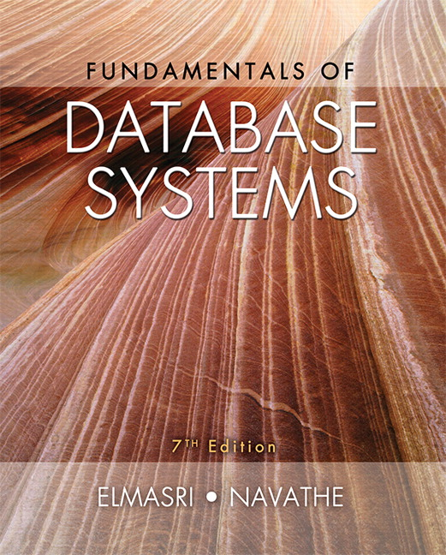

Slide 2
CHAPTER 15
Relational Database Design Algorithms and Further Dependencies

Slide 3
Chapter Outline
1. Further topics in Functional Dependencies
1.1 Inference Rules for FDs
1.2 Equivalence of Sets of FDs
1.3 Minimal Sets of FDs
2. Properties of Relational Decompositions
3. Algorithms for Relational Database Schema Design
4. Nulls, Dangling Tuples, Alternative Relational Designs

Slide 4
Chapter Outline
5. Multivalued Dependencies and Fourth Normal Form – further discussion
6. Other Dependencies and Normal Forms
6.1 Join Dependencies
6.2 Inclusion Dependencies
6.3 Dependencies based on Arithmetic Functions and Procedures
6.2 Domain-Key Normal Form

Slide 5
1. Functional Dependencies : Inference Rules, Equivalence and Minimal Cover
We discussed functional dependencies in the last chapter.
To recollect:
A set of attributes X functionally determines a set of attributes Y if the value of X determines a unique value for Y.
Our goal here is to determine the properties of functional dependencies and to find out the ways of manipulating them.

Slide 6
Defining Functional Dependencies
X → Y holds if whenever two tuples have the same value for X, they must have the same value for Y
For any two tuples t1 and t2 in any relation instance r(R): If t1[X]=t2[X], then t1[Y]=t2[Y]
X → Y in R specifies a constraint on all relation instances r(R)
Written as X → Y; can be displayed graphically on a relation schema as in Figures in Chapter 14. ( denoted by the arrow: ).
FDs are derived from the real-world constraints on the attributes

Slide 7
1.1 Inference Rules for FDs (1)
Definition: An FD X → Y is inferred from or implied by a set of dependencies F specified on R if X → Y holds in every legal relation state r of R; that is, whenever r satisfies all the dependencies in F, X → Y also holds in r.
Given a set of FDs F, we can infer additional FDs that hold whenever the FDs in F hold

Slide 8
Inference Rules for FDs (2)
Armstrong's inference rules:
IR1. (Reflexive) If Y subset-of X, then X → Y
IR2. (Augmentation) If X → Y, then XZ → YZ
(Notation: XZ stands for X U Z)
IR3. (Transitive) If X → Y and Y → Z, then X → Z
IR1, IR2, IR3 form a sound and complete set of inference rules
These are rules hold and all other rules that hold can be deduced from these
Notes:
Sound: any dependency inferred from F by using IR1-IR3 holds
Complete: by repeating making new dependencies, we can complete F

Slide 9
Inference Rules for FDs (3)
Proof of IR1
Suppose that X ⊇ Y and that two tuples t₁ and t₂ exist in some relation instance r of R such that t₁[X] = t₂[X]. Then t₁[Y] = t₂ [Y] because X ⊇ Y; hence, X→Y must hold in r
Proof of IR2 (by contradiction)
Assume that X→Y holds in a relation instance r of R but that XZ → YZ does not hold. Then there must exist two tuples t₁ and t₂ in r such that (1) t₁[X] = t₂[X], (2) t₁[Y] = t₂[Y], (3) t₁[XZ] = t₂[XZ], and (4) t₁[YZ] ≠ t₂[YZ]. This is not possible because from (1) and (3) we deduce (5) t₁[Z] = t₂[Z], and from (2) and (5) we deduce (6) t₁[YZ] = t₂[YZ], contradicting (4)
Proof of IR3
Assume that (1) X→Y and (2) Y→Z both hold in a relation r. Then for any two tuples t₁ and t₂ in r such that t₁[X] = t₂[X], we must have (3) t₁[Y] = t₂ [Y], from assumption (1); hence we must also have (4) t₁[Z] = t₂ [Z] from (3) and assumption (2); thus X→Z must hold in r.

Slide 10
Inference Rules for FDs (4)
Some additional inference rules that are useful:
Decomposition (IR4): If X → YZ, then X → Y and X → Z
Union (IR5): If X → Y and X → Z, then X → YZ
Psuedotransitivity (IR6): If X → Y and WY → Z, then WX → Z
The last three inference rules, as well as any other inference rules, can be deduced from IR1, IR2, and IR3 (completeness property)

Slide 11
Inference Rules for FDs (5)
Proof of IR5 (If X → Y and X → Z, then X → YZ)
1. X→Y (given)
2. X→Z (given)
3. X→XY (using IR2 on 1 by augmenting with X; notice that XX=X)
4. XY→YZ (using IR2 on 2 by augmenting with Y)
5. X→YZ (using IR3 on 3 and 4)

Slide 12
Closure
Closure of a set F of FDs is the set F⁺ of all FDs that can be inferred from F
Closure of a set of attributes X with respect to F is the set X⁺ of all attributes that are functionally determined by X
X⁺ can be calculated by repeatedly applying IR1, IR2, IR3 using the FDs in F

Slide 13
Algorithm to determine Closure
Algorithm 15.1. Determining X⁺, the Closure of X under F
Input: A set F of FDs on a relation schema R, and a set of attributes X, which is a subset of R.
X⁺ := X;
repeat
oldX⁺ := X⁺;
for each functional dependency Y → Z in F do
if X⁺ ⊇ Y then X⁺ := X⁺ ∪ Z;
until (X⁺ = oldX⁺);
Notes:
If Y (left hand side) belongs to X+, then add Z (right hand side) to X+.

Slide 14
Example of Closure (1)
For example, consider the following relation schema about classes held at a university in a given academic year.
CLASS ( Classid, Course#, Instr_name, Credit_hrs, Text, Publisher, Classroom, Capacity).
Let F, the set of functional dependencies for the above relation include the following f.d.s:
FD1: Classid → Course#, Instr_name, Credit_hrs, Text, Publisher, Classroom, Capacity;
FD2: Course# → Credit_hrs;
FD3: {Course#, Instr_name} → Text, Classroom;
FD4: Text → Publisher
FD5: Classroom → Capacity
These f.d.s above represent the meaning of the individual attributes and the relationship among them and defines certain rules about the classes.

Slide 15
Example of Closure (2)
The closures of attributes or sets of attributes for some example sets:
{ Classid } ⁺ = { Classid , Course#, Instr_name, Credit_hrs, Text, Publisher, Classroom, Capacity } = CLASS
{ Course#} ⁺ = { Course#, Credit_hrs}
{ Course#, Instr_name } ⁺ = { Course#, Credit_hrs, Text, Publisher, Classroom, Capacity }
Note that each closure above has an interpretation that is revealing about the attribute(s) on the left-hand-side. The closure of { Classid } ⁺ is the entire relation CLASS indicating that all attributes of the relation can be determined from Classid and hence it is a key.

Slide 16
1.2 Equivalence of Sets of FDs
Definition (Covers):
F covers G if every FD in G can be inferred from F
G is covered by F
(i.e., if G⁺ subset-of F⁺)
Two sets of FDs F and G are equivalent if F⁺ =G⁺ :
Therefore,
Every FD in F can be inferred from G, and
Every FD in G can be inferred from F
F and G are equivalent if F covers G and G covers F
There is an algorithm for checking equivalence of sets of FDs

Slide 17
1.2 Equivalence of Sets of FDs (contd.)
How to determine F covers G
By calculating X⁺ with respect to F for each FD X→Y in G
Then checking whether this X⁺ includes the attributes in Y
If this is the case for every FD in G, then F covers G
How to determine F and G are equivalent
By checking F covers G and G covers F
Example
F = {A→C, AC→D, E→AD, E→H}
G = {A→CD, E→AH}

Slide 18
1.3 Finding Minimal Cover of F.D.s (1)
Just as we applied inference rules to expand on a set F of FDs to arrive at F⁺, its closure, it is possible to think in the opposite direction to see if we could shrink or reduce the set F to its minimal form so that the minimal set is still equivalent to the original set F.
Definition: An attribute in a functional dependency is considered extraneous attribute if we can remove it without changing the closure of the set of dependencies. Formally, given F, the set of functional dependencies and a functional dependency X → A in F , attribute Y is extraneous in X if Y is a subset of X, and F logically implies (F- (X → A) ∪ { (X – Y) → A } )

Slide 19
Minimal Sets of FDs (2)
A set of FDs is minimal if it satisfies the following conditions:
Every dependency in F has a single attribute for its RHS.
We cannot remove any dependency from F and have a set of dependencies that is equivalent to F.
We cannot replace any dependency X → A in F with a dependency Y → A, where Y is a proper-subset-of X and still have a set of dependencies that is equivalent to F.

Slide 20
Minimal Sets of FDs (3)
Algorithm 15.2. Finding a Minimal Cover F for a Set of Functional Dependencies E
Input: A set of functional dependencies E.
Set F:=E.
(step1) Replace each functional dependency X → {A1, A2, ..., An} in F by the n functional dependencies X →A1, X →A2, ..., X → An.
(step2) For each functional dependency X → A in F for each attribute B that is an element of X if { {F – {X → A} } ∪ { (X – {B} ) → A} } is equivalent to F then replace X → A with (X – {B} ) → A in F.
(* The above constitutes a removal of the extraneous attribute B from X *)
(step3) For each remaining functional dependency X → A in F if {F – {X → A} } is equivalent to F, then remove X → A from F.
(* The above constitutes a removal of the redundant dependency X → A from F *)

Slide 21
Computing the Minimal Sets of FDs (4)
We illustrate algorithm 15.2 with the following:
Let the given set of FDs be E : {B → A, D → A, AB → D}.We have to find the minimum
cover of E.
■ All above dependencies are in canonical form; so we have completed step 1
of Algorithm 15.2 and can proceed to step 2. In step 2 we need to determine
if AB → D has any redundant attribute on the left-hand side; that is, can it be
replaced by B → D or A → D?
■ Since B → A, by augmenting with B on both sides (IR2), we have BB → AB, or
B → AB (i). However, AB → D as given (ii).
■ Hence by the transitive rule (IR3), we get from (i) and (ii), B → D. Hence
AB → D may be replaced by B → D.
■ We now have a set equivalent to original E , say E′ : {B → A, D → A, B → D}.
No further reduction is possible in step 2 since all FDs have a single attribute
on the left-hand side.
■ In step 3 we look for a redundant FD in E′. By using the transitive rule on
B → D and D → A, we derive B → A. Hence B → A is redundant in E’ and can
be eliminated.
■ Hence the minimum cover of E is {B → D, D → A}.

Slide 22
Minimal Sets of FDs (5)
Every set of FDs has an equivalent minimal set
There can be several equivalent minimal sets
There is no simple algorithm for computing a minimal set of FDs that is equivalent to a set F of FDs. The process of Algorithm 15.2 is used until no further reduction is possible.
To synthesize a set of relations, we assume that we start with a set of dependencies that is a minimal set
E.g., see algorithm 15.4

Slide 23
DESIGNING A SET OF RELATIONS (1)
The Approach of Relational Synthesis (Bottom-up Design):
Assumes that all possible functional dependencies are known.
First constructs a minimal set of FDs
Then applies algorithms that construct a target set of 3NF or BCNF relations.
Additional criteria may be needed to ensure the the set of relations in a relational database are satisfactory (see Algorithm 15.3).

Slide 24
DESIGNING A SET OF RELATIONS (2)
Goals:
Lossless join property (a must)
Algorithm 15.3 tests for general losslessness.
Dependency preservation property
Observe as much as possible
Algorithm 15.5 decomposes a relation into BCNF components by sacrificing the dependency preservation.
Additional normal forms
4NF (based on multi-valued dependencies)
5NF (based on join dependencies)

Slide 25
Algorithm to determine the key of a relation
Algorithm 15.2a Finding a Key K for R, given a set F of Functional Dependencies
Input: A universal relation R and a set of functional dependencies F on the attributes of R.
1. Set K := R;
2. For each attribute A in K {
Compute (K - A)⁺ with respect to F;
If (K - A)⁺ contains all the attributes in R,
then set K := K - {A};
}

Slide 26
2. Properties of Relational Decompositions (1)
Relation Decomposition and Insufficiency of Normal Forms:
Universal Relation Schema:
A relation schema R = {A1, A2, …, An} that includes all the attributes of the database.
Universal relation assumption:
Every attribute name is unique.

Slide 27
Properties of Relational Decompositions (2)
2.1 Relation Decomposition and Insufficiency of Normal Forms (cont.):
Decomposition:
The process of decomposing the universal relation schema R into a set of relation schemas D = {R₁,R₂, …, R_{m}} that will become the relational database schema by using the functional dependencies.
Attribute preservation condition:
Each attribute in R will appear in at least one relation schema R_{i} in the decomposition so that no attributes are “lost”.

Slide 28
Properties of Relational Decompositions (3)
Another goal of decomposition is to have each individual relation R_{i} in the decomposition D be in BCNF or 3NF.
Additional properties of decomposition are needed to prevent from generating spurious tuples (Non-additive (Lossless) Join Property)

Slide 29
Properties of Relational Decompositions (4)
2.2 Dependency Preservation Property of a Decomposition:
Definition: Given a set of dependencies F on R, the projection of F on R_{i}, denoted by p_{Ri}(F) where R_{i} is a subset of R, is the set of dependencies X  Y in F⁺ such that the attributes in X υ Y are all contained in R_{i}.
Hence, the projection of F on each relation schema R_{i} in the decomposition D is the set of functional dependencies in F⁺, the closure of F, such that all their left- and right-hand-side attributes are in R_{i}.

Slide 30
Properties of Relational Decompositions (5)
Dependency Preservation Property of a Decomposition (cont.):
Dependency Preservation Property:
A decomposition D = {R1, R2, ..., Rm} of R is dependency-preserving with respect to F if the union of the projections of F on each R_{i} in D is equivalent to F; that is ((π_{R1}(F)) υ . . . υ (π_{Rm}(F)))⁺ = F⁺
(See examples in Fig 14.13a (N) and Fig 14.12 (Y))
Claim 1:
It is always possible to find a dependency-preserving decomposition D with respect to F such that each relation R_{i} in D is in 3NF.

Slide 31
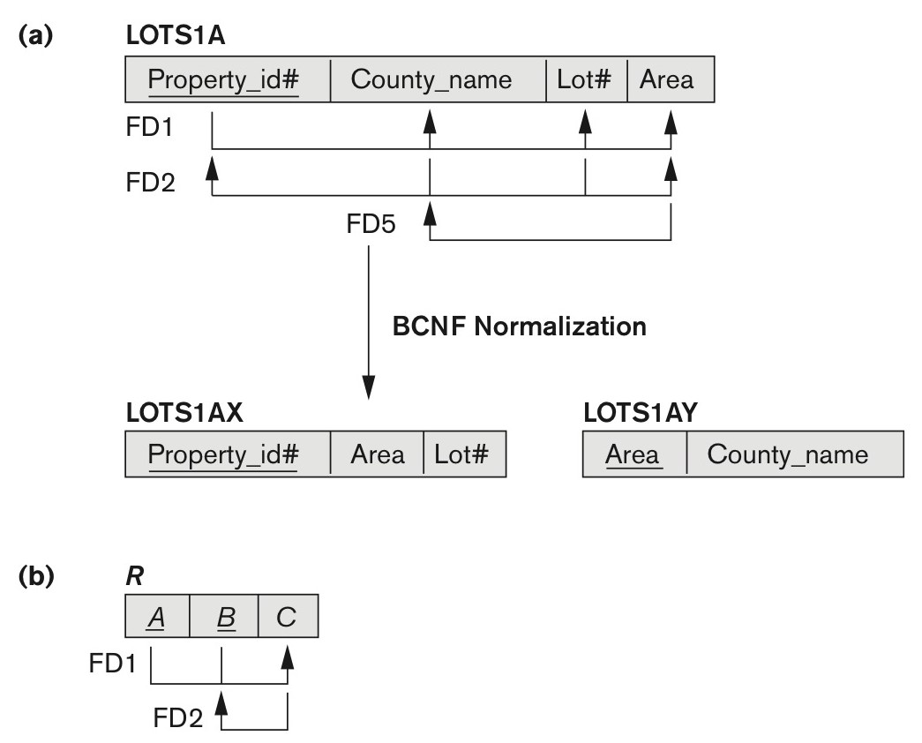
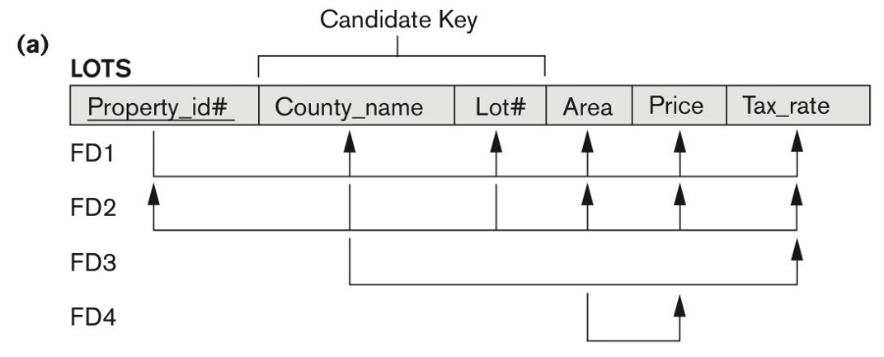
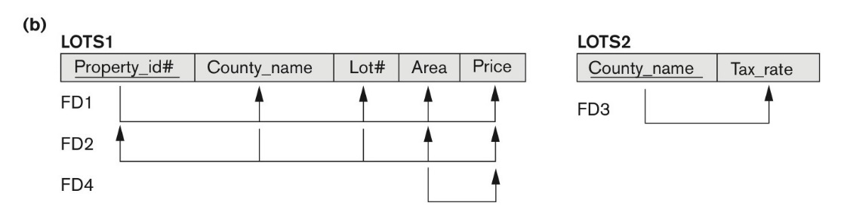
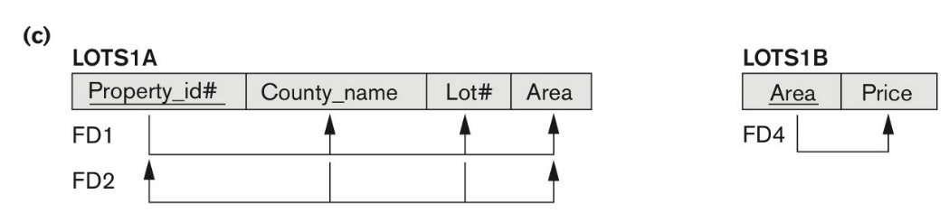
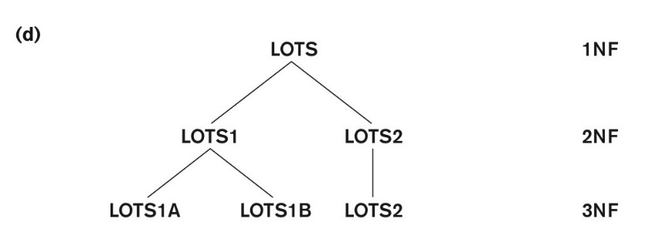
Fig 14.13 and 12

Slide 32
Properties of Relational Decompositions (6)
2.3 Non-additive (Lossless) Join Property of a Decomposition:
Definition: Lossless join property: a decomposition D = {R1, R2, ..., Rm} of R has the lossless (nonadditive) join property with respect to the set of dependencies F on R if, for every relation state r of R that satisfies F, the following holds, where * is the natural join of all the relations in D:
* (π _{R1}(r), ..., π_{Rm}(r)) = r
Note: The word loss in lossless refers to loss of information, not to loss of tuples. In fact, for “loss of information” a better term is “addition of spurious information”

Slide 33
Properties of Relational Decompositions (7)
Lossless (Non-additive) Join Property of a Decomposition :
Algorithm 15.3: Testing for Lossless Join Property
Input: A universal relation R, a decomposition D = {R₁, R₂, ..., R_{m}} of R, and a set F of functional dependencies.
1. Create an initial matrix S with one row i for each relation R_{i} in D, and one column j for each attribute A_{j} in R.
2. Set S(i,j):=b_{ij} for all matrix entries. (* each b_{ij} is a distinct symbol associated with indices (i,j) *).
3. For each row i representing relation schema R_{i}
{for each column j representing attribute A_{j}
{if (relation R_{i} includes attribute A_{j}) then set S(i,j):= a_{j};};};
(* each a_{j} is a distinct symbol associated with index (j) *)
CONTINUED on NEXT SLIDE

Slide 34
Properties of Relational Decompositions (8)
Lossless (Non-additive) Join Property of a Decomposition (cont.):
Algorithm 15.3: Testing for Lossless Join Property (continued)
4. Repeat the following loop until a complete loop execution results in no changes to S
{for each functional dependency X Y in F
{for all rows in S which have the same symbols in the columns corresponding to attributes in X
{make the symbols in each column that correspond to an attribute in Y be the same in all these rows as follows:
If any of the rows has an “a” symbol for the column, set the other rows to that same “a” symbol in the column.
If no “a” symbol exists for the attribute in any of the rows, choose one of the “b” symbols that appear in one of the rows for the attribute and set the other rows to that same “b” symbol in the column ;};
};
};
5. If a row is made up entirely of “a” symbols, then the decomposition has the lossless join property; otherwise it does not.

Slide 35
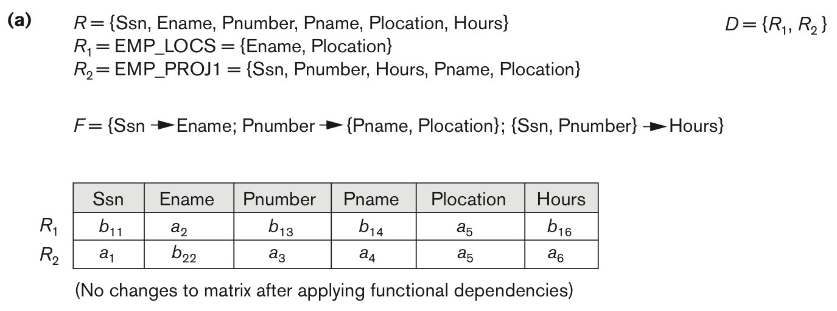
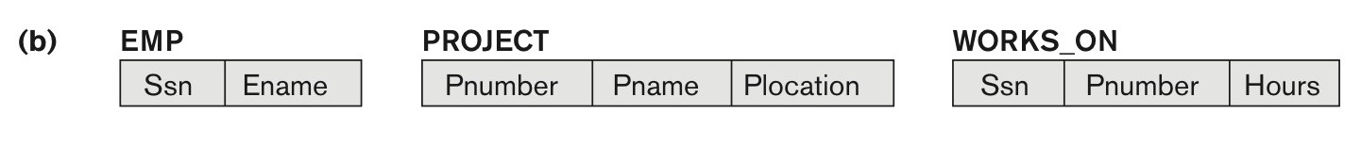
Properties of Relational Decompositions (9)
Figure 15.1 Nonadditive join test for n-ary decompositions.
(a) Case 1: Decomposition of EMP_PROJ into EMP_PROJ1 and EMP_LOCS fails test.
(b) A decomposition of EMP_PROJ that has the lossless join property.

Slide 36
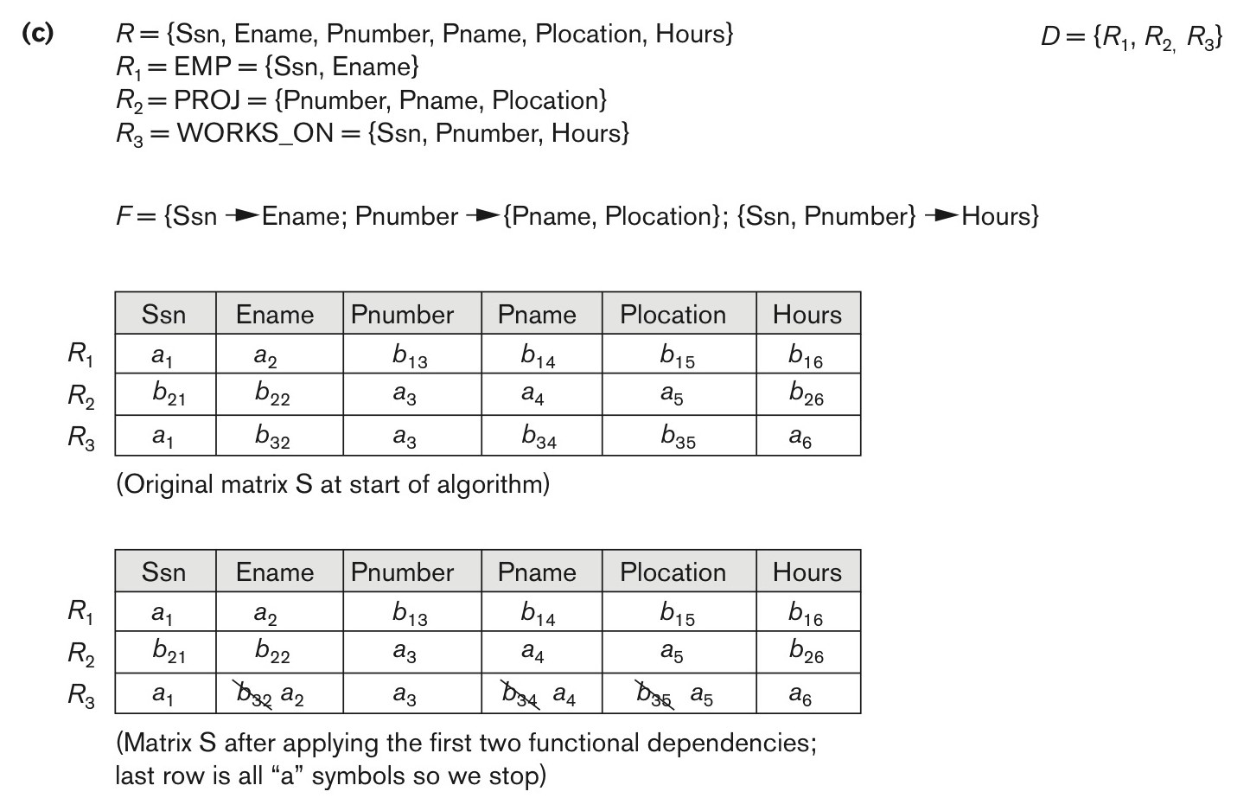
Properties of Relational Decompositions (10)
Nonadditive join test for n-ary decompositions. (Figure 15.1) (c) Case 2: Decomposition of EMP_PROJ into EMP, PROJECT, and WORKS_ON satisfies test.

Slide 37
Test for checking non-additivity of Binary Relational Decompositions (11)
2.4 Testing Binary Decompositions for Non-additive Join (Lossless Join) Property
Binary Decomposition: Decomposition of a relation R into two relations.
PROPERTY NJB (non-additive join test for binary decompositions): A decomposition D = {R1, R2} of R has the lossless join property with respect to a set of functional dependencies F on R if and only if either
The f.d. ((R1 ∩ R2)  (R1- R2)) is in F⁺, or
The f.d. ((R1 ∩ R2)  (R2 - R1)) is in F⁺.

Slide 38
Properties of Relational Decompositions (12)
2.5 Successive Non-additive Join Decomposition:
Claim 2 (Preservation of non-additivity in successive decompositions):
If a decomposition D = {R1, R2, ..., Rm} of R has the lossless (non-additive) join property with respect to a set of functional dependencies F on R,
and if a decomposition Di = {Q1, Q2, ..., Qk} of Ri has the lossless (non-additive) join property with respect to the projection of F on Ri,
then the decomposition D2 = {R1, R2, ..., Ri-1, Q1, Q2, ..., Qk, Ri+1, ..., Rm} of R has the non-additive join property with respect to F.

Slide 39
3. Algorithms for Relational Database Schema Design (1)
Design of 3NF Schemas:
Algorithm 15.4 Relational Synthesis into 3NF with Dependency Preservation and Non-Additive (Lossless) Join Property
Input: A universal relation R and a set of functional dependencies F on the attributes of R.
1. Find a minimal cover G for F (use Algorithm 15.2).
2. For each left-hand-side X of a functional dependency that appears in G,
create a relation schema in D with attributes {X υ {A1} υ {A2} ... υ {Ak}},
where X  A1, X  A2, ..., X –>Ak are the only dependencies in G with X as left-hand-side (X is the key of this relation).
3. If none of the relation schemas in D contains a key of R, then create one more relation schema in D that contains attributes that form a key of R. (Use Algorithm 15.2a to find the key of R)

Slide 40
3. Algorithms for Relational Database Schema Design (1) – contd.
Design of 3NF Schemas:
4. Eliminate redundant relations from the resulting set of relations in the relational database schema. A relation R is considered redundant if R is a projection of another relation S in the schema; alternatively, R is subsumed by S.
Example
Universal Relation (E,P,S,H,D,N,L)
Functional Dependencies
FD1: E -> {S,H,D}, FD2: P->{N,L}, FD3: {E,P}->{S,H,D,N,L}
1. Minimal cover
P is an extraneous attribute from FD3₁ {E,P}->{S,H,D} => FD1
E is an extraneous attribute in FD3₂ {E,P}->{N,L} => FD2
So the minimal cover G={FD1, FD2}
2. R1(E,S,H,D), R2(P,N,L)
3. Since there is no key in either R1 and R2, add one more relation
R3(E,P)
Therefore, R1(E,S,H,D), R2(P,N,L), R3(E,P)

Slide 41
Algorithms for Relational Database Schema Design (2)
Design of BCNF Schemas
Algorithm 15.5: Relational Decomposition into BCNF with Lossless (non-additive) join property
Input: A universal relation R and a set of functional dependencies F on the attributes of R.
1. Set D := {R};
2. While there is a relation schema Q in D that is not in BCNF
do {
choose a relation schema Q in D that is not in BCNF;
find a functional dependency X  Y in Q that violates BCNF;
replace Q in D by two relation schemas (Q - Y) and (X υ Y);
};
Assumption: No null values are allowed for the join attributes.

Slide 42
Algorithms for Relational Database Schema Design (2) – contd.
Design of BCNF Schemas
Algorithm 15.5: Example
D(N,B,A,M,V)
F={N->A, N->V, B->M}
Key = {N,B}
1) N->A violates BCNF
Q = D(N,B,A,M,V)
Q₁(N,A) and Q₂(N,B,M,V)
2) N->V violates BCNF from Q₂
Q₂₁(N,V) and Q₂₂(N,B,M)
3) B->M violates BCNF from Q₂₂
Q₂₂₁(B,M) and Q₂₂₂(N,B)
Now the decomposition D = {Q₁, Q₂₁, Q₂₂₁, Q₂₂₂}

Slide 43
4. Problems with Null Values and Dangling Tuples (1)
4.1 Problems with NULL values
when some tuples have NULL values for attributes that will be used to join individual relations in the decomposition that may lead to incomplete results.
E.g., see Figure 15.2(a), where two relations EMPLOYEE and DEPARTMENT are shown. The last two employee tuples—‘Berger’ and ‘Benitez’—represent newly hired employees who have not yet been assigned to a department (assume that this does not violate any integrity constraints).
If we want to retrieve a list of (Ename, Dname) values for all the employees. If we apply the NATURAL JOIN operation on EMPLOYEE and DEPARTMENT (Figure 15.2(b)), the two aforementioned tuples will not appear in the result.
In such cases, LEFT OUTER JOIN may be used. The result is shown in Figure 15.2 (c).
.

Slide 44
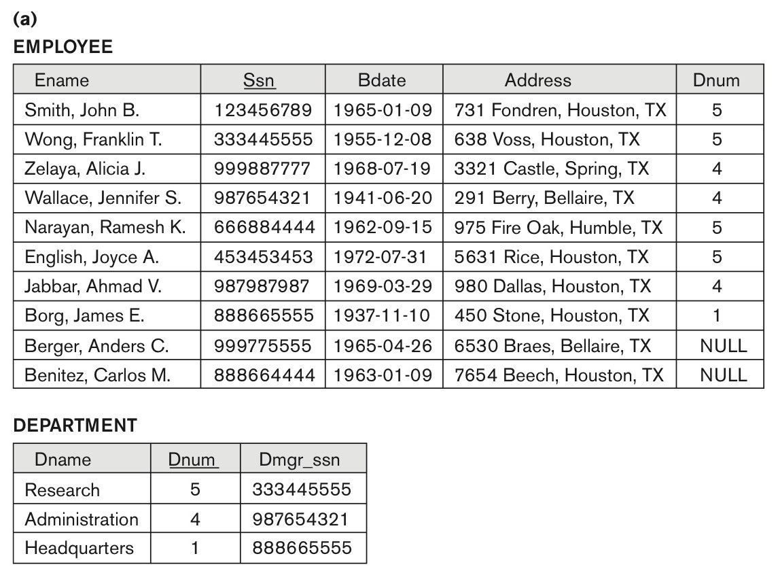
Problems with Null Values and Dangling Tuples (2)
Figure 15.2
Issues with NULL-value joins. (a) Some EMPLOYEE tuples have NULL for the join attribute Dnum.

Slide 45
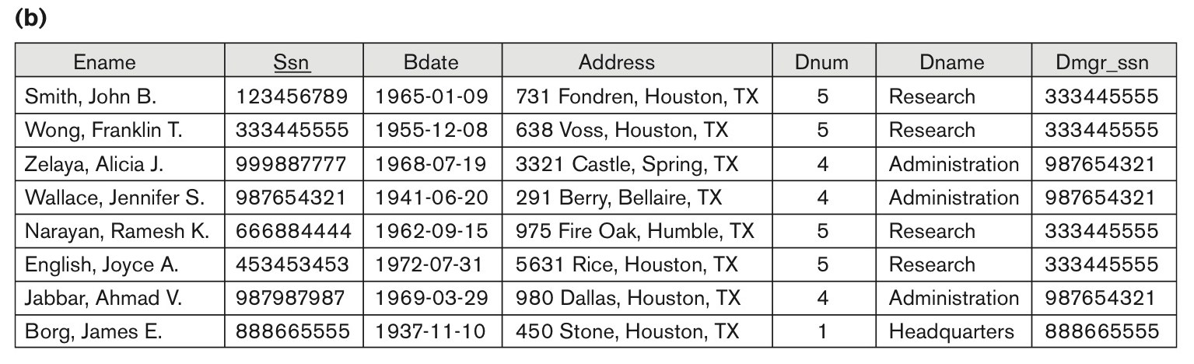
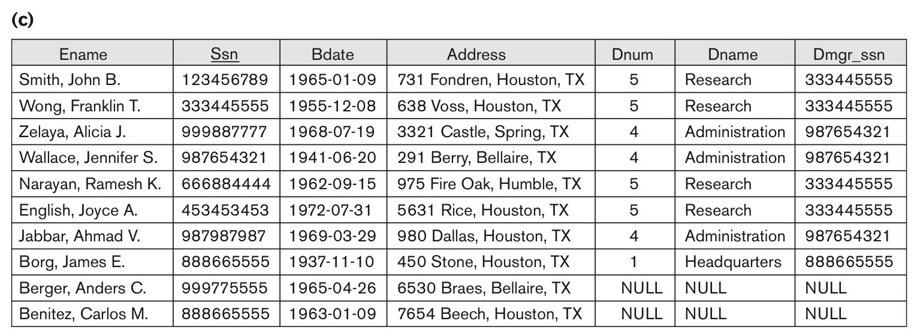
Problems with Null Values and Dangling Tuples (3)
Figure 15.2
Issues with NULL-value joins.
(b) Result of applying NATURAL JOIN to the EMPLOYEE and DEPARTMENT relations.
(c) Result of applying LEFT OUTER JOIN to EMPLOYEE and DEPARTMENT

Slide 46
Problems with Null Values and Dangling Tuples (4)
Problems with Dangling Tuples
Consider the decomposition of EMPLOYEE into EMPLOYEE_1 and EMPLOYEE_2 as shown in Figure 15.3 (a) and !5.3 (b).
Their NATURAL JOIN yields the original relation EMPLOYEE in Figure 15.2(a).
We may use the alternative representation, shown in Figure 15.3(c), where we do not include a tuple in EMPLOYEE_3 if the employee has not been assigned a department (instead of including a tuple with NULL for Dnum as in EMPLOYEE_2).
If we use EMPLOYEE_3 instead of EMPLOYEE_2 and apply a NATURAL JOIN on EMPLOYEE_1 and EMPLOYEE_3, the tuples for Berger and Benitez will not appear in the result; these are called dangling tuples in EMPLOYEE.

Slide 47
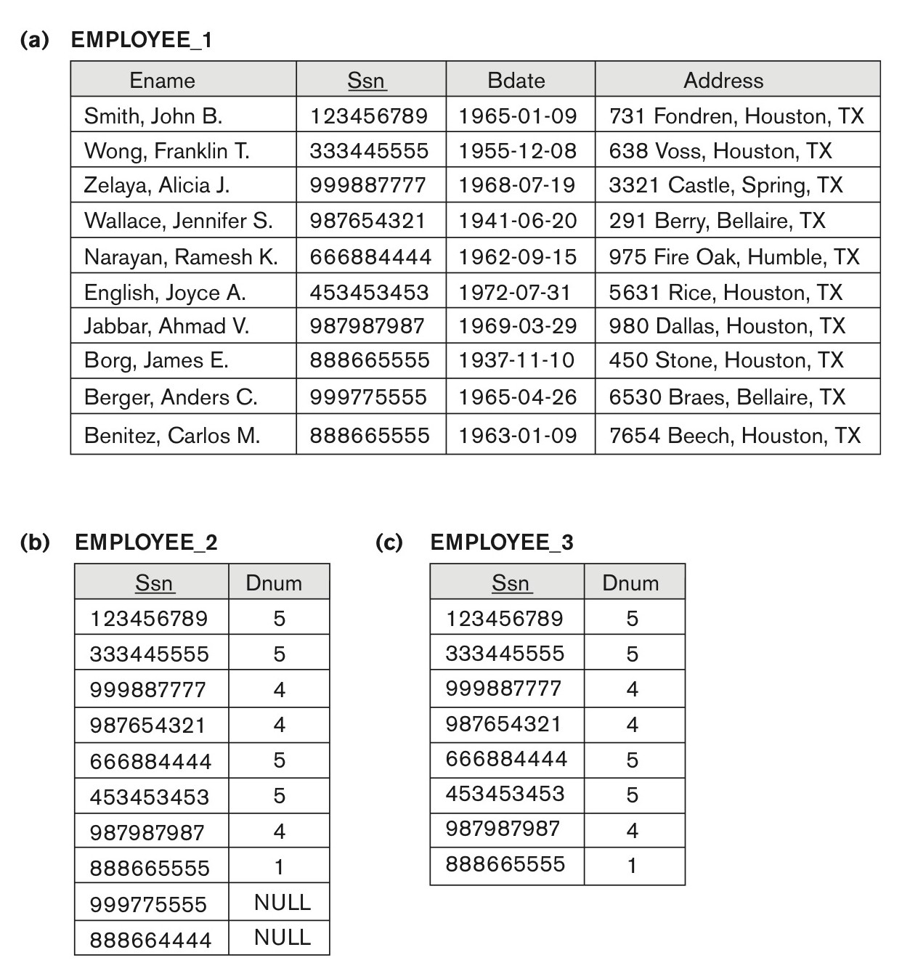
Problems with Null Values and Dangling Tuples (5)
Figure 15.3
The dangling tuple problem. (a) The relation EMPLOYEE_1 (includes all attributes of EMPLOYEE from Figure 15.2(a) except Dnum). (b) The relation EMPLOYEE_2 (includes Dnum attribute with NULL values). (c) The relation EMPLOYEE_3 (includes Dnum attribute but does not include tuples for which Dnum has NULL values).

Slide 48
About Normalization Algorithms
4.2 Discussion of Normalization Algorithms:
Problems:
The database designer must first specify all the relevant functional dependencies among the database attributes.
These algorithms are not deterministic in general.
It is not always possible to find a decomposition into relation schemas that preserves dependencies and allows each relation schema in the decomposition to be in BCNF (instead of 3NF as in Algorithm 15.5).

Slide 49
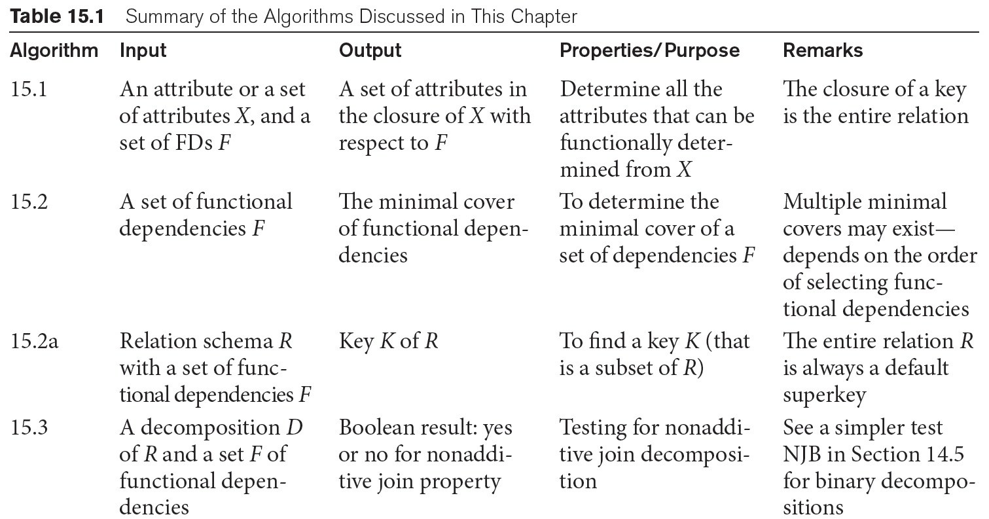
Summary of Algorithms for Relational Database Schema Design (1)

Slide 50
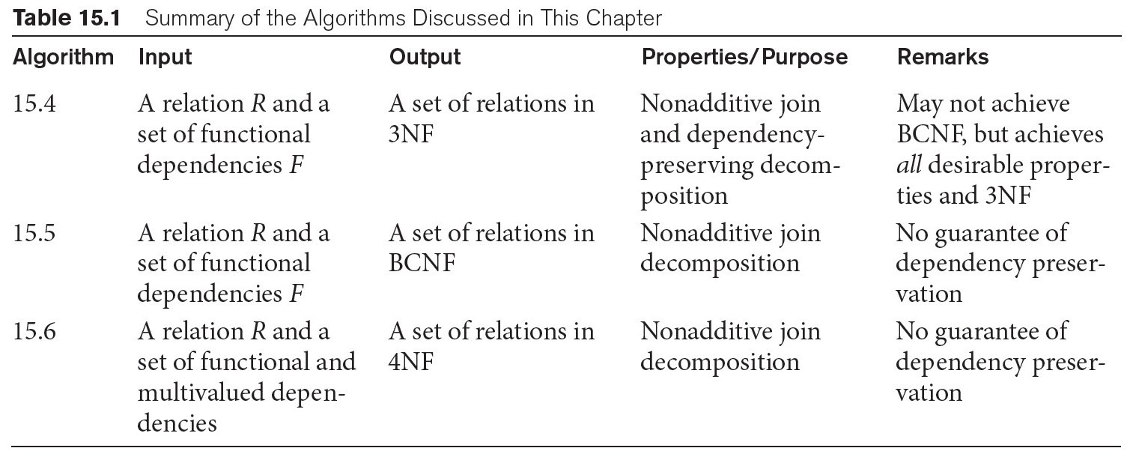
Summary of Algorithms for Relational Database Schema Design (2)

Slide 51
5. Multivalued Dependencies and Fourth Normal Form – Further Discussion (1)
Definition:
A multivalued dependency (MVD) X —>> Y specified on relation schema R, where X and Y are both subsets of R, specifies the following constraint on any relation state r of R: If two tuples t₁ and t₂ exist in r such that t₁[X] = t₂[X], then two tuples t₃ and t₄ should also exist in r with the following properties, where we use Z to denote (R 2 (X υ Y)):
t₃[X] = t₄[X] = t₁[X] = t₂[X].
t₃[Y] = t₁[Y] and t₄[Y] = t₂[Y].
t₃[Z] = t₂[Z] and t₄[Z] = t₁[Z].
An MVD X —>> Y in R is called a trivial MVD if (a) Y is a subset of X, or (b) X υ Y = R.

Slide 52
Multivalued Dependencies and Fourth Normal Form (2)
Inference Rules for Functional and Multivalued Dependencies:
IR1 (reflexive rule for FDs): If X ⊇ Y, then X → Y.
IR2 (augmentation rule for FDs): {X → Y} ⏐= XZ → YZ.
IR3 (transitive rule for FDs): {X → Y, Y → Z} ⏐= X → Z.
IR4 (complementation rule for MVDs): {X —>> Y} ⏐= X —>> (R – (X ∪ Y))}.
IR5 (augmentation rule for MVDs): If X —>> Y and W ⊇ Z then WX —>> YZ.
IR6 (transitive rule for MVDs): {X —>> Y, Y —>> Z} ⏐= X —>> (Z - Y).
IR7 (replication rule for FD to MVD): {X –> Y} ⏐= X —>> Y.
IR8 (coalescence rule for FDs and MVDs): If X —>> Y and there exists W with the properties that
(a) W ∩ Y is empty, (b) W –> Z, and (c) Y ⊇ Z, then X –> Z.

Slide 53
Multivalued Dependencies and Fourth Normal Form (3)
Definition:
A relation schema R is in 4NF with respect to a set of dependencies F (that includes functional dependencies and multivalued dependencies) if, for every nontrivial multivalued dependency X —>> Y in F⁺, X is a superkey for R.
Note: F⁺ is the (complete) set of all dependencies (functional or multivalued) that will hold in every relation state r of R that satisfies F. It is also called the closure of F.

Slide 54
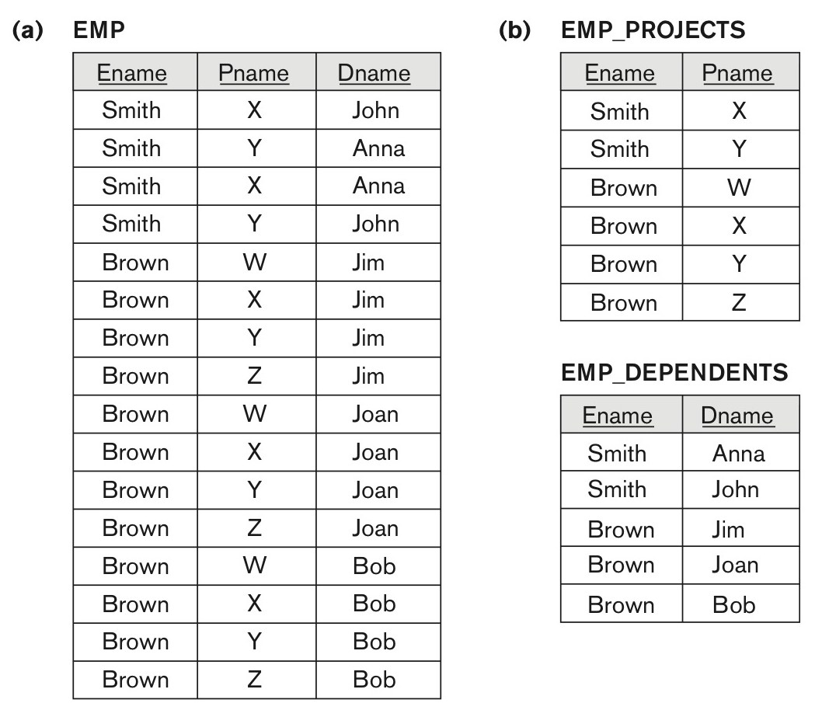
Multivalued Dependencies and Fourth Normal Form (4)
Fig. 15.4 Decomposing a relation state of EMP that is not in 4NF.
(a) EMP relation with additional tuples.
(b) Two corresponding 4NF relations EMP_PROJECTS and EMP_DEPENDENTS.

Slide 55
Multivalued Dependencies and Fourth Normal Form (5)
5.3 Non-additive( Lossless) Join Decomposition into 4NF Relations:
PROPERTY NJB’
The relation schemas R₁ and R₂ form a lossless (non-additive) join decomposition of R with respect to a set F of functional and multivalued dependencies if and only if
(R₁ ∩ R₂) —>> (R₁ - R₂)
or by symmetry, if and only if
(R₁ ∩ R₂) —>> (R₂ - R₁)).

Slide 56
Multivalued Dependencies and Fourth Normal Form (6)
Algorithm 15.7: Relational decomposition into 4NF relations with non-additive join property
Input: A universal relation R and a set of functional and multivalued dependencies F.
Set D := { R };
While there is a relation schema Q in D that is not in 4NF do {
choose a relation schema Q in D that is not in 4NF;
find a nontrivial MVD X —>> Y in Q that violates 4NF;
replace Q in D by two relation schemas (Q - Y) and (X ∪ Y);
};

Slide 57
6. Other Dependencies and Normal Forms
Join Dependency was defined in Chapter 14:
Definition:
A join dependency (JD), denoted by JD(R₁, R₂, ..., R_{n}), specified on relation schema R, specifies a constraint on the states r of R.
The constraint states that every legal state r of R should have a non-additive join decomposition into R₁, R₂, ..., R_{n}; that is, for every such r we have * (π_{R1}(r), π_{R2}(r), ..., π_{Rn}(r)) = r
Note: an MVD is a special case of a JD where n = 2.
A join dependency JD(R₁, R₂, ..., R_{n}), specified on relation schema R, is a trivial JD if one of the relation schemas R_{i} in JD(R₁, R₂, ..., R_{n}) is equal to R.

Slide 58
Join Dependencies and Fifth Normal Form
Definition of 5NF:
A relation schema R is in fifth normal form (5NF) (or Project-Join Normal Form (PJNF)) with respect to a set F of functional, multivalued, and join dependencies if,
for every nontrivial join dependency JD(R₁, R₂, ..., R_{n}) in F⁺ (that is, implied by F),
every R_{i} is a superkey of R.
Discovering join dependencies in practical databases with hundreds of relations is next to impossible. Therefore, 5NF is rarely used in practice.

Slide 59
Inclusion Dependencies (1)
Definition:
An inclusion dependency R.X < S.Y between two sets of attributes—X of relation schema R, and Y of relation schema S—specifies the constraint that, at any specific time when r is a relation state of R and s a relation state of S, we must have
π_{X}(r(R)) ⊆ π_{Y}(s(S))
Note:
The ⊆ (subset) relationship does not necessarily have to be a proper subset.
The sets of attributes on which the inclusion dependency is specified—X of R and Y of S—must have the same number of attributes.
In addition, the domains for each pair of corresponding attributes should be compatible.

Slide 60
Inclusion Dependencies (2)
Objective of Inclusion Dependencies:
To formalize two types of interrelational constraints which cannot be expressed using F.D.s or MVDs:
Referential integrity constraints
Class/subclass relationships
Inclusion dependency inference rules
IDIR1 (reflexivity): R.X < R.X.
IDIR2 (attribute correspondence): If R.X < S.Y
where X = {A₁, A₂ ,..., A_{n}} and Y = {B₁, B₂, ..., B_{n}} and A_{i} Corresponds-to B_{i}, then R.A_{i} < S.B_{i}
for 1 ≤ i ≤ n.
IDIR3 (transitivity): If R.X < S.Y and S.Y < T.Z, then R.X < T.Z.

Slide 61
Functional Dependencies based on Arithmetic functions and procedures (1)
Arithmetic Functions:
As long as a unique value of Y is associated with every X, we can still consider that the FD X → Y exists.
For example,consider the relation:
ORDER_LINE (Order#, Item#, Quantity, Unit_price, Extended_price, Discounted_price)
each tuple represents an item from an order with a particular quantity, and the price per unit for that item. In this relation,
(Quantity, Unit_price ) → Extended_price by the formula
Extended_price = Quantity * Unit_price .
Hence, there is a unique value for Extended_price for every pair (Quantity, Unit_price ), and thus it conforms to the definition of functional dependency.

Slide 62
Functional Dependencies based on Arithmetic functions and procedures (2)
Procedures:
There may be a procedure that takes into account the quantity discounts, the type of item, and so on and computes a discounted price for the total quantity ordered for that item. Therefore, we can say
(Item#, Quantity, Unit_price ) → Discounted_price, or
(Item#, Quantity, Extended_price) → Discounted_price.

Slide 63
Other Dependencies and Normal Forms (3)
6.4 Domain-Key Normal Form (DKNF):
Definition:
A relation schema is said to be in DKNF if all constraints and dependencies that should hold on the valid relation states can be enforced simply by enforcing the domain constraints and key constraints on the relation.
The idea is to specify (theoretically, at least) the “ultimate normal form” that takes into account all possible types of dependencies and constraints. .
For a relation in DKNF, it becomes very straightforward to enforce all database constraints by simply checking that each attribute value in a tuple is of the appropriate domain and that every key constraint is enforced.
The practical utility of DKNF is limited

Slide 64
Recap
Functional Dependencies Revisited
Designing a Set of Relations by Synthesis
Properties of Relational Decompositions
Algorithms for Relational Database Schema Design in 3Nf and BCNF
Multivalued Dependencies and Fourth Normal Form
Other Dependencies and Normal Forms

