Slide 1
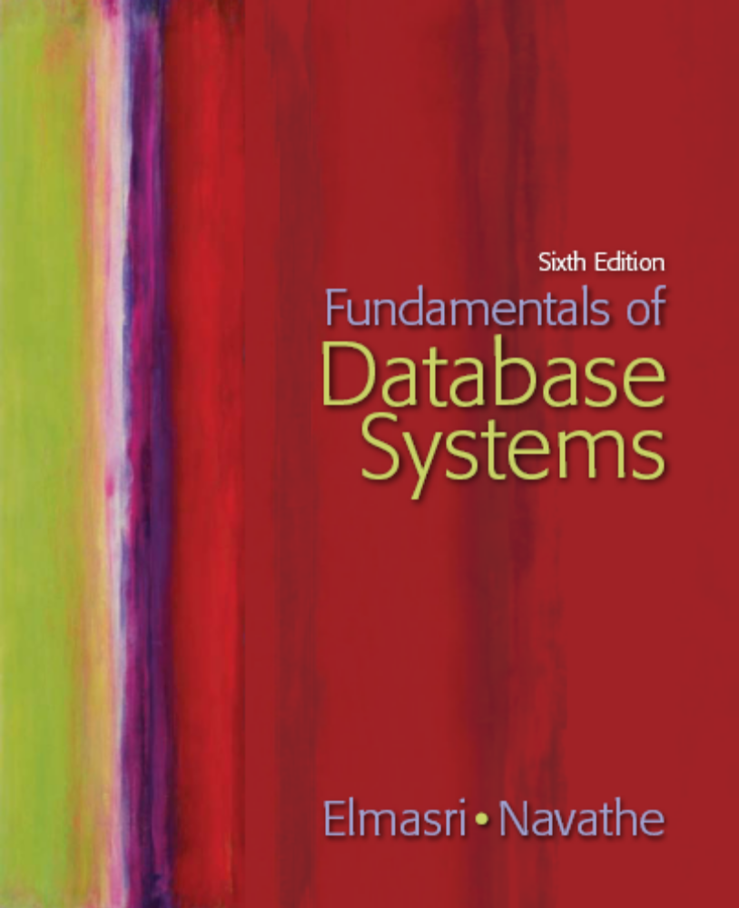
Slide 16- <number>

Slide 2
Chapter 16
Disk Storage, Basic File Structures, and Hashing
Copyright © 2007 Pearson Education, Inc. Publishing as Pearson Addison-Wesley

Slide 3
Chapter Outline
Disk Storage Devices
Files of Records
Operations on Files
Unordered Files
Ordered Files
Hashed Files
  Dynamic and Extendible Hashing Techniques
RAID Technology
Slide 16- <number>

Slide 4
Disk Storage Devices
Preferred secondary storage device for high storage capacity and low cost.
Data stored as magnetized areas on magnetic disk surfaces.
A disk pack contains several magnetic disks connected to a rotating spindle.
Disks are divided into concentric circular tracks on each disk surface.
  Track capacities vary typically from 4 to 50 Kbytes or more
Slide 16- <number>

Slide 5
Disk Storage Devices (contd.)
A track is divided into smaller blocks or sectors
  because it usually contains a large amount of information
The division of a track into sectors is hard-coded on the disk surface and cannot be changed.
  One type of sector organization calls a portion of a track that subtends a fixed angle at the center as a sector.
A track is divided into blocks.
  The block size B is fixed for each system.
    Typical block sizes range from B=512 bytes to B=4096 bytes.
  Whole blocks are transferred between disk and main memory for processing.
Slide 16- <number>

Slide 6
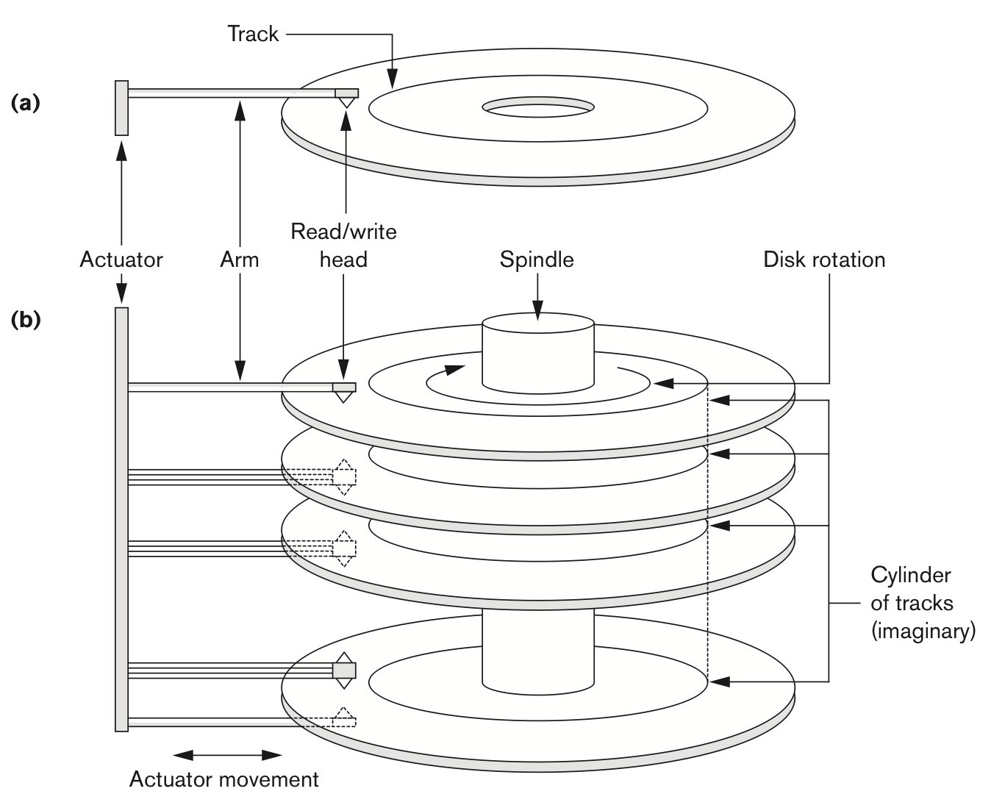
Figure 16.1 (a) A single-sided disk with read/write hardware. (b) A disk pack with read/write hardware.
Slide 16- <number>

Slide 7
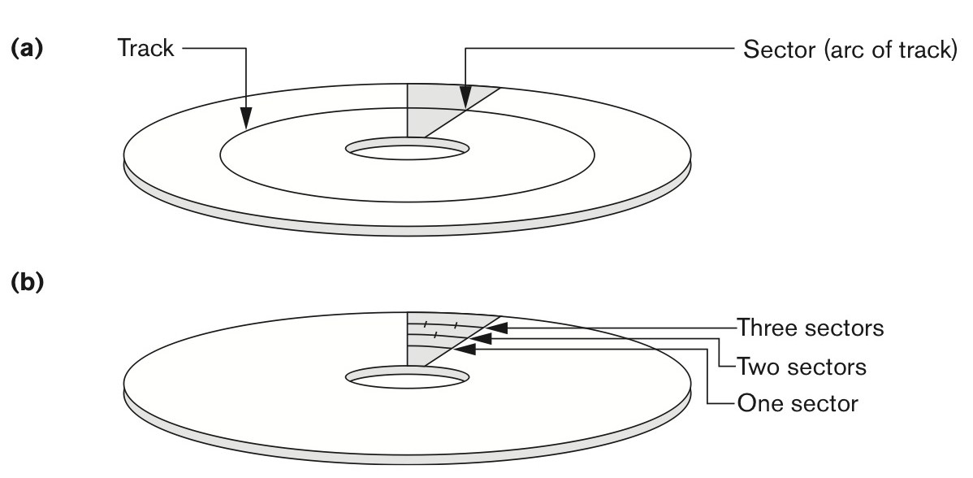
Figure 16.2 Different sector organizations on disk. (a) Sectors subtending a fixed angle. (b) Sectors maintaining a uniform recording density.
Slide 16- <number>

Slide 8
Disk Storage Devices (contd.)
A read-write head moves to the track that contains the block to be transferred.
  Disk rotation moves the block under the read-write head for reading or writing.
A physical disk block (hardware) address consists of:
  a cylinder number (imaginary collection of tracks of same radius from all recorded surfaces)
  the track number or surface number (within the cylinder)
  and block number (within track).
Reading or writing a disk block is time consuming because of the seek time s and rotational delay (latency) rd.
Double buffering can be used to speed up the transfer of contiguous disk blocks.
Slide 16- <number>

Slide 9
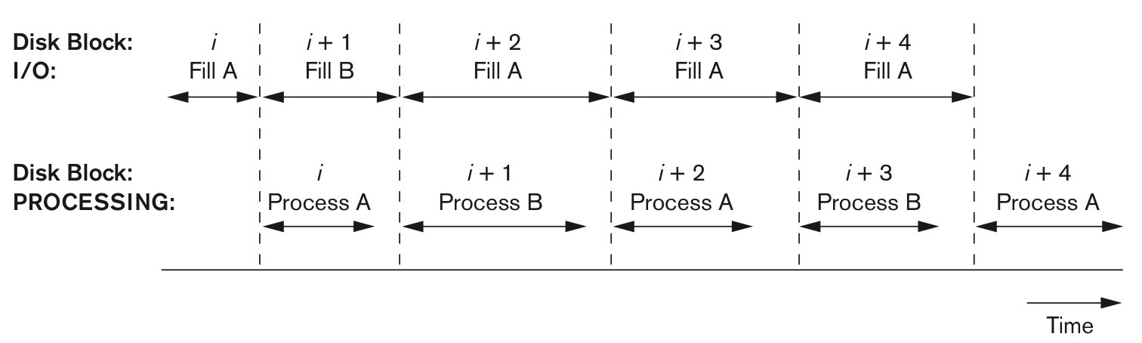
Figure 16.4 Use of two buffers, A and B, for reading from disk.
Fill B
Slide 16- <number>

Slide 10
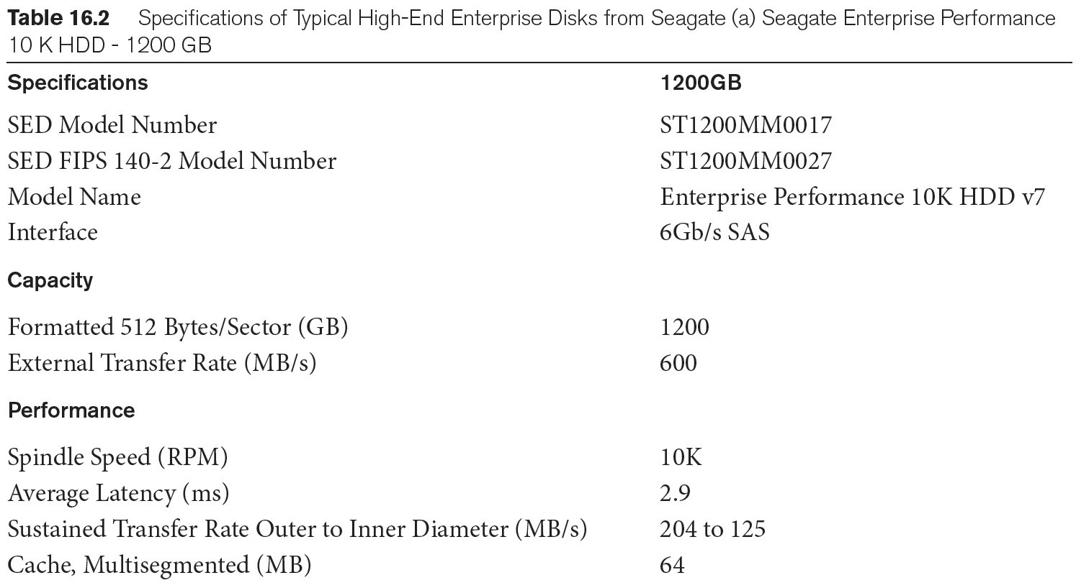
Typical Disk Parameters
Slide 16- <number>

Slide 11
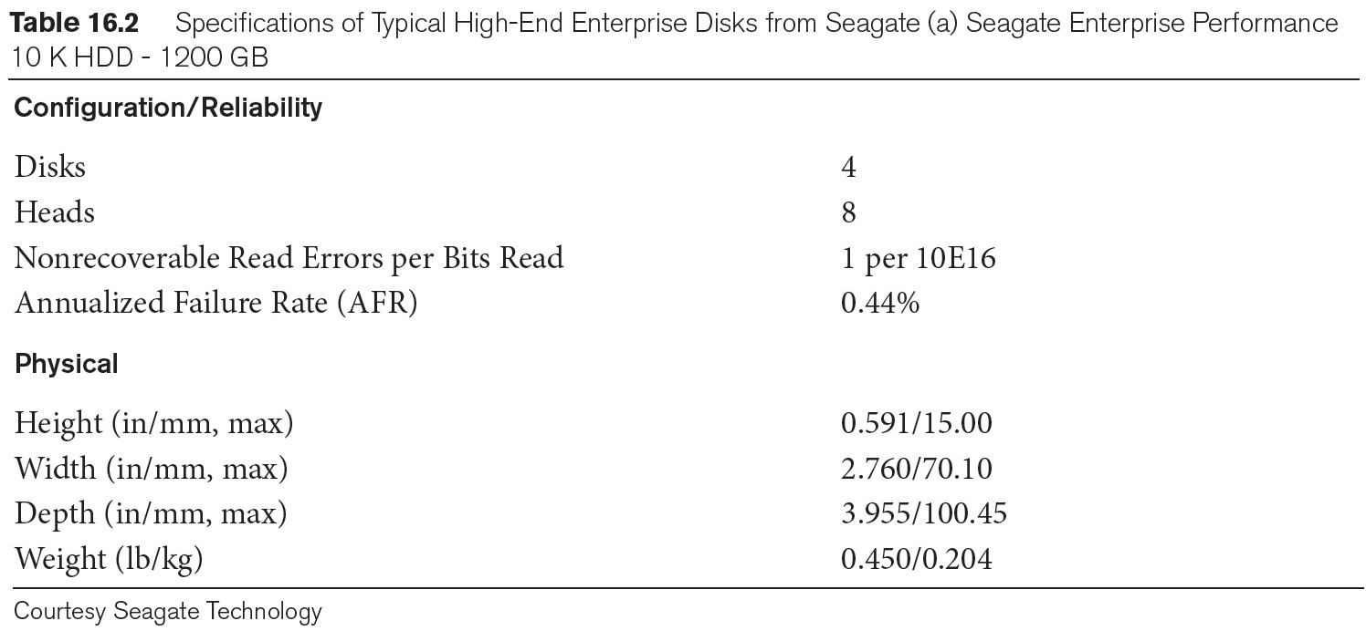
Typical Disk Parameters (contd.)
Slide 16- <number>

Slide 12
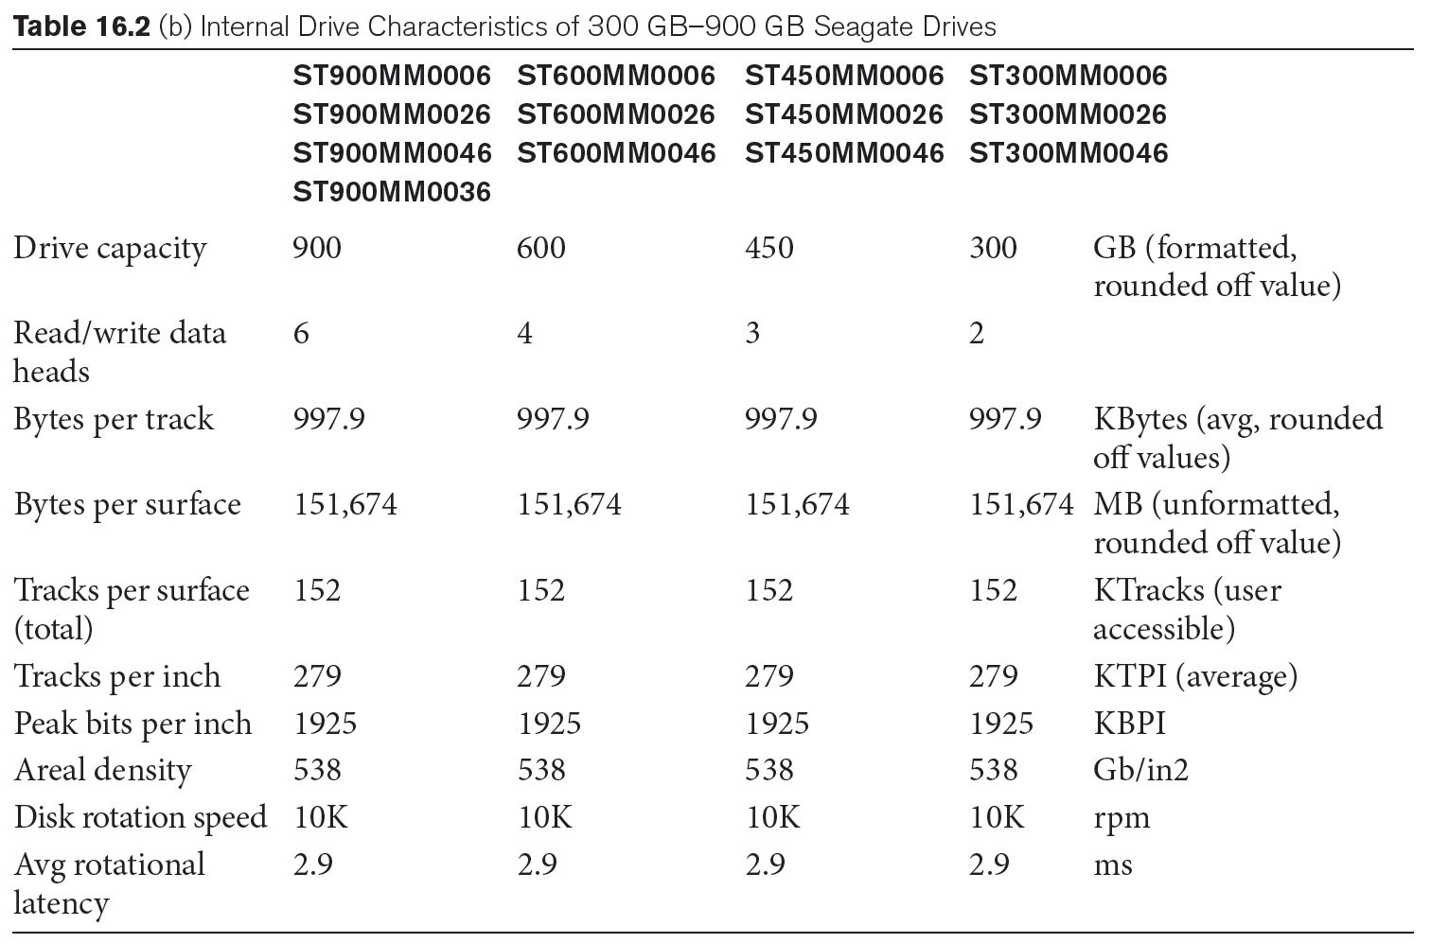
Slide 16- <number>

Slide 13
Records
Fixed and variable length records
Records contain fields which have values of a particular type
  E.g., amount, date, time, age
Fields themselves may be fixed length or variable length
Variable length fields can be mixed into one record:
  Separator characters or length fields are needed so that the record can be “parsed.”
Slide 16- <number>

Slide 14
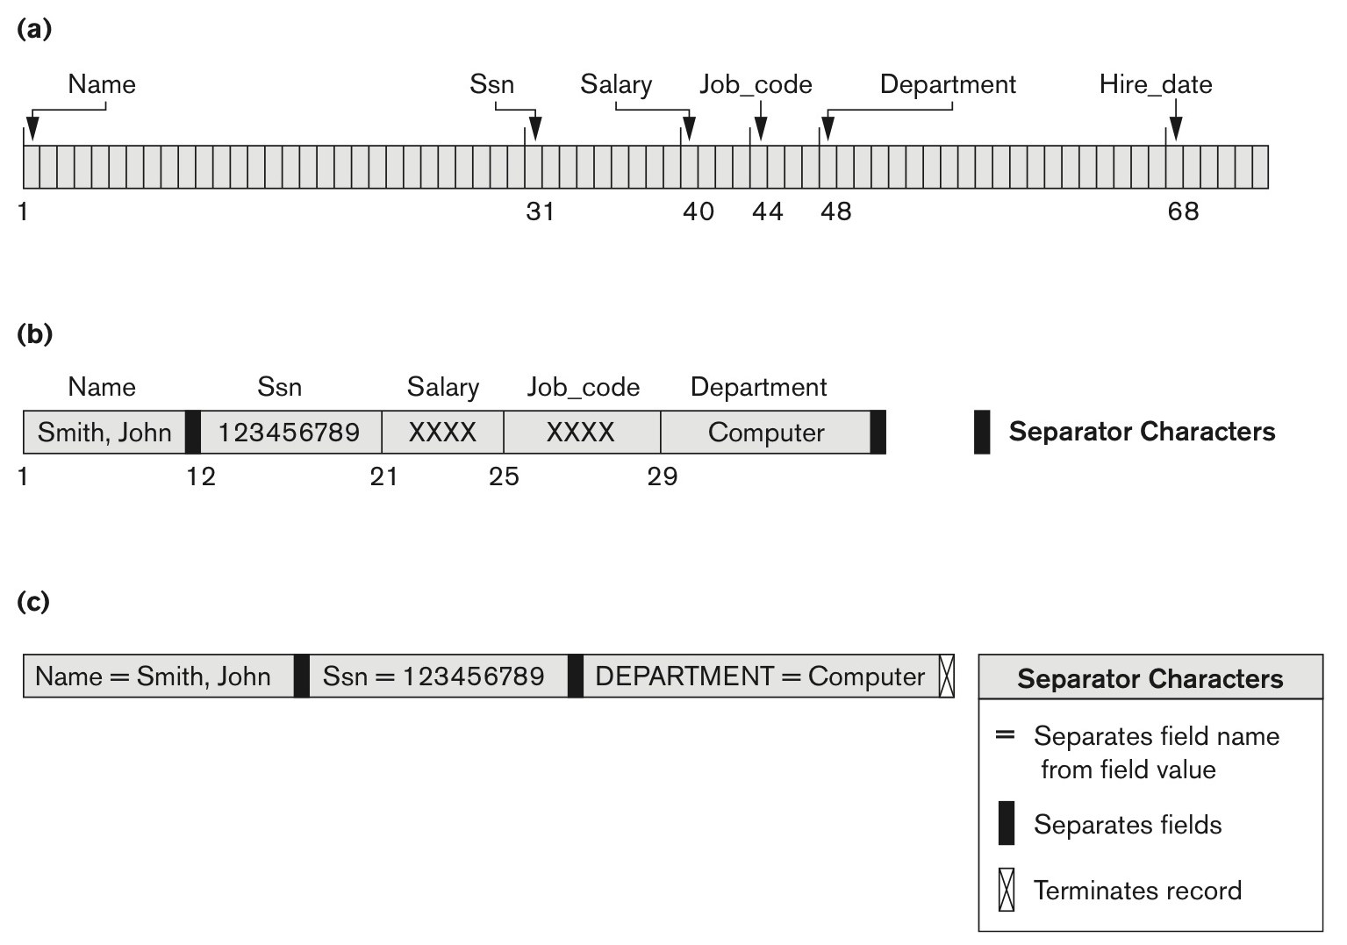
Fixed or Variable length Records
Figure 16.5 Three record storage formats. (a) A fixed-length record with six fields and size of 71 bytes. (b) A record with two variable-length fields and three fixed-length fields. (c) A variable-field record with three types of separator characters.
Slide 16- <number>

Slide 15
Blocking
Blocking:
  Refers to storing a number of records in one block on the disk.
Blocking factor (bfr) refers to the number of records per block.
There may be empty space in a block if an integral number of records do not fit in one block.
Spanned Records:
  Refers to records that exceed the size of one or more blocks and hence span a number of blocks.
Slide 16- <number>

Slide 16
Files of Records
A file is a sequence of records, where each record is a collection of data values (or data items).
A file descriptor (or file header) includes information that describes the file, such as the field names and their data types, and the addresses of the file blocks on disk.
Records are stored on disk blocks.
The blocking factor bfr for a file is the (average) number of file records stored in a disk block.
A file can have fixed-length records or variable-length records.
Slide 16- <number>

Slide 17
Files of Records (contd.)
File records can be unspanned or spanned
  Unspanned: no record can span two blocks
  Spanned: a record can be stored in more than one block
The physical disk blocks that are allocated to hold the records of a file can be contiguous, linked, or indexed.
In a file of fixed-length records, all records have the same format. Usually, unspanned blocking is used with such files.
Files of variable-length records require additional information to be stored in each record, such as separator characters and field types.
  Usually spanned blocking is used with such files.
Slide 16- <number>

Slide 18
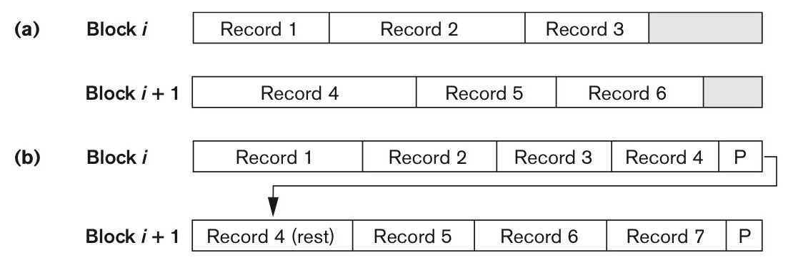
Figure 16.6 Types of record organization. (a) Unspanned. (b) Spanned.
Slide 16- <number>

Slide 19
Operation on Files
Typical file operations include:
  OPEN: Prepares the file for reading and writing, and associates a pointer that will refer to a current file record at each point in time.
  FIND: Searches for the first file record that satisfies a certain condition, and makes it the current file record.
  FINDNEXT: Searches for the next file record (from the current record) that satisfies a certain condition, and makes it the current file record.
  READ: Reads the current file record into a program variable.
  INSERT: Inserts a new record into the file & makes it the current file record.
  DELETE: Removes the current file record from the file, usually by marking the record to indicate that it is no longer valid.
  MODIFY: Changes the values of some fields of the current file record.
  CLOSE: Terminates access to the file.
  REORGANIZE: Reorganizes the file records.
    For example, the records marked deleted are physically removed from the file or a new organization of the file records is created.
  READ_ORDERED: Read the file blocks in order of a specific field of the file.
Slide 16- <number>

Slide 20
Unordered Files
Also called a heap or a pile file.
New records are inserted at the end of the file.
A linear search through the file records is necessary to search for a record.
  This requires reading and searching half the file blocks on the average, and is hence quite expensive.
Record insertion is quite efficient.
Reading the records in order of a particular field requires sorting the file records.
Slide 16- <number>

Slide 21
Ordered Files
Also called a sequential file.
File records are kept sorted by the values of an ordering field.
Insertion is expensive: records must be inserted in the correct order.
  It is common to keep a separate unordered overflow (or transaction) file for new records to improve insertion efficiency; this is periodically merged with the main ordered file.
A binary search can be used to search for a record on its ordering field value.
  This requires reading and searching log₂ of the file blocks on the average, an improvement over linear search.
Reading the records in order of the ordering field is quite efficient.
Slide 16- <number>

Slide 22
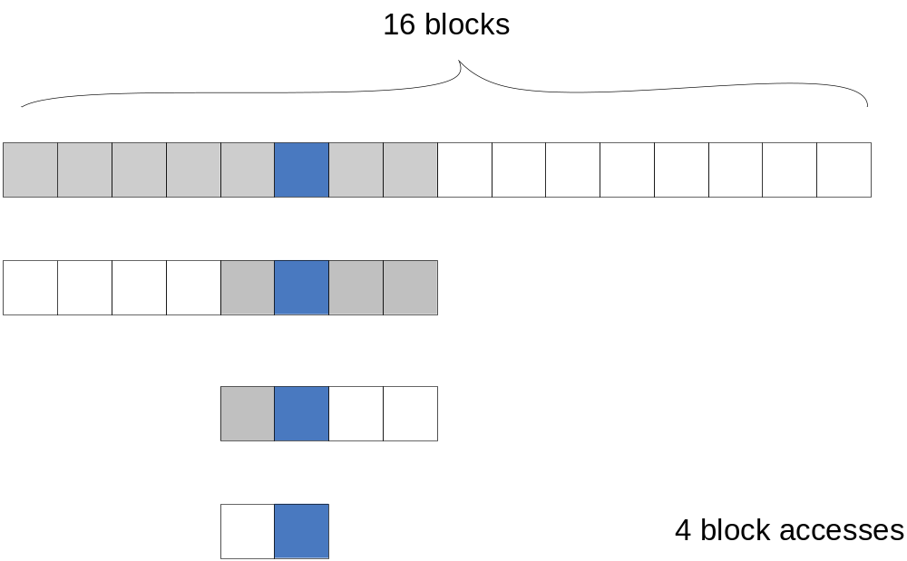
Binary Search
Slide 16- <number>

Slide 23
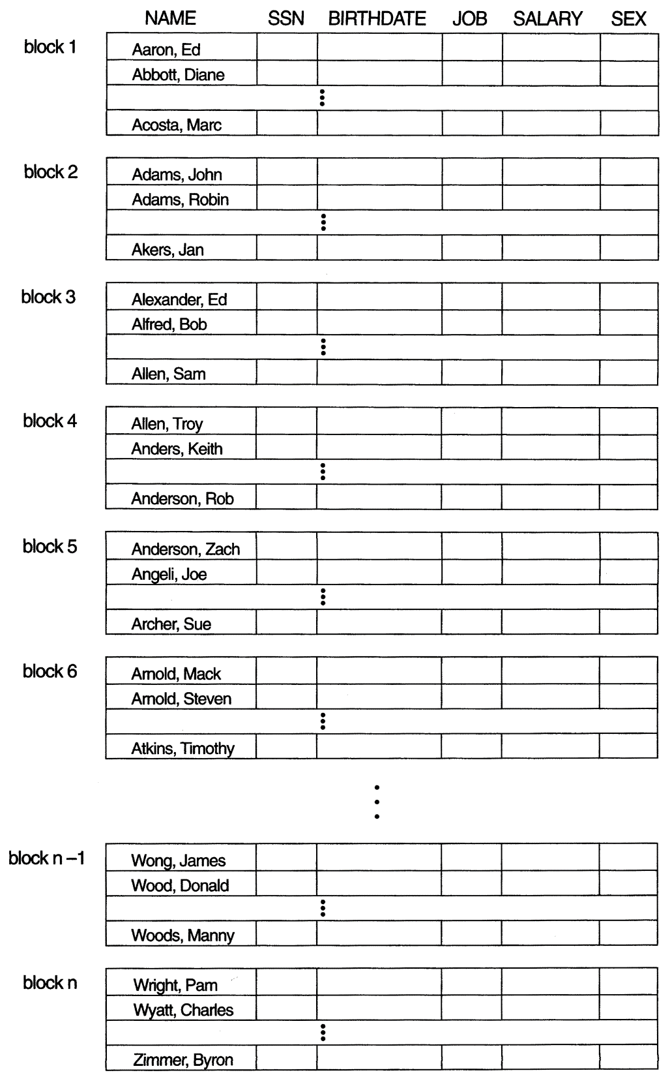
Figure 16.7 Some blocks of an ordered (sequential) file of EMPLOYEE records with Name as the ordering key field.
Slide 13- <number>

Slide 24
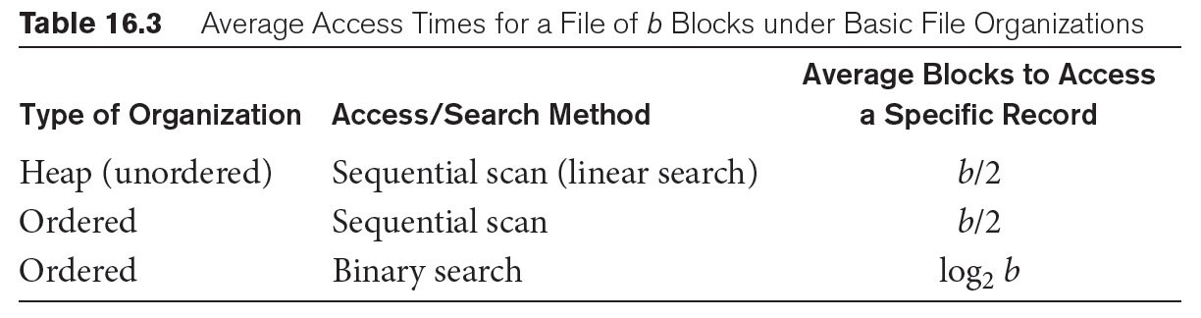
Average Access Times
The following table shows the average access time to access a specific record for a given type of file
Slide 16- <number>

Slide 25
Hashing Techniques
The file blocks are divided into M equal-sized buckets (or slots), numbered bucket₀, bucket₁, ..., bucket_{M-1}.
  Typically, a bucket corresponds to one (or a fixed number of) disk block.
Internal/External hashing
One of the file fields is designated to be the hash key of the file.
The record with hash key value K is stored in bucket i, where i=h(K), and h is the hashing function.
Search is very efficient on the hash key.
Collisions occur when a new record hashes to a bucket that is already full.
  An overflow file is kept for storing such records.
  Overflow records that hash to each bucket can be linked together.
Slide 16- <number>

Slide 26
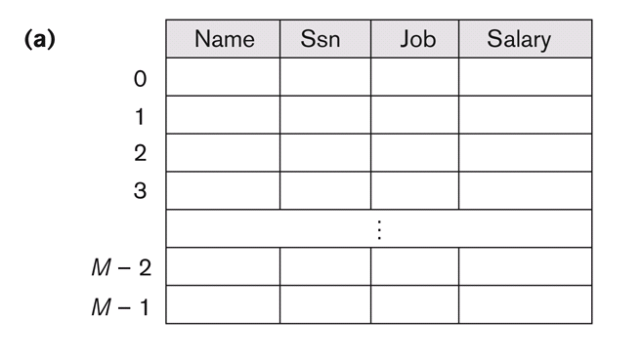
Internal Hashing
Hash table
  The use of an array of records
  Simple hash function: h(K) = K mod M
Slide 16- <number>

Slide 27
Internal Hashing (contd.)
Collision: the same hash values
There are numerous methods for collision resolution, including the following:
  Open addressing: Proceeding from the occupied position specified by the hash address, the program checks the subsequent positions in order until an unused (empty) position is found.
  Chaining: For this method, various overflow locations are kept, usually by extending the array with a number of overflow positions. In addition, a pointer field is added to each record location. A collision is resolved by placing the new record in an unused overflow location and setting the pointer of the occupied hash address location to the address of that overflow location.
  Multiple hashing: The program applies a second hash function if the first results in a collision. If another collision results, the program uses open addressing or applies a third hash function and then uses open addressing if necessary.
Slide 16- <number>

Slide 28
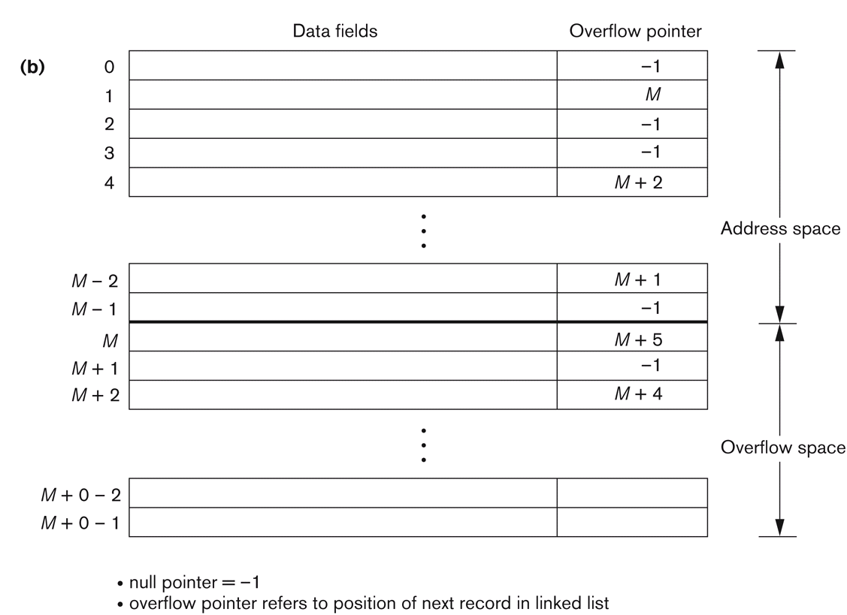
Chaining
Slide 16- <number>

Slide 29
Internal Hashing (contd.)
To reduce overflow records, a hash file is typically kept 70-80% full.
The hash function h should distribute the records uniformly among the buckets
  Otherwise, search time will be increased because many overflow records will exist.
Prime number or a power of 2 is a good selection for modulo M
Slide 16- <number>

Slide 30
External Hashing for Disk Files
Hashing for disk files is called External Hashing
Collision problem is less severe with buckets.
  Multiple records could be in a bucket
Static hashing: fixed number of buckets M is allocated.
Main disadvantages of static external hashing:
  Fixed number of buckets M is a problem if the number of records in the file grows or shrinks.
  Need to change M depending and use a new hash function.
  Dynamic method is necessary.
Slide 16- <number>

Slide 31
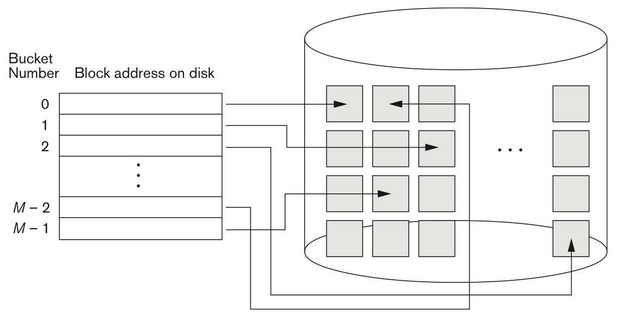
Hashed Files in External Hashing
Figure 16.9 Matching bucket numbers to disk block addresses.
Slide 16- <number>

Slide 32
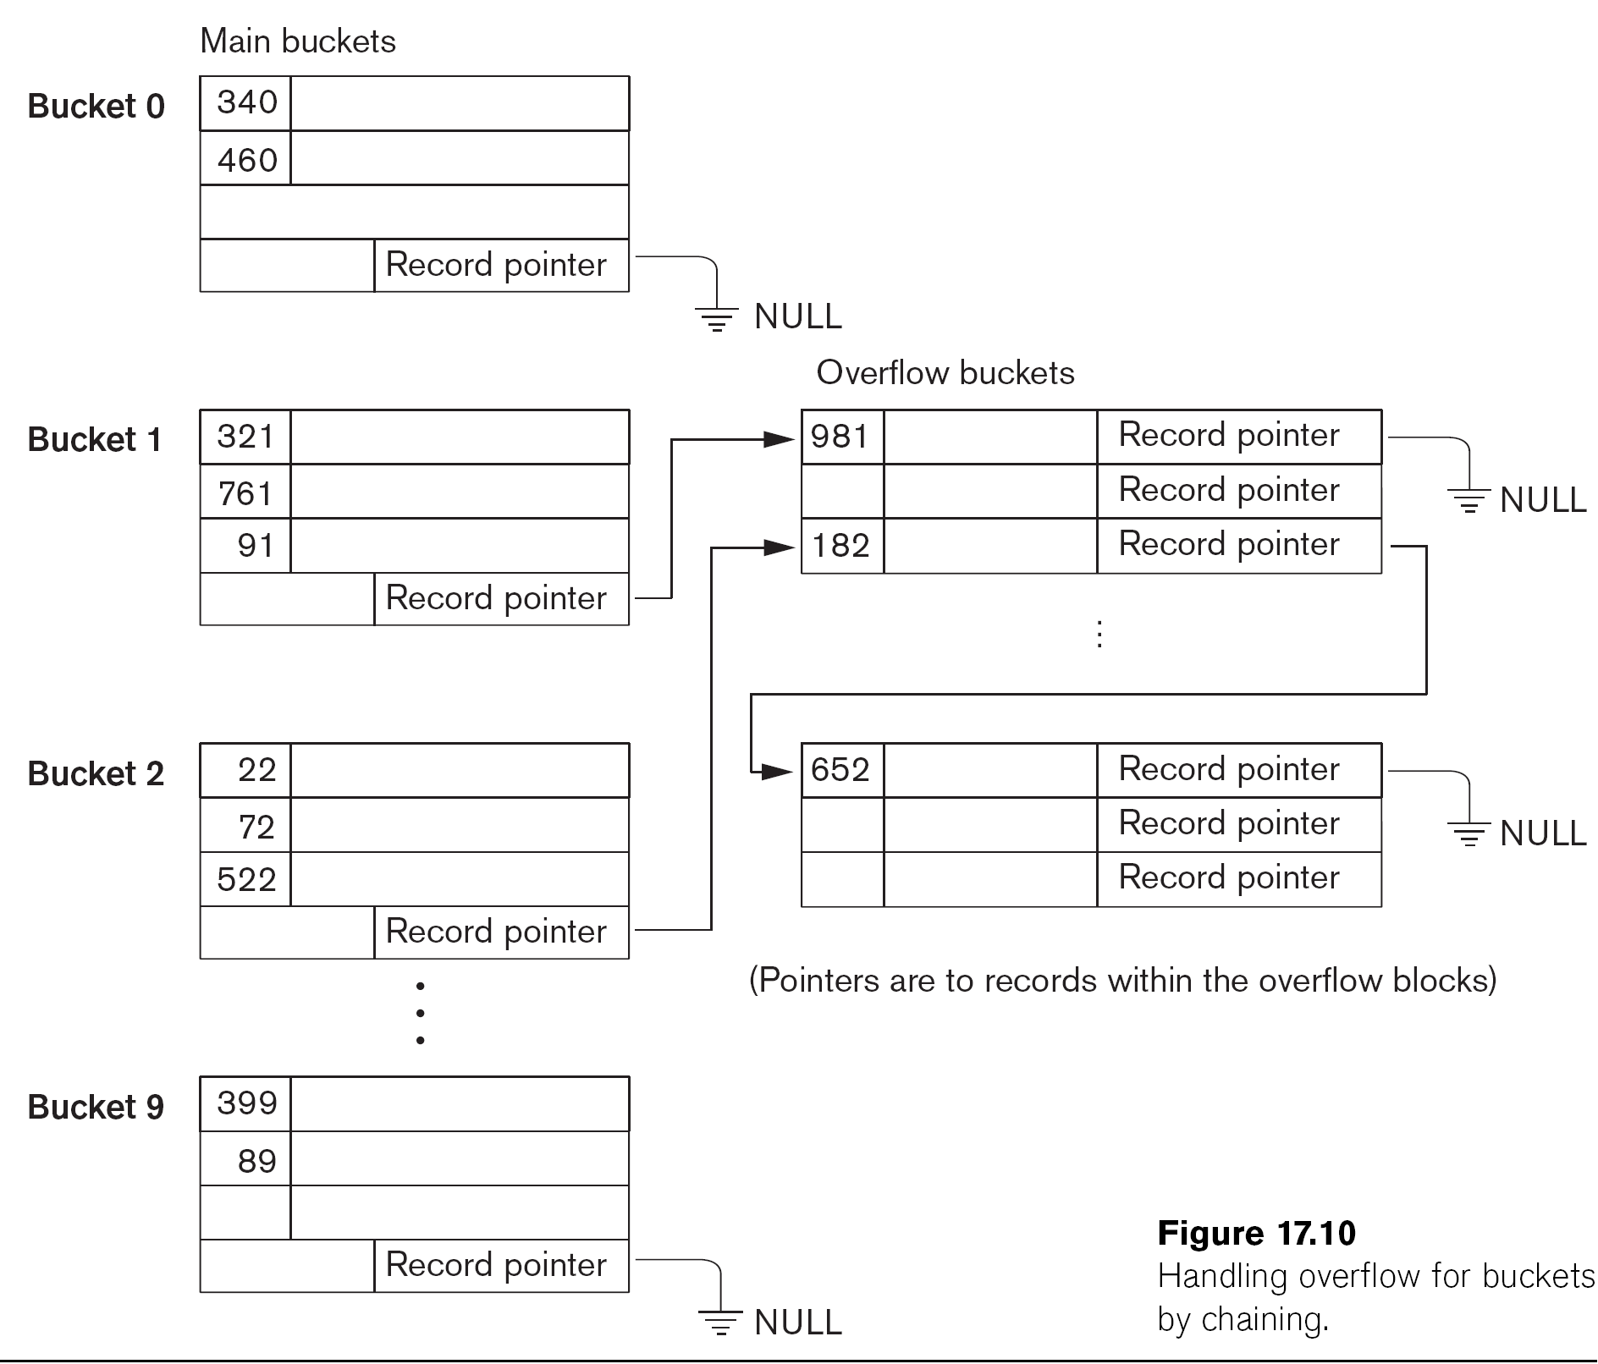
Hashed Files - Overflow handling
Slide 16- <number>

Slide 33
Dynamic And Extendible Hashed Files
Dynamic and Extendible Hashing Techniques
  Hashing techniques are adapted to allow the dynamic growth and shrinking of the number of file records.
  These techniques include the following: dynamic hashing, extendible hashing, and linear hashing.
Both dynamic and extendible hashing use the binary representation of the hash value h(K) in order to access a directory.
  In dynamic hashing the directory is a binary tree.
  In extendible hashing the directory is an array of size 2^{d} where d is called the global depth.
Slide 16- <number>

Slide 34
Dynamic And Extendible Hashing (contd.)
The directories can be stored on disk, and they expand or shrink dynamically.
  Directory entries point to the disk blocks that contain the stored records.
An insertion in a disk block that is full causes the block to split into two blocks and the records are redistributed among the two blocks.
  The directory is updated appropriately.
Dynamic and extendible hashing do not require an overflow area.
Linear hashing does require an overflow area but does not use a directory.
  Blocks are split in linear order as the file expands.
Slide 16- <number>

Slide 35
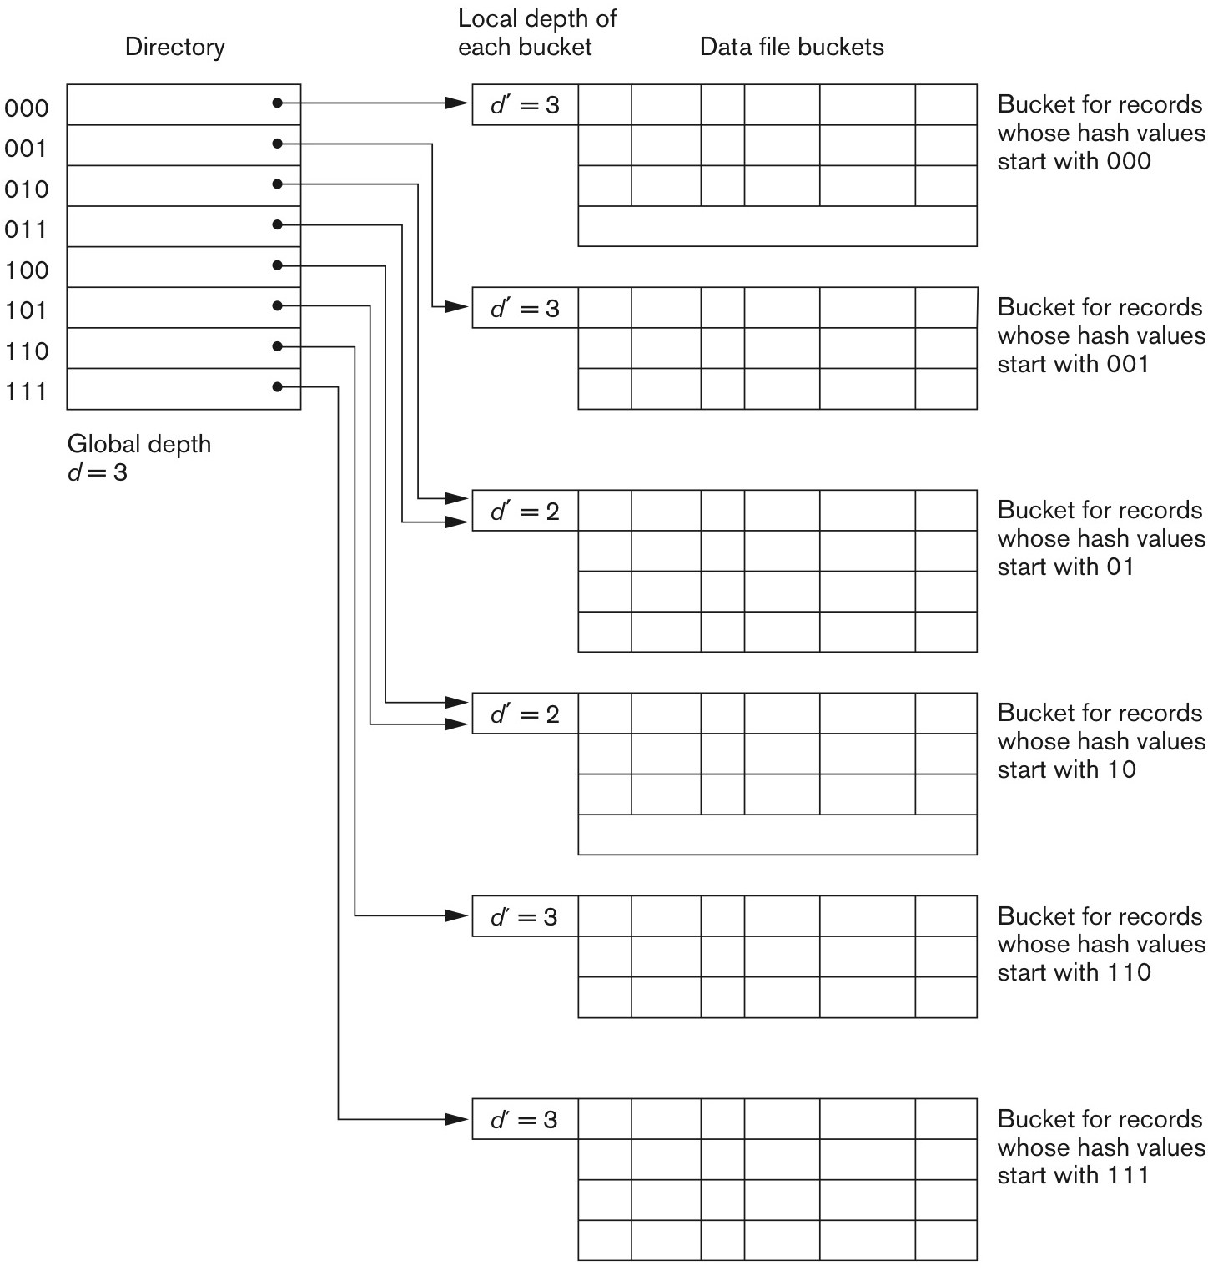
Figure 16.11 Structure of the extendible hashing scheme.
Slide 13- <number>

Slide 36
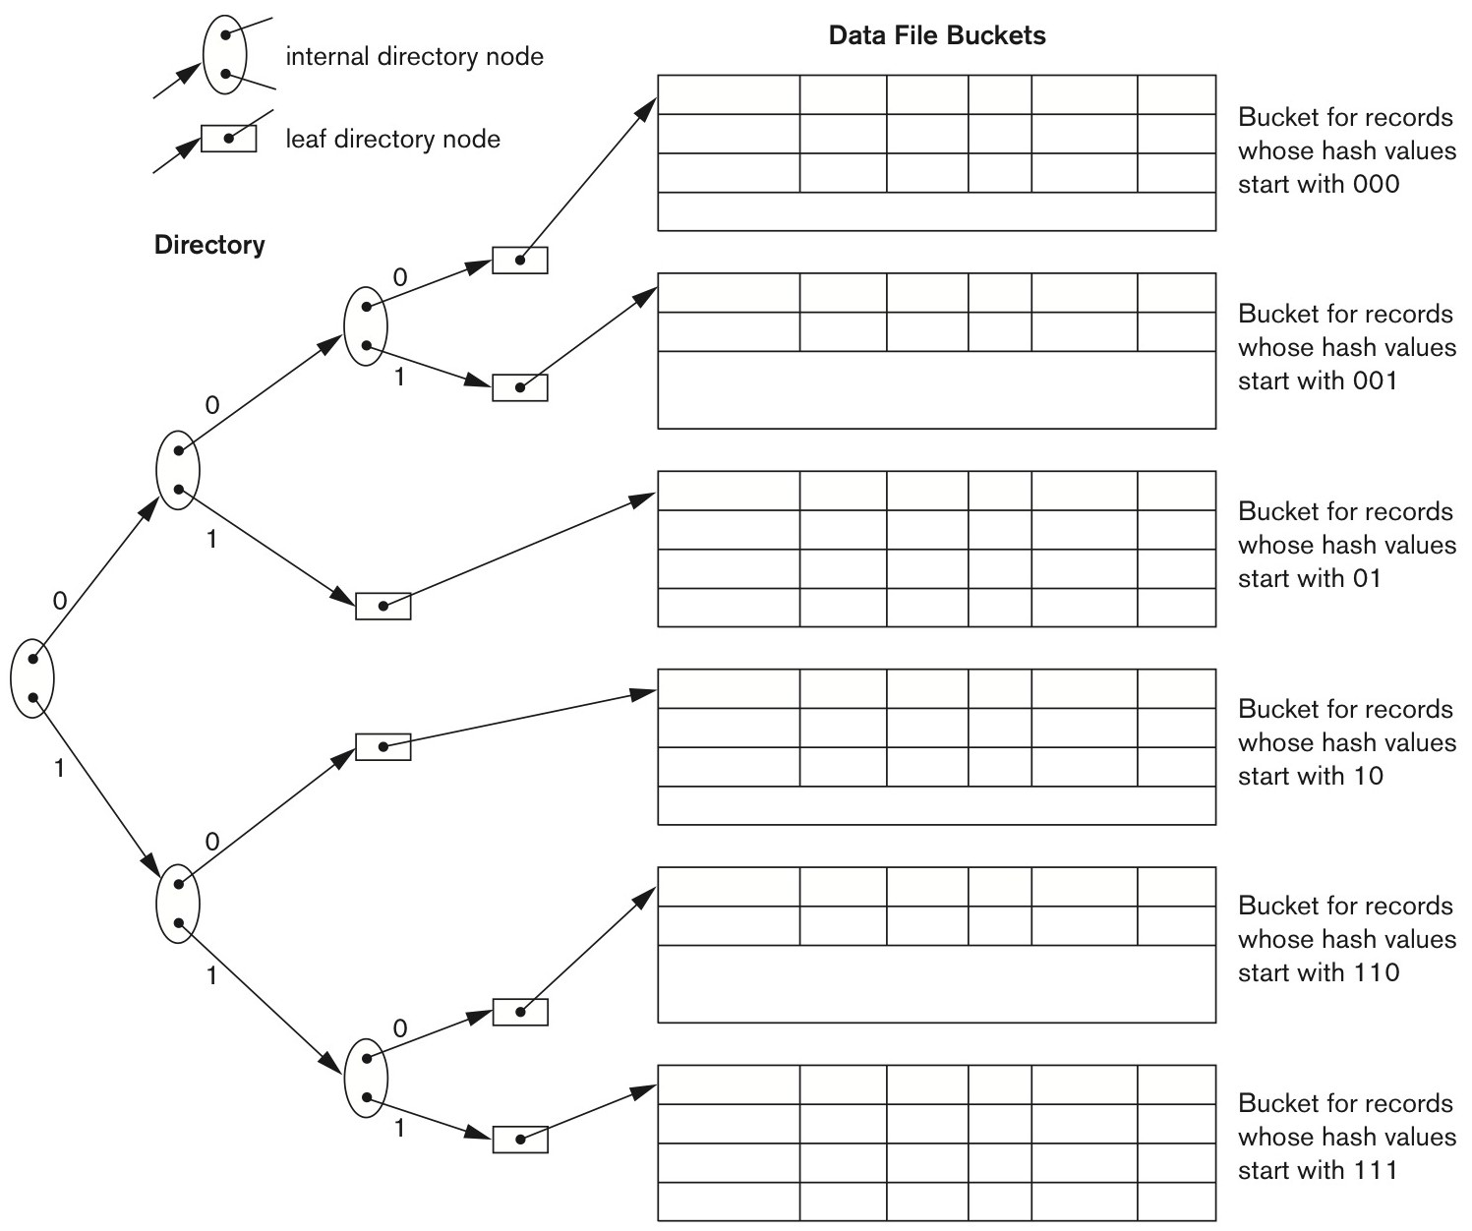
Figure 16.12 Structure of the dynamic hashing scheme.
Slide 16- <number>

Slide 37
Parallelizing Disk Access using RAID Technology.
Secondary storage technology must take steps to keep up in performance and reliability with processor technology.
A major advance in secondary storage technology is represented by the development of RAID, which originally stood for Redundant Arrays of Inexpensive Disks.
The main goal of RAID is to even out the widely different rates of performance improvement of disks against those in memory and microprocessors.
Slide 16- <number>

Slide 38
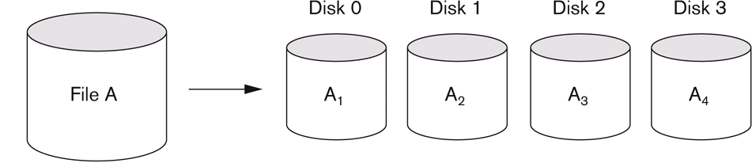
RAID Technology (contd.)
A natural solution is a large array of small independent disks acting as a single higher-performance logical disk.
A concept called data striping is used, which utilizes parallelism to improve disk performance.
Data striping distributes data transparently over multiple disks to make them appear as a single large, fast disk.
Slide 16- <number>

Slide 39
RAID Technology (contd.)
Different raid organizations were defined based on different combinations of the two factors of granularity of data interleaving (striping) and pattern used to compute redundant information.
Slide 16- <number>

Slide 40
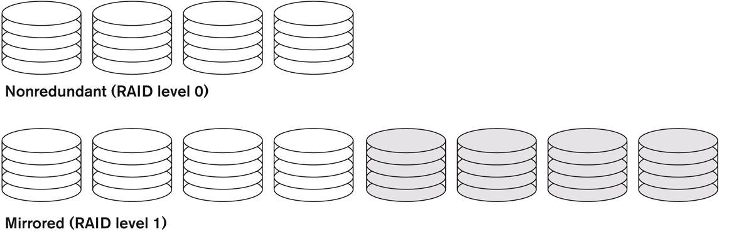
Raid level 0
  no redundant data and hence has the best write performance at the risk of data loss
Raid level 1
  uses mirrored disks.
Slide 16- <number>

Slide 41
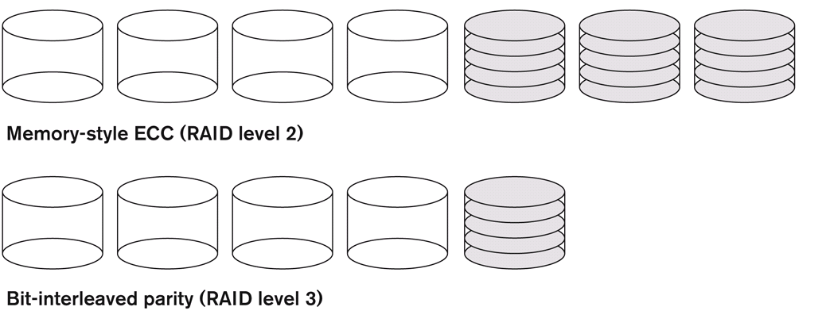
Raid level 2
  memory-style redundancy by using Hamming codes, which contain parity bits for distinct overlapping subsets of components. Level 2 includes both error detection and correction.
Raid level 3
  a single parity disk relying on the disk controller to figure out which disk has failed.
Slide 16- <number>

Slide 42
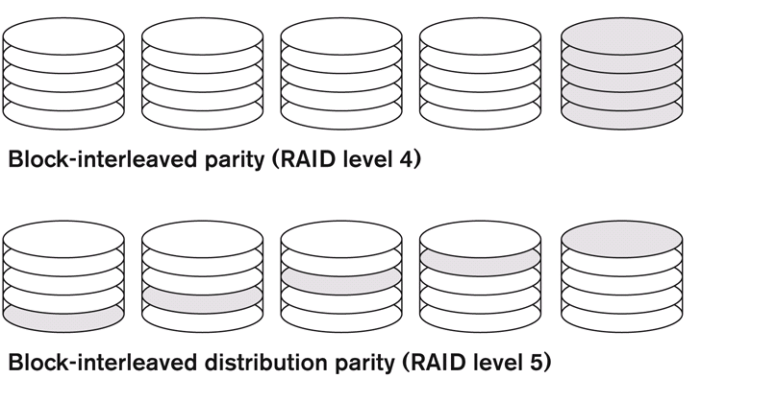
Raid Levels 4 and 5
  block-level data striping, with level 5 distributing data and parity information across all disks.
Slide 16- <number>

Slide 43
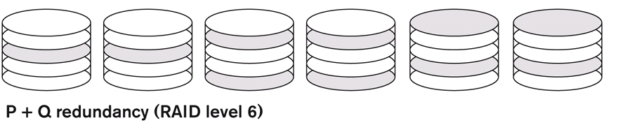
Raid level 6
  applies the so-called P + Q redundancy scheme using Reed-Soloman codes to protect against up to two disk failures by using just two redundant disks.
Slide 16- <number>

Slide 44
Use of RAID Technology (contd.)
Different raid organizations are being used under different situations
  Raid level 1 (mirrored disks) is the easiest for rebuild of a disk from other disks
    It is used for critical applications like logs
  Raid level 2 uses memory-style redundancy by using Hamming codes, which contain parity bits for distinct overlapping subsets of components.
    Level 2 includes both error detection and correction.
  Raid level 3 (single parity disks relying on the disk controller to figure out which disk has failed) and level 5 (block-level data striping) are preferred for Large volume storage, with level 3 giving higher transfer rates.
Most popular uses of the RAID technology currently are:
  Level 0 (with striping), Level 1 (with mirroring) and Level 5 with an extra drive for parity.
Design Decisions for RAID include:
  Level of RAID, number of disks, choice of parity schemes, and grouping of disks for block-level striping.
Slide 16- <number>

Slide 45
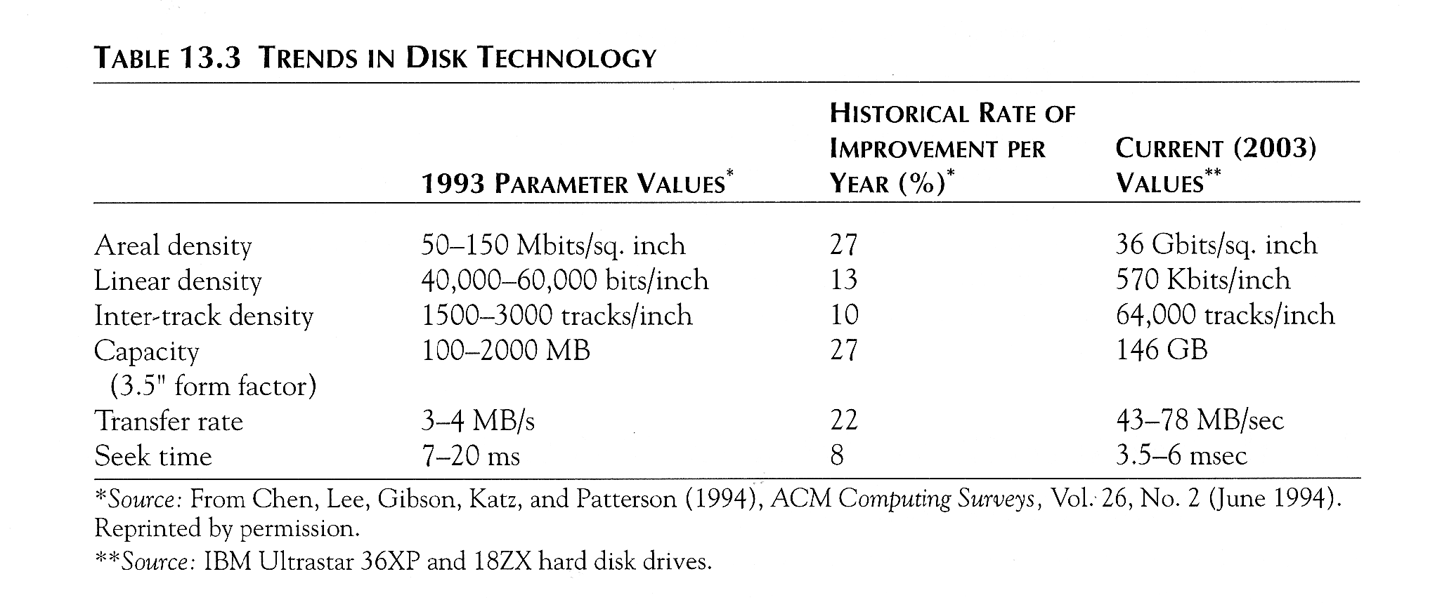
Trends in Disk Technology
Slide 16- <number>

Slide 46
Storage Area Networks
The demand for higher storage has risen considerably in recent times.
Organizations have a need to move from a static fixed data center oriented operation to a more flexible and dynamic infrastructure for information processing.
Thus they are moving to a concept of Storage Area Networks (SANs).
  In a SAN, online storage peripherals are configured as nodes on a high-speed network and can be attached and detached from servers in a very flexible manner.
This allows storage systems to be placed at longer distances from the servers and provide different performance and connectivity options.
Slide 16- <number>

Slide 47
Storage Area Networks (contd.)
Advantages of SANs are:
  Flexible many-to-many connectivity among servers and storage devices using fiber channel hubs and switches.
  Up to 10km separation between a server and a storage system using appropriate fiber optic cables.
  Better isolation capabilities allowing non-disruptive addition of new peripherals and servers.
SANs face the problem of combining storage options from multiple vendors and dealing with evolving standards of storage management software and hardware.
Slide 16- <number>

Slide 48
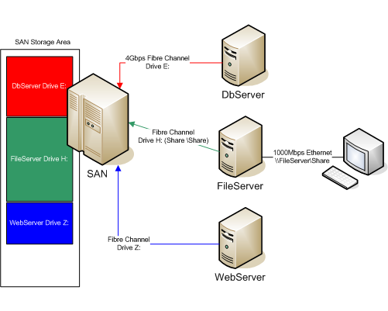
Example of SAN configuration
Slide 16- <number>

Slide 49
NAS: Network Attached Storage
NAS devices are among the latest of storage devices being used for high-performance storage solution at low cost.
NAS device can be anywhere on a LAN
Slide 16- <number>

Slide 50
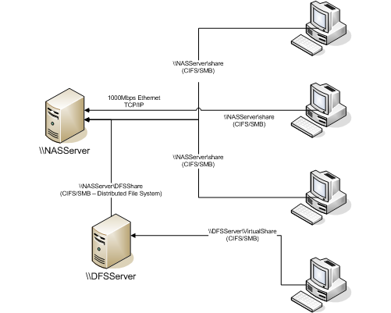
Example of NAS configuration
Slide 16- <number>

Slide 51

iSCSI
iSCSI is basically the SCSI disk control protocol over IP (internet protocol).
Slide 16- <number>

Slide 52
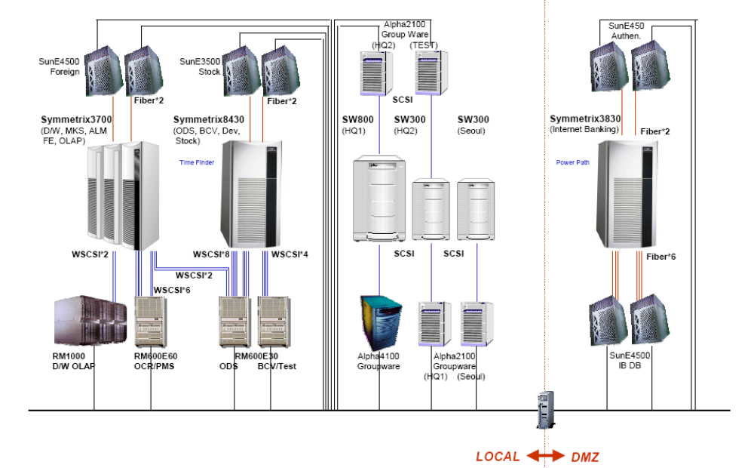
Real example of Storage configuration
Slide 16- <number>

Slide 53
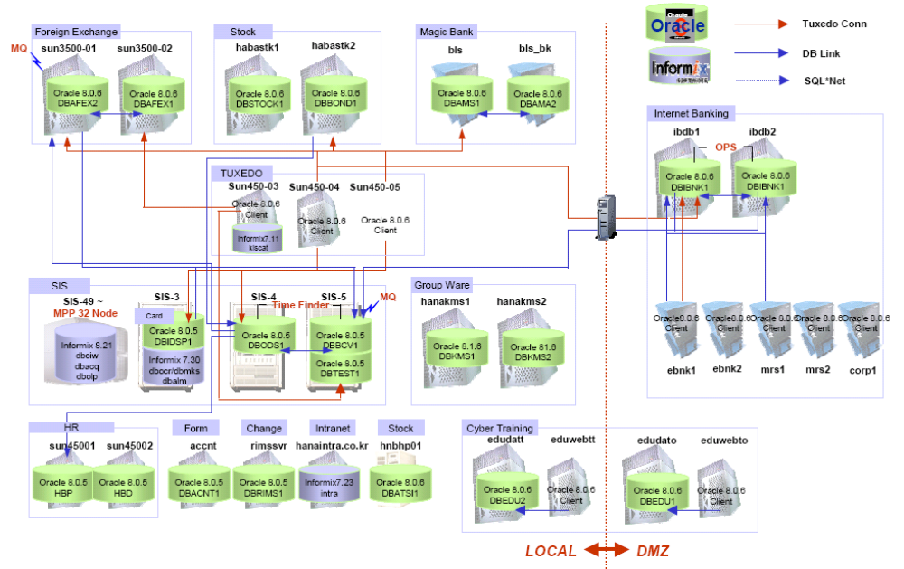
Real example of DB configuration
Slide 16- <number>

Slide 54
Summary
Disk Storage Devices
Files of Records
Operations on Files
Unordered Files
Ordered Files
Hashed Files
  Dynamic and Extendible Hashing Techniques
RAID Technology
Slide 16- <number>

