Slide 1

Slide 17- <number>

Slide 2
Chapter 17-1
Indexing Structures for Files
Copyright © 2007 Pearson Education, Inc. Publishing as Pearson Addison-Wesley

Slide 3
Chapter Outline
Types of Single-level Ordered Indexes
  Primary Indexes
  Clustering Indexes
  Secondary Indexes
Multilevel Indexes
Dynamic Multilevel Indexes Using B-Trees and B+-Trees
Indexes on Multiple Keys
Slide 17- <number>

Slide 4
Indexes as Access Paths
A single-level index is an auxiliary file that makes it more efficient to search for a record in the data file.
The index is usually specified on one field of the file (although it could be specified on several fields)
One form of an index is a file of entries <field value, pointer to record>, which is ordered by field value
The index is called an access path on the field.
Slide 17- <number>

Slide 5
Indexes as Access Paths (contd.)
The index file usually occupies considerably less disk blocks than the data file because its entries are much smaller
A binary search on the index yields a pointer to the file record
Indexes can also be characterized as dense or sparse
  A dense index has an index entry for every search key value (and hence every record) in the data file.
  A sparse (or nondense) index, on the other hand, has index entries for only some of the search values
Slide 17- <number>

Slide 6
Indexes as Access Paths (contd.)
Example: Given the following data file
  EMPLOYEE(NAME, SSN, ADDRESS, JOB, SAL, ... )
Suppose that:
  record size R=150 bytes block size B=512 bytes r=30000 records
Then, we get:
  blocking factor Bfr= └B/R┘ = └ 512/150 ┘ = 3 records/block
  number of file blocks b= ┌ r/Bfr ┐ = ┌ 30000/3 ┐ = 10000 blocks
For an index on the SSN field, assume the field size V_{SSN}=9 bytes, assume the record pointer size P_{R}=7 bytes. Then:
  index entry size R_{I}=(V_{SSN}+ P_{R})=(9+7)=16 bytes
  index blocking factor Bfr_{I}= └B/R_{I┘} = └ 512 /16 ┘ = 32 entries/block
  number of index blocks b_{I}= ┌ r/ Bfr_{I} ┐ = ┌ 30000/32 ┐ = 938 blocks
  binary search needs log₂b_{I}= log₂938= 10 block accesses
  This is compared to an average linear search cost of:
    ┌ b/2 ┐ = 10000/2= 5000 block accesses
  If the file records are ordered, the binary search cost would be:
    ┌ log₂b ┐ = log₂10000= 14 block accesses
Slide 17- <number>

Slide 7
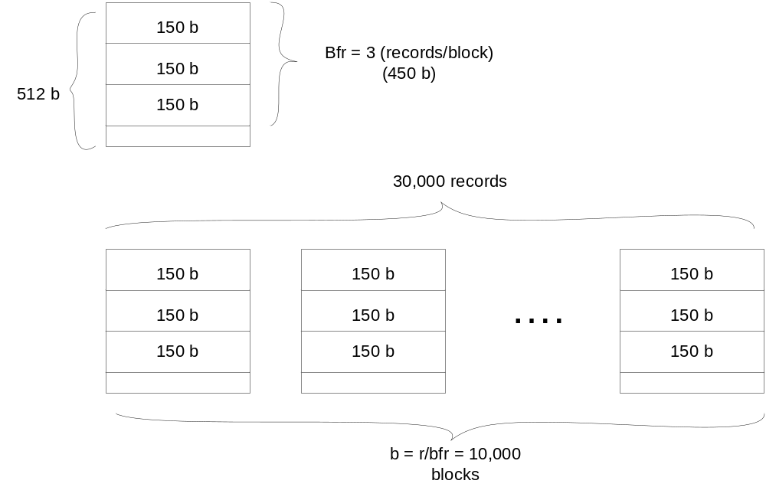
Indexes as Access Paths (contd.)
Slide 17- <number>

Slide 8
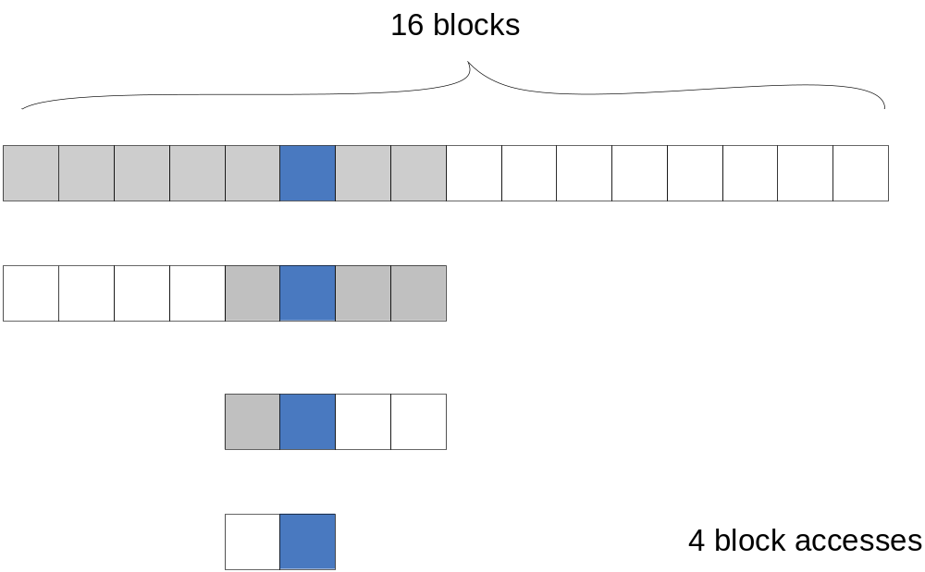
Indexes as Access Paths (contd.)
Slide 17- <number>

Slide 9
Types of Single-Level Indexes
Primary Index
  Defined on an ordered data file
  The data file is ordered on a key field
  Includes one index entry for each block in the data file; the index entry has the key field value for the first record in the block, which is called the block anchor
  A similar scheme can use the last record in a block.
  A primary index is a nondense (sparse) index, since it includes an entry for each disk block of the data file and the keys of its anchor record rather than for every search value.
Slide 17- <number>

Slide 10
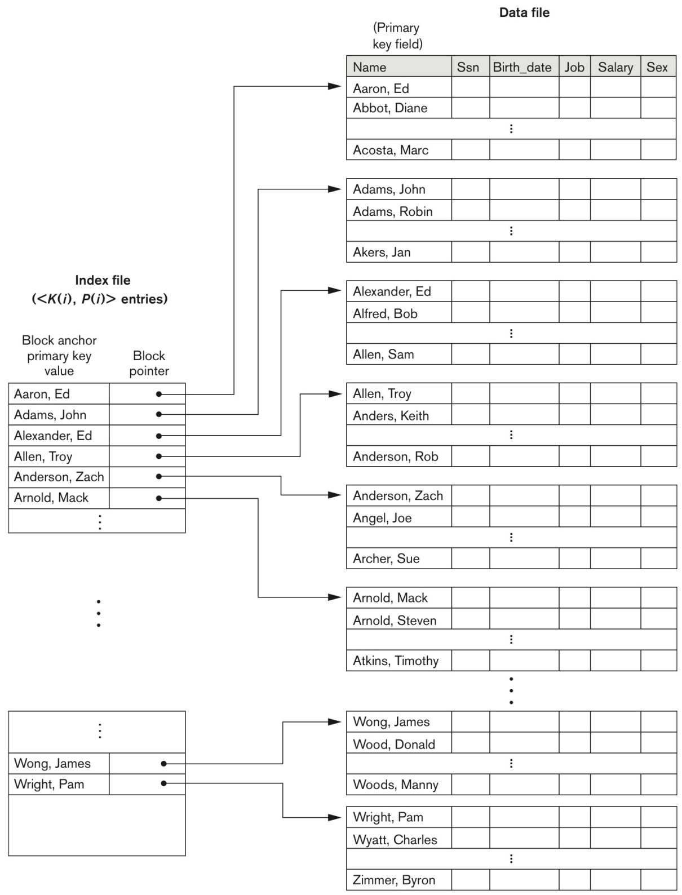
Primary index on the ordering key field
FIGURE 17.1
Primary index on the ordering key field of the file shown in Figure 16.7.
Slide 17- <number>

Slide 11
Example 1.
Suppose that:
  record size R=100 bytes block size B=1024 bytes r=30000 records
  file records are fixed and unspanned
Then, we get:
  blocking factor Bfr= └B/R┘= └1024/100┘ = 10 records/block
  number of file blocks b= ┌r/Bfr ┐= (30000/10)= 3000 blocks
  binary search on data file
    ┌ log₂b ┐= ┌ log₂3000 ┐= 12 block accesses
For an index on the SSN field, assume the field size V_{SSN}=9 bytes, assume the record pointer size P_{R}=6 bytes. Then:
  index entry size R_{I}=(V_{SSN}+ P_{R})=(9+6)=15 bytes
  index blocking factor Bfr_{I}= └ B/R_{I ┘} = └1024/15┘ = 68 entries/block
  the total number of index entries r_{I}=3000 (why?)
  number of index blocks b_{I}= ┌ r_{I}/ Bfr_{I} ┐= ┌ 3000/68 ┐= 45 blocks
  binary search needs ┌ log₂b_{I} ┐ = ┌ log₂45 ┐ = 6 block accesses
  Total we need 7 = 6 + 1 block access (1 for data file)
Slide 17- <number>
Notes:
ri is same as the number of blocks, since it’s non-dense

Slide 12
Types of Single-Level Indexes
Clustering Index
  Defined on an ordered data file
  The data file is ordered on a non-key field unlike primary index, which requires that the ordering field of the data file have a distinct value for each record.
  Includes one index entry for each distinct value of the field; the index entry points to the first data block that contains records with that field value.
  It is another example of nondense index where Insertion and Deletion is relatively straightforward with a clustering index.
Slide 17- <number>

Slide 13
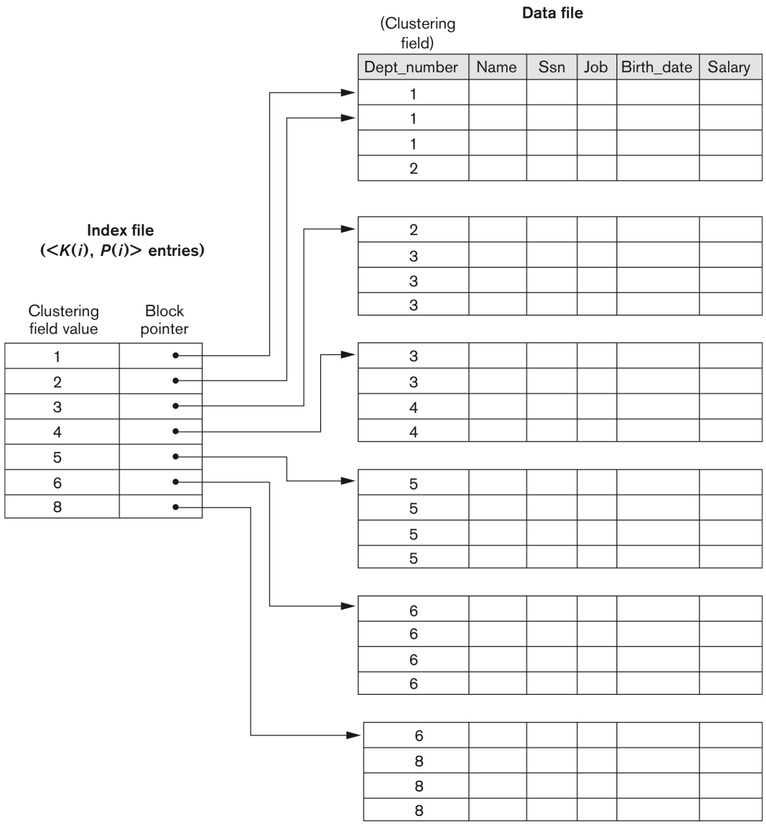
A Clustering Index Example
FIGURE 17.2
A clustering index on the DEPTNUMBER ordering non-key field of an EMPLOYEE file.
Slide 17- <number>

Slide 14
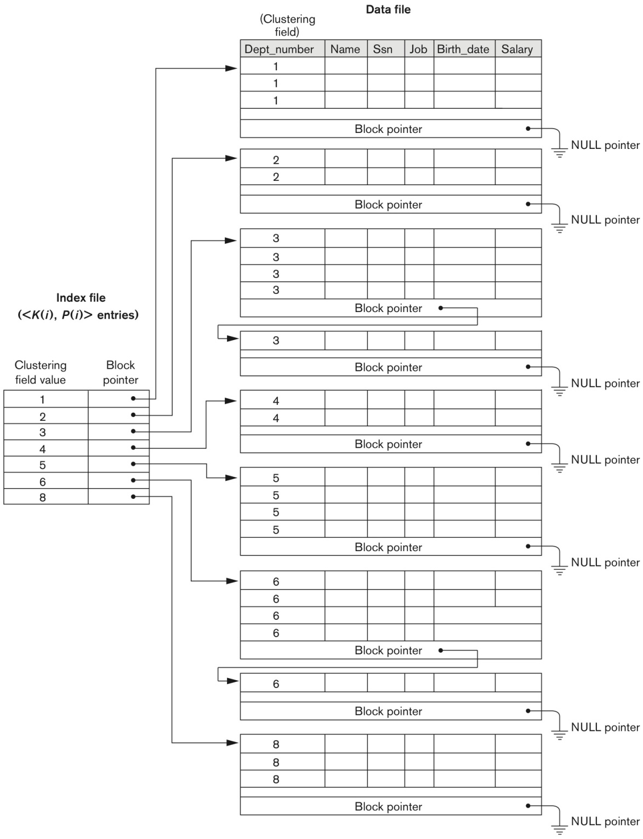
Another Clustering Index Example
FIGURE 17.3
Clustering index with a separate block cluster for each group of records that share the same value for the clustering field.
Slide 17- <number>

Slide 15
Types of Single-Level Indexes
Secondary Index
  A secondary index provides a secondary means of accessing a file for which some primary access already exists.
  The secondary index may be on a field which is a candidate key and has a unique value in every record, or a non-key with duplicate values.
  The index is an ordered file with two fields.
    The first field is of the same data type as some non-ordering field of the data file that is an indexing field.
    The second field is either a block pointer or a record pointer.
    There can be many secondary indexes (and hence, indexing fields) for the same file.
  Includes one entry for each record in the data file; hence, it is a dense index
Slide 17- <number>

Slide 16
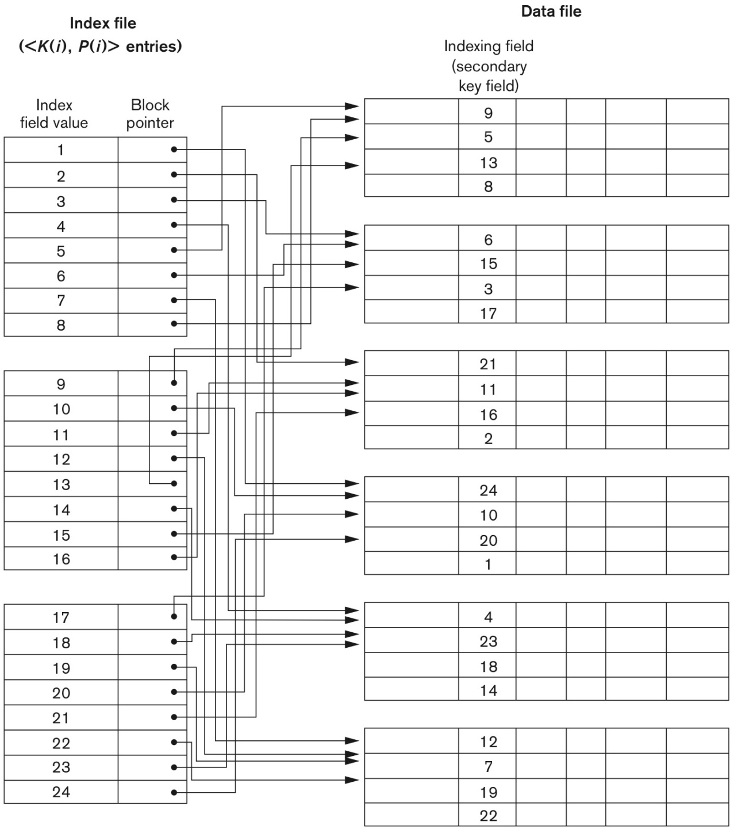
Example of a Dense Secondary Index
FIGURE 17.4
A dense secondary index (with block pointers) on a non-ordering key field of a file.
Slide 17- <number>

Slide 17
Example 2
r=30,000 fixed-length records, R=100 bytes, B=1,024 bytes, and b= 3000 blocks.
  Linear search: b/2 = 3000/2 = 1500 block accesses
Secondary index on a nonordering key field: V=9 bytes, and P=6 bytes
  R_{i} = (9+6) = 15 bytes
  bfr_{i} = ⎣ B/R_{i} ⎦ = ⎣ 1024/15 ⎦ = 68 entries/block
  # of index entries, r_{i} = r since dense
  b_{i} = ⎡ r_{i}/bfr_{i}⎤ = ⎡ 30,000/68 ⎤ = 442 blocks
  Binary search needs ⎡ log₂b_{i}⎤ = ⎡ log₂442⎤ = 9 block accesses
  Total block accesses = 9 + 1 = 10
Slide 17- <number>

Slide 18
For nonkey, non-ordering field
Option 1:
  Duplicate index entries with the same K(i) values. Dense index
Option 2:
  Variable length records for the index entries (repeating pointer): e.g. <P(i,1), …, P(i,k)> for K(i)
Option 3:
  Create extra level to handle the multiple pointers
  See next slide
Slide 17- <number>

Slide 19
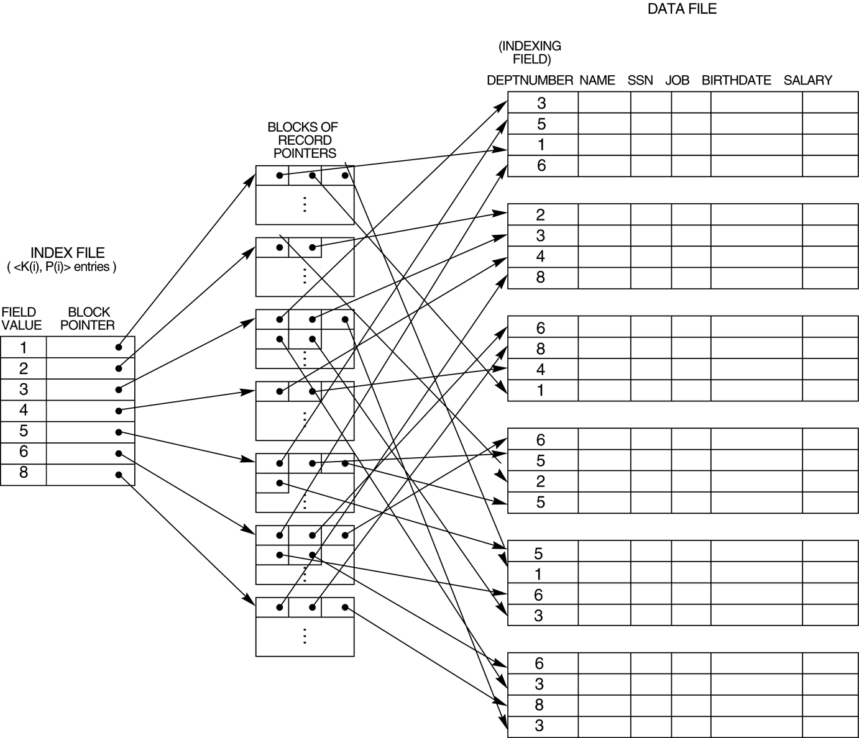
An Example of a Secondary Index
FIGURE 17.5
A secondary index (with recorded pointers) on a non-key field implemented using one level of indirection so that index entries are of fixed length and have unique field values.
Slide 17- <number>

Slide 20
Types of Indexes Based on The Properties of the Indexing Field
 | Index Field Used for Ordering the File | Index Field Not Used for Ordering the File
Indexing field is key | Primary Index | Secondary Index (Key)
Indexing field is nonkey | Clustering Index | Secondary Index (NonKey)
 | Ordered | Non-ordered
Key | Primary Index | Secondary Index (Key)
NonKey | Clustering Index | Secondary Index (NonKey)
Slide 17- <number>

Slide 21
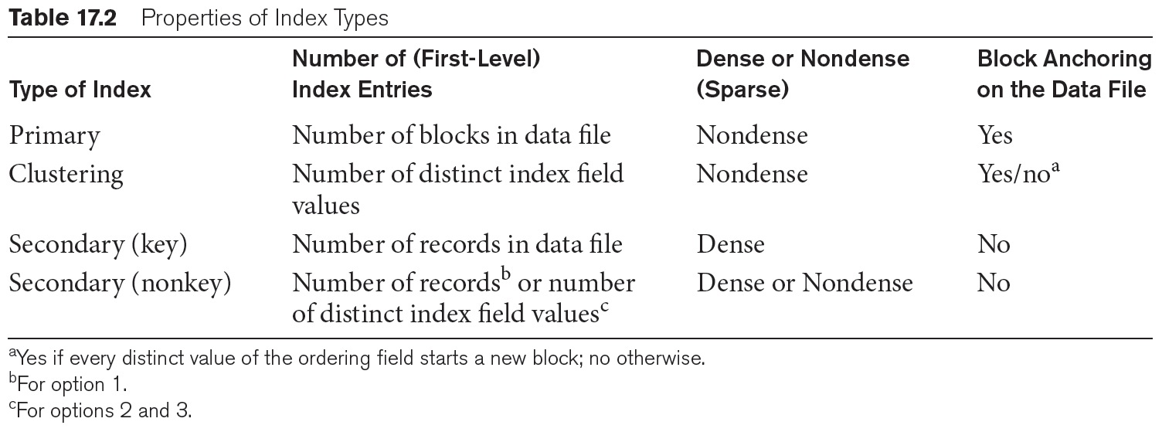
Properties of Index Types
Slide 14- <number>

Slide 22
Multi-Level Indexes
Because a single-level index is an ordered file, we can create a primary index to the index itself;
  In this case, the original index file is called the first-level index and the index to the index is called the second-level index.
We can repeat the process, creating a third, fourth, ..., top level until all entries of the top level fit in one disk block
A multi-level index can be created for any type of first-level index (primary, secondary, clustering) as long as the first-level index consists of more than one disk block
Slide 17- <number>

Slide 23
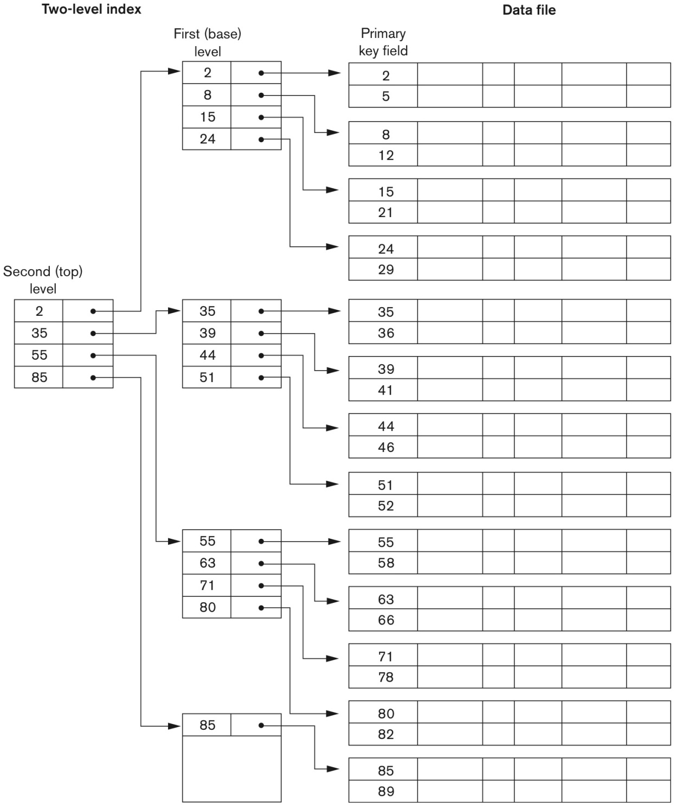
A Two-level Primary Index
FIGURE 17.6
A two-level primary index resembling ISAM (Indexed Sequential Access Method) organization.
Slide 17- <number>

Slide 24
Example 3
Convert Example 2 into a multilevel index
  bfr_{i} = fo (fan-out) = 68
  # of first-level blocks b₁ = 442 blocks
  # of second-level blocks b₂ = ⎡b₁/fo⎤ = ⎡442/68 ⎤ =7 blocks
  # of third-level blocks b₃ = ⎡b₂/fo⎤ = ⎡7/68⎤ = 1 block
  Therefore, third level is top level (t=3)
  Total block accesses = t+1 = 4 block accesses
Slide 17- <number>

Slide 25
Multi-Level Indexes
Such a multi-level index is a form of search tree
  However, insertion and deletion of new index entries is a severe problem because every level of the index is an ordered file.
  Dynamic multilevel index: leaves some space in each of its block for inserting new entries
  That is called B-tree or B⁺-tree
Slide 17- <number>

Slide 26
Dynamic Multilevel Indexes
Tree data structure
  A tree is formed of nodes
  Each node has one parent node (except root) and several child nodes.
  A root does not have parent node
  A leaf does not have child node
  A subtree of a node consists of that node and all its descendant nodes
Slide 17- <number>

Slide 27
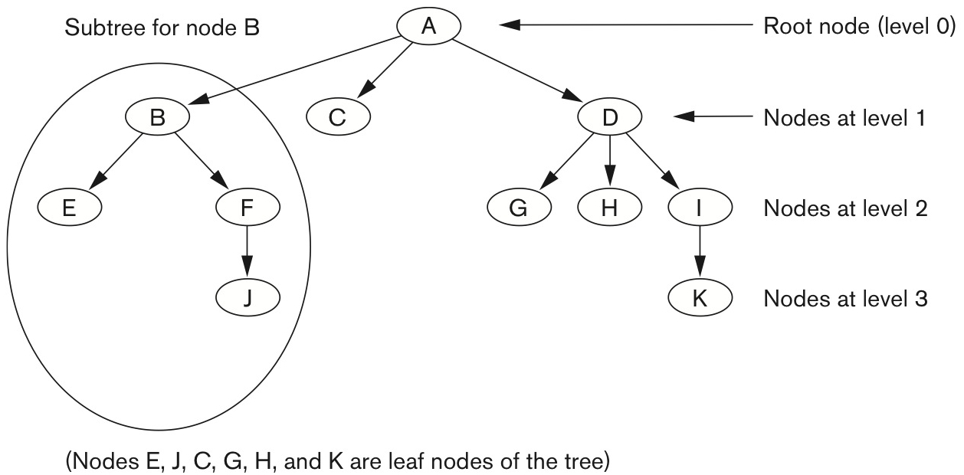
Example of a tree data structure
Figure 17.7 A tree data structure that shows an unbalanced tree.
Slide 17- <number>

Slide 28
Search Tree
A search tree of order p is a tree such that
  Each node contains at most p-1 search values, and
  P pointers in the order of <P₁, K₁, P₂, K₂,…, P_{q-1}, K_{q-1}, P_{q}>
    (P_{i} is pointer to a child node, and K_{i} is a search value)
  Two constraints must hold at all times on the search tree
    Within each node K₁ < K₂ < … < K_{q-1}
    For all values X in the subtree pointed at by P, we have K_{i-1} <X< K_{i} for 1<i<q; X< K_{i} for i=1, and K_{i-1}<X for i=q
Slide 17- <number>

Slide 29
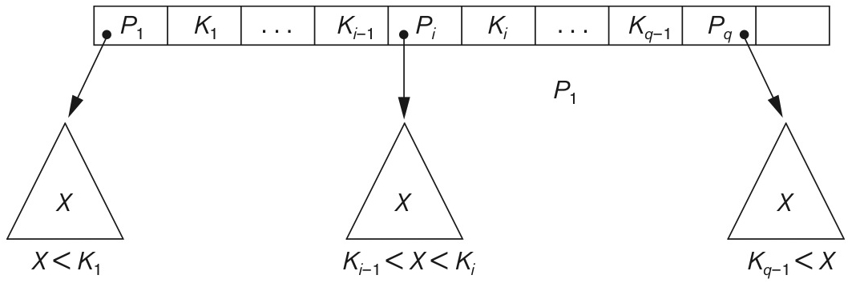
A Node in a Search Tree with Pointers to Subtrees below It
Figure 17.8 A node in a search tree with pointers to subtrees below it.
Slide 17- <number>

Slide 30
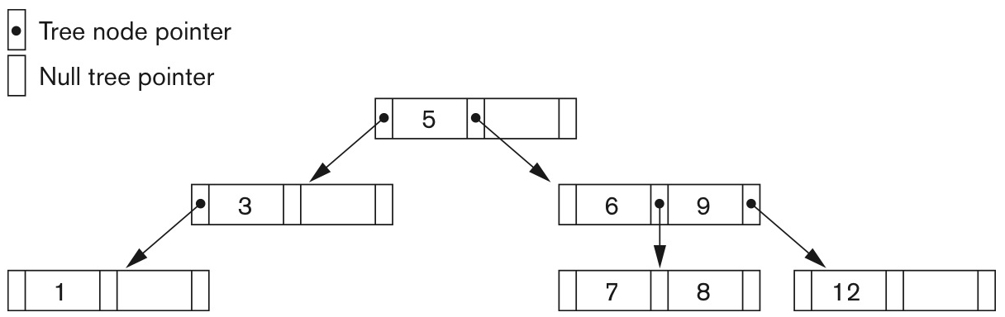
FIGURE 17.9
A search tree of order p = 3.
Slide 17- <number>

Slide 31
Dynamic Multilevel Indexes Using B-Trees and B⁺-Trees
Most multi-level indexes use B-tree or B⁺-tree data structures because of the insertion and deletion problem
  This leaves space in each tree node (disk block) to allow for new index entries
These data structures are variations of search trees that allow efficient insertion and deletion of new search values.
In B-Tree and B⁺-Tree data structures, each node corresponds to a disk block
Each node is kept between half-full and completely full
Slide 17- <number>

Slide 32
Dynamic Multilevel Indexes Using B-Trees and B⁺-Trees (contd.)
An insertion into a node that is not full is quite efficient
  If a node is full the insertion causes a split into two nodes
Splitting may propagate to other tree levels
A deletion is quite efficient if a node does not become less than half full
If a deletion causes a node to become less than half full, it must be merged with neighboring nodes
Slide 17- <number>

Slide 33
Difference between B-tree and B⁺-tree
In a B-tree, pointers to data records exist at all levels of the tree
In a B⁺-tree, all pointers to data records exists at the leaf-level nodes
A B⁺-tree can have less levels (or higher capacity of search values) than the corresponding B-tree
Slide 17- <number>

Slide 34
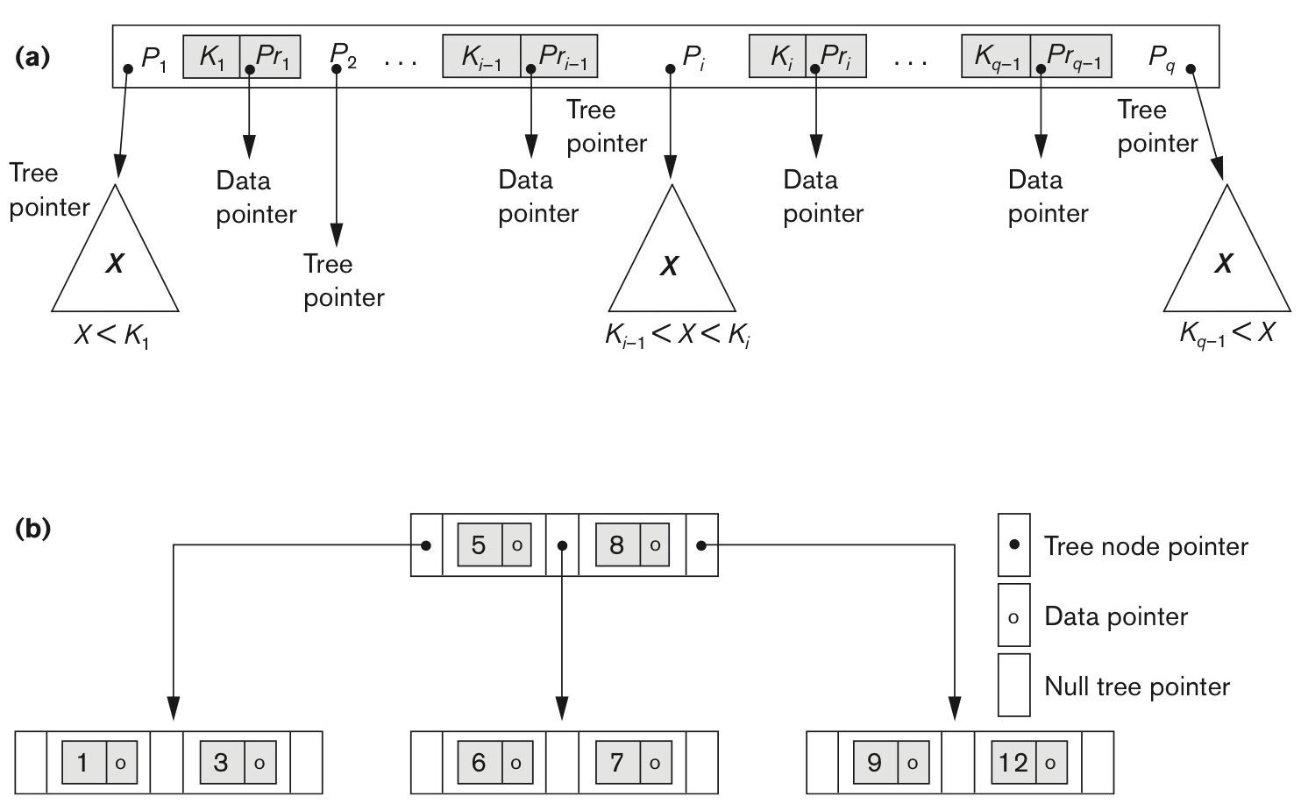
B-tree Structures
Figure 17.10 B-tree structures. (a) A node in a B-tree with q − 1 search values. (b) A B-tree of order p = 3. The values were inserted in the order 8, 5, 1, 7, 3, 12, 9, 6.
Slide 17- <number>

Slide 35
B-tree of order p
Each internal node in the B-tree
<P₁,<K₁,Pr₁>,P₂,<K₂,Pr₂>, …, <K_{q-1},Pr_{q-1}>,P_{q}> where q ≤ p
P_{i}: tree pointer, and Pr_{i}: data pointer
Within each node, K₁<K₂<. . .<K_{q-1}
For all search key field values X in the subtree
K_{i-1}<X<K_{i} for 1<i<q, X<K_{i} for i=1, and K_{i-1}<X for i=q
Each node has at most p tree pointers
Each node has at least ⎡p/2⎤ tree pointers
A node with q tree pointers, q ≤ p, has q-1 search key field values
All leaf nodes are at the same level. Leaf nodes have the same structure as internal nodes
Slide 17- <number>

Slide 36
Example 4: Order p of B-tree
Search field V=9 bytes,
Block size B=512 bytes,
Data pointer Pr=7 bytes, and
Block pointer P=6 bytes
  At most p tree pointers, p-1 data pointers, and p-1 search key fields, which should be in a single block
  (p*P) + ((p-1)*(Pr+V)) ≤ B
  (p*6) + ((p-1)*(7+9)) ≤ 512
  (22*p) ≤ 528
  Therefore, p = 23 (not 24)
Slide 17- <number>
Notes:
P != 24 because of the extra info should be stored in a node, such as the number of entries q, and a pointer to the parent node

Slide 37
Example 5: #of Blocks and Levels
Search field of Example 4 = nonordering key field
Each node of B-tree is 69 % full
  Each node will have p*0.69 = 23 * 0.69 = 16 pointers, and 15 search key field values. fo = 16
  Root: 1 node 15 entries 16 pointers
  Level1: 16 nodes 240 entries 256 pointers
  Level2: 256 nodes 3840 entries 4096 pointers
  Level3: 4096 nodes 61440 entries
  For example, two-level (3840+240+15=4095), or three-level (65,535 entries)
Slide 17- <number>

Slide 38
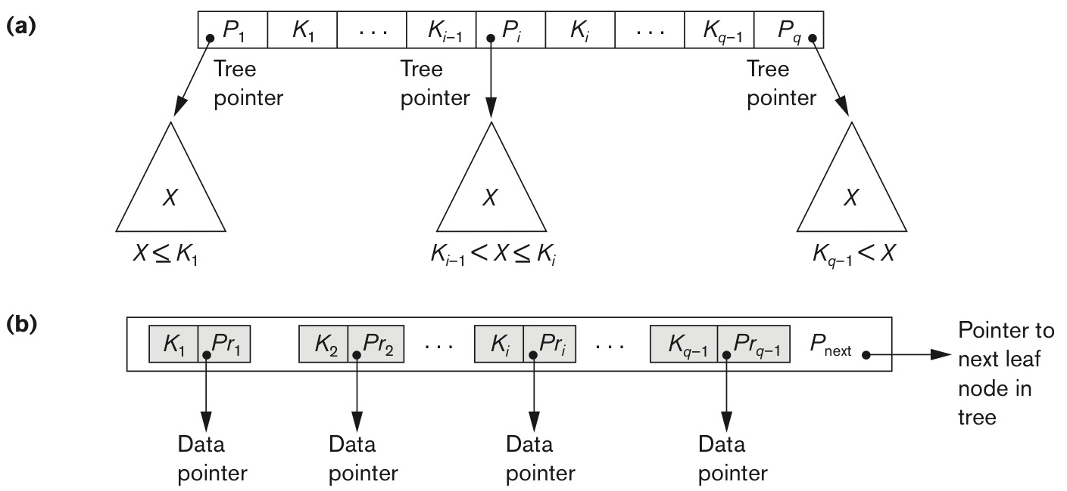
The Nodes of a B⁺-tree
Figure 17.11 The nodes of a B⁺-tree. (a) Internal node of a B⁺-tree with q − 1 search values. (b) Leaf node of a B⁺-tree with q − 1 search values and q − 1 data pointers.
Slide 17- <number>

Slide 39
B⁺-tree of order p (Internal nodes)
Each internal node is
<P₁,K₁,P₂,K₂, …,P_{q-1},K_{q-1} P_{q}> where q ≤ p,
each P_{i} is a tree pointer
Within each internal node, K₁<K₂<. . .<K_{q-1}
For all search field values X in the subtree pointed at by Pi, K_{i-1}<X<K_{i} for 1<i<q, X<K_{i} for i=1, and K_{i-1}<X for i=q
Each internal node has at most p tree pointers
Each internal node has at least ⎡p/2⎤ tree pointers
An internal node with q pointers q ≤ p, has q-1 search field values
Slide 17- <number>

Slide 40
B⁺-tree of order p (leaf nodes)
Each leaf node is
<<K₁,Pr₁>, <K₂,Pr₂>,…, <K_{q-1},Pr_{q-1}>,P_{next}> where q ≤ p, each Pr_{i} is a data pointer, and P_{next} points to the next leaf node
Within each leaf node, K₁<K₂<. . .<K_{q-1},q ≤ p
Each Pr_{i} is a data pointer points to K_{i} search field value
Each leaf node has at least ⎡p/2⎤ values
All leaf nodes are at the same level
Slide 17- <number>

Slide 41
Example 6: Order p of B⁺-tree
Search field V=9 bytes,
Block size B=512 bytes,
Data pointer Pr=7 bytes, and
Block pointer P=6 bytes
  At most p tree pointers, and p-1 search key fields, which should be in a single block
  (p*P) + ((p-1)*V) ≤ B
  (p*6) + ((p-1)*9) ≤ 512
  (15*p) ≤ 521
  Therefore, p = 34
  The leaf node order p_{leaf}
  (p_{leaf}*(Pr+V)) + P ≤ B (p_{leaf}*(7+9) + 6) ≤ 512
  (16* p_{leaf}) ≤ 506 ➔ p_{leaf} = 31
Slide 17- <number>

Slide 42
Example 7: # of Entries
Construct B+-tree for Example 6
Each node of B-tree is 69 % full
  Each node will have 34 * 0.69 = 23 pointers, and 22 search key field values.
  Each leaf node 0.69*p_{leaf} = 0.69 * 31 ➔ 21 data record pointer
  Root: 1 node 22 entries 23 pointers
  Level1: 23 nodes 506 entries 529 pointers
  Level2: 529 nodes 11,638 entries 12,167 pointers
  Level3: 12,167 nodes 255,507 data record pointer
  (leaf nodes are in level 3)
  For example, three-level B+-tree 255,507 record pointers
Slide 17- <number>

Slide 43
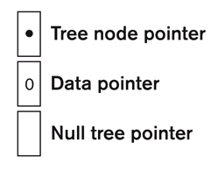
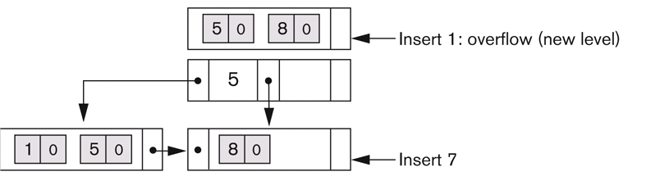
Insertion with B⁺-tree
p = 3 and p_{leaf} = 2
Insertion sequence
  8, 5, 1, 7, 3, 12, 9, 6
Insert 8, 5, 1
Slide 17- <number>

Slide 44
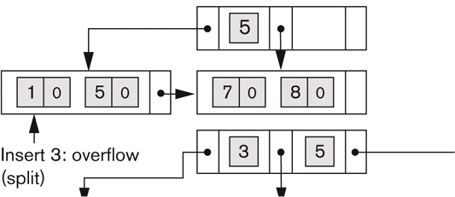
Insertion with B⁺-tree
Insert 7, 3
Slide 17- <number>

Slide 45
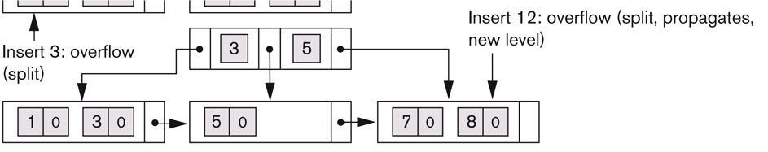
Insertion with B⁺-tree
Insert 12
Slide 17- <number>

Slide 46
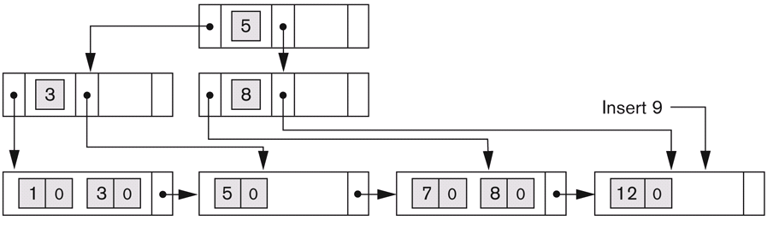
Insertion with B⁺-tree
Insert 9
Slide 17- <number>

Slide 47
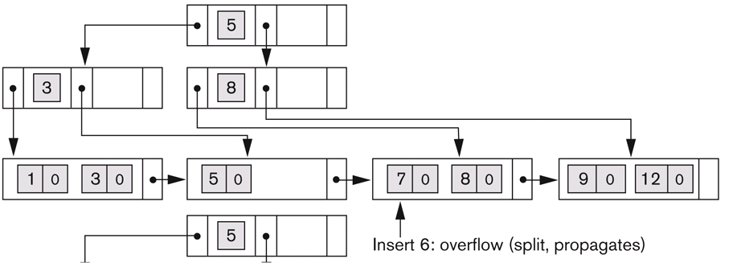
Insertion with B⁺-tree
Insert 6
Slide 17- <number>

Slide 48
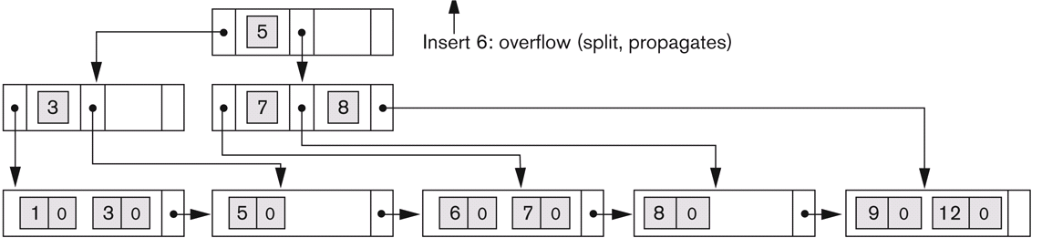
Insertion with B⁺-tree
Done
Slide 17- <number>

Slide 49
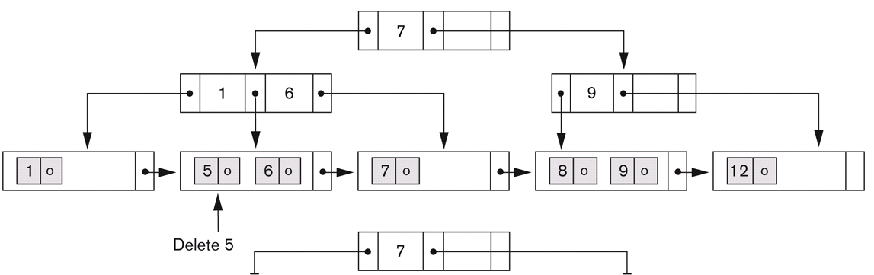
Deletion with B⁺-tree
Deletion sequence: 5,12, 9
Delete 5
Slide 17- <number>

Slide 50
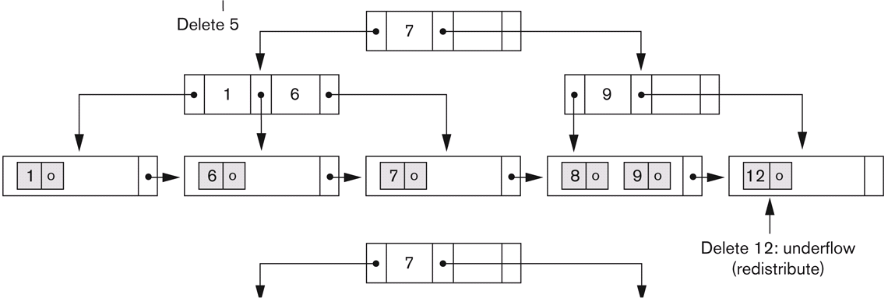
Deletion with B⁺-tree
Delete 12
Slide 17- <number>

Slide 51
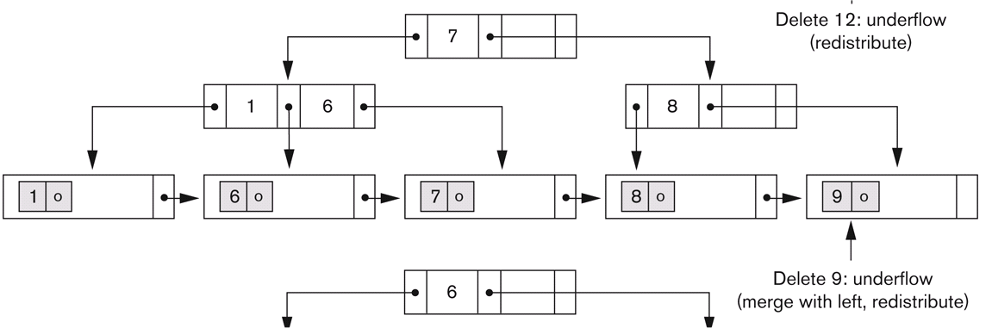
Deletion with B⁺-tree
Delete 9
Slide 17- <number>

Slide 52
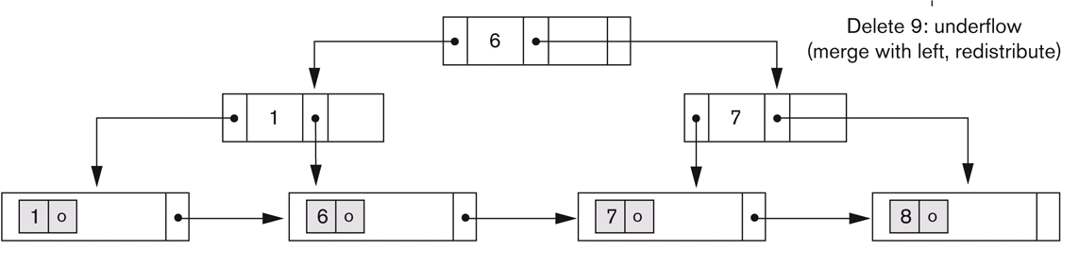
Deletion with B⁺-tree
Done
Slide 17- <number>

Slide 53
Summary
Types of Single-level Ordered Indexes
  Primary Indexes
  Clustering Indexes
  Secondary Indexes
Multilevel Indexes
Dynamic Multilevel Indexes Using B-Trees and B+-Trees
Indexes on Multiple Keys
Slide 17- <number>

