Slide 1
One

Slide 2
Git
Version Control System
Used by more than 80% of the programming community
Let’s use it!!!

Slide 3
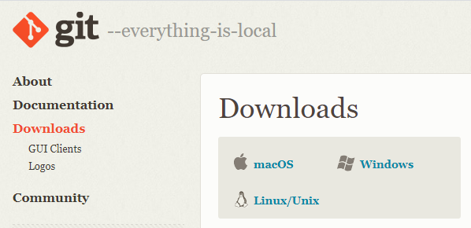
Install Git

Slide 4
git config --global user.name "FIRST_NAME LAST_NAME“
git config --global user.email "MY_NAME@example.com"

Slide 5

Create GitHub Account

Slide 6
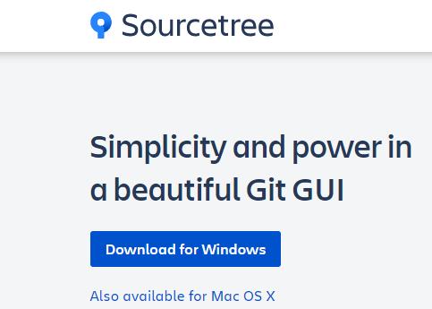
Install Sourcetree

Slide 7
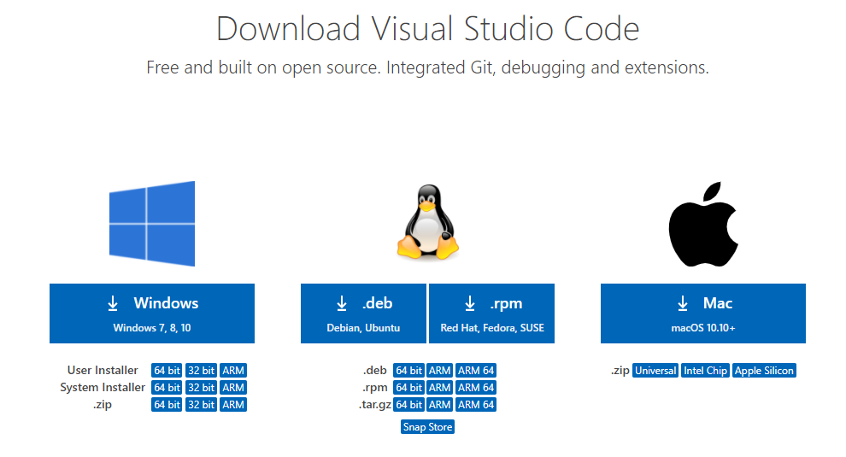
Install VS Code

Slide 8

Create a new folder

Slide 9

Initialize a Repository
git init

Slide 10

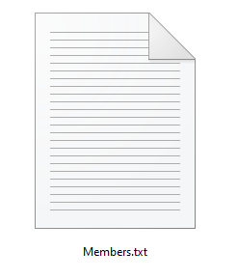
Create a Members.txt File

Slide 11
Commit
Add file:
git add Members.txt
Commit File:
git commit –m “Initial Commit”

