Slide 1
Electrical Water Heater

Slide 2
Presented by
“Youssef Hussein ismail”
“Samir adel”
“Abdelrahman Mohamed Soliman”
Supervised by
“AMIT”

Slide 3
Introduction
Water heaters are devices used to heat the surrounding water. This is best suitable for industrial application where the thermostatic control will automatically turn on or off when it reaches the temperature you set.

Slide 4
Specifications
1-Temperature Setting
2-ON/OFF Behavior
3-Temperature Sensing
4-Heating and Cooling Elements
5-Seven Segments
6-Heating Element Led

Slide 5
Components
24C08 EEPROM, or use the internal
Temp sensor (LM35, OR equivalent DS18B20)
Cooling element (Peltier)
Heating Element (3d ceramic heater)
7-Segments
LEDs
Push Buttons
Solid State Relays
Cooling Fins and Fans

Slide 6
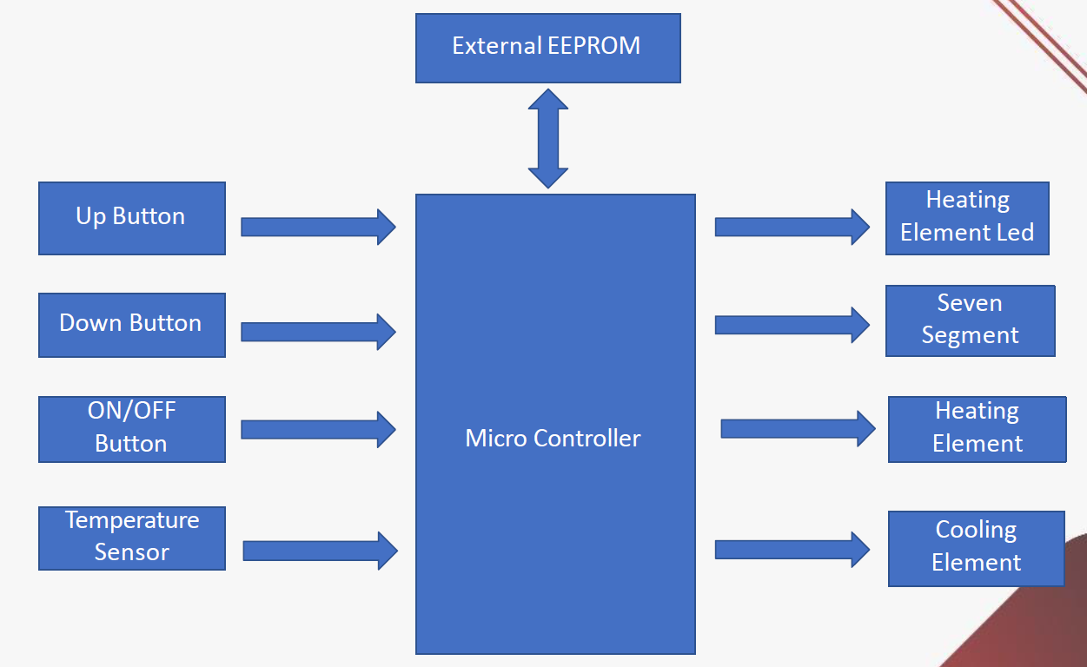
Block Diagram

Slide 7
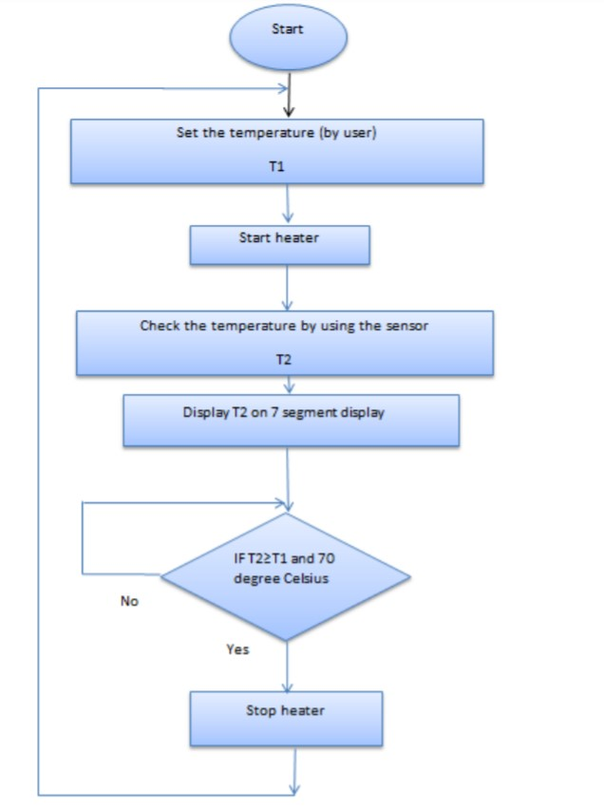
Flow Chart
The flow chart presented is the logic developed to make a responsive system that would react to change in temperature with the help of microcontroller and sensor. By this way we can
easily understand the logic behind the temperature control. The user needs to start the water heater by plugging it to the power source, and then it can be operated to a desired temperature
level by entering the temperature value (T1) in degree Celsius, using the push button.

Slide 8
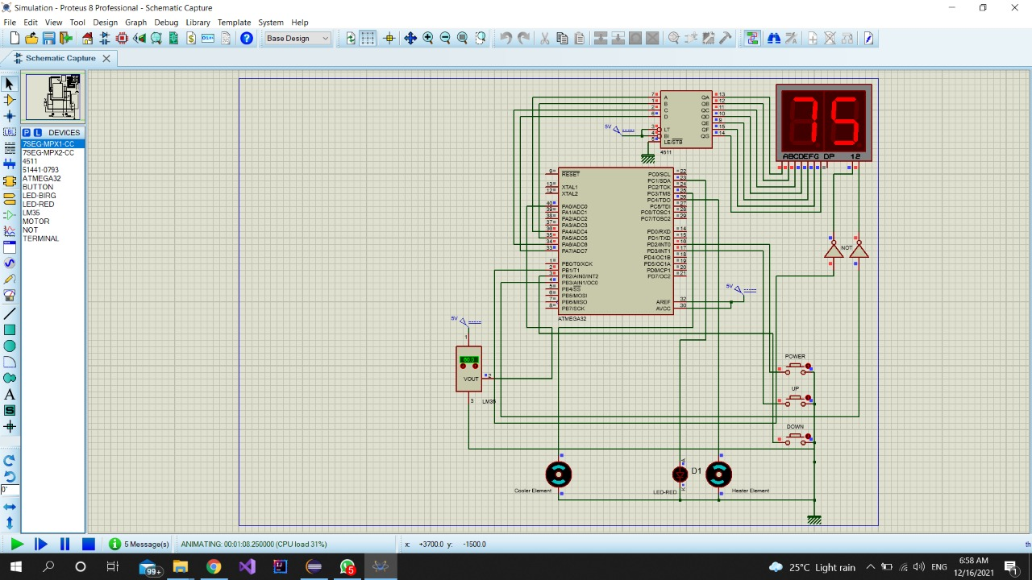
Simulation Screenshot

Slide 9
Thank You

