Slide 1
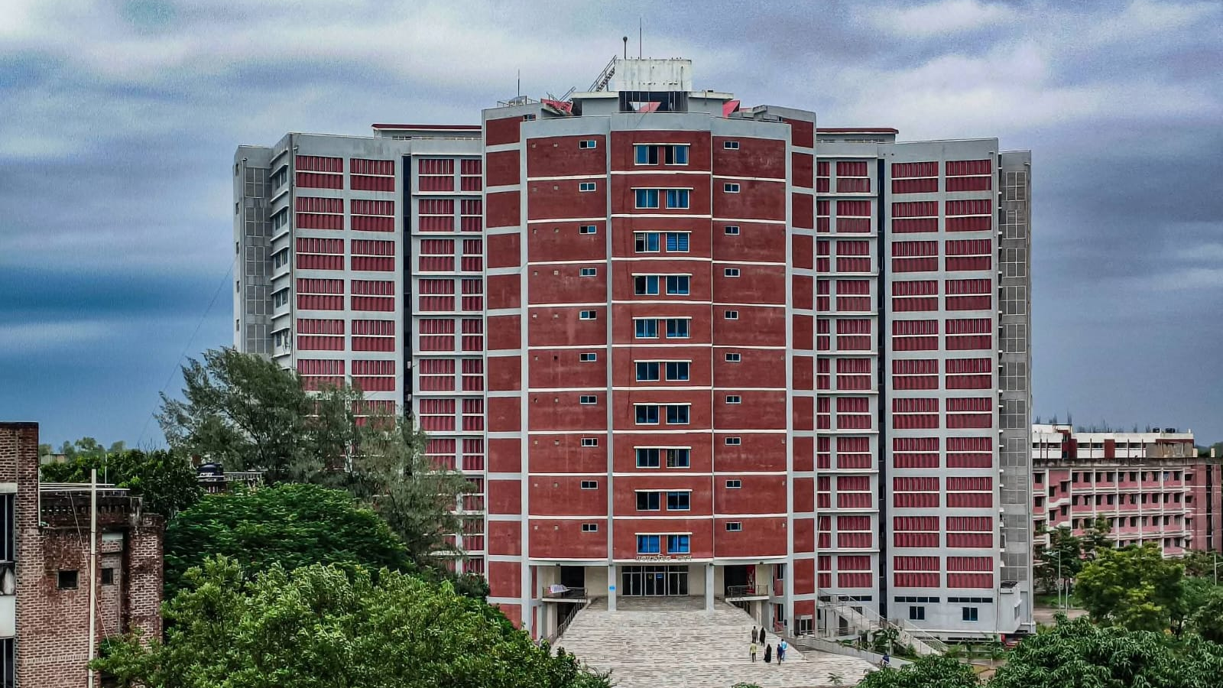


Mawlana Bhashani Science and Technology University
Department of ICT
Santosh, Tangail
Simple Mail Transfer Protocol (SMTP)
How the Internet sends, relays and delivers email
Presented By
Supervised By
MD. Samir Tahrian
Dr. Nazrul Islam
ID: IT-24007
Dept. of ICT, MBSTU
Associate Professor
Dept. of ICT, MBSTU
Course title: Data Communication | Course code: ICT-3101
Application-layer protocol | Email transport
Notes:
Introduce yourself, your supervisor, the course and the topic. SMTP is the protocol that moves email across the Internet.

Slide 2

Mawlana Bhashani Science and Technology University
Department of ICT | Santosh, Tangail
Introduction and History of SMTP
SMTP is the standard application-layer protocol that moves email from a sender's mail client to the recipient's mail server.
TCP
25 · 587 · 465
RFC 5321
Push
Reliable transport
Well-known ports
Current core standard
Sender initiates transfer
History
1971
1982
1995
2008
2018
First network email
RFC 821
RFC 1869
RFC 5321
RFC 8314
Ray Tomlinson, ARPANET, uses the @ sign
SMTP standardised (RFC 788 in 1981 was first)
ESMTP: EHLO and extensions
Current SMTP standard
TLS by default for submission
SMTP (Simple Mail Transfer Protocol)
MD. Samir Tahrian | IT-24007
02
Notes:
SMTP only transports mail and is a push protocol. Email matters for business, banking, education and OTP/verification. Each RFC refined SMTP while staying backward compatible.

Slide 3
Mawlana Bhashani Science and Technology University
Department of ICT | Santosh, Tangail
Email System Architecture
Sender's MUA
Mail client such as Outlook or Gmail app
SMTP
(587)
Sending MTA
Outgoing mail server
SMTP
(25)
Receiving MTA
Recipient domain's mail server
Local
delivery
MDA + Mailbox
Stores the message
IMAP /
POP3
Recipient's MUA
Reads the mail
MUA: Mail User Agent
MSA: Mail Submission Agent
MTA: Mail Transfer Agent
MDA: Mail Delivery Agent
The client the person uses to write and read email.
Accepts new mail from clients, usually on port 587, after login.
Relays mail between servers using SMTP (Postfix, Exim, Exchange).
Places the final message into the user's mailbox.
SMTP (Simple Mail Transfer Protocol)
MD. Samir Tahrian | IT-24007
03
Notes:
Five parties take part. MUA = client, MSA accepts submission, MTA relays, MDA stores in the mailbox.

Slide 4
Mawlana Bhashani Science and Technology University
Department of ICT | Santosh, Tangail
How an Email Travels
1
Compose
2
Submit
3
DNS lookup
The user writes the message in a mail client (MUA).
The client sends it to the outgoing server over SMTP, usually port 587, after login.
The sending MTA asks DNS for the MX record of the recipient's domain.
4
Relay
5
Deliver
6
Retrieve
It opens a TCP connection to the receiving MTA on port 25 and transfers the message.
The MDA stores the message in the recipient's mailbox.
The recipient reads it using IMAP, POP3 or webmail.
DNS and MX records: a lower preference number means higher priority; backup MX servers accept mail if the primary is down; with no MX record the sender falls back to the domain's A/AAAA record.
SMTP (Simple Mail Transfer Protocol)
MD. Samir Tahrian | IT-24007
04
Notes:
Six steps from clicking Send to reading the message. DNS MX records tell the sender which server accepts mail for the domain.

Slide 5
Mawlana Bhashani Science and Technology University
Department of ICT | Santosh, Tangail
Characteristics and Ports
Text-based: readable ASCII commands and replies ending in CRLF
Runs over TCP: reliable, ordered delivery
Push protocol: the sender pushes mail; it cannot pull
Client-server: sending side is the client, receiving side the server
Command-reply: every command gets a numeric reply code
Store and forward: servers queue mail and retry later
Port | Name | Purpose | Encryption
25 | SMTP | Server-to-server relay (MTA to MTA) | Optional STARTTLS
587 | Submission | Client to server submission (RFC 6409) | STARTTLS and login
465 | SMTPS | Submission over implicit TLS (RFC 8314) | TLS from first byte
2525 | Alternative | Unofficial fallback used by some providers | Usually STARTTLS
SMTP (Simple Mail Transfer Protocol)
MD. Samir Tahrian | IT-24007
05
Notes:
Six properties explain SMTP's strengths and weaknesses. Port 25 is for relay, 587 and 465 are for client submission.

Slide 6
Mawlana Bhashani Science and Technology University
Department of ICT | Santosh, Tangail
SMTP Commands and Reply Codes
Command | Purpose
EHLO | Greets the server and lists its extensions
MAIL FROM | Starts a transaction with the sender address
RCPT TO | Names one recipient (repeat for more)
DATA | Begins the message; ends with a lone dot line
RSET | Aborts the current transaction
VRFY | Checks whether a mailbox exists (often disabled)
STARTTLS | Upgrades the connection to TLS
AUTH | Authenticates the client (RFC 4954)
QUIT | Ends the session politely
2xx
Success
250 OK, 220 Ready, 221 Closing
3xx
Intermediate
354 Start mail input
4xx
Temporary failure
421 Unavailable, 450 Mailbox busy
5xx
Permanent failure
550 No such mailbox, 554 Failed
SMTP (Simple Mail Transfer Protocol)
MD. Samir Tahrian | IT-24007
06
Notes:
MAIL FROM and RCPT TO form the envelope. First digit of a reply: 2 success, 3 more input, 4 try later, 5 permanent failure.

Slide 7
Mawlana Bhashani Science and Technology University
Department of ICT | Santosh, Tangail
A Complete SMTP Session
S: 220 mx.example.com ESMTP ready
C: EHLO mail.sender.org
S: 250 mx.example.com Hello
C: MAIL FROM:<alice@sender.org>
S: 250 2.1.0 Sender OK
C: RCPT TO:<bob@example.com>
S: 250 2.1.5 Recipient OK
C: DATA
S: 354 Start mail input
C: From: Alice <alice@sender.org>
C: To: Bob <bob@example.com>
C: Subject: Hello
C:
C: Hi Bob, this is a test.
C: .
S: 250 2.0.0 Queued as 4F2A1
C: QUIT
S: 221 2.0.0 Closing connection
1
Greeting
Server announces readiness (220); client identifies itself with EHLO.
2
Envelope
MAIL FROM and RCPT TO name the sender and recipients.
3
Data
Headers, a blank line, then the body, ended by a lone dot.
4
Close
Server queues the message (250); QUIT ends the session.
SMTP (Simple Mail Transfer Protocol)
MD. Samir Tahrian | IT-24007
07
Notes:
C is the client, S is the server. The dot on its own line ends the message body.

Slide 8
Mawlana Bhashani Science and Technology University
Department of ICT | Santosh, Tangail
Message Format and MIME
ENVELOPE (used by SMTP)
MAIL FROM:<a@sender.org> RCPT TO:<b@example.com>
MIME (RFC 2045) lets 7-bit ASCII SMTP carry attachments, images and non-English text.
HEADER (RFC 5322)
MIME-Version: 1.0
Content-Type: multipart/mixed; boundary="X"
Content-Transfer-Encoding: base64
Received: from mail.sender.org
From: Alice <alice@sender.org>
To: Bob <bob@example.com>
Subject: Meeting agenda
Date: Thu, 05 Nov 2026 11:09 +0600
Message-ID: <abc123@sender.org>
Content-Type | Used for
text/plain, text/html | Message text
multipart/mixed | Attachments
multipart/alternative | Plain + HTML
application/pdf | Documents
BODY
Text, HTML and attachments (MIME parts) after one blank line.
SMTP (Simple Mail Transfer Protocol)
MD. Samir Tahrian | IT-24007
08
Notes:
Envelope is used by SMTP for routing (Bcc exists only there). Header and body follow RFC 5322. MIME wraps binary as text; Base64 adds about 33% size.

Slide 9
Mawlana Bhashani Science and Technology University
Department of ICT | Santosh, Tangail
ESMTP Service Extensions
Extension | RFC | What it adds
STARTTLS | 3207 | Upgrade a plain connection to TLS encryption
AUTH | 4954 | Client authentication (PLAIN, LOGIN, OAuth)
SIZE | 1870 | Declare message size and server limit before sending
8BITMIME | 6152 | Send 8-bit data without extra encoding
PIPELINING | 2920 | Send several commands without waiting for each reply
DSN | 3461 | Delivery status notifications (success, delay, failure)
CHUNKING | 3030 | Transfer large messages in binary chunks (BDAT)
SMTPUTF8 | 6531 | Internationalised addresses and headers (UTF-8)
SMTP (Simple Mail Transfer Protocol)
MD. Samir Tahrian | IT-24007
09
Notes:
A client sends EHLO; the server lists which extensions it supports, so features can be added without breaking old servers.

Slide 10
Mawlana Bhashani Science and Technology University
Department of ICT | Santosh, Tangail
SMTP vs POP3 vs IMAP
Feature | SMTP | POP3 | IMAP
Purpose | Send and relay mail | Download mail | Access and sync mail
Direction | Push | Pull | Pull and synchronise
Ports | 25, 587, 465 | 110, 995 (TLS) | 143, 993 (TLS)
Mail stored | In server queues in transit | On the device; often removed from server | Kept on the server
Multiple devices | Not applicable | Limited | Excellent
Specification | RFC 5321 | RFC 1939 | RFC 9051 (IMAP4rev2)
SMTP (Simple Mail Transfer Protocol)
MD. Samir Tahrian | IT-24007
10
Notes:
SMTP sends mail; POP3 and IMAP let users retrieve it. A mail system needs both sides.

Slide 11
Mawlana Bhashani Science and Technology University
Department of ICT | Santosh, Tangail
Email Security: Threats and Protections
Threats
Protections
Sender spoofing: From is not verified
Spam and phishing
Open relay abuse
Eavesdropping (MITM) without TLS
STARTTLS stripping (downgrade)
Malware attachments and mail bombing
SPF
Domain lists the IPs allowed to send its mail in DNS; receivers check the sending IP.
RFC 7208
DKIM
Sender signs the message with a private key; receivers verify with the public key in DNS.
RFC 6376
DMARC
Requires domain alignment with SPF or DKIM; policy is none, quarantine or reject.
RFC 7489
Receiver checks: SPF, then DKIM, then DMARC policy, then inbox, spam or reject. Gmail and Yahoo require this for bulk senders (2024).
Also: TLS / STARTTLS, SMTP AUTH, MTA-STS and DANE
SMTP (Simple Mail Transfer Protocol)
MD. Samir Tahrian | IT-24007
11
Notes:
SMTP was designed in a trusting era: no sender verification and plain text by default. SPF, DKIM and DMARC work together in DNS.

Slide 12
Mawlana Bhashani Science and Technology University
Department of ICT | Santosh, Tangail
SMTP Software and Applications
Software / service | Highlights
Postfix | Open-source MTA by Wietse Venema (1998); secure and fast
Sendmail | Open-source MTA by Eric Allman (1983); very configurable
Exim | Open-source MTA from Cambridge (1995); Debian default
Microsoft Exchange | Enterprise mail and calendar server for Windows
Gmail SMTP | smtp.gmail.com on port 587 (STARTTLS) or 465 (TLS)
Amazon SES, SendGrid | Cloud services with API or SMTP interface for bulk mail
Real-world applications
Transactional email: OTP, receipts, password resets
Alerts: banking, security, monitoring
Newsletters and marketing campaigns
Institutional communication: universities, offices
Automated reports and backups
Web apps, IoT devices and printers via relay
SMTP (Simple Mail Transfer Protocol)
MD. Samir Tahrian | IT-24007
12
Notes:
Both self-hosted software and cloud services speak SMTP. SMTP is also used by software, not only by people typing email.

Slide 13
Mawlana Bhashani Science and Technology University
Department of ICT | Santosh, Tangail
Advantages, Limitations and Conclusion
Advantages
Limitations
Simple, text-based and easy to debug
Universal: every provider can exchange mail
Store-and-forward queues with retries
Extensible through ESMTP
No built-in sender authentication
Plain text unless TLS is used
Push only: needs POP3 or IMAP to read mail
Spam, abuse and size limits (e.g. 25 MB)
Conclusion: after more than 40 years, SMTP remains the backbone of Internet email because it is simple, extensible and universal.
Future: wider MTA-STS, DANE and DMARC enforcement, UTF-8 addresses and AI-based spam filtering.
SMTP (Simple Mail Transfer Protocol)
MD. Samir Tahrian | IT-24007
13
Notes:
Simple and universal, but the original design needs add-ons for security. Close with the key takeaway and future directions.

Slide 14
Mawlana Bhashani Science and Technology University
Department of ICT | Santosh, Tangail
Selected References
[1]
J. Klensin, “Simple Mail Transfer Protocol,” RFC 5321, IETF, Oct. 2008.
[2]
P. Resnick, “Internet Message Format,” RFC 5322, IETF, Oct. 2008.
[3]
N. Freed and N. Borenstein, “MIME Part One: Format of Internet Message Bodies,” RFC 2045, Nov. 1996.
[4]
P. Hoffman, “SMTP Service Extension for Secure SMTP over TLS,” RFC 3207, Feb. 2002.
[5]
S. Kitterman, “Sender Policy Framework (SPF),” RFC 7208, Apr. 2014.
[6]
D. Crocker, T. Hansen and M. Kucherawy, “DomainKeys Identified Mail (DKIM) Signatures,” RFC 6376, Sep. 2011.
[7]
M. Kucherawy and E. Zwicky, “DMARC,” RFC 7489, Mar. 2015.
[8]
K. Moore and C. Newman, “Cleartext Considered Obsolete: Use of TLS for Email Submission and Access,” RFC 8314, Jan. 2018.
[9]
J. Kurose and K. Ross, Computer Networking: A Top-Down Approach. Pearson.
SMTP (Simple Mail Transfer Protocol)
MD. Samir Tahrian | IT-24007
14
Notes:
References follow IEEE numbering.

Slide 15
Mawlana Bhashani Science and Technology University
Department of ICT | Santosh, Tangail
Thank you
Questions and Discussion
SMTP (Simple Mail Transfer Protocol)
MD. Samir Tahrian | IT-24007
15
Notes:
Thank the audience and invite questions.

