Slide 1
Welcome to my presentation
.

Slide 2
My presentation topic is…..
Pharmacy Inventory Management System

Slide 3
;
Submitted by
All-amin (samir)
Student id :213002019
Course code:Cse202
Submitted to
Ayesha Khatun
Co-ordinitor of GUB

Slide 4
.
The Pharmacy Inventory Management System is a project developed to automate medical stores’ activities and improve their productivity. This helps pharmacies organize, manage, and secure drug information efficiently.

Slide 5
Objective:
The main objective of the study is to develop a drug inventory system for pharmacy.
The main aim of the project is the management of the database of the pharmaceutical shop.
To improve the efficiency of the system by ensuring effective monitoring of services and activities.
Making the pharmacy organizations computerized by creating network through minimizing and decreasing malfunctioned works on the medical usage by giving correct information on each medicine.

Slide 6
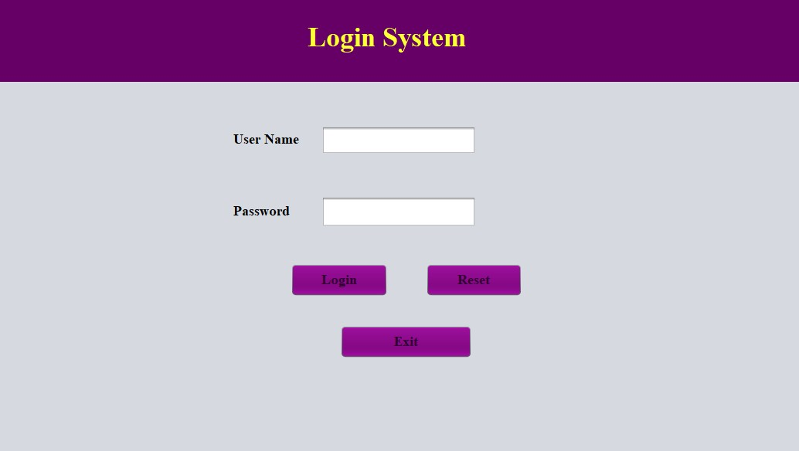
Design:

Slide 7
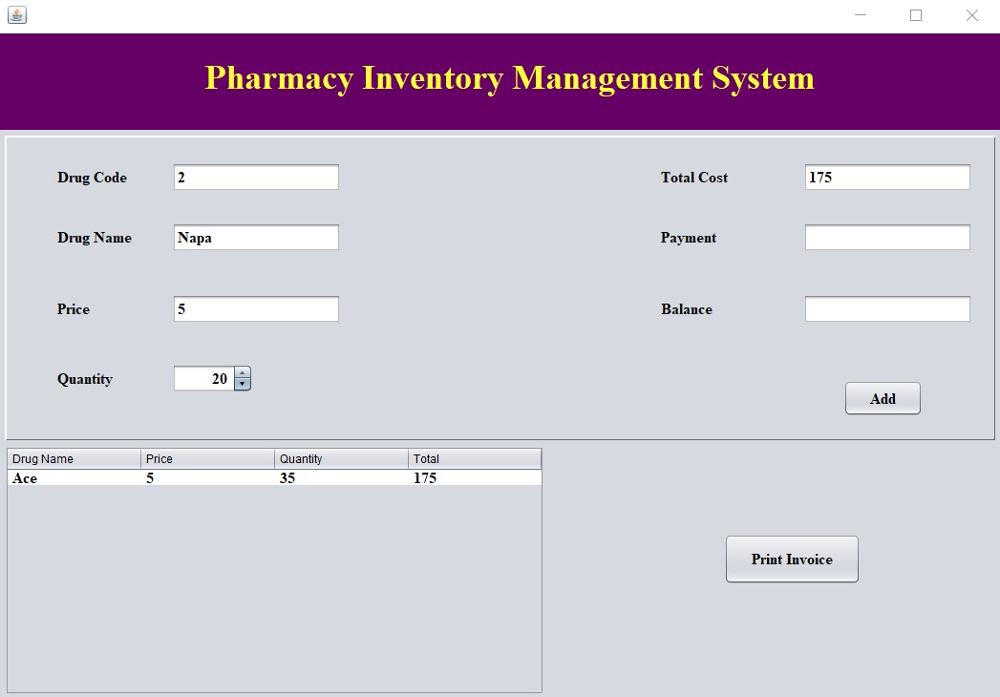
.
.

Slide 8
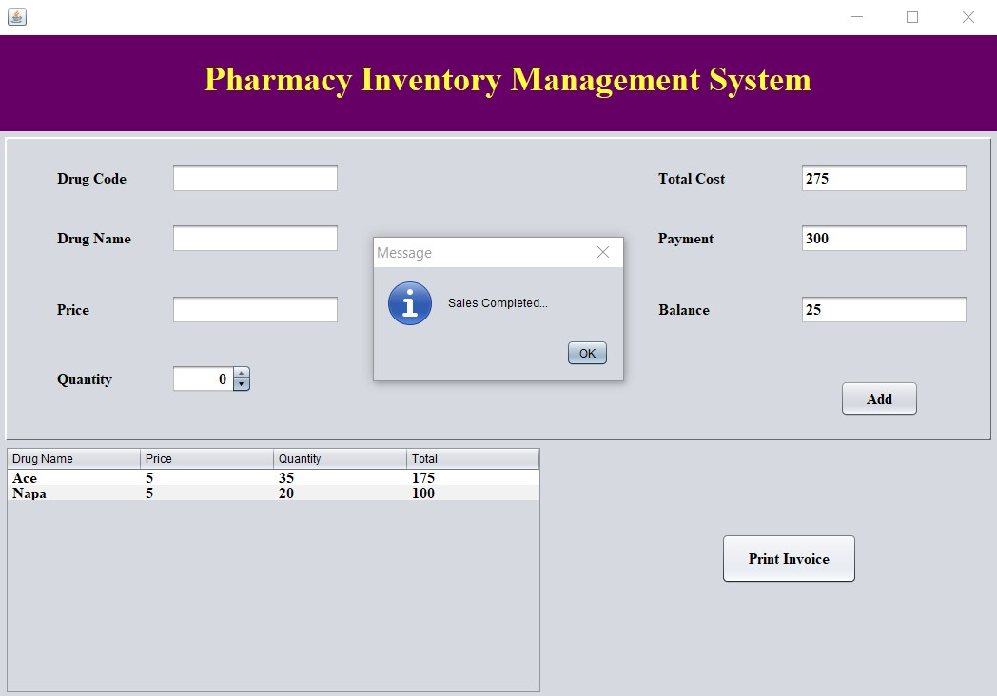
.

Slide 9
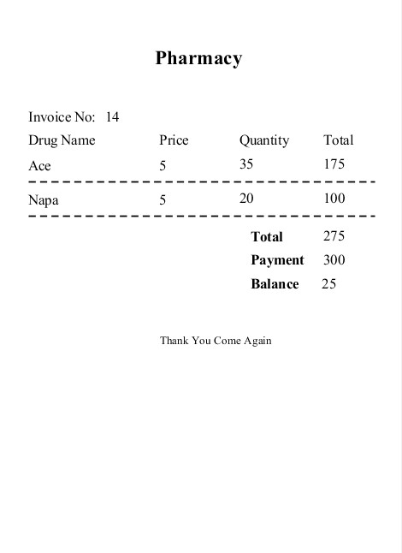
.
,

Slide 11
Conclusion:
The Pharmacy Inventory Management System is developed using Java and mysql servers. The project is built to manage pharmacy items and transactions. To make a new transaction, fields such as: drag name, qty and payment needs to be selected. If you like to learn point of sales systems step by step, this is the right place to learn from the beginning. In this tutorial, we will learn crystal reports step by step and design and print receipts for the payments.

Slide 12
.
Thank you
Do you have any question?

