Slide 1
Lecture 5 SMART SENSORS and SMART ACTUATORS
CC5053NP - Cloud Computing and the Internet of Things

Slide 2
Lecture Objectives
Sensors
Sensor Output
Smart Sensor
Smart Sensor Types
Smart Actuator and Types
Advantages of using Smart Sensors and Actuators
Case Studies

Slide 3


What is a Sensor
Device that senses a physical quantity
This physical quantity becomes input to the sensor
Output of the sensor is an electrical quantity
Input is called measured quantity or “measurand”
Input (Physical quantity
or Measurand)
Sensor
Output (Electrical quantity)

Slide 4
Sensor Output
The electrical output of a sensor can be one of the two types:
Variation of an electrical parameter: Passive Sensor
An electrical signal: Active Sensor
Variation of electrical parameter means
Variation of resistance
Variation of inductance
Variation of capacitance
Electrical signal means
Voltage signal, or
Current signal

Slide 5
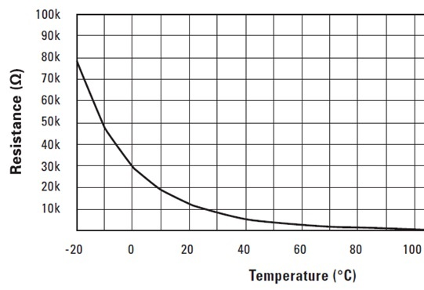
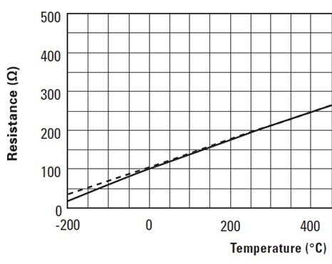
Sensor Output
Notes:
Reference: https://www.ti.com/document-viewer/lit/html/SSZTCA2

Slide 6
Smart Sensors
Most of the sensors now labeled as Smart Sensors by the manufacturers:
“Smart Sensor is a micro-sensor integrated with appropriate micro-electronics, such that the final output is fully or easily compatible with the intended end device or devices”
Indicating device
Display device
Storage device
Comm. device
Controller
Micro-
sensor
Micro-
electronics
Electrical output signal
Measurand
Integrated together

Slide 7
Level Of Integration
The output signal of smart sensor can have one of three forms:
Analog
Digital
PWM
Extent/ level of integration of electronics with the micro-sensor:
Lowest Level: Smart sensor with analog output
Low Level:
High Level:
Smart sensor with pwm output
Smart sensor with digital output
Higher Level: Smart intelligent sensor
Highest Level: Smart network sensor

Slide 8
Smart Sensor with Analog Output
Analog signal processing Unit (ASPU)
Analog output signal
e.g. 0-1 V
0-5 V
4-20 mA
0-20 mA
Micro- sensor
Integrated together

Slide 9
Smart Sensor with PWM Output
Analog voltage output
Micro-
sensor
PWM output
ASPU
PWM
Integrated together
Pulse width » Measurand

Slide 10
Smart Sensor with Digital Output
Analog voltage output
Micro-
sensor
ASPU
ADC
Digital output
0 – 5V to
0-1023 values
Integrated together

Slide 11



Smart Intelligent Sensor
Analog signal
Digital signal (data)
Micro- sensor
ASPU
ADC
Data processing unit (DPU)
Processed data (serial or parallel)
Integrated together
DPU = Microcontroller
OR
uP + memory + I/O interface
Can be readily connected to a host computer or other digital system

Slide 12

Smart Network Sensor
Micro-
sensor
ASPU
ADC
Comm.
interface
Network port
DPU
output
Data Network
Output: processed data on integrated network port in appropriate format

Slide 13
Smart Actuators
Communication/ PWM / Analog Interface
DPU / microController
Driver/ Power Stage
Actuator
Set point
Feedback
“Smart Actuator is an actuator integrated with its own control and signal processing unit, so that it can enhance traditional actuators with intelligence, network communication, and control logic.”

Slide 14
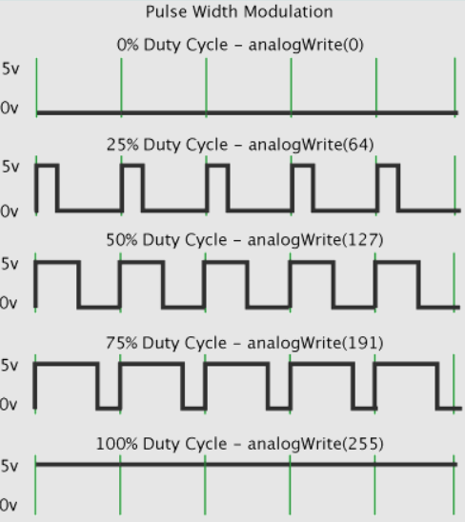
Smart Actuators
Analog Actuators
Accept analog input signals (e.g., 0–10V, 4–20mA).
The actuator's position or speed varies proportionally to the input.
Digital Actuators
Receive on/off or discrete position commands.
Example: Open/close valve, forward/reverse motor.
PWM-Controlled Actuators
Input is a digital pulse with varying duty cycle.
Used in DC motor control, servo motors, lighting systems.

Slide 15
Smart Actuators
Smart Intelligent Actuators
Embedded microcontroller
Can execute tasks autonomously (e.g., self-calibration, diagnostics).
Often integrate sensors internally for feedback (position, temperature, etc.).
Smart Networked Actuators
Allow multiple actuators to be controlled from a central Controller or cloud platform.
Wireless Smart Actuators, Ideal for hard-to-reach locations or battery-powered systems.

Slide 16
Advantages of Smart Sensor and Actuator (1)
User’s Convenience because of:
No wiring
Compact size
No headache of selecting extra circuit
No headache of designing extra circuit
Superior Performance because:
External noise/disturbance effect is absent.
Built-in device-specific circuits perform better
Built-in feedback reduces error
Built-in compensating circuits reduce sensitivity to temperature.

Slide 17
Advantages of Smart Sensor and Actuator (2)
High Reliability because of:
Reduced component count
Reduced wiring
Cost Reduction because of:
Concurrent production of electronics and sensor
Mass production techniques

Slide 18

Case Study #1
Smart Three-Terminal Temperature Sensor
Manufacturer: National Semiconductor Corporation Website: www.national.com

Slide 19
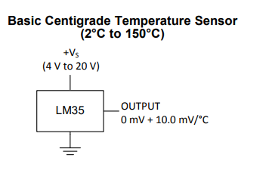

LM35.…….
Major Specifications
LM35: Centigrade (or Celcius) Temperature Sensor
Basic Range: 2 to 150 °C
Output: 10 mV/°C
Accuracy: ±0.2 °C (typical)
Gives Linear Output
Datasheet for different modes

Slide 20
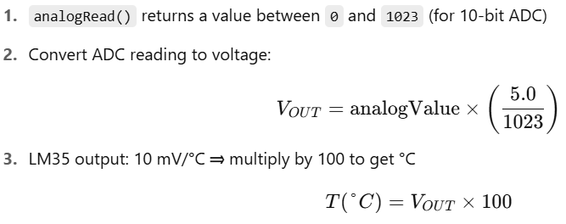
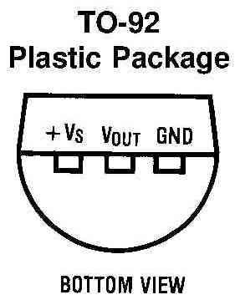
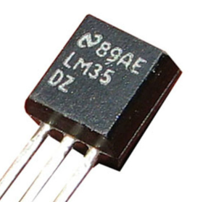
LM35.…….
Interfacing with Arduino

Slide 21
Case Study #2
LCD with I2C Interface:
Inter-Integrated Circuit: a two wire synchronous communication protocol
Wires:
SDA (Serial Data) – transfers data
SCL (Serial Clock) – synchronizes data transfer
Reduces number of pins needed to just 2 (SDA, SCL)
Easier wiring and cleaner circuit design
Can connect multiple I2C devices with just 2 wires and GND
LCD: Liquid Crystal Display
16x2 or 20x4 characters LCD
Common I2C address: 0x27 or 0x3F

Slide 22
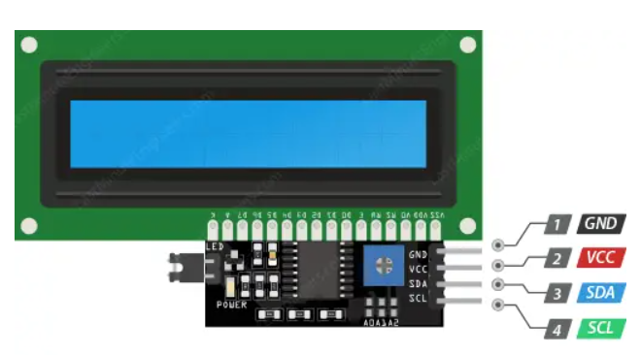

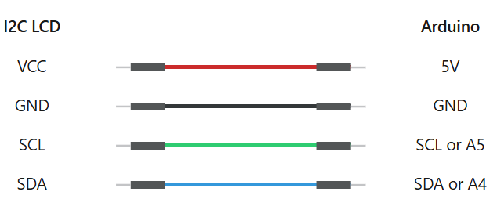
Interfacing with Arduino
Library:
LiquidCrystal_I2C
0X3F: Address
16: Number of characters per line
2: Number of Lines
https://lastminuteengineers.com/i2c-lcd-arduino-tutorial/

Slide 23
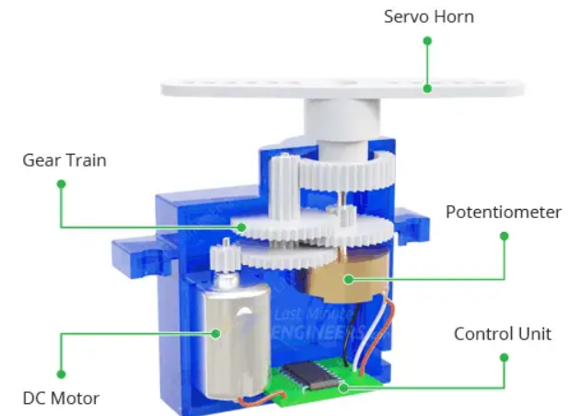
Case Study #3 Servo Motor
a rotary actuator that precisely controls angular position.
combines a DC motor, gearbox, position sensor (typically a potentiometer), and an internal control circuit.
Smart Actuator
Built-in feedback mechanism to self-adjusts to reach the commanded angle
Receives PWM control signal
Rotation Range
1. Typically 0° to 180°
2. Continuous mode 360°
Robotics (arm joints, wheels)
Drones, RC vehicles, Camera

Slide 24
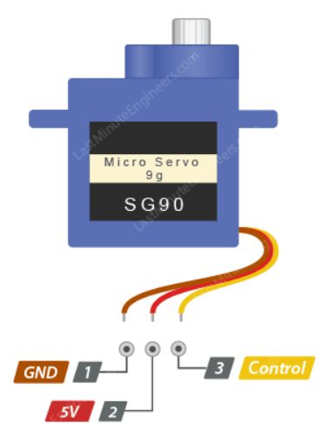
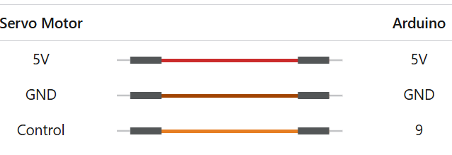
Interfacing with Arduino
SG90 servo motor to the Arduino:
Red wire to the 5V pin
Black or Brown wire to the GND
Orange or Yellow wire to PWM pin
Library: Servo.h
Create Servo servo obj
Attach control pin servo.attach(9)
servo.write(angle)
https://lastminuteengineers.com/servo-motor-arduino-tutorial/

Slide 25
End of the Lecture

