Slide 1
“Operativ Qerargah”
Ahmadov Mahmud
Ahmadzada Sevana
Aliyev Samir
Mammadgulu Novruzov

Slide 2
Motivation
Educate people about current situation
Visualize data in a graphic form to explain the circumstances for the future
Realizing which measure to take is required by government according to predictions
Notes:
Samir

Slide 3
Related Works
E-Tebib – useful for adding medical information about yourself
Notes:
Samir

Slide 4
Data Processing
TWO METHODS
Web Scraping ( from koronavirusinfo.az)
Fetching data from texts in every page
Manually from pdf
Ready Dataset (all countries) from GitHub
https://github.com/owid/covid-19-data/tree/master/public/data
Notes:
Mamed

Slide 5
Application of ML methods
For Predictions:
Random Forest Regressor
Linear Regression
Ridge Regression
Lasso Regression
ElasticNet Regression
Polynomial Regression
To Cluster the current situation in Azerbaijan:
Kmean Clustering
Notes:
Mamed

Slide 6
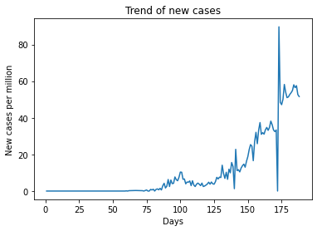
Visualization Trend of new cases
This graph demonstrates the ratio new cases per million to every day
Notes:
Mahmud

Slide 7
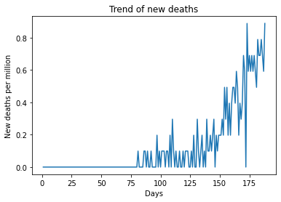
Trend of new deaths
This graph demonstrates the ratio new deaths per million to every day
Notes:
Mahmud

Slide 8
Comparison of results
model cases_accuracy death_accuracy
RandomForestRegressor 0.683 0.388
LinearRegression 0.342 0.197
Ridge 0.303 0.192
Lasso 0.101 0.013
ElasticNet 0.043 0.015
PolynomialFeatures 0.578 0.473
Notes:
Sevana

Slide 9
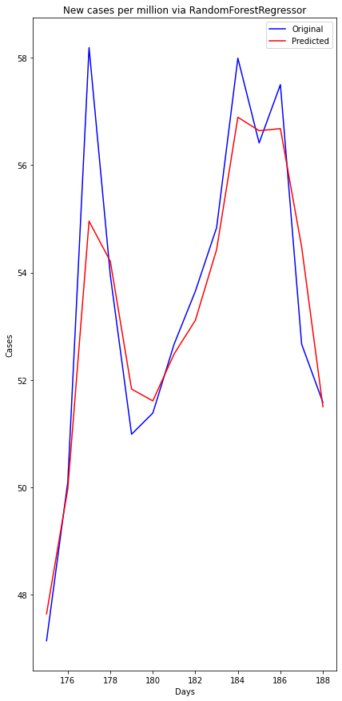
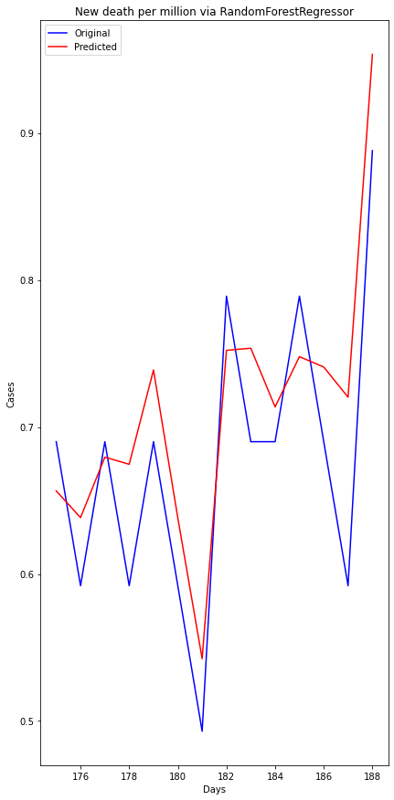
Random Forest Regression
Notes:
Random forest is a bagging technique and not a boosting technique. The trees in random forests are run in parallel. There is no interaction between these trees while building the trees.
It operates by constructing a multitude of decision trees at training time.

Slide 10
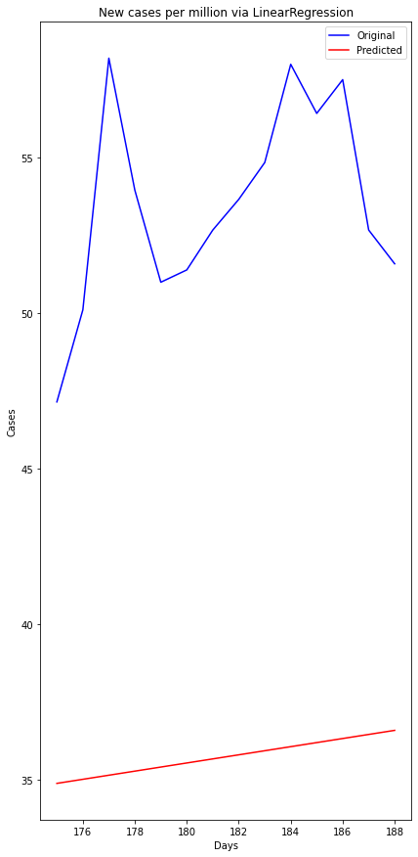
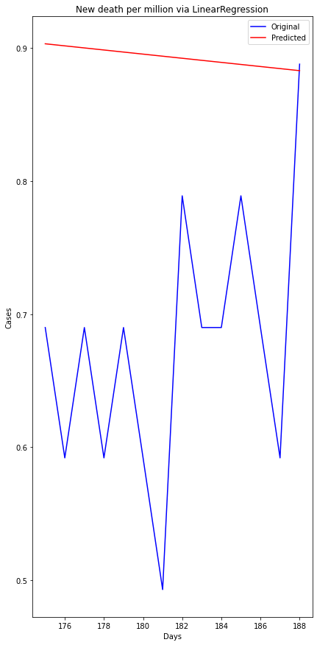
Linear Regression

Slide 11
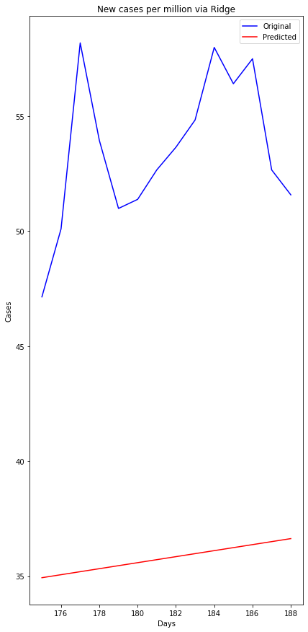
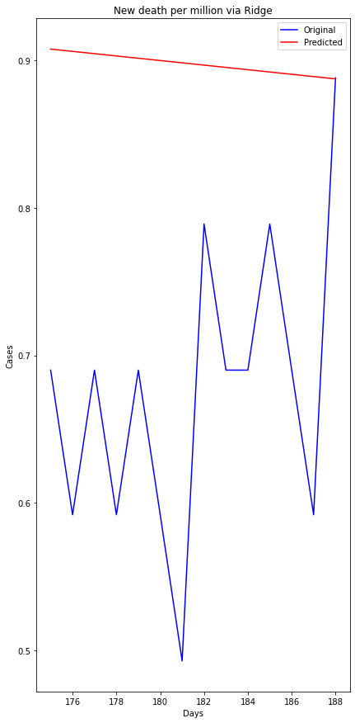
Ridge Regression

Slide 12
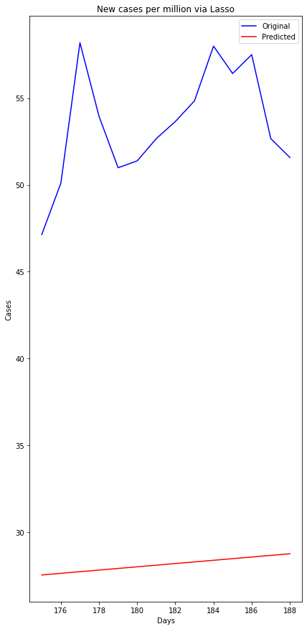
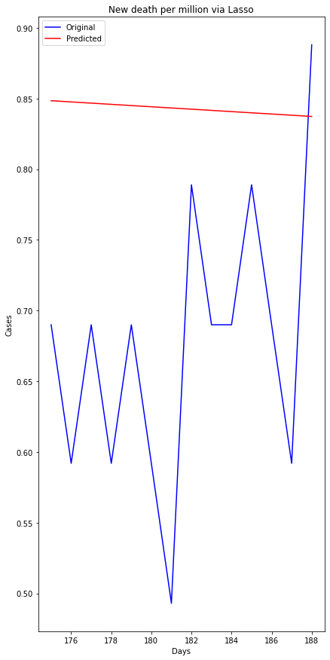
Lasso Regression

Slide 13
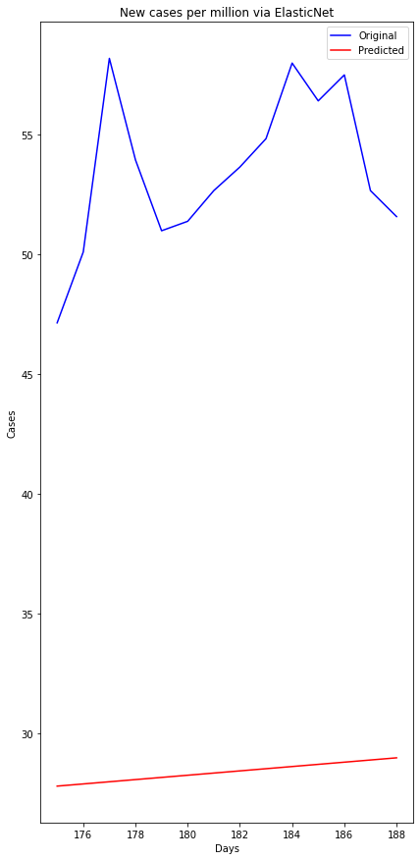
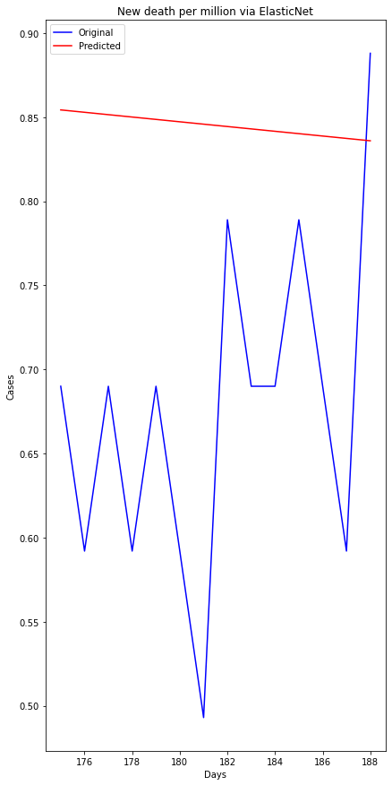
ElasticNet Regression

Slide 14
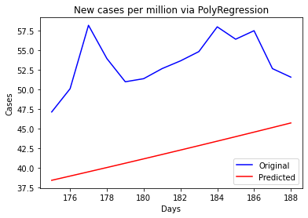
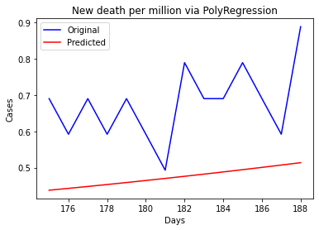
Polynomial Regression (degree =2)

Slide 15
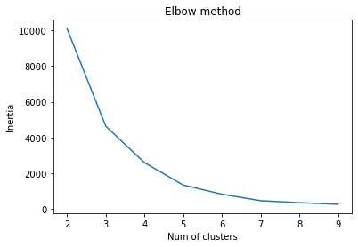
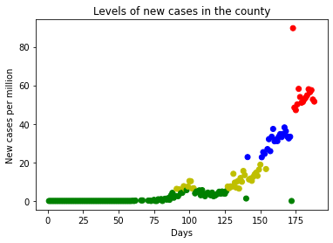
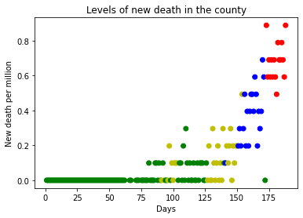
Kmean Clustering
Notes:
To find optimal number of clusters we apply elbow method. 4. We grouped in levels, cases and death in county

