Slide 1
Mini Search Engine
with RAG Extension
AI356 — Information Retrieval
Jordan University of Science and Technology
Samira Aldamen
Wajd Almadi
Batool Mahashi

Slide 2
Project Overview
1
2
3
Part 1
Part 2
Part 3
Data & Index
Retrieval Engine
Eval & RAG
Parse Cranfield dataset → Text preprocessing → Build Inverted Index
TF-IDF weighting → Cosine similarity → Top-K retrieval
MAP + NDCG evaluation → RAG pipeline with GPT-4o-mini

Slide 3
1
Classical Information Retrieval
Dataset · Preprocessing · Inverted Index · TF-IDF · Retrieval

Slide 4
The Cranfield Dataset
1,400
225
5,656
Documents
Test Queries
Unique Terms
File | Content | Used For
cran.all.1400 | 1400 aerodynamics abstracts | Document collection
cran.qry | 225 test queries | Search queries
cranqrel | Relevance judgments (1–4, -1) | Ground truth evaluation

Slide 5
Text Preprocessing Pipeline
1
2
3
4
Lowercase
+ Remove
numbers/punct
Tokenize
Remove
Stopwords
Stem
(Porter)
Example
Input: "Experimental investigations of aerodynamics of a wing in a slipstream2"
Step 1–2: ["experimental", "investigations", "aerodynamics", "wing", "slipstream"]
Step 3: ["experimental", "investigations", "aerodynamics", "wing", "slipstream"]
Step 4 (out): ["experiment", "investig", "aerodynam", "wing", "slipstream"]

Slide 6
TF-IDF Weighting
Formulas
Sample Values — Document 1
TF(t,d)
Term | TF | IDF
slipstream | 0.0649 | 2.0322
wing | 0.0390 | 0.8117
experiment | 0.0260 | 0.6198
aerodynam | 0.0130 | 0.9056
propel | 0.0130 | 1.6990
count(t in d) / total terms in d
IDF(t)
log₁₀( N / (df(t) + 1) ) + 1
TF-IDF
TF(t,d) × IDF(t)

Slide 7
Inverted Index
What is it?
Maps each unique term to the list of documents containing it.
Why use it?
Enables fast retrieval without scanning all 1400 documents for every query.
Statistics
• 5,656 unique terms
• ‘wing’ → 108 docs
• ‘aerodynam’ → 67 docs
• Saved to inverted_index.pkl
Structure
{
“wing”: [1,13,14,30,...]
“aerodynam”: [1,5,11,...]
“experiment”: [1,3,7,...]
...
}
Construction:
for doc in documents:
for token in doc:
index[token].add(doc_id)

Slide 8
Top-K Retrieval Results
Query: boundary layer heat transfer
Query: wing aerodynamics
Rank 1 — Score: 0.5413
Rank 1 — Score: 0.4102
Doc 145 — Skin friction in the laminar boundary layer
Doc 749 — Aerodynamic effects of aspect ratio on flutter
Query: compressible flow pressure
Query: aircraft engine efficiency
Rank 1 — Score: 0.4364
Rank 1 — Score: 0.3514
Doc 775 — Studies on 2D flows of compressible fluid
Doc 100 — Vibration isolation of aircraft power plants

Slide 9
2
Evaluation
MAP · NDCG · Results & Discussion

Slide 10
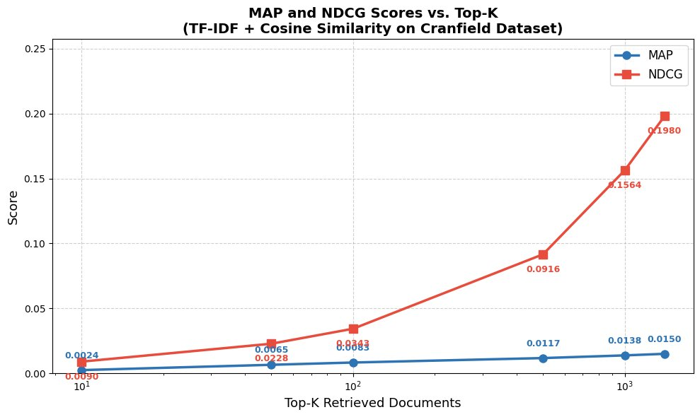
Evaluation Results — MAP & NDCG
MAP (Binary Relevance)
k | MAP Score
10 | 0.0024
50 | 0.0065
100 | 0.0083
NDCG (Graded Relevance)
k | NDCG Score
10 | 0.0090
50 | 0.0228
100 | 0.0343
500 | 0.0916
1000 | 0.1564
Figure 1: MAP and NDCG vs Top-K (TF-IDF + Cosine Similarity on Cranfield Dataset)

Slide 11
3
RAG Extension
Retrieval-Augmented Generation Pipeline

Slide 12
RAG Pipeline
User
Query
TF-IDF
Retrieval
Context
Construction
LLM
Generation
Top-5 docs
ID + Title + Abstract (600 chars)
GPT-4o-mini
Best Result — Query: "boundary layer heat transfer"
All 5 retrieved documents scored above 0.50. The LLM generated a comprehensive answer covering: laminar & turbulent boundary layer behavior, transpiration cooling at Mach 3.2, generalized calculation methods using Thwaites' correlation, and supersonic cases on yawed cones. The model cited only retrieved documents and explicitly acknowledged gaps — no hallucination.

Slide 13
Interactive Search Demo
🔎 Mini Search Engine — Interactive Widget
Query: [ boundary layer heat transfer ]
Top-K: [◄—●————►] 5 [☑ Generate RAG Answer]
[ 🔍 Search ]
Top-5 Results:
Rank 1 | Doc 145 | Score: 0.5413 — Skin friction in the laminar boundary layer
Rank 2 | Doc 959 | Score: 0.5242 — Heat transfer in separated flows
Rank 3 | Doc 339 | Score: 0.5065 — Heat transfer with transpiration cooling
💡 RAG Answer (GPT-4o-mini):
“Based on retrieved documents, boundary layer heat transfer involves laminar and turbulent
regimes, transpiration cooling at Mach 3.2, and Thwaites’ correlation methods...”
Built with ipywidgets in Google Colab — supports any query with adjustable Top-K (1–20) and optional RAG generation

Slide 14
Conclusion
1
Successfully built a complete IR pipeline: parsing → preprocessing → inverted index → TF-IDF → retrieval
2
Evaluated using MAP and NDCG on 152 Cranfield queries — results consistent with baseline TF-IDF benchmarks
3
RAG pipeline grounded LLM answers in retrieved documents, preventing hallucination
4
Key limitation: vocabulary mismatch in TF-IDF (no semantic understanding) — BM25 or dense retrieval would improve results
Jordan University of Science and Technology | AI356 — Information Retrieval | 2026

