Slide 1
MilTrack
UAV-Based Military Vehicle Detection & Tracking System
AI447 - Computer Vision • Spring 2025-2026
Instructor: Dr. Abdullah Al-Amaren
Team Members:
Samira Al-Damen • Wajd Almadi • Batool Mahashi

Slide 2
Problem Statement
Why detect military vehicles from UAVs?
• Surveillance & threat assessment in conflict zones
• Real-time intelligence for military operations
• Automated monitoring without ground personnel
Key Challenges:
Small Objects
Vehicles as small as 32×32 pixels at high altitude
Environmental Variability
Day, night, fog conditions
Occlusion
Vehicles hidden by buildings/trees
Real-Time Constraint
≥30 FPS requirement
Class Imbalance
80% cars, 12% trucks, 8% buses
Multi-Class Detection
Car, Truck, Bus classification
Goal: Detect + Track 3 vehicle types in real-time under all conditions

Slide 3
Dataset: UAVDT
Dataset Overview
Metric | Value
Total Videos | 100 sequences
Total Frames | ~40,000 frames
Resolution | 1920×1080 @ 30 FPS
Annotations | ~840,000 bounding boxes
Classes | Car (80%), Truck (12%), Bus (8%)
Conditions | Day, Night, Fog
Altitude | Low, Medium, High

Slide 4
Dataset: UAVDT
Data Split (70/15/15)
Training
35 sequences
~27,623 frames
Validation
7 sequences
~5,562 frames
Test
8 sequences
~3,500 frames

Slide 5
System Architecture (Processing Pipeline)
Video Input
(UAV footage)
Detection
(YOLO/RT-DETR)
Tracking
(ByteTrack)
Annotated
Output
Pipeline Components:
1- Detection: YOLOv11 or RT-DETR identifies vehicles and draws bounding boxes
2- Tracking: ByteTrack associates detections across frames using Kalman Filter
3- Output: Annotated video with vehicle IDs and class labels

Slide 6
Detection: YOLOv11
What is YOLOv11?
• Latest CNN-based single-stage detector from Ultralytics
• Fast inference: Processes entire image in one forward pass
• Three variants tested: Nano (2.6M), Medium (20M), Large (25M) parameters

Slide 7
Detection: YOLOv11
Why YOLOv11 for UAV?
Feature | Benefit for UAV
Speed | 67 FPS on T4 GPU (meets 30 FPS requirement)
PANet Neck | Multi-scale fusion for small objects
Anchor-Free | Better generalization to varied vehicle sizes
Lightweight | Edge-deployable (51MB model size)
6 Models trained: YOLOv11 (n/m/l) × configs A/B/C + RT-DETR

Slide 8
Detection: RT-DETR
What is RT-DETR?
• Transformer-based detector (not CNN)
• NMS-Free: End-to-end detection without post-processing
• Deformable Attention: Focus on small objects dynamically

Slide 9
Detection: RT-DETR
RT-DETR vs YOLOv11
Criterion | YOLOv11 | RT-DETR
Architecture | CNN | Transformer
Speed (T4 GPU) | 67 FPS | 26 FPS
Small Objects | Good | Excellent (theory)
NMS Required | Yes | No (end-to-end)
Training Stability | Stable | Needs tuning
Test mAP@0.5 | 0.618 | 0.658
RT-DETR slower (26 FPS) due to suboptimal hyperparameters

Slide 10
Tracking: ByteTrack
What is ByteTrack?
• Multi-object tracking algorithm
• Associates detection bounding boxes across video frames
• Maintains vehicle IDs even during occlusion

Slide 11
Tracking: ByteTrack
Why ByteTrack for Aerial Tracking?
- Two-Stage Association
• Stage 1: Match high-confidence detections
• Stage 2: Recover low-confidence (occluded vehicles)
- Kalman Filter
• Predicts vehicle position when detection fails
• Handles temporary occlusion
- Robust to UAV Motion
• Handles camera shake & altitude changes
• Maintains IDs across frames
- Real-Time Performance
• Lightweight algorithm
• No additional GPU overhead
ByteTrack enables continuous vehicle tracking across video sequences

Slide 12
Training & Experiments
3 Experimental Configurations:
Config | mosaic | copy_paste | cls | Key Change
A | 0.7 | 0.1 | 1.0 | Reduced mosaic + copy-paste
B | 1.0 | 0.0 | 1.0 | Baseline (default)
C | 0.9 | 0.3 | 2.0 | Aggressive augmentation

Slide 13
Training & Experiments
Augmentation Strategies:
Mosaic
Combines 4 images into one
Increases object density
Helps small object detection
Copy-Paste
Copies minority classes
Pastes onto other images
Goal: Fix class imbalance
cls=2.0
Doubles classification loss
Forces learning of trucks/buses
Config C only
Training: 30 epochs on NVIDIA A100 GPU (~8 min/epoch for YOLO)

Slide 14
Results & Comparison
Model Performance Comparison:
Model | Config | Test mAP@0.5 | Speed (FPS) | Status
YOLOv11m | B | 0.618 🥇 | 67 | Best
YOLOv11m | C | 0.629 | 67 | Valid
YOLOv11l | B | 0.582 | 67 | Valid
RT-DETR-l | Default | 0.658 | 26 | Slow
YOLOv11m | A | 0.554 | 67 | Collapsed

Slide 15
Results & Comparison
Learning Curves & Confusion Matrix:
Class Collapse
• All models: Truck recall = 0.00
• All models: Bus recall = 0.00
• Only detected cars!
• 80/12/8 imbalance too severe
Config A: Domain Gap
• Train loss ↓ (0.697 → 0.236)
• Val loss ↑ (→ 1.162 → 1.965)
• Largest train/val gap across
all configs (1.729)

Slide 16
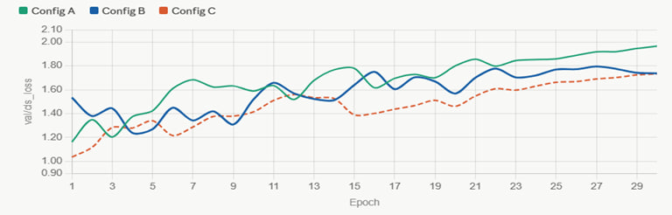
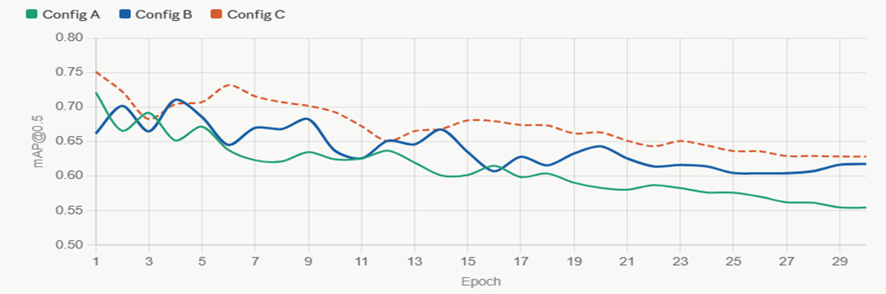
Results & Comparison
Learning Curves
Config A: collapses after Epoch 1
Config B: most stable (std = 0.007)
Config C: starts high, gradual decline

Slide 17
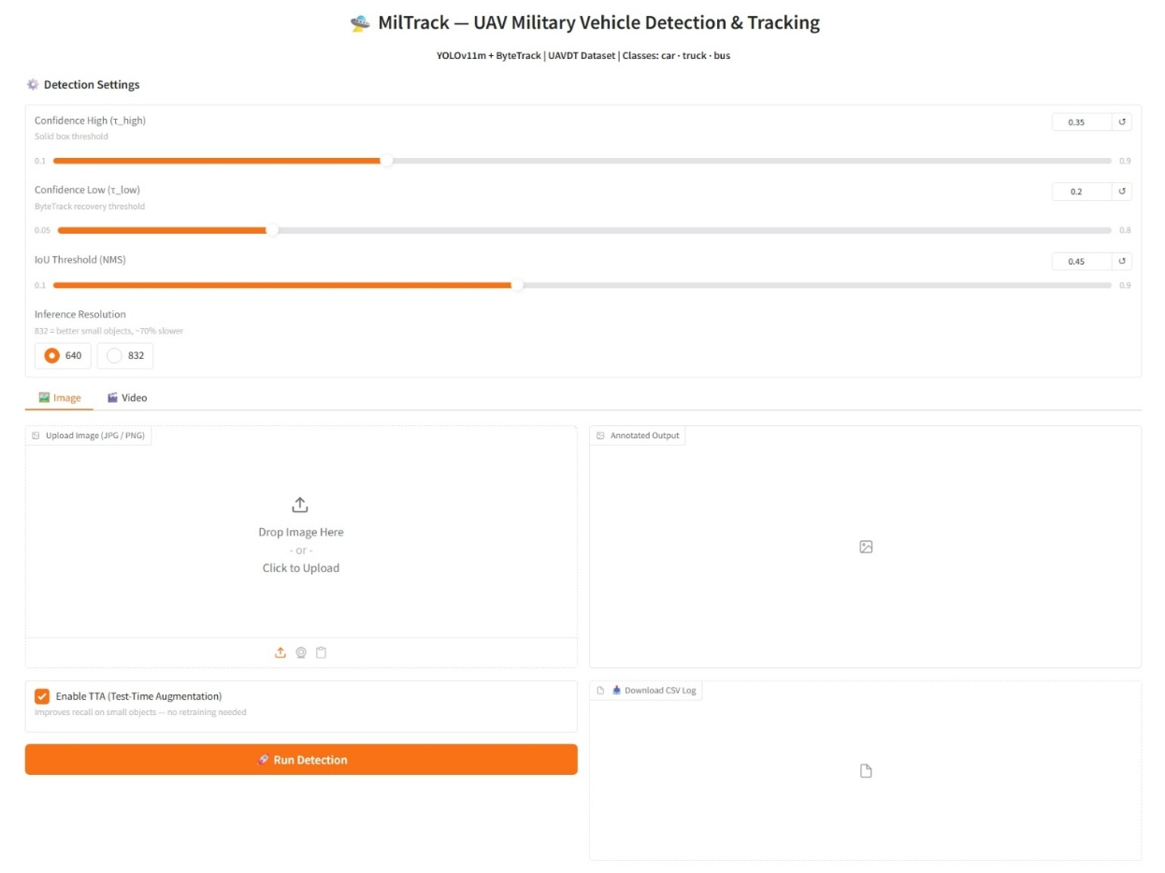
Interface Demo (Gradio)
System Interface:
Image Tab:
• Upload single image
• Select model (YOLO or RT-DETR)
• Click 'Detect'
• View annotated image with bounding boxes
Video Tab:
• Upload video file
• Select detection model
• Enable ByteTrack tracking
• Download annotated video
🎛️ Interface built with Gradio framework - user-friendly controls for detection & tracking

Slide 18
Limitations & Future Work
Current Limitations:
Class Imbalance Unresolved
• 80% cars dominate training
• Trucks/buses recall = 0%
• Copy-paste & cls=2.0 failed
RT-DETR Speed Issue
• 26 FPS (below 30 FPS req)
• Needs TensorRT optimization
• Hyperparameters not tuned

Slide 19
Limitations & Future Work
Future Work Recommendations:
Priority | Recommendation | Impact
High | Implement Focal Loss | Directly fix class imbalance
High | Train at 1280×720 | Preserve small vehicle features
Medium | Tune RT-DETR lr0 | Unlock transformer potential
Medium | Optimize with TensorRT | Speed up RT-DETR to 30+ FPS
Focal Loss requires source code modification - beyond project scope

Slide 20
Conclusion
Winner: YOLOv11m Config B
Test mAP@0.5: 0.618
Speed: 67 FPS
Edge-deployable: 51MB
Most stable training (lowest val/cls_loss variance across 30 epochs)
Selected over RT-DETR (mAP 0.658) — 67 FPS meets real-time UAV requirement; RT-DETR fails at 26 FPS

Slide 21
Conclusion
Key Findings:
• Model scale not the bottleneck (nano → large only +2% mAP)
• Dataset imbalance is the performance ceiling (80/12/8 distribution)
• YOLOv11 outperformed RT-DETR under current training conditions
• ByteTrack enables robust multi-object tracking (+5 bonus marks)
• System meets real-time requirement (67 FPS >> 30 FPS)
Production Recommendation:
YOLOv11m Config B selected for deployment due to real-time speed (67 FPS) and training stability, despite RT-DETR achieving higher mAP@0.5 (0.658 vs 0.618)

Slide 22

Thank You
Questions?

