Slide 1
U.S. Census Transportation Data
Years: 2012 - 2016
Samira Karimi Apr, 2020

Slide 2

Data Explanation
The CTPP data product based on 2012 – 2016 5-year American Community Survey (ACS) Data is designed to help transportation analysts and planners understand where people are commuting to and from, and how they get there. The information is organized by residence, workplace, and by the commute from home to work.

Slide 3
Project Applications
Investment Capacity
Education Level
Public Transportation Availability
Families Welfare
Enrepreuneurship
Transportation policy and planning efforts.
Socioeconomic factors
Recognizing capacities
Recognizing needs

Slide 4
Data Preprocessing
Data not aimed for one specific task like classification or regression
No certain response variable
Required to set a goal for data preprocessing
Acquired and merged data from many tables
Initial downloaded data size: 114 Mg

Slide 5
Analysis
Many columns for a small number of states and districts (52)
need to explore the relationships between the columns and find the effective ones
Every factor can be analyzed separately
As examples, a number of initial guesses has been explored.

Slide 6
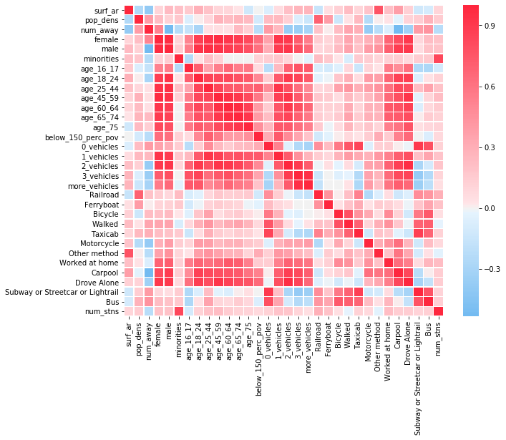
Analysis: Correlation Heatmap
High correlation of public transportation with 0-vehicle and 1-vehicle households (obvious result)
The effect of age not as meaningful
Manipulation of the columns
Making more general columns
Example: all public transportation means in one column,
Dividing ages to young, middle age and over 65

Slide 7
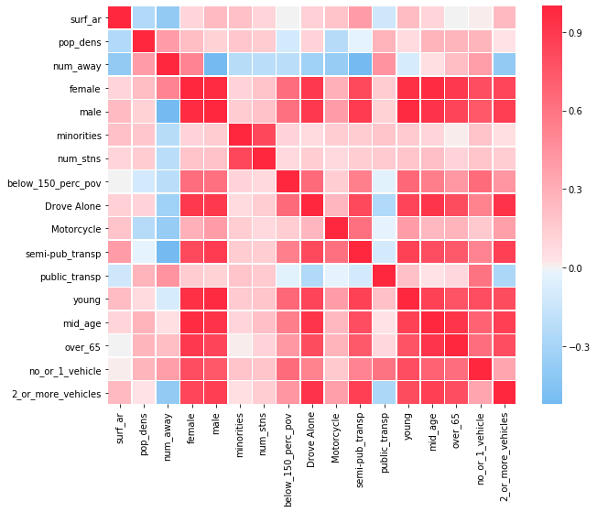
Analysis: Correlation Heatmap
1. The number of vehicles in a household: 2 or more vehicles , a high positive correlation with driving alone and semi-public transportation , negative correlation with public transportation, One or no vehicles highly and positively correlated with public transportation
2. percentage of minorities: high positive correlation with the number of amtrak stations ('num_stns'). Could be due to the culture and pupulation combination of many northern and west-side states
3. The number of Amtrak stations: No positive correlation with the percent of away workers. A better metric: number_of_stations/surface_area
4. Surface area: Negative correlation with away workers and public transportation (expected)

Slide 8
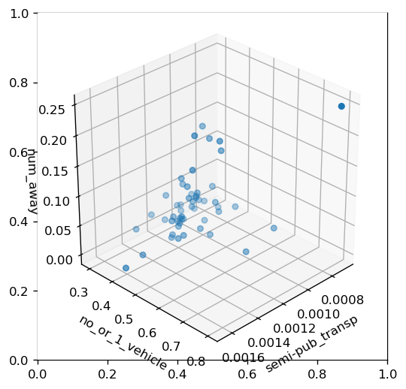
Analysis: Bar chart
A somewhat linear relationship between the number of away workers with semi-public transportation users

Slide 9
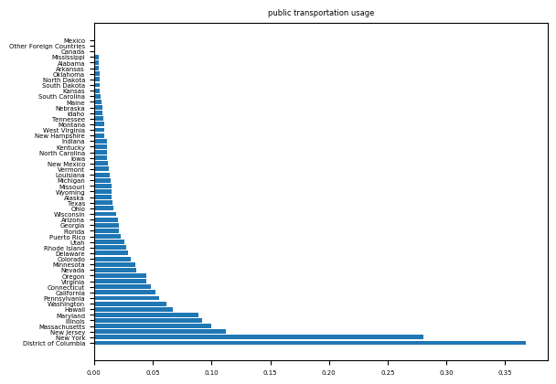
Analysis: Barchart
Considerably higher usage of public transportation in New York and District of Columbia

Slide 10
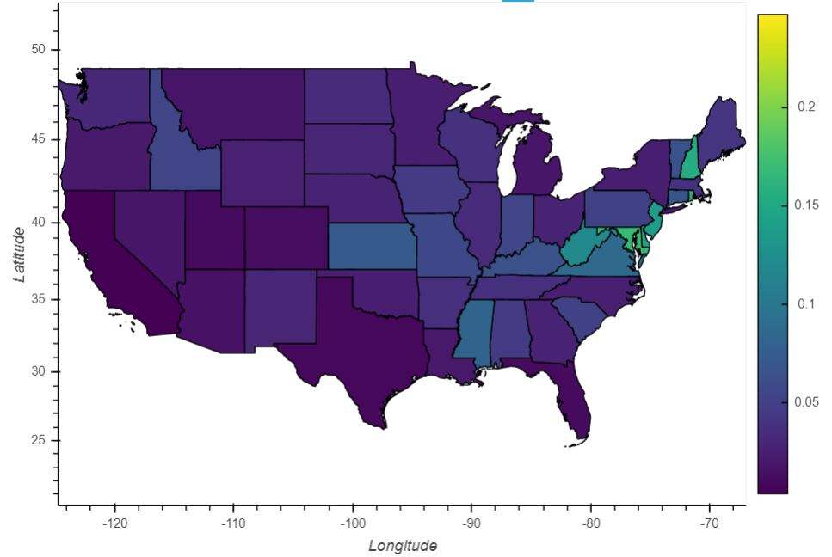
Analysis: heatmap
Texas and : lowest percentage of away workers
Some north-eastern states: highest percentage of away workers (could be due to the low surface area)

Slide 11
Forecast
Ridge Regression
Lasso Regression
Clustering (Healthy Transportation)
Different Response Variables

Slide 12
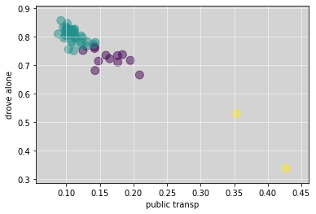
Clustering: Public Transportation Usage
The two yellow dots 'New York' and 'District of Columbia‘: Remarkably healthier transportation method than all other states

Slide 13
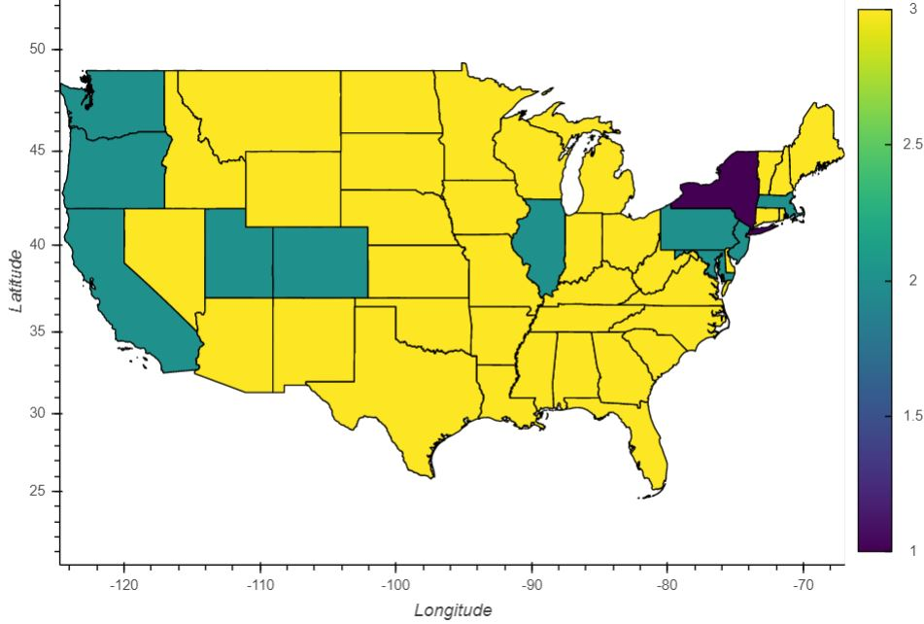
Clustering: HeatMap
The two yellow dots 'New York' and 'District of Columbia‘: Remarkably healthier transportation method than all other states

Slide 14
Regression: Public Transportation
Independent var’s: 'surf_ar','pop_dens','young','minorities','num_stns','no_or_1_vehicle','num_away','semi-pub_transp'
Lasso: Public transportation usage can be explained through a linear regression based on the number of away workers.
MSE: 0.0071, Coef = [-0., 0. , 0. , 0. , -0. , 0. , 0.183, -0.]
Ridge: Also gives importance to having no or one vehicle and semi-public transportation.
MSE: 0.0065, Coef = [-6.63e-09, 4.23e-06, 6.85e-03, 7.40e-11, -3.95e-05, 2.14e-02, 6.44e-02, -1.62e-02]

Slide 15
Regression: Number of Away workers
Independent var’s: 'surf_ar','pop_dens','young','minorities','num_stns','no_or_1_vehicle','public_transp','semi-pub_transp‘
Highly correlated data; Ridge seems a better choice
Usefulness of Lasso variable selection
Lasso: number of away workers explained mostly by public transportation.
MSE: 0.0040, Coef = [-2.53e-08, 3.78e-05, 0.0, -3.04e-10, -0.0, 1.47e-03, 4.48e-01, -0.0]
Ridge: Also gives importance to semi-public transportation. Reason: Correlation
MSE: 0.0022, Coef = [-5.16e-08, 3.80e-05, 2.64e-02, -3.25e-09, -2.45e-04, 5.47e-02, 2.38e-01, -1.28e-01]

