Slide 1

University of Quebec at Rimouski
Second Assignment
Professor Mehdi Adda
8INF954 Data Mining
Noktehdan, Hamed
Mohammadi, Samira

Slide 2
Introduction
In this project, we aim to apply data mining techniques to analyze a cardiovascular dataset and predict the presence of heart disease.
The give dataset contains 14 attributes related to heart disease. It has 5 different outputs indicating the severity of heart disease.

Slide 3
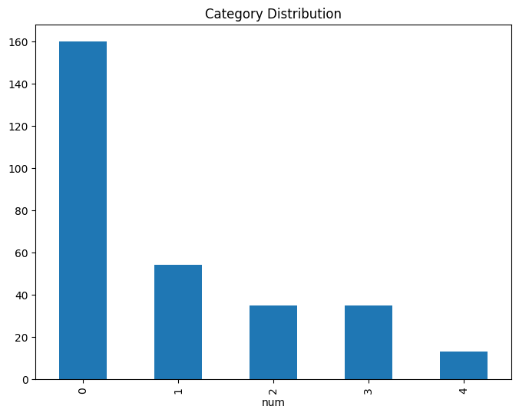
Overview of the Dataset
0 represents no disease
Others represent different
cardiovascular disease
Unbalanced

Slide 4
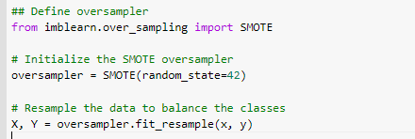
Oversampling

Slide 5
Data preprocessing
Manage missing or erroneous data
replace with the median of the column
KNN technique
In our case , because there are less than 5 missing values we decided to remove these erroneous records.

Slide 6
Dimensionality reduction
Reduction algorithms are commonly used in machine learning and data analysis to reduce the dimensionality of datasets while preserving important information. Two commonly used reduction algorithms are Independent Component Analysis (ICA) and Linear Discriminant Analysis (LDA).

Slide 7
Classification Algorithms
Classification algorithms are a type of machine learning algorithms that are used to classify data into different categories or classes based on certain features. Two commonly used classification algorithms are Support Vector Machines (SVM) and Random Forest.

Slide 8
Comparison of SVM & Random forest
Method | accuracy
SVM with hyper parameters without reduction and 10-fold cross-validation Best hyperparameters: {'C': 100, 'gamma': 0.001, 'kernel': 'rbf'} | 81%
SVM with hyper parameters with LDA reduction and 10-fold cross-validation | 62%
Random Forests with hyper parameters without reduction and 10-fold cross-validation Best Hyperparameters: {'max_depth': None, 'min_samples_leaf': 1, 'min_samples_split': 2, 'n_estimators': 100} | 86%
Random Forests with hyper parameters with ICA dimention reduction and 10-fold cross-validation | 85%

Slide 9
Clustering Algorithms
K-means and fuzzy clustering are two popular techniques used in data clustering, which is the process of grouping similar objects or data points together based on certain characteristics.

Slide 10
Analysis
We can see that the K-means algorithm without dimension reduction and the fuzzy clustering algorithm without dimension reduction both identified a cluster with a very small number of data points (cluster 2 in K-means and cluster 4 in fuzzy clustering). This suggests that these algorithms might not be the best choice for this particular dataset.
In contrast, the K-means algorithm with ICA dimension reduction and the fuzzy clustering algorithm with LDA dimension reduction did not have such a problem and identified clusters that are more evenly distributed. However, there are differences in the specific clusters that each algorithm identified as the largest (cluster 3 in K-means with ICA and cluster 2 in fuzzy clustering with LDA).
Overall, the choice of algorithm and dimension reduction technique depends on the specific dataset and the goals of the analysis. It's important to carefully consider the results and choose the approach that best suits the particular task at hand.

Slide 11
K-means algorithm without dimension reduction | Cluster 3 has the largest number of data points (118). Cluster 1 has 90 data points. Cluster 0 has 84 data points. Cluster 2 has only 5 data points.
K-means algorithm with ICA dimension reduction | Cluster 0 has the largest number of data points (106). Cluster 1 has 76 data points. Cluster 3 has 58 data points. Cluster 2 has 57 data points.
Fuzzy Clustering algorithm without dimension reduction | Cluster 2 has the largest number of data points (159). Cluster 1 has 133 data points. Cluster 4 has only 4 data points. Cluster 0 has only 1 data point.
Fuzzy Clustering algorithm with LDA dimension reduction | Cluster 2 has the largest number of data points (69). Cluster 0 has 67 data points. Cluster 3 has 60 data points. Cluster 4 has 54 data points. Cluster 1 has 47 data points

Slide 12
References
[1] Levenson, J. W., Skerrett, P. J., & Gaziano, J. M. (2002). Reducing the global burden of cardiovascular disease: the role of risk factors. Preventive cardiology, 5(4), 188-199.
[2] https://archive.ics.uci.edu/ml/machine-learning-databases/heart-disease/
[3] Lu, W., & Rajapakse, J. C. (2005). Approach and applications of constrained ICA. IEEE transactions on neural networks, 16(1), 203-212.
[4] Samaitis, V., Yilmaz, B., & Jasiuniene, E. (2023). Adhesive bond quality classification using machine learning algorithms based on ultrasonic pulse-echo immersion data. Journal of Sound and Vibration, 546, 117457.
[5] Kaur, S., & Jindal, S. (2016). A survey on machine learning algorithms. Int J Innovative Res Adv Eng (IJIRAE), 3(11), 2349-2763.
[6] Aljarah, I., Al-Zoubi, A. M., Faris, H., Hassonah, M. A., Mirjalili, S., & Saadeh, H. (2018). Simultaneous feature selection and support vector machine optimization using the grasshopper optimization algorithm. Cognitive Computation, 10, 478-495.
[7] Naji, M. A., El Filali, S., Aarika, K., Benlahmar, E. H., Abdelouhahid, R. A., & Debauche, O. (2021). Machine learning algorithms for breast cancer prediction and diagnosis. Procedia Computer Science, 191, 487-492.
[8] Sujatha, S., & Sona, A. S. (2013). New fast k-means clustering algorithm using modified centroid selection method. International Journal of Engineering Research & Technology (IJERT), 2(2), 1-9.
[9] Bora, D. J., Gupta, D., & Kumar, A. (2014). A comparative study between fuzzy clustering algorithm and hard clustering algorithm. arXiv preprint arXiv:1404.6059.

