Slide 1
Covid-safe Room Term project of CSE 316
SUPERVISED BY:
MAHJABIN NAHAR
LECTURER
DEPT. OF CSE, BUET
Presented by:
Md. Shafqat Talukder (1705026) Samira Akhter (1705028) Simantika Bhattacharjee (1705029) Joy saha (1705030)

Slide 2
Features
Contact-less temperature detection
Temperature display in LCD
Automated entrance

Slide 3
Features(Continued)
Limited allowance of people into the room.
Automated hand sanitizing device.
Automated exit.

Slide 4
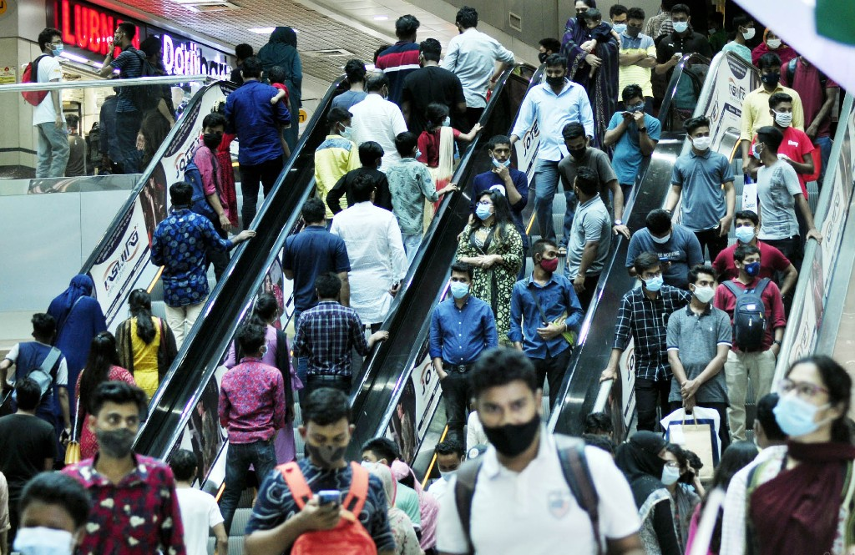
Motivation
Mismanagement in the current manual temperature measuring process.

Slide 5
Motivation (Continued) :
Safety issue of the person assigned to measure temperature manually.
Covid-safe locations are not covid-safe actually!!!!

Slide 6
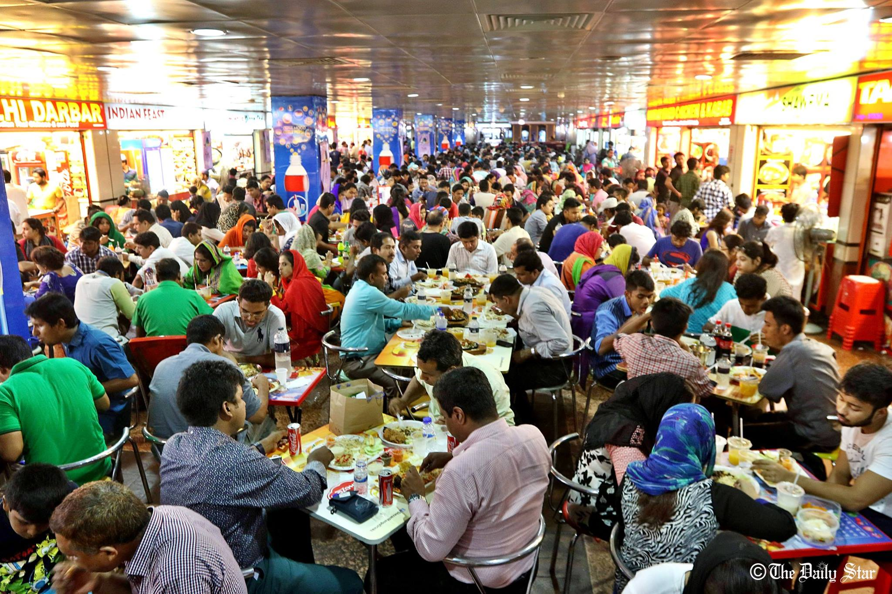
Motivation (Continued) :
Controlling mass gathering
is too difficult now-a-days.

Slide 7

Motivation(Continued) :
Manual ways of hand sanitizing are unhygienic and common sources of infection

Slide 8
Specifications:
Sensors:
Ultrasonic distance sensor (HC-SR04)
IR temperature sensor (MLX90614)
Actuator:
Servo Motors

Slide 9
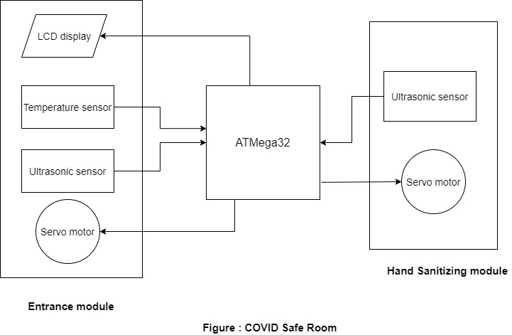
Block Diagram

Slide 10
Thank You.

