Slide 1
Version 1.0.1 Cluster
1.0.1 Application
Dynamic Software Update Proxy
downstream
1.0.1 Application
downstream
client
upstream
routing
& upgrading
Application
Update
Version 1.0.0 Cluster
downstream
downstream
1.0.0 Application
1.0.0 Application

Slide 2
Message Based Proxy
Web Servers
downstream
Docker container
downstream
client
upstream
router
downstream
Docker container
downstream
STREAM
REQ
ROUTER
DEALER
REP
STREAM

Slide 3
Content Counting Socket Based Proxy
Connect
Accept
Loop
Client
Routing
Cluster
Write
Read
Loop
Read
Read
Write
Routing
Read
Loop

Slide 4
Docker Daemon
Configuration Service
File Parser
REST API
Docker
Client
Manage
Containers
Cluster & Container Management
Connect
Version 1.0.1 Cluster
Accept
Loop
Configuration
Docker Container
Forward Pipe
1.0.1 Application
Read
Write
Read
Route
Write
Complete
Docker Container
1.0.1 Application
Client
Back Pipe
Connect
Application
Update
Version 1.0.0 Cluster
Write
Read
Docker Container
Complete
Write
Route
Read
1.0.0 Application
Docker Container
1.0.0 Application

Slide 5
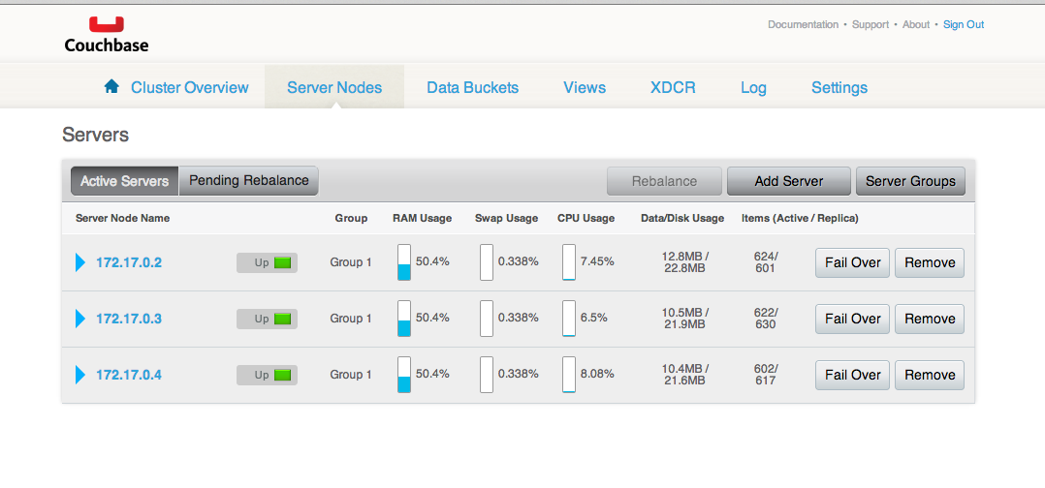

Slide 6


Pre-Upgrade
proxy
1.0.0 Application
INSTANT Upgrade
no failure
proxy
1.0.1 Application
1.0.0 Application
INSTANT Upgrade
failure
proxy
1.0.1 Application
1.0.0 Application

Slide 7


Pre-Upgrade
proxy
1.0.0 Application
SESSION Upgrade
with cookie
proxy
1.0.1 Application
1.0.0 Application
SESSION Upgrade
without cookie
proxy
1.0.1 Application
1.0.0 Application

Slide 8

Pre-Upgrade
proxy
1.0.0 Application
GRADUAL Upgrade
non upgrade bucket
proxy
1.0.1 Application
1.0.0 Application
GRADUAL Upgrade
upgrade bucket
proxy
1.0.1 Application
1.0.0 Application

Slide 9
Pre-Upgrade
proxy
1.0.0 Application
CONCURRENT Upgrade
no failure
proxy
1.0.1 Application
1.0.0 Application
CONCURRENT Upgrade
1.0.1 fails
proxy
1.0.1 Application
1.0.0 Application

