Slide 2
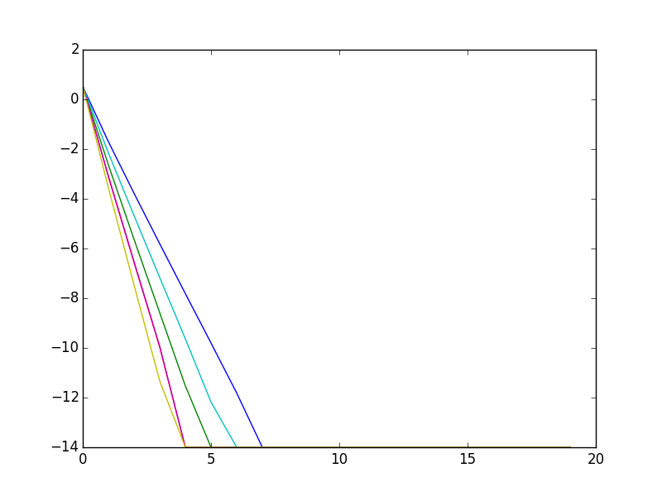
Experiments with sampling on the machines (m=4)
N = 6000
Blue: no sampling (6000))
Green:
sampling (1/3: 6000 from 18000)
Red:
sampling (1/5: 6000 from 30000)
N = 10000
Cian: no sampling
Magnet:
sampling (1/3: 10000 from 30000)
Yellow:
Sampling (1/5: 1000 from 50000)
Observation: the curve for 6000 from 30000 and 10000 from 30000 are the same → it depends how many data points initially we have
work with very small samples

Slide 3
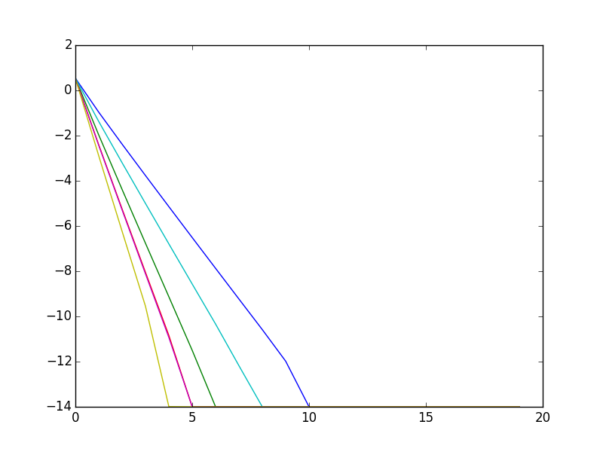
Experiments with sampling on the machines (m=8)
Same pattern:

Slide 4
Experiments with different inner loop accuracies (ridge regression)
changed the previous least square solution (‘np.linalg.lstsq’) to (‘sparsela.lsmr’) to be able to give the max iteration number
(with “LSMR: An iterative algorithm for sparse least-squares problems”)
ran experiments setting
max inner iteration number: 50, 100, 300, 500, 1000, unbounded
4 or 16 machines
6000, 10000 or 14000 datapoints

Slide 5
observations
small dataset, few machines:
higher max-iter doesn’t make much difference
no max-iter takes more outer iterations!
bigger dataset, few machines:
higher max-iter doesn’t make much difference
no max-iter takes more outer iterations!
small dataset, more machines:
higher max-iter gives higher number of outer iterations -
no max-iter takes more outer iterations!
bigger datasets, more machines:
higher max-iter gives higher number of iterations -
no max-iter takes more outer iterations!

