Slide 1
Module 2: Syntax Analysis (Part 1)
Introduction
Context Free Grammars
Top-down parsing:
Recursive Descent Parsing,
Brute Force Parsing,
Non-recursive Predictive Parsing,
Bottom-Up parsing:
Shift Reduce Parsing
Error Recovery in LR Parsers
Parser Generator (YACC).

Slide 2
Need for Syntax Analysis
programs may contain syntactic errors, we will discuss extensions of the parsing methods for recovery from common errors.
Rules of PLs prescribe the syntactic structure of well-formed programs
E.g. In C, programs… functions… declarations… statements… expressions…
Syntax of PL constructs can be specified by CONTEXT FREE GRAMMARs.

Slide 3
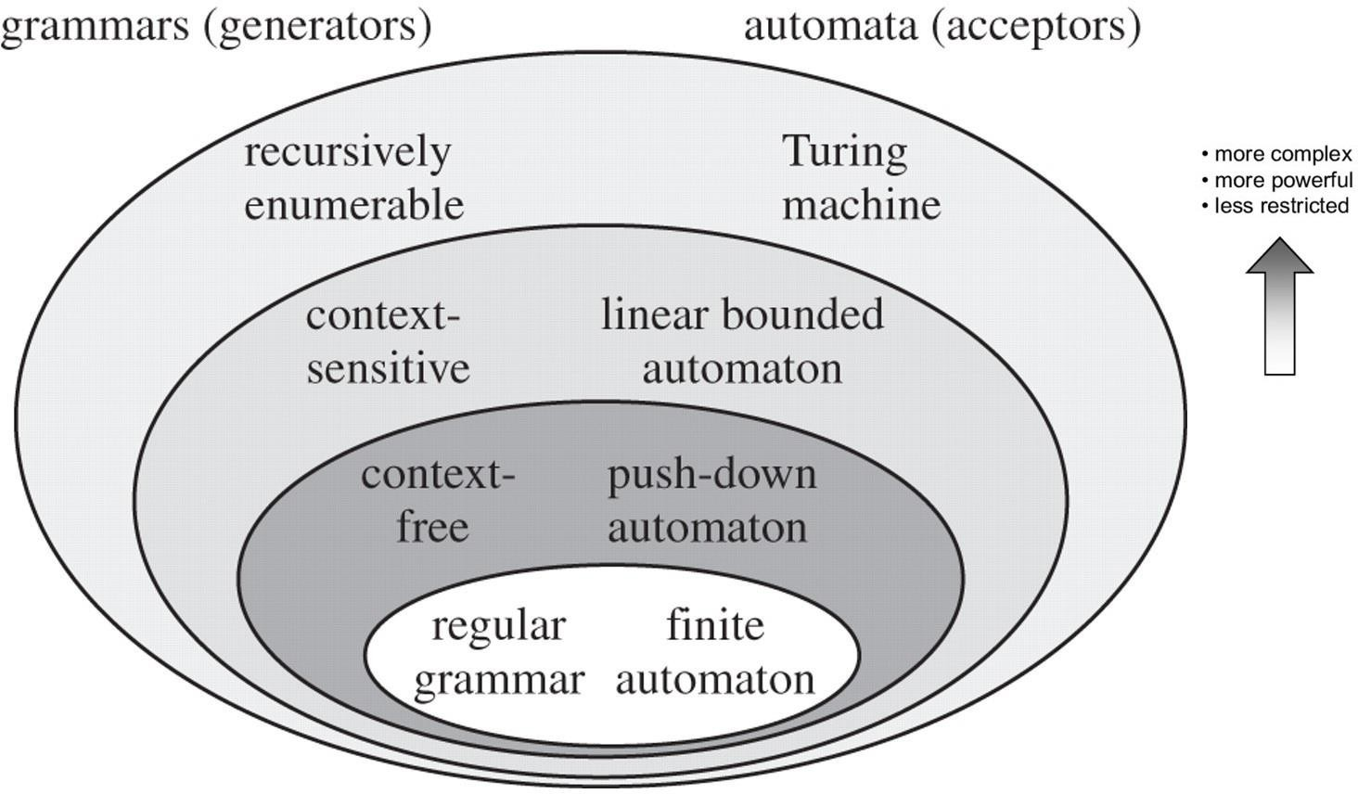
Formal Languages
Syntax Analyzer or
Parser
Lexical Analyzer
or Tokenizer or Scanner

Slide 4
Review Question
Consider the following statements related to compiler construction :
Lexical Analysis is specified by context-free grammars and implemented by pushdown automata.
Syntax Analysis is specified by regular expressions and implemented by finite-state machine. Which of the above statement(s) is/are correct
?
Only I
B. Only II
C. Both I and II
D. Neither I nor II

Slide 5
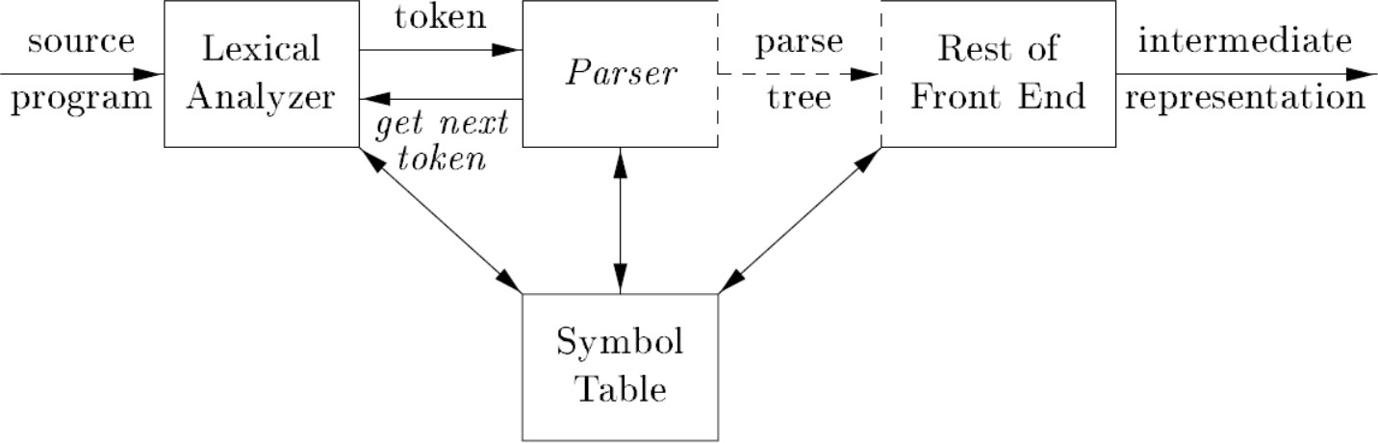
Role of the Parser
Reports any syntax error
Recover from commonly occurring errors to continue processing the remainder of the program

Slide 6
What syntax analysis cannot do!
To check whether variables are of types on which operations are allowed
To check whether a variable has been declared before use
To check whether a variable has been initialized
These issues will be handled in semantic analysis
The information which syntax analysis phase gets from the previous phase (lexical analysis) is whether a token is valid or not and which class of tokens does it belong to.
Hence it is beyond the capabilities of the syntax analysis phase to settle issues like:
Whether or not a variable has already been declared?
Whether or not a variable has been initialized before use?
Whether or not a variable is of the type on which the operation is allowed?
All such issues are handled in the semantic analysis phase.

Slide 7
Why Not Regular Expressions for Syntax Analysis
This fact is a fundamental limitation of res; the corresponding recognizers cannot count because they have only a finite set of states.
The language {{^{m} }^{n} | where m = n} is not regular.
In principle, Finite Automata cannot count.
While they work well for micro-syntax, they are not suitable to describe some important programming language features.

Slide 8
Context-Free Grammars
Context-free grammars consist of:
Set of symbols:
terminals that denotes token types
non-terminals that denotes a set of strings
Start symbol
Rules:
symbol ::= symbol symbol ... symbol
left-hand side: non-terminal
right-hand side: terminals and/or non-terminals
rules explain how to rewrite non-terminals (beginning with start symbol) into terminals

Slide 9
Context-Free Grammars
A string is in the language of the CFG if and only if it is possible to derive that string using the following non- deterministic procedure:
begin with the start symbol
while any non-terminals exist, pick a non-terminal and rewrite it using a
rule <== could be many choices here
stop when all you have left are terminals (and check you arrived at the string your were hoping to)
Parsing is the process of checking that a string is in the CFG for your programming language. It is usually coupled with creating an abstract syntax tree.

Slide 10
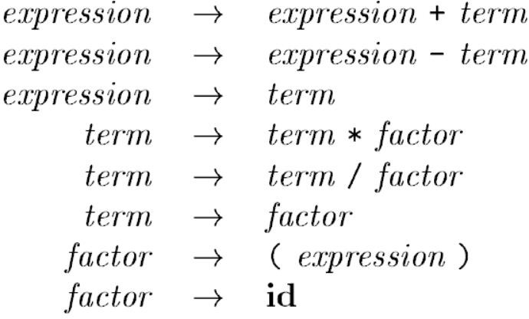
Context-Free Grammars
If else
:: =
Arithmetic expression
Non-terminals

Slide 11
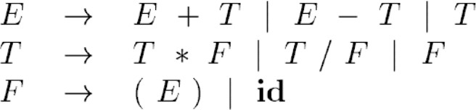
Arithmetic expressions as CFG
Start Symbol
E, T and F are Non-terminals E is the start symbol
+,-,*,/,( , ) and id are terminals

Slide 12
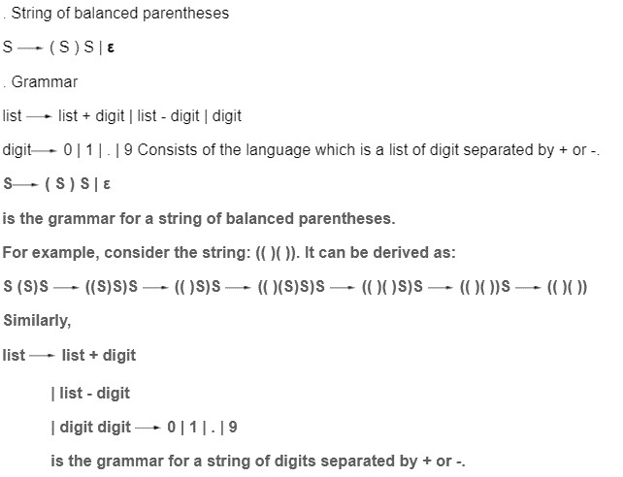
Balanced Parenthesis as CFG

Slide 13
non-terminals: terminals: rules:
S, E, Elist
ID, NUM, PRINT, +, :=, (, ), ;
1. S ::= S; S
E ::= ID
E ::= NUM 6. E ::= E + E
7. E ::= ( S , Elist )
Elist ::= E
Elist ::= Elist , E
2. S ::= ID := E
3. S ::= PRINT ( Elist )
Derive me!
ID = NUM ; PRINT ( NUM )

Slide 14
non-terminals: terminals: rules:
S, E, Elist
ID, NUM, PRINT, +, :=, (, ), ;
1. S ::= S; S
E ::= ID
E ::= NUM 6. E ::= E + E
7. E ::= ( S , Elist )
Elist ::= E
Elist ::= Elist , E
2. S ::= ID := E
3. S ::= PRINT ( Elist )
Derive me!
S
ID = NUM ; PRINT ( NUM )

Slide 15
non-terminals: terminals: rules:
S, E, Elist
ID, NUM, PRINT, +, :=, (, ), ;
1. S ::= S; S
E ::= ID
E ::= NUM 6. E ::= E + E
7. E ::= ( S , Elist )
Elist ::= E
Elist ::= Elist , E
2. S ::= ID := E
3. S ::= PRINT ( Elist )
Derive me!
S
ID = E
ID = NUM ; PRINT ( NUM )

Slide 16
non-terminals: terminals: rules:
S, E, Elist
ID, NUM, PRINT, +, :=, (, ), ;
1. S ::= S; S
E ::= ID
E ::= NUM 6. E ::= E + E
7. E ::= ( S , Elist )
Elist ::= E
Elist ::= Elist , E
2. S ::= ID := E
3. S ::= PRINT ( Elist )
Derive me!
S
ID = E
oops, can’t make progress
E
ID = NUM ; PRINT ( NUM )

Slide 17
non-terminals: terminals: rules:
S, E, Elist
ID, NUM, PRINT, +, :=, (, ), ;
1. S ::= S; S
E ::= ID
E ::= NUM 6. E ::= E + E
7. E ::= ( S , Elist )
Elist ::= E
Elist ::= Elist , E
2. S ::= ID := E
3. S ::= PRINT ( Elist )
Derive me!
S
ID = NUM ; PRINT ( NUM )

Slide 18
non-terminals: terminals: rules:
S, E, Elist
ID, NUM, PRINT, +, :=, (, ), ;
1. S ::= S; S
E ::= ID
E ::= NUM 6. E ::= E + E
7. E ::= ( S , Elist )
Elist ::= E
Elist ::= Elist , E
2. S ::= ID := E
3. S ::= PRINT ( Elist )
Derive me!
S
S ; S
ID = NUM ; PRINT ( NUM )

Slide 19
non-terminals: terminals: rules:
S, E, Elist
ID, NUM, PRINT, +, :=, (, ), ;
1. S ::= S; S
E ::= ID
E ::= NUM 6. E ::= E + E
7. E ::= ( S , Elist )
Elist ::= E
Elist ::= Elist , E
2. S ::= ID := E
3. S ::= PRINT ( Elist )
Derive me!
S
S ; S
ID := E ; S
ID = NUM ; PRINT ( NUM )

Slide 20
non-terminals: terminals: rules:
S, E, Elist
ID, NUM, PRINT, +, :=, (, ), ;
1. S ::= S; S
E ::= ID
E ::= NUM 6. E ::= E + E
7. E ::= ( S , Elist )
Elist ::= E
Elist ::= Elist , E
2. S ::= ID := E
3. S ::= PRINT ( Elist )
Derive me!
S
S ; S
ID = E ; S
ID = NUM ; S
ID = NUM ; PRINT ( Elist ) ID = NUM ; PRINT ( E )
ID = NUM ; PRINT ( NUM )

Slide 21
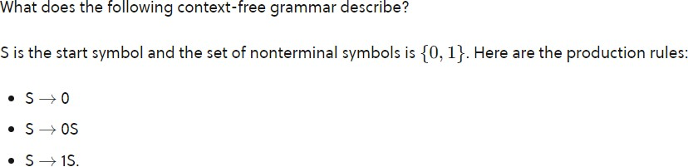
Review Questions

Slide 22
Derivation
Here is a context-free grammar that generates arithmetic expressions (subtraction, addition, division, and multiplication)
Production rules:
<expression> → number
<expression>→ (<expression>)
<expression> → <expression> + <expression>
<expression>→ <expression> - <expression>
<expression> → <expression> * <expression>
<expression> → <expression> / <expression>
Show the steps of deriving the following expression: (4 + 5) * (2 - 6)

Slide 23
non-terminals: terminals: rules:
S, E, Elist
ID, NUM, PRINT, +, :=, (, ), ;
1. S ::= S; S
E ::= ID
E ::= NUM 6. E ::= E + E
7. E ::= ( S , Elist )
Elist ::= E
Elist ::= Elist , E
2. S ::= ID := E
3. S ::= PRINT ( Elist )
S
S ; S
ID = E ; S
ID = NUM ; S
ID = NUM ; PRINT ( Elist )
ID = NUM ; PRINT ( E )
ID = NUM ; PRINT ( NUM )
S
S ; S
S ; PRINT ( Elist ) S ; PRINT ( E )
S ; PRINT ( NUM )
ID = E ; PRINT ( NUM )
ID = NUM ; PRINT ( NUM )
Another way to derive the same string
left-most derivation
right-most derivation

Slide 24
Parse Trees
Representing derivations as trees
useful in compilers: Parse trees correspond quite closely (but not exactly) with abstract syntax trees we’re trying to generate
difference: abstract syntax vs concrete (parse) syntax
each internal node is labeled with a non-terminal
each leaf node is labeled with a terminal
each use of a rule in a derivation explains how to generate children in the parse tree from the parents

Slide 25
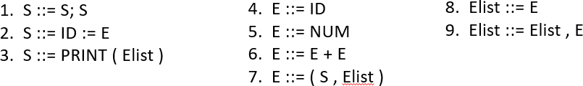
Parse Trees
parse trees have meaning.
order of children, nesting of subtrees is significant
S
S
S
S
;
S
S
;
ID
:=
E
PRINT
( L )
PRINT
( L ) ID
:=
E
E
E
NUM
NUM
NUM
NUM

Slide 26
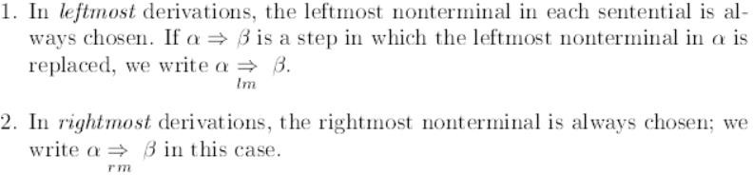
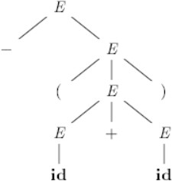
Derivation

Slide 27
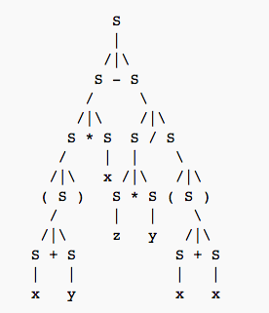
Review Question
What expression does this parse tree generate?
( x + y ) * x - z * y / ( x + x )

Slide 28
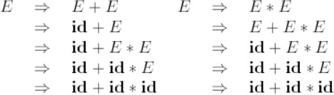
Ambiguity
a grammar that produces more than one parse tree for some sentence is said to be ambiguous
An ambiguous grammar is one that produces more than one leftmost or rightmost derivation for the same sentence.

Slide 29
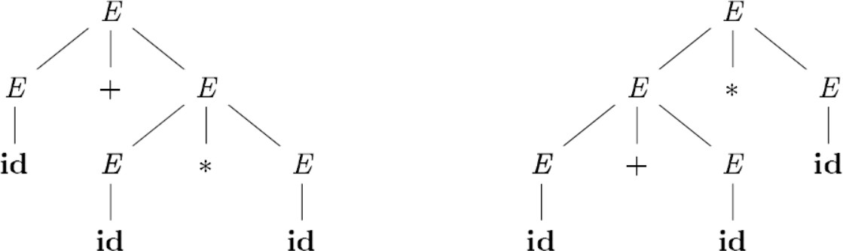
Two parse trees for id + id * id

Slide 30
Ambiguous Grammars
problem: compilers use parse trees to interpret the meaning of parsed expressions
different parse trees have different meanings
eg: (4 + 5) * 6 is not 4 + (5 * 6)
languages with ambiguous grammars are DISASTROUS; The meaning of programs isn’t well-defined! You can’t tell what your program might do!
solution: rewrite grammar to eliminate ambiguity
fold precedence rules into grammar to disambiguate
fold associativity rules into grammar to disambiguate
other tricks as well

Slide 31
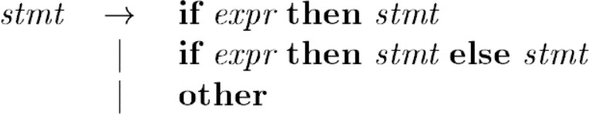
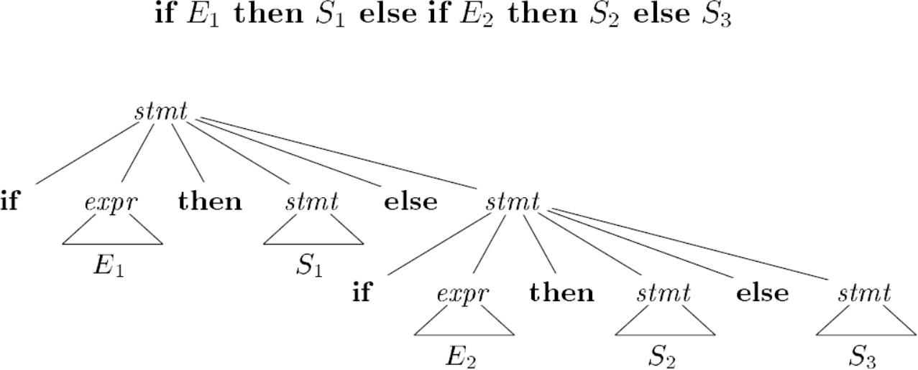
More on Ambiguity

Slide 32
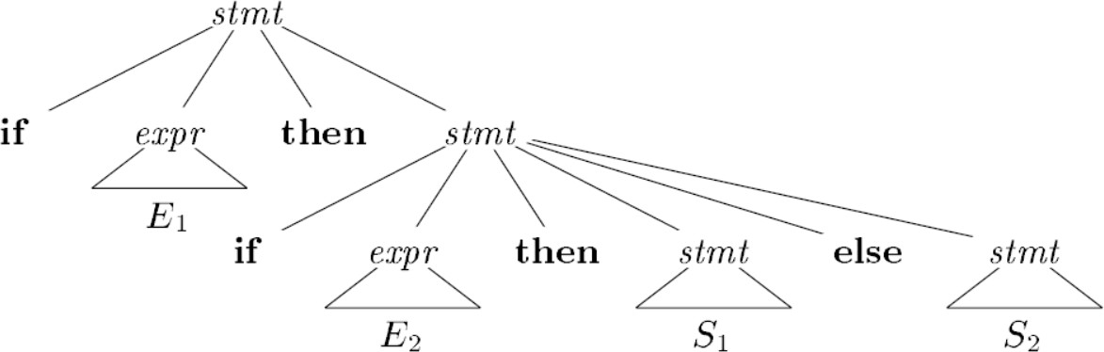
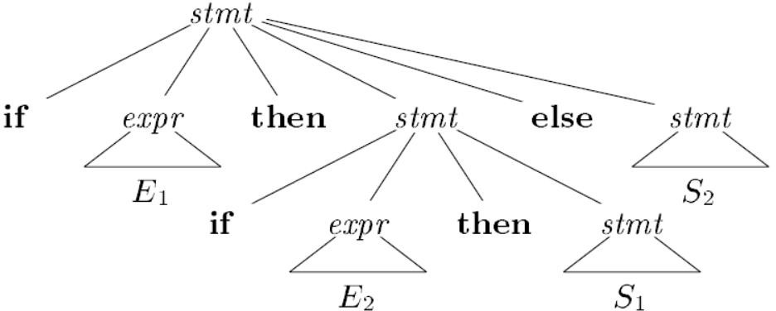

Slide 33
Removing Ambiguity
Ambiguity can be handled in several ways
Enforce associativity and precedence
Rewrite the grammar (cleanest way)
There are no general techniques for handling ambiguity
It is impossible to convert automatically an ambiguous
unambiguous one
grammar to an
Ambiguity is harmful to the intent of the program. The input might be deciphered in a way which was not really the intention of the programmer, as shown above in the 9-5+2 example. Though there is no general technique to handle ambiguity i.e., it is not possible to develop some feature which automatically identifies and removes ambiguity from any grammar.

Slide 34
Associativity
If an operand has operator on both the sides, the side on which operator takes this operand is the associativity of that operator
• +, -, *, / are left associative
For example,
6*5*4 = (6*5)*4 and not 6*(5*4)
6/5/4 = (6/5)/4 and not 6/(5/4)
^, = are right associative
For example,
6^5^4 => 6^(5^4) and not (6^5)^4)
x=y=z=5 => x=(y=(z=5))

Slide 35
Precedence
String a+5*2 has two possible interpretations because of two different parse trees corresponding to (a+5)*2 and a+(5*2)
Precedence determines the correct interpretation.
Precedence is a simple ordering, based on either importance or sequence.
One thing is said to "take precedence" over another if it is either regarded as more important or is to be performed first.
For example, consider the string a+5*2.
It has two possible interpretations because of two different parse trees corresponding to (a+5)*2 and a+(5*2).
But the * operator has precedence over the + operator.
So, the second interpretation is correct. Hence, the precedence determines the correct interpretation.

Slide 36
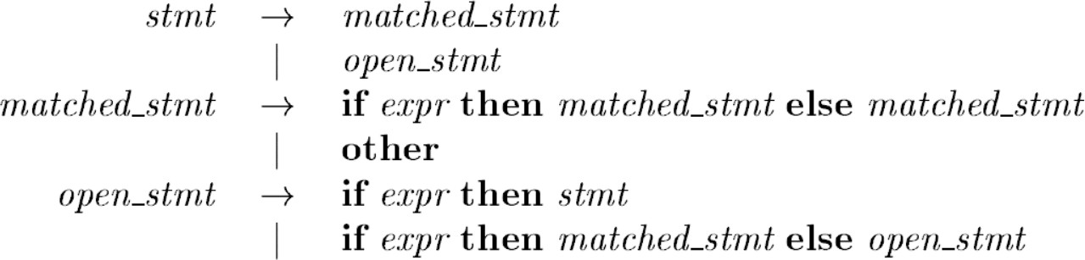
Unambiguous Grammar
General rule: match each else with the closest previous then

Slide 37
General types of parsers for grammars
Universal (INEFFICIENT)
Cocke-Younger-Kasami algorithm
Earley’s algorithm
Top-down
Parse trees from top (root) to bottom (leaves)
Bottom-up
Parse trees from bottom (leaves) to top (root)
Input scanned from left to right; one symbol at a time

Slide 38
Classification of Parsers
Parsers
Bottom-up Shift reduce parser
It can work for some ambiguous grammar
Top-down
With Backtracking
Without
backtracking
LR(k)
Operator
Precedence
Brute-force parser
Recursive Descent
LR(0)
LR(1)
Non-recursive Predictive (LL1)
LR(0)
Look Ahead LR (LALR)
Uses parse table
SLR(1)
Canonical LR (CLR)

Slide 39
Parsing
Fortunately, there are large classes of grammars for which we can build parsers that run in linear time
The two most important classes are called
LL and LR
LL stands for
'Left-to-right, Leftmost derivation'.
LR stands for
'Left-to-right, Rightmost derivation’

Slide 40
Review Question
Which of these is true about LR parsing?
Is most general non-backtracking shift-reduce parsing
It is still efficient
Both a and b
None of the mentioned

Slide 41
Top-down Parsing
The process of constructing the parse tree which starts from the root and goes down to the leaf, is Top-Down Parsing.
Top-Down Parsers constructs from the Grammar which is free from ambiguity and left recursion.
Top-Down Parsers uses leftmost derivation to construct a parse tree.
It allows grammar that is free from Left Factoring.
4. Top-down parsing can be viewed as finding the leftmost derivation for an input string.

Slide 42
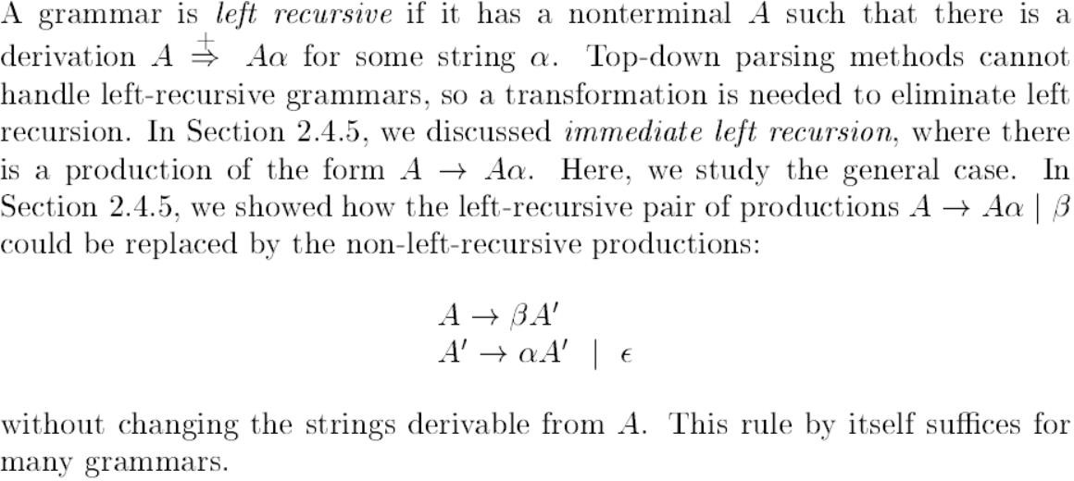
Left Recursion

Slide 43

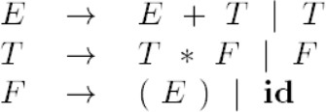
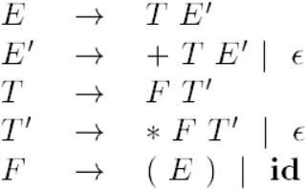

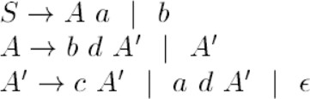
EXAMPLE: Eliminating Left Recursion

Slide 44
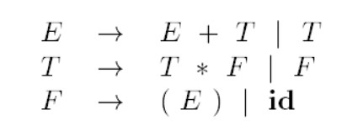
Two parse trees for id + id * id

Slide 45
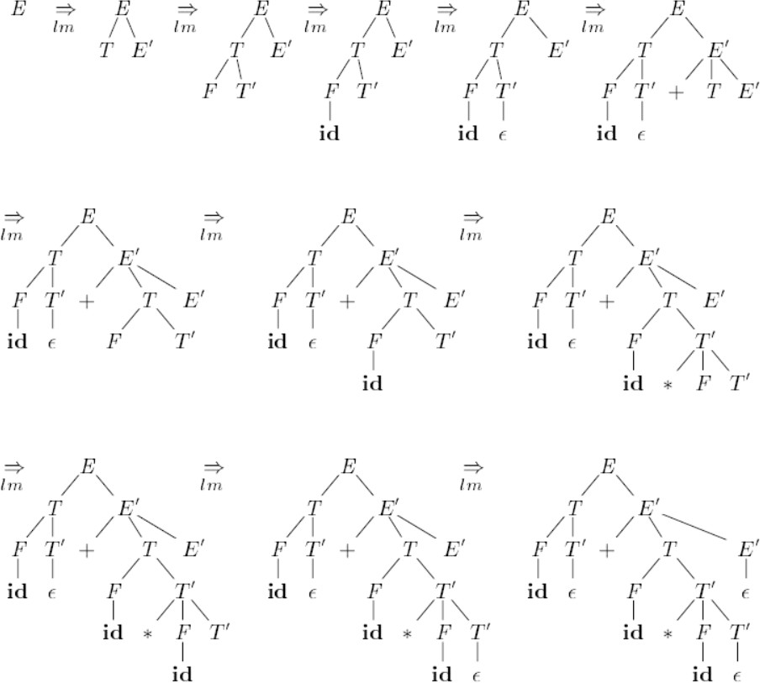
Top-down Parse of id + id * id

Slide 46
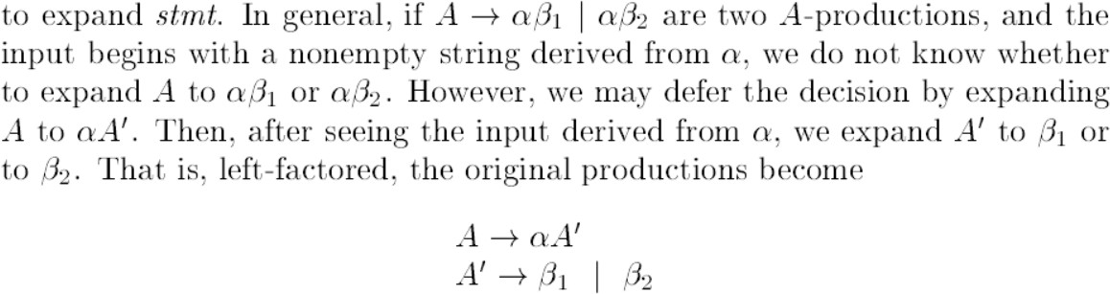
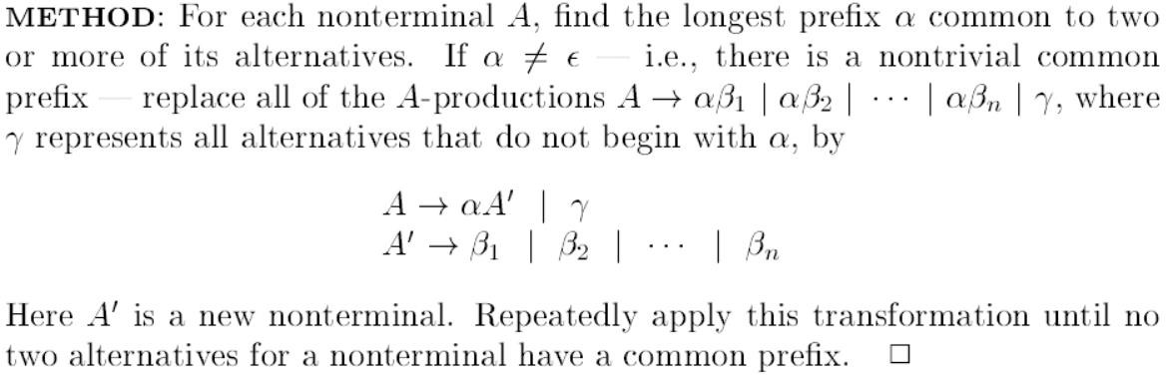
Left factoring

Slide 47
EXAMPLE: Left Factoring
Consider the context-free grammar:
S -> S S + | S S * | a
Extract the left common factor S -> S S A | a
A -> + | *
S -> 0 S 1 | 0 1
Extract the left common factor S -> 0 A
A -> S 1 | 1

Slide 48
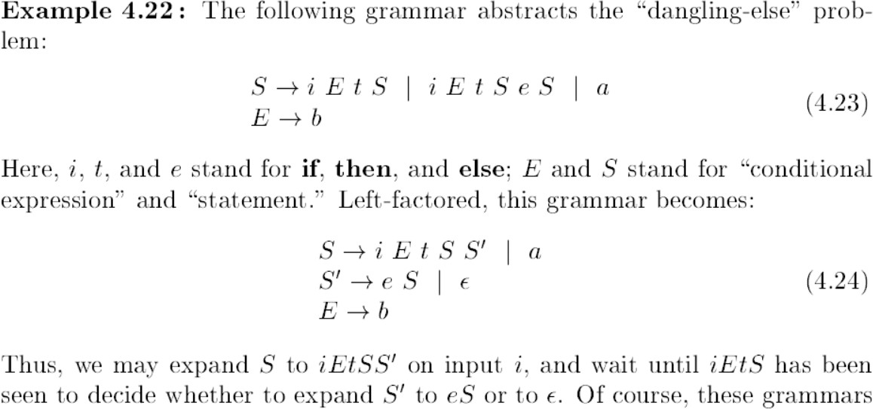
EXAMPLE: Left Factoring

Slide 49
Recursive Descent Parsing
RD parsing program consists of a set of procedures, one for each non-terminal
Execution begins with the procedure for the start symbol which halts and announces success if its procedure body scans the entire input string
May/may not use backtracking

Slide 50
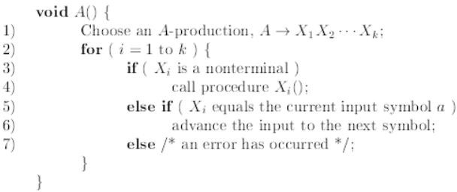
A typical procedure for a Non-Terminal

Slide 51
Recursive Descent Parsing
For the Recursive Descent Parser, we will write one program for every variable.
Example: Grammar:
E --> i E'
E' --> + i E' | e

Slide 52
// E is a start symbol.
E();
E --> i E'
E' --> + i E' | e
// if lookahead = $, it represents the end of the string
// Here l is lookahead. if (l == '$')
printf("Parsing Successful");
}
// Definition of E, as per the given production E()
{
if (l == 'i') {
match('i');
E'();
}
}
// Definition of E' as per the given production
E'()
{
if (l == '+') {
match('+');
match('i');
E'();
}//The second condition of E' else if ( l == 'e' )
{
match('e');
}
return ();
}
// Match function match(char t)
{
if (l == t) {
l = getchar();
}
else
printf("Error");
}

Slide 53
Recursive v/s Non Recursive Predictive Parsing
Recursive Predictive Descent Parser | Non-Recursive Predictive Descent Parser
It is a technique which may or may not require backtracking process. | It is a technique that does not require any kind of backtracking.
It uses procedures for every non-terminal entity to parse strings. | It finds out productions to use by replacing input string.
It contains several small functions one for each non- terminals in grammar. | The predictive parser uses a look ahead pointer which points to next input symbols to make it parser back tracking free, predictive parser puts some constraints on grammar.
It accepts all kinds of grammars. | It accepts only a class of grammar known as LL(k) grammar.

Slide 54
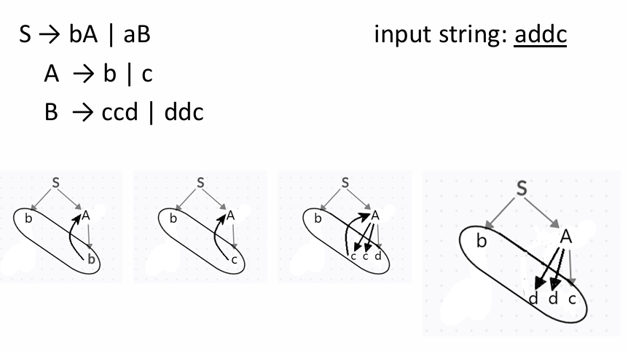
Brute Force Parsing

Slide 55
FIRST and FOLLOW
Construction of both top-down and bottom-up parsers is aided by two function:
FIRST
FOLLOW
In top-down: FIRST and FOLLOW used to choose which production to apply

Slide 56
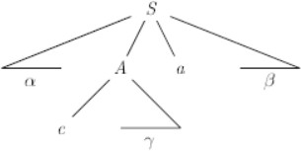
Rules to find FIRST set
Rule-01:
For a production rule X → ∈,
First(X) = { ∈ }
Rule-02:
For any terminal symbol ‘a’,
First(a) = { a }
Rule-03:
For a production rule X → Y₁Y₂Y₃,
Calculating First(X)
If ∈ ∉ First(Y₁), then First(X) = First(Y₁)
If ∈ ∈ First(Y₁), then First(X) = { First(Y₁) – ∈ } 𝖴 First(Y₂Y₃)
Calculating First(Y₂Y₃)
If ∈ ∉ First(Y₂), then First(Y₂Y₃) = First(Y₂)
If ∈ ∈ First(Y₂), then First(Y₂Y₃) = { First(Y₂) – ∈ } 𝖴 First(Y₃)
Similarly, we can make expansion for any production rule X → Y₁Y₂Y₃…..Y_{n}.

Slide 57
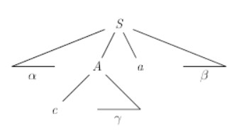
FOLLOW
FOLLOW(A), for non-terminal A, is set of terminals a that can appear immediately to the right of A in some sentential form.
∗
If S ֜ 𝛼𝐴𝑎𝛽, then a is in the FOLLOW(A)
If A is the rightmost symbol, then $ is in FOLLOW(A)
End-marker

Slide 58
Rules to Find Follow set
Rule-01:
For the start symbol S, place $ in Follow(S).
Rule-02:
For any production rule A → αB,
Follow(B) = Follow(A)
Rule-03:
For any production rule A → αBβ,
If ∈ ∉ First(β), then Follow(B) = First(β)
If ∈ ∈ First(β), then Follow(B) = { First(β) – ∈ } 𝖴 Follow(A)

Slide 59
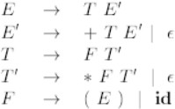
Finding FIRST and FOLLOW
Non-left- recursive
FOLLOW(E)=FOLLOW(E’)
={),$}
FOLLOW(T)=FOLLOW(T’)
={+,$,)}
FOLLOW(F)={+,$,),*}
FIRST(E)=FIRST(T)=FIRST(F)
={(,id}
FIRST(E’)={+,ε}
FIRST(T’)={*, ε}

Slide 60
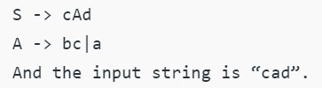
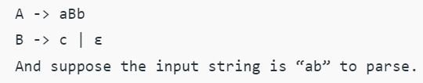
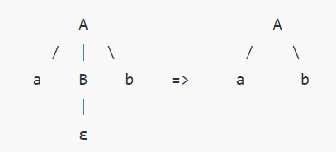
Requirement of FIRST and FOLLOW

Slide 61
LL(1) Grammars
Predictive parsers, i.e. recursive descent parsers needing no backtracking can be constructed for a class of grammars called LL(1)
No left recursion
No ambiguity
LL(1)
Scanning input
“left to right”
Leftmost derivation
One lookahead symbol

Slide 62
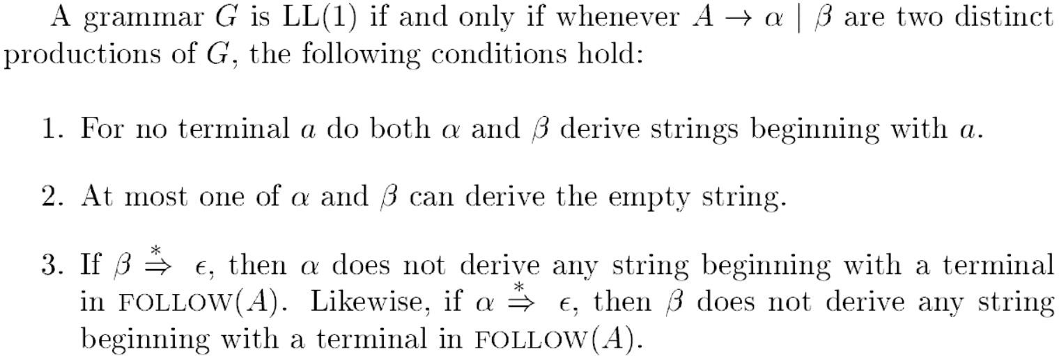
LL(1) Grammars

Slide 63
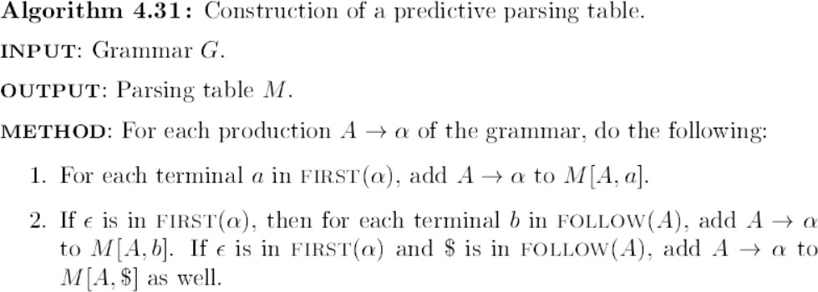
Construction of Predictive Parsing Table

Slide 64






EXAMPLE 1: Construction of predictive parsing table
FIRST(E)=FIRST(T)=FIRST(F)={(,id}
FIRST(E’)={+,ε}
FIRST(T’)={*, ε}
FOLLOW(E)=FOLLOW(E’)={),$}
FOLLOW(T)=FOLLOW(T’)={+,$,)}
FOLLOW(F)={+,$,),*}
 | id | + | * | ( | ) | $
E
E’
T
T’
F

Slide 65

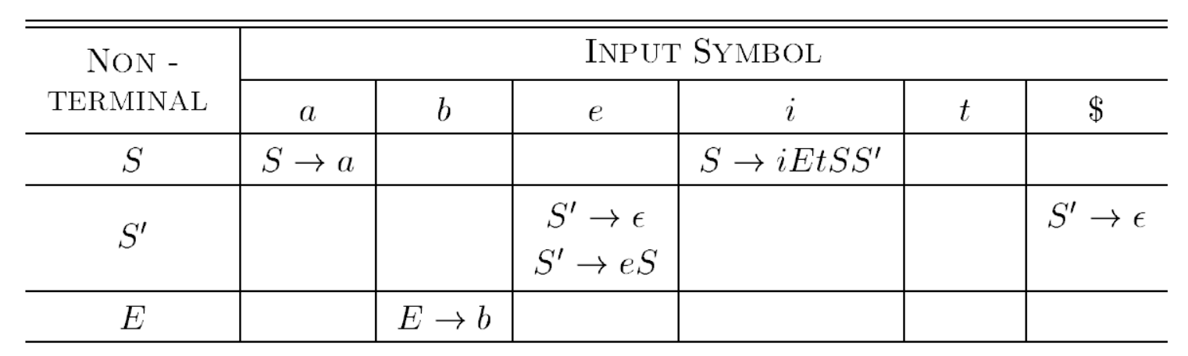
EXAMPLE 2: Construction of predictive parsing table
FIRST(S)={ i, a}
FIRST(S’)={e, ε}
FIRST(E)={b}
FOLLOW(S)={e,$}
FOLLOW(S’)={e,$}
FOLLOW(E)={t}
 | i | t | a | e | b | $
S
S’
E

Slide 66
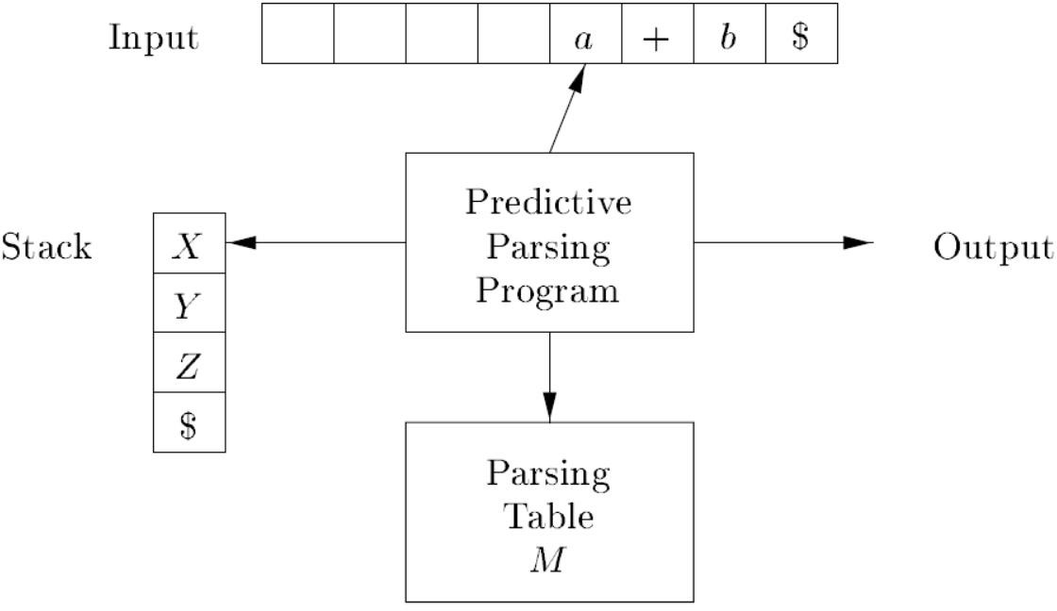
(Non-recursive) Predictive Parsing
Non-recursive predictive parser maintains an explicit stack.
NOTE: the stack was implicit in recursive descent parser using recursive calls.

Slide 67
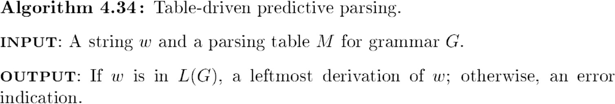
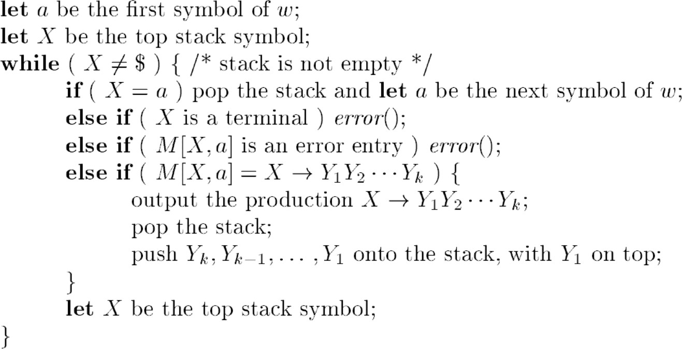
Table-driven Predictive Parser

Slide 68
Left Most Derivation
id + id * id

Slide 69
Top-down Parse of id + id * id

Slide 70
EXAMPLE 1: Construction of predictive parsing table
FIRST(E)=FIRST(T)=FIRST(F)={(,id}
FIRST(E’)={+,ε}
FIRST(T’)={*, ε}
FOLLOW(E)=FOLLOW(E’)={),$}
FOLLOW(T)=FOLLOW(T’)={+,$,)}
FOLLOW(F)={+,$,),*}
 | id | + | * | ( | ) | $
E
E’
T
T’
F

Slide 71
MATCHED | STACK | INPUT | ACTION
 | E$ | id + id * id $

Slide 72
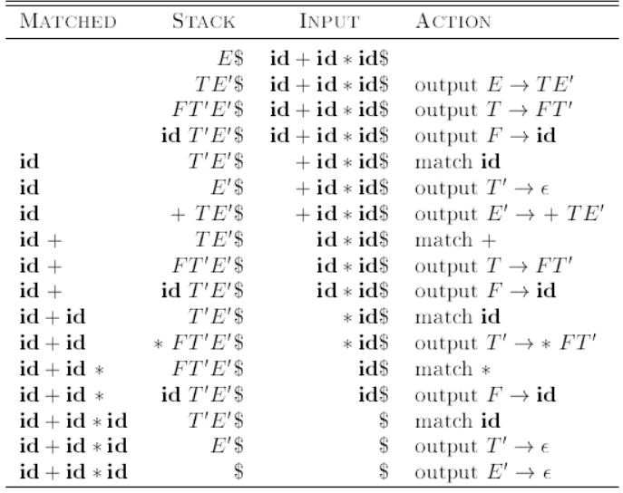

Slide 73
Bottom-Up parsing
Construct a parse tree for an input string beginning at leaves and going towards root
Reduce a string w of input to start symbol of grammar
Consider a grammar
S→ aABe
A→ Abc | b a b b c d e
B→ d
**Choose the correct substring, choose the correct production and (reverse) Right most derivation

Slide 74
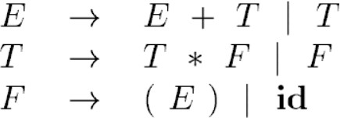
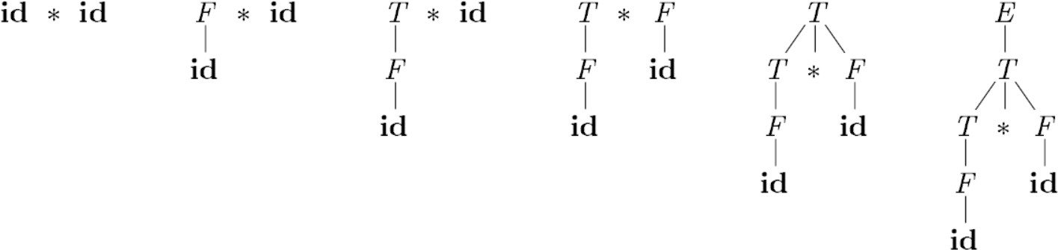
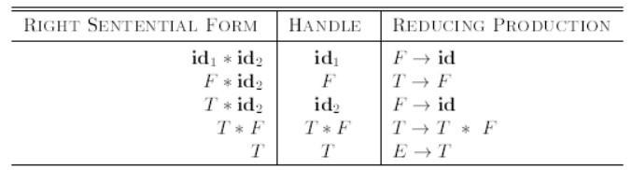
Bottom-up parse for id * id

Slide 75
(1) Shift Reduce Parsing
General case of bottom up parsing
STACK | INPUT | ACTION
$ | id1 * id2 $

Slide 76
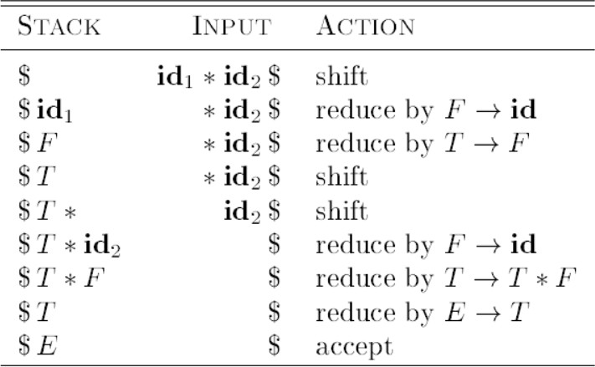
(1) Shift Reduce Parsing
General case of bottom-up parsing

Slide 77
Practice
STACK | INPUT | ACTION
$ | id1+id2*id3$

Slide 78
Actions in Shift Reduce Parser
SHIFT: shift the next input symbol onto the top of the stack
REDUCE:
the right end of the string to be reduced must be at top of the stack
Locate the left end of the string within the stack and
decide with what nonterminal to replace the string
ACCEPT: Successful completion of parsing
ERROR: Discover syntax error and call an error recovery routine.

Slide 79
Handle
Two important properties:
A substring that matches the body of a production
Its reduction represents one step along the reverse of rightmost derivation
FORMAL Definition:
∗𝑟𝑚 𝑟𝑚
If S 𝛼𝐴𝑤 𝛼𝛽𝑤, then β (corresponding to the
production 𝐴 → 𝛽) in the position following α is a handle of 𝛼𝛽𝑤

Slide 80
Review Questions
Consider the grammar E → E + n | E × n | n
For a sentence n + n × n, the handles in the right-sentential form of the reductions are ?
n, E + n and E + n × n
n, E + n and E + E × n
n, n + n and n + n × n
n, E + n and E × n

Slide 81
Conflicts
Shift/Reduce conflict
Shall I choose shift or reduce?
Reduce/reduce conflict
Which reduction production to use if more than one possible production?

Slide 82
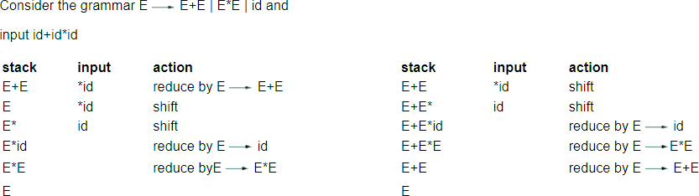
Shift Reduce Conflict

Slide 83
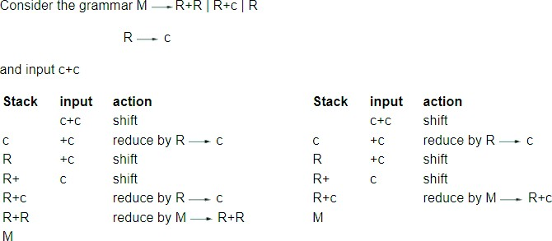
Reduce-reduce conflict

Slide 84
Review Question
If a state does not know whether it will make a shift operation or reduction for a terminal is called
Shift/reduce conflict
Reduce /shift conflict
Shift conflict
Reduce conflict

