Slide 2


Slide 3
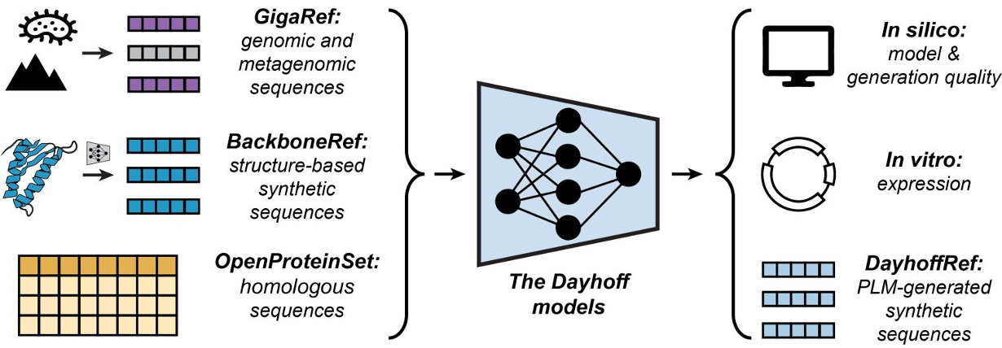

Slide 4
Dayhoff models

Slide 5
