Slide 1
Chemical Equilibrium
IRREVERSIBLE REACTIONS : Reactions which always proceed to completion in one direction only are called irreversible reactions. For example,
AgNO₃ + HCl → AgCl + HNO₃
REVERSIBLE REACTIONS : Reactions which do not always proceed to completion and may be made to proceed in the opposite direction under suitable conditions are called reversible reactions. For example,
3Fe + 4H₂0 ⇄ Fe₃O₄ + 4H₂
CHEMICAL EQUILIBRIUM : When a reversible reaction is carried out in a closed vessel a stage reached when the speed of the forward reaction equals the speed of the backward reaction and chemical equilibrium is said to be established.
CHARACTERISTICS OF CHEMICAL EQUILIBRIUM :
(i) Equilibrium can be attained from either side.
(ii) Equilibrium is dynamic in nature i.e. at equilibrium, reaction does not stop at equilibrium.
(iii) At equilibrium there is no change in the concentration of various species.
(iv) The equilibrium state remains uneffected by the presence of catalyst. Catalyst helps to attain the equilibrium state rapidly.
(v) It can be achieved in a closed container.
(vi) The observable properties of the process become constant and remain unchanged.

Slide 2
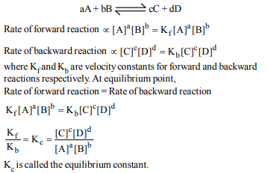
LAW OF MASS ACTION
The law states that the rate at which a substance reacts is directly proportional to its active mass and the rate of a chemical reaction is directly proportional to the product of the active masses of the reacting substances. For a general reaction.

Slide 3

FACTORS INFLUENCING EQUILIBRIUM CONSTANT:
(i) The equilibrium constant is not influenced by :
Concentration of reactants and products.
Presence of a catalyst.
Pressure.
Presence of inert materials.
The direction from which the equilibrium state is reached.
(ii) The equilibrium constant is influenced by :
Temperature : The variation of equilibrium constant is given by Van't Hoff equation:
where ΔH = Enthalpy change , (Kp)₁ and (Kp)₂ = Equilibrium Constant at temperature T₁ & T₂ .
R = Universal gas Constant.
For exothermic reaction , ΔH= -ve. If T₂>T₁, then (Kp)₂ < (Kp)₁. Thus, Kp decreases with increase of temperature.Similarly for endothermic reaction, Kp increases with increase of temperature.

Slide 4


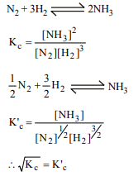

(B) The mode of representing
For the reaction : A + B ⇄C + D ,
However, for the reverse equilibrium, C + D ⇄ A + B,
(C) Stoichiometric representation of equation :
USE OF PARTIAL PRESSURE INSTEAD OF CONCENTRATIONS : For gaseous reacting substances partial pressures are conveniently used since at any fixed temperature partial pressure is directly proportional to concentration. For a general reaction

Slide 5
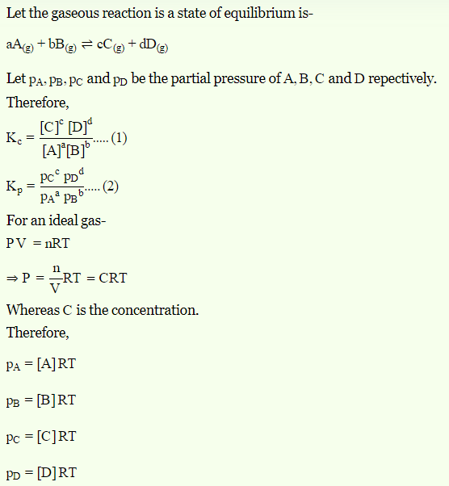
RELATION BETWEEN Kc AND Kp :

Slide 6
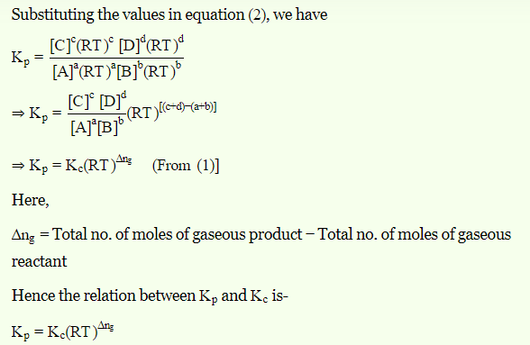

Slide 7
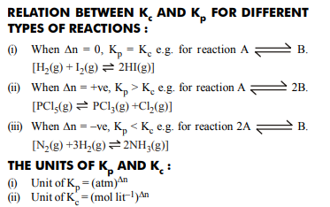
CHARACTERISTICS OF EQUILIBRIUM CONSTANT :
1. It has definite value for every chemical reaction at a particular temperature
2. The more is the value of K_{c} or K_{p} , the more is the completion of reaction or the more is the concentration of products.
3. When the reaction can be expressed as sum of two other reactions, the Kc of overall reaction is equal to the product of equilibrium constants of individual reactions.
4. Independent of presence of catalyst.
5. Kc for backward reaction is inverse of Kc for forward reaction
6. The more is the value of K_{c} or K_{p} , the more is the completion of reaction or the more is the concentration of products.

Slide 8
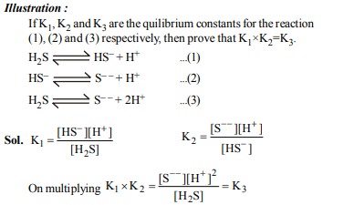
6. When the reaction can be expressed as sum of two other reactions, the Kc of overall reaction is equal to the product of equilibrium constants of individual reactions.

Slide 9


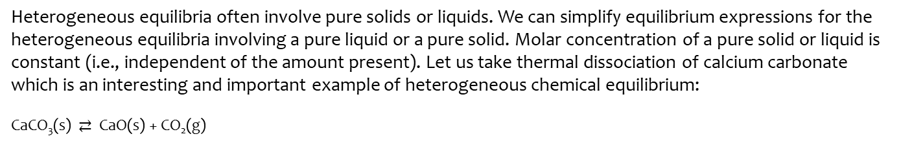
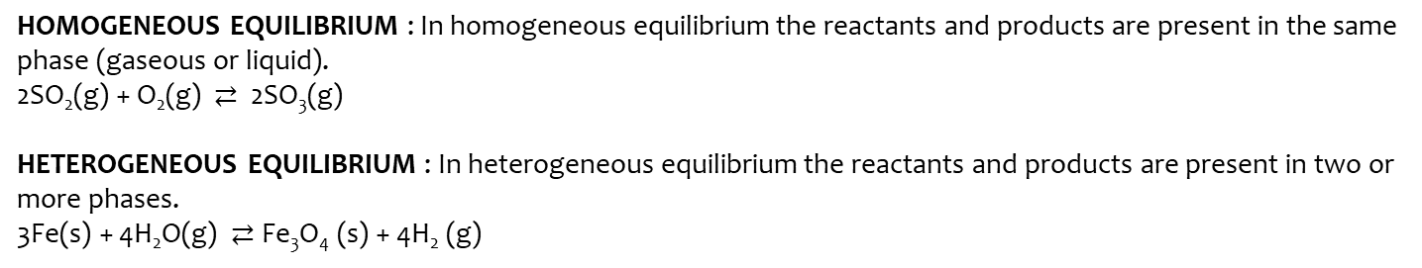
HOMOGENEOUS EQUILIBRIUM : In homogeneous equilibrium the reactants and products are present in the same phase (gaseous or liquid).
2SO₂(g) + O₂(g) $⇄$ 2SO₃(g)
HETEROGENEOUS EQUILIBRIUM : In heterogeneous equilibrium the reactants and products are present in two or more phases.
3Fe(s) + 4H₂O(g) $⇄$Fe₃O₄ (s) + 4H₂ (g)
Heterogeneous equilibria often involve pure solids or liquids. We can simplify equilibrium expressions for the heterogeneous equilibria involving a pure liquid or a pure solid. Molar concentration of a pure solid or liquid is constant (i.e., independent of the amount present). Let us take thermal dissociation of calcium carbonate which is an interesting and important example of heterogeneous chemical equilibrium:
CaCO₃(s) $⇄$ CaO(s) + CO₂(g)
Since [CaCO₃(s)] and [CaO(s)] are both constant, therefore modified equilibrium constant for the thermal decomposition of calcium carbonate will be

Slide 10
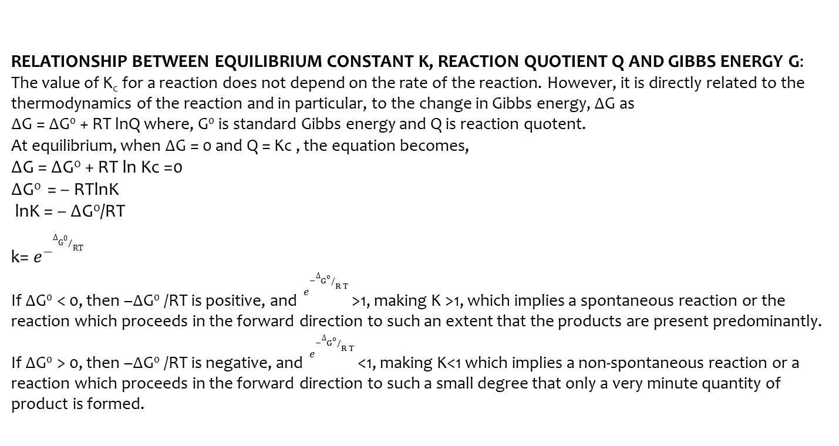
RELATIONSHIP BETWEEN EQUILIBRIUM CONSTANT K, REACTION QUOTIENT Q AND GIBBS ENERGY G:
The value of K_{c} for a reaction does not depend on the rate of the reaction. However, it is directly related to the thermodynamics of the reaction and in particular, to the change in Gibbs energy, ∆G as
∆G = ∆G⁰ + RT lnQ where, G⁰ is standard Gibbs energy and Q is reaction quotent.
At equilibrium, when ∆G = 0 and Q = Kc , the equation becomes,
∆G = ∆G⁰ + RT ln Kc =0
∆G⁰ = – RTlnK
lnK = – ∆G⁰/RT
k= $e^{−{∆G}^{0}/RT}$
If ∆G⁰ < 0, then –∆G⁰ /RT is positive, and $e^{−{∆G}^{0}/R T }$>1, making K >1, which implies a spontaneous reaction or the reaction which proceeds in the forward direction to such an extent that the products are present predominantly.
If ∆G⁰ > 0, then –∆G⁰ /RT is negative, and $e^{−{∆G}^{0}/R T }$<1, making K<1 which implies a non-spontaneous reaction or a reaction which proceeds in the forward direction to such a small degree that only a very minute quantity of product is formed.

Slide 11
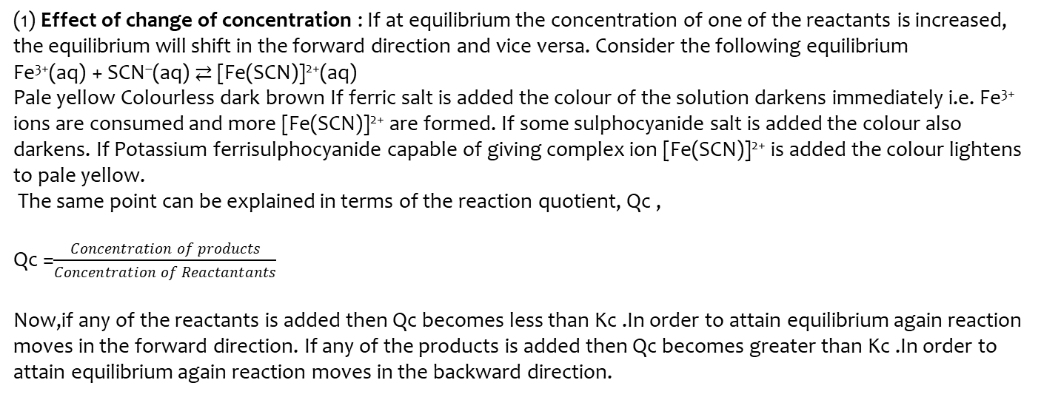
Le Chatelier’s principle: It states that a change in any of the factors that determine the equilibrium conditions of a system will cause the system to change in such a manner so as to reduce or to counteract the effect of the change. This is applicable to all physical and chemical equilibria.
(1) Effect of change of concentration : If at equilibrium the concentration of one of the reactants is increased, the equilibrium will shift in the forward direction and vice versa. Consider the following equilibrium
Fe³⁺(aq) + SCN–(aq) ⇄ [Fe(SCN)]²⁺(aq)
Pale yellow Colourless dark brown If ferric salt is added the colour of the solution darkens immediately i.e. Fe³⁺ ions are consumed and more [Fe(SCN)]²⁺ are formed. If some sulphocyanide salt is added the colour also darkens. If Potassium ferrisulphocyanide capable of giving complex ion [Fe(SCN)]²⁺ is added the colour lightens to pale yellow.
The same point can be explained in terms of the reaction quotient, Qc ,
Qc =$\frac{Concentration of products}{Concentration of Reactantants}$
Now,if any of the reactants is added then Qc becomes less than Kc .In order to attain equilibrium again reaction moves in the forward direction. If any of the products is added then Qc becomes greater than Kc .In order to attain equilibrium again reaction moves in the backward direction.

Slide 12
(2) Effect of Pressure Change: A pressure change obtained by changing the volume can affect the yield of products in case of a gaseous reaction where the total number of moles of gaseous reactants and total number of moles of gaseous products are different. In applying Le Chatelier’s principle to a heterogeneous equilibrium the effect of pressure changes on solids and liquids can be ignored because the volume (and concentration) of a solution/liquid is nearly independent of pressure. The effect of pressure can be summarized as follows:
(a) No effect of pressure on equilibria having same moles of reactants and products e.g.
(I) N₂ + O₂ ⇄ 2NO
(II) H₂ + I₂ ⇄ 2HI
(b) When there is change in the number of moles the equilibrium will shift in the direction having smaller number of moles when the pressure is increased and vice versa e.g.
N₂ + 3H₂ ⇄ 2NH₃
More pressure more ammonia
PCl₅ ⇄ PCl₃ + Cl₂
The more the pressure, the lesser the dissociation of PCl₅ .

Slide 13
(3) Effect of temperature : When temperature increases then equilibrium shifts in that direction in which excess heat is absorbed. So, we can say that
(I) When process is exothermic - Low temperature favours the formation of products, because in such reactions heat is absorbed in backward direction.
(II) When process is endothermic - High temperature favours the formation of products, because in such reactions heat is absorbed in forward direction e.g.
N₂ + 3H₂ ⇄ 2NH₃ + 24.0 kcal. Since the production of NH₃ is exothermic low temperature favours its formation.
(4) Effect of addition of inert gas :
Addition of Inert gas at constant volume : The total pressure of the system is increased, but the partial pressure of each reactant and product remains the same. Hence no effect on the state of equilibrium.
Addition of Inert gas at constant pressure : The total volume is increased, the number of moles per unit volume of each reactant and product is decreased. Hence equilibrium will shift to the side where number of moles are increased e.g. PCl₅ (g) ⇄ PCl₃ (g) + Cl₂ (g) Introduction of inert gas at constant pressure will shift the equilibrium to right hand side.

Slide 14
(5) Effect of a Catalyst: A catalyst increases the rate of the chemical reaction by making available a new low energy pathway for the conversion of reactants to products. It increases the rate of forward and reverse reactions that pass through the same transition state and does not affect equilibrium. Catalyst lowers the activation energy for the forward and reverse reactions by exactly the same amount. Catalyst does not affect the equilibrium composition of a reaction mixture. It does not appear in the balanced chemical equation or in the equilibrium constant expression. However, a catalyst helps to attain the state of equilibrium quickly.
Apllication of Le Chatteliers principle to Physical Equlibria :
(i) Effect of pressure on solubility : The increased pressure, will increase the solubility of a gas and vice versa.
(ii) Effect of temperature on solubility : The substances which dissolve with the absorption of heat, their solubility will increase with increase of temperature and vice versa e.g. dissolution of NH₄Cl, KCl, KNO₃ is endothermic which increases with increase of temperature. The dissolution of calcium acetate and Calcium hydroxide is exothermic, their solubility is lowered at higher temperature.
(iii) Effect of pressure on the melting point of ice : Ice liquid water The ice occupy the more volume than liquid water, so increased pressure will result in melting of ice according to Le Chatelier's principle.

Slide 15
FAVOURABLE CONDITIONS FOR SOME IMPORTANT REACTIONS :
(1) Synthesis of ammonia (Haber's process) :
N₂(g) + 3H₂(g) ⇄ 2NH₃(g) + 22.4 kcal.
(I) Low temperature (500°C), (II) High pressure (200 – 1000 atm.),(III) Excess of N₂ and H₂
(2) Synthesis of NO (nitric acid birkland eyde process)
N₂ (g) + O₂ (g) ⇄ 2NO(g)– 43.2 kcal
(I) High temperature ,(II) Excess of N₂ and O_{2,}(III) No effect of pressure
(3) Formation of SO3 (sulphuric acid contact process)
2SO₂ (g) + O₂ (g) ⇄ 2SO₃ + 42.0 kcal
(I) Low temperature ,(II) High pressure ,(III) Excess of SO₂ and O₂
(4) Formation of nitrogen dioxide
2NO + O₂ ⇄ 2NO₂ + 27.8 kcal
(I) Low temperature ,(II) High pressure ,(III) Excess of NO and O₂
(5) Dissociation of nitrogen tetraoxide
N₂O₄ ⇄ 2NO₂ – 14 kcal
(I) High temperature ,(II) Low pressure ,(III) Excess of N₂O₄
(6) Oxidation of CO by steam (Bosch process)
CO + H₂O ⇄ CO₂ + H2 + x kcal
(I) Low temperature ,(II) Excess of steam and CO ,(III) No effect of pressure
(7) Dissociation of PCl5
PCl₅ ⇄ PCl₃ + Cl₂ – 15 kcal
(I) High temperature ,(II) Low pressure ,(III) Excess of PCl5

