Slide 1
METAL
FORMING
PROCESSES

Slide 2
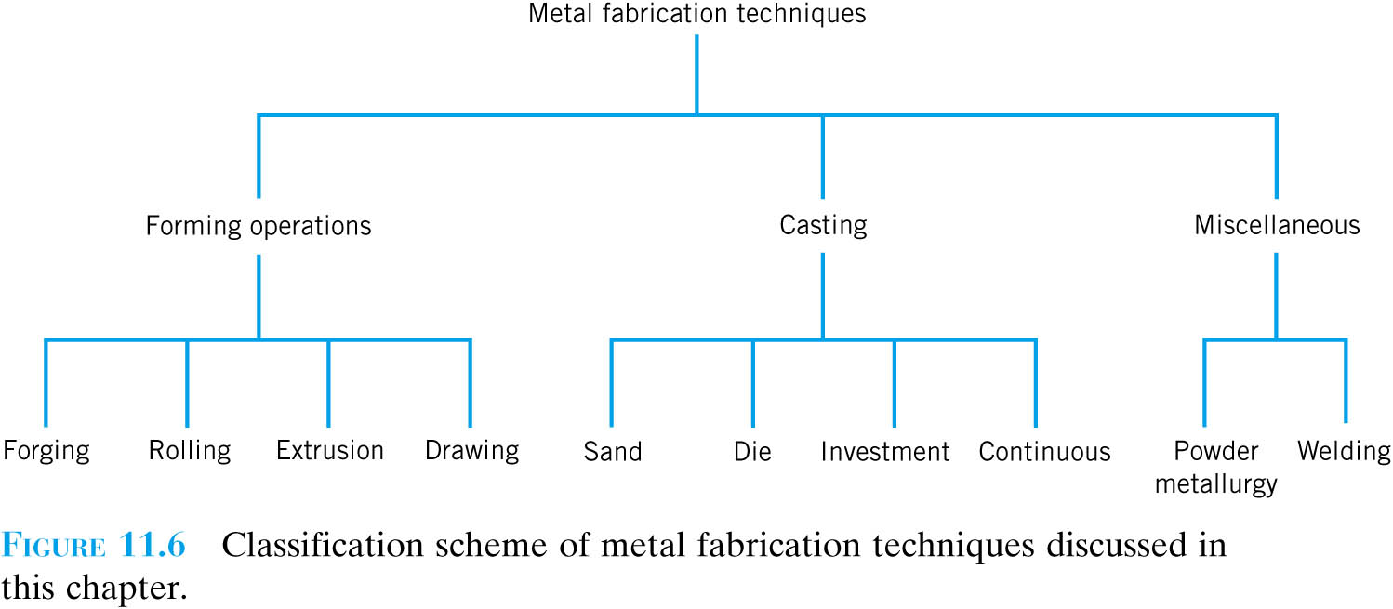

Slide 3
Metal Forming - Introduction
It is the process in which plastic deformation is used to change the shape of the metal pieces under the action of external forces.
Not only create useful shape shapes but also control mechanical properties

Slide 4
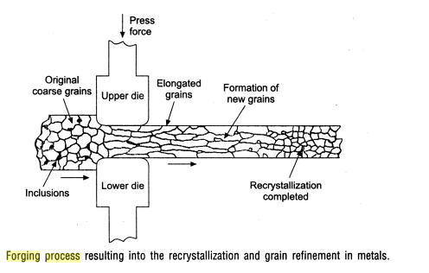

Slide 5
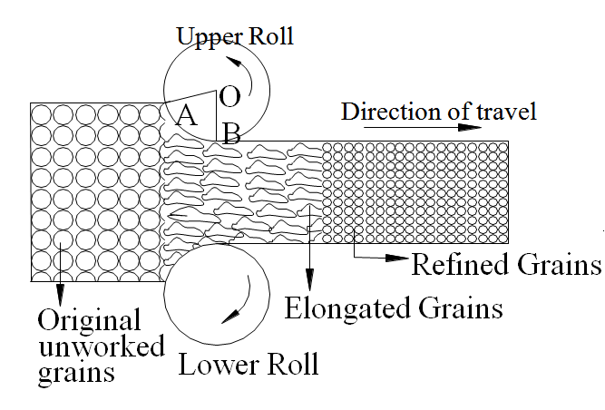

Slide 6
Deformation
It is a change in the shape or size of an object due to an applied force.
Deformation results from the use of a tool (die), which applies stresses, that exceeds the yield strength of the metal.

Slide 7
Metal therefore deforms to take a shape determined by the geometry of die.
With the application of suitable pressures, the material is moved to obtain the desired shape with almost no wastage.

Slide 8
The required pressures are generally high and the tools and equipment needed are quite expensive.
Large production quantities are often necessary to justify the process.

Slide 9
Stresses applied to plastically deform metal are:
Compressive
Shear stress
Stretch
Bend

Slide 10
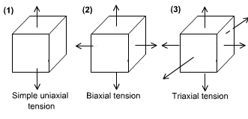
State of the stresses metal undergo during deformation
As a metal is deformed into useful shape, it experiences stresses such as tension, compression, shear, or various combinations.

Slide 11
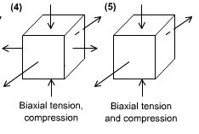
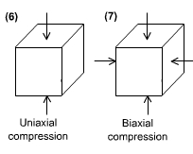
State of the stresses metal undergo during deformation

Slide 12
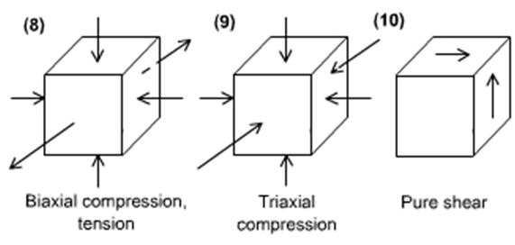
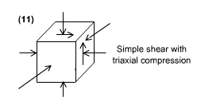
State of the stresses metal undergo during deformation

Slide 13
Metal forming involve application of various forces.
Compressive stresses
Forging b) Rolling c) Extrusion
Tensile stresses
Stretch forming b) Creep forming
3. Shearing stresses
Shearing b) Blanking c) Fine blanking
Tensile & Compressive
a) Wire drawing b) Deep drawing

Slide 14
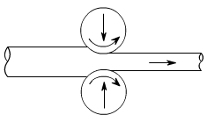
Some common metal forming processes are schematically given in along with the state of stress(es) experienced by the metal during the process.
Process | State of Stress in Main Part During Forming
Rolling | Bi-axial compression

Slide 15
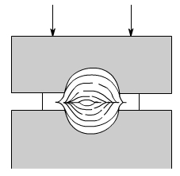
Some common metal forming processes are schematically given in along with the state of stress(es) experienced by the metal during the process.
Process | State of Stress in Main Part During Forming
Forging | Tri-axial compression

Slide 16
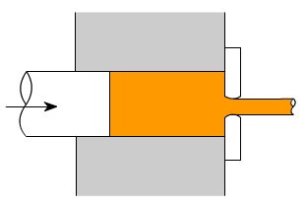
Some common metal forming processes are schematically given in along with the state of stress(es) experienced by the metal during the process.
Process | State of Stress in Main Part During Forming
Extrusion | Tri-axial compression

Slide 17
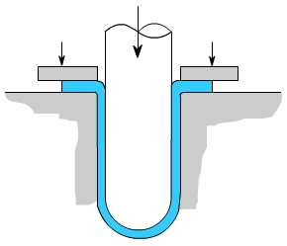
Some common metal forming processes are schematically given in along with the state of stress(es) experienced by the metal during the process.
Process | State of Stress in Main Part During Forming
Tube Drawing | In flange of blank, bi-axial tension and compression. In wall of cup, simple uni-axial tension.

Slide 18
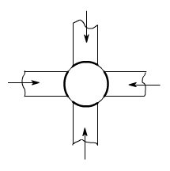
Some common metal forming processes are schematically given in along with the state of stress(es) experienced by the metal during the process.
Process | State of Stress in Main Part During Forming
Swaging | Bi-axial compression

Slide 19
PURPOSE OF MECHANICAL WORKING
To reduce the original block / ingot to finished dimensions of part.
To achieve optimum mechanical properties in metal.
Impurities in metal get elongated with grains and in the process get broken & dispersed through out the metal.

Slide 20
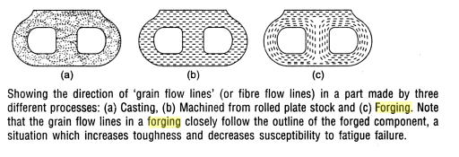

Slide 21
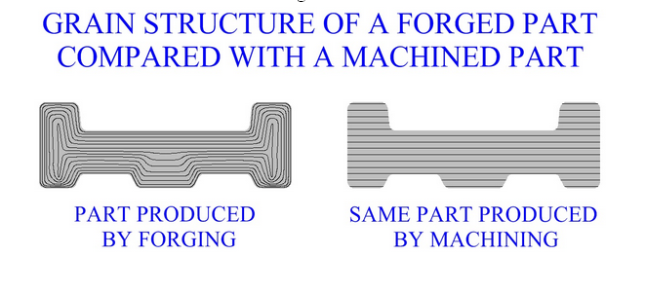

Slide 22
TYPES OF DEFORMATION
Magnitude of amount will be directly proportional to the force applied.
In Elastic deformation material regains its original shape on removal of load.
Ex: Think of stretching rubber band, then releasing it, and having it go back to its original shape.

Slide 23
TYPES OF DEFORMATION
Geometric change in material is no longer directly proportional to stress and geometric changes remain after the stress is released.
In plastic deformation material does not return to its original shape on removal of load.

Slide 24
To be successfully formed, a metal must possess certain properties.
Desirable properties include:
Low yield strength.
High ductility
Such properties are affected by temperature.

Slide 25
EFFECT OF TEMPERATURE IN METAL FORMING
Properties of metal change with an increase in temperature.
Metal reacts differently to same manufacturing operation if it is performed under different temperatures and manufactured part may posses different properties.

Slide 26
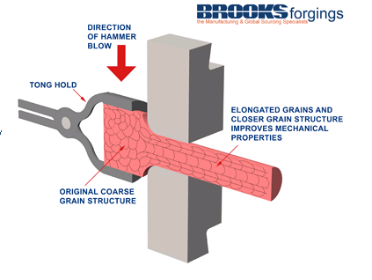
RECRYSTALLIZATION

Slide 27
Under action of heat and force, when the atoms reach a certain higher energy level, new crystals start forming.
New crystals start forming is termed as recrystallisation.
Recrystallisation destroys the old grain structure deformed by mechanical working, entirely new strain free crystals are formed.

Slide 28
A entirely new grain structure (equi axed, stress free) with reduced grain size starts forming.
This phenomenon is called Recrystallisation which decreases strength & raise ductility of metal.

Slide 30
In industrial metal forming manufacture, there are three basic temperature ranges at which metal can be formed:
Cold working of metals
Warm working of metals
Hot working of metals

Slide 31
COLD WORKING OF METALS
Plastic deformation of metal is carried out at a temperature below the recrystallisation temperature.
Yield point of metal is also higher at lower temperature range.
Hence, force required to shape a metal is greater.
At this temperatures, ductility of metal is limited.

Slide 32
Various cold working processes:
Drawing
Bending
Hobbing
Cold extruding

Slide 33
Advantages
Part will be stronger & harder (due to strain hardening)
Better surface finish (as no oxide is formed on surface)
More accurate geometric tolerances.
No heat is required.
Economical for small sizes.
Easier to handle cold parts.

Slide 34
Disadvantages
Higher forces are required for deformation.
Heavier and more powerful equipment is required.
Equipment cost is high
Severe stresses are setup, hence stress relieving process is required.
Brittle materials can’t be cold worked.

Slide 35
HOT WORKING OF METALS
When plastic deformation of metal is carried out at a temperature above the recrystallisation temperature the processes performed on metals is called hot working.
In hot working, the temperature at which the working is completed is important since any extra heat left after working will aid in the grain growth, thus giving poor mechanical properties.

Slide 36
Various hot working processes:
Rolling
Forging
Extrusion
Drawing

Slide 37
Advantages
No strain hardening.
Deformation energy required is low, since shear stress gets reduced at high temperatures.
Greater ductility of metal is available.
Equipment of lesser power is needed.
High production rate
Even brittle metals can be hot worked.
Structure can be altered to improve final properties.

Slide 38
Disadvantages
Some metals can’t be hot worked bcz. Of their brittleness at high temperatures.
Surface finish is poor bcz. of scale formation.
Handling of material is not easy
Heat resisting tools are required which is expensive.
Close tolerances can’t be maintained because of non-uniform cooling.

Slide 39
Hot Working | Cold Working
carried out above recrystalization temperature. | carried out below recrystalization temperature.
Internal and residual stresses are not produced. | Internal and residual stresses are produced.
Less stress is required for deformation | More stress is required for deformation
Refinement of crystal occurs | Grain structure is distorted.
Energy required for plastic deformation is less. | Energy required for plastic deformation is more.
If cracks & blow holes are present in the metal they are finished / removed | The existing cracks propagates and new cracks may develop.

Slide 40
Hot Working | Cold Working
Tensile strength, yield point, fatigue strength, hardness are not affected if hot working is done properly. | Tensile strength, yield point, fatigue strength, hardness is increased while resistance to corrosion is decreased.
Heavy oxidation is occurred during hot working | No oxidation is occurred during hot working
Surface finish is poor due to oxidation & scaling at high temperatures. | Cold worked parts carry better surface finish.
Difficult to control dimensions because of contraction occurring during cooling | Easy to control dimensions with in tolerance limits.
Handling of materials is difficult | Handling of materials is easy

Slide 41
METAL FORMING PROCESSES
It can be classified under two major groups:
Bulk deformation process (low surface area to volume ratio).
Sheet metal working processes (high surface area to volume ratio).

Slide 42
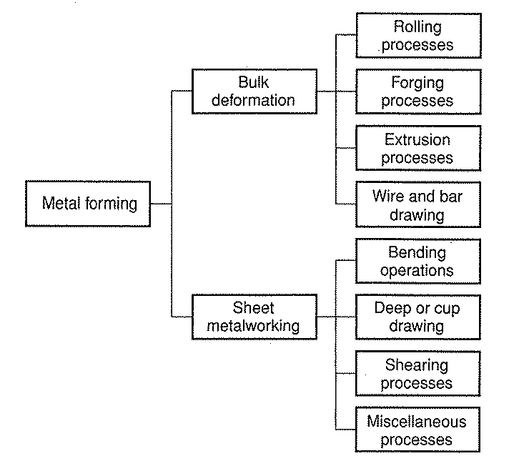

Slide 43
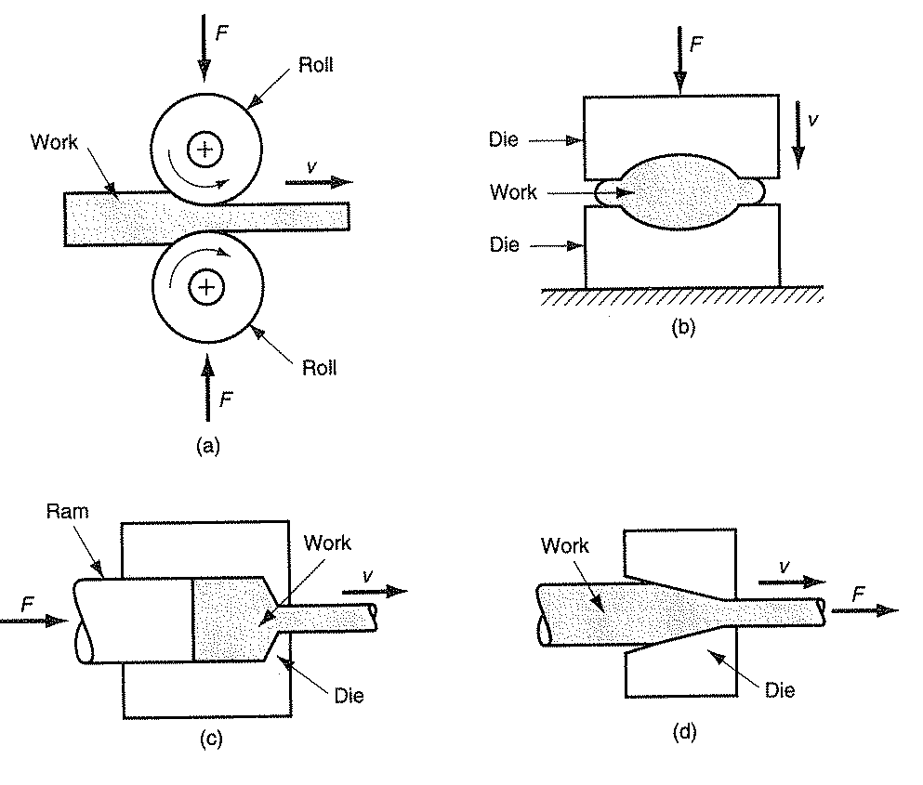
Basic Bulk Deformation Process

Slide 44
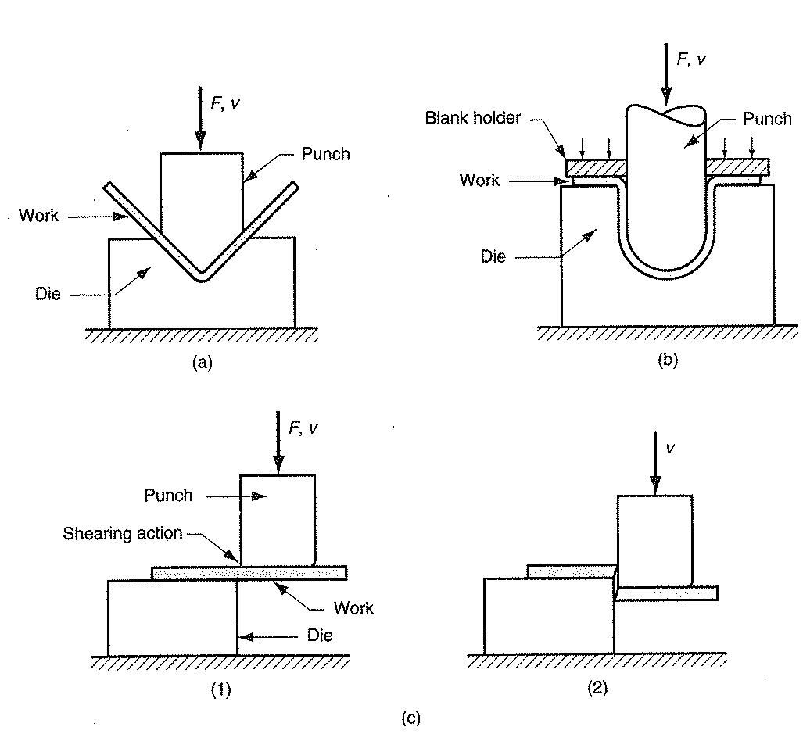
Basic Sheet Metal

