Slide 1
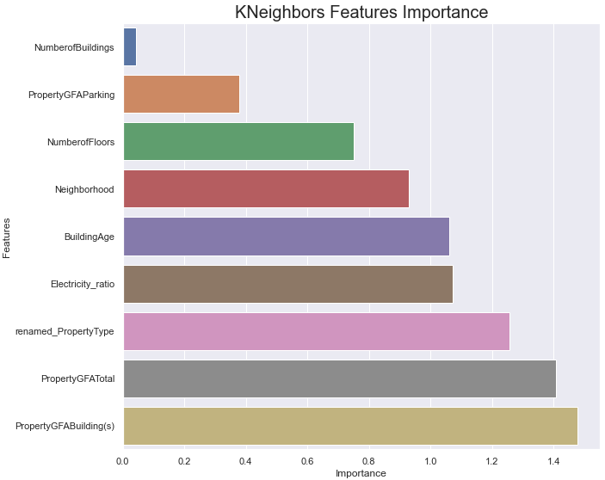
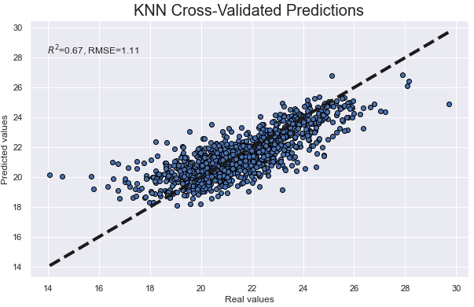
Ce que nous avons vu la semaine dernière
OpenClassrooms

Slide 2
Ce que j'ai fait cette semaine
Tunning hyperparameters
KNeighborse k Nearest Neighbors
Find the k Nearest Neighbors
RandomForestRegressor
GradientBoostingRegressor
LinearRegression / PolynomialFeatures
Outliers
OpenClassrooms

Slide 3
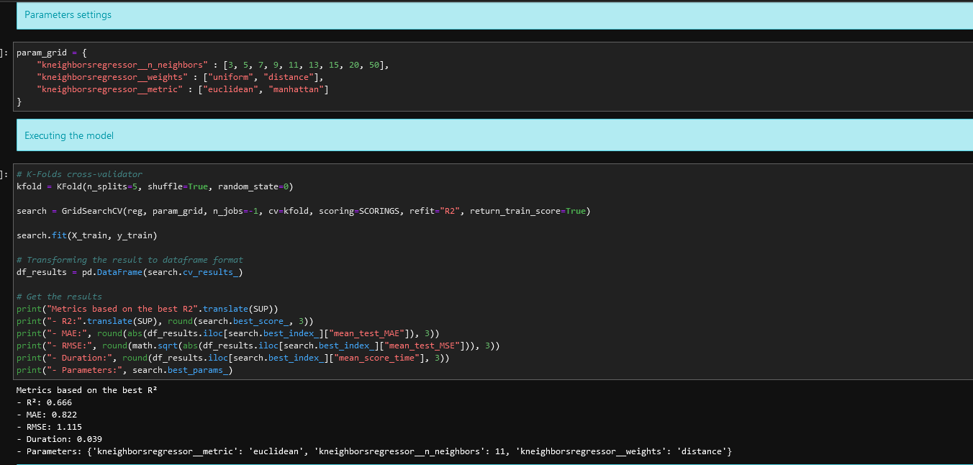
Find the k Nearest Neighbors
OpenClassrooms

Slide 4
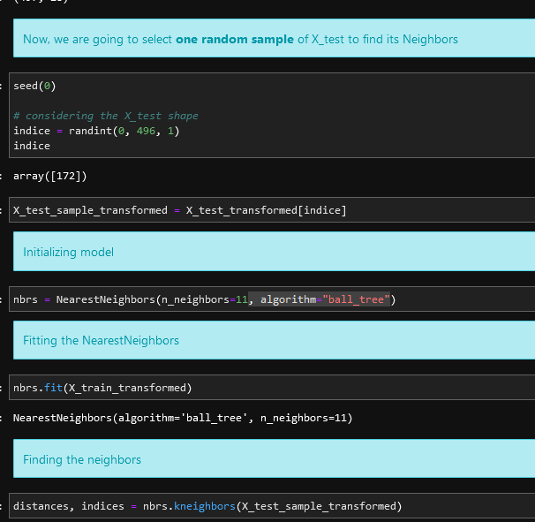
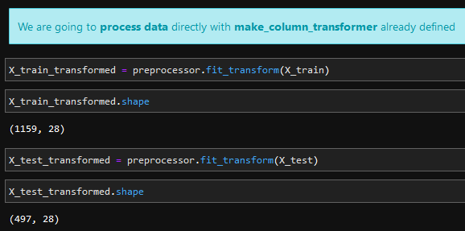
Find the k Nearest Neighbors
OpenClassrooms

Slide 5
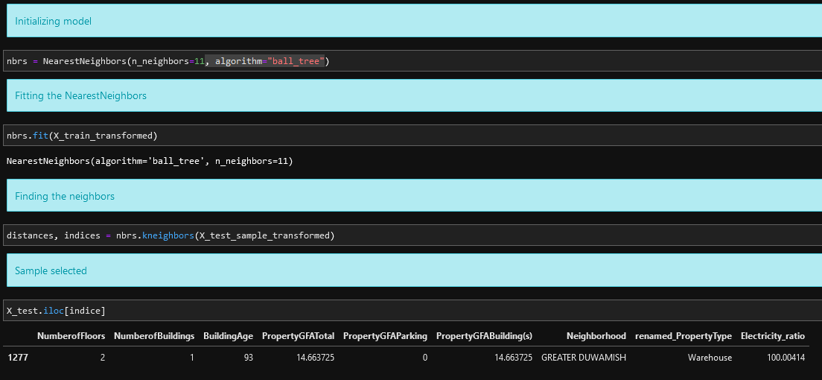
Find the k Nearest Neighbors
Project 3 - Conception d’une application au service de la santé publique
OpenClassrooms

Slide 6
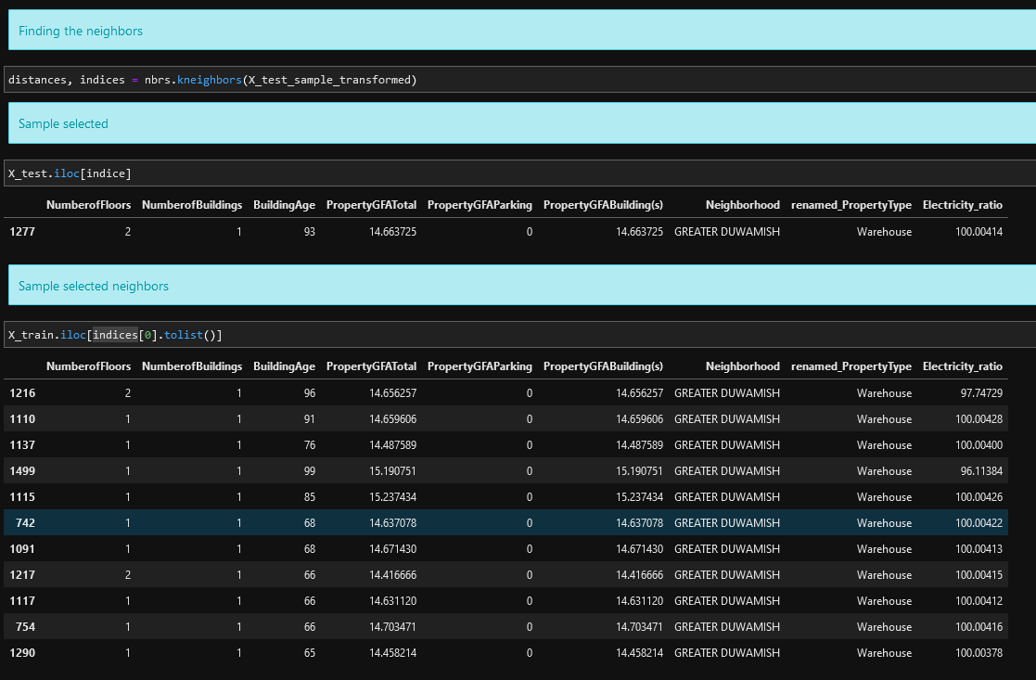
Find the k Nearest Neighbors
OpenClassrooms

Slide 7
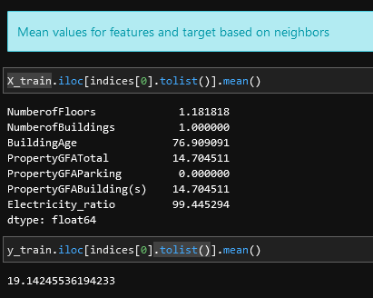
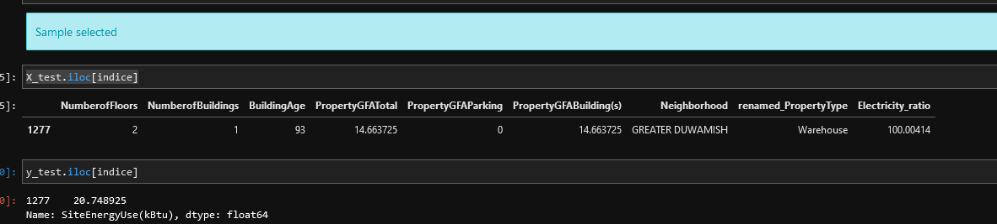
Find the k Nearest Neighbors
OpenClassrooms

Slide 8
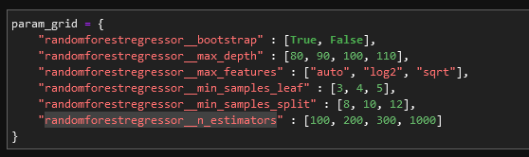
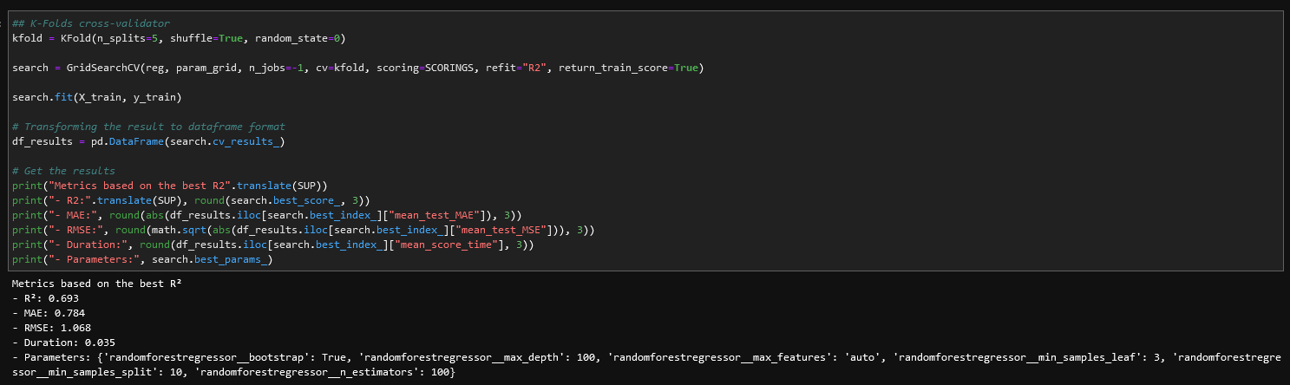
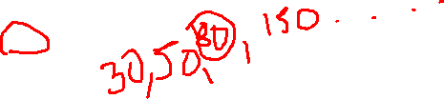
RandomForestRegressor
OpenClassrooms

Slide 9
RandomForestRegressor
OpenClassrooms

Slide 10

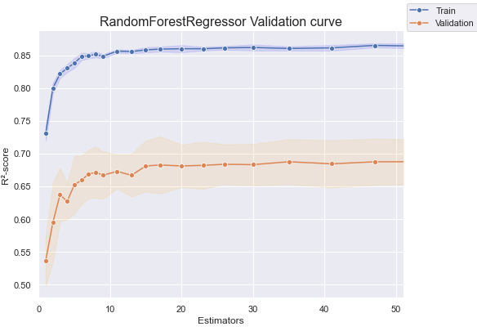
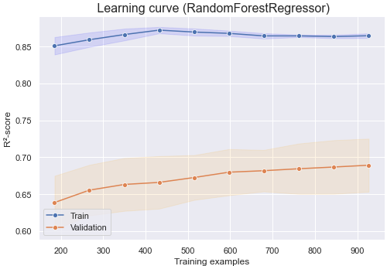
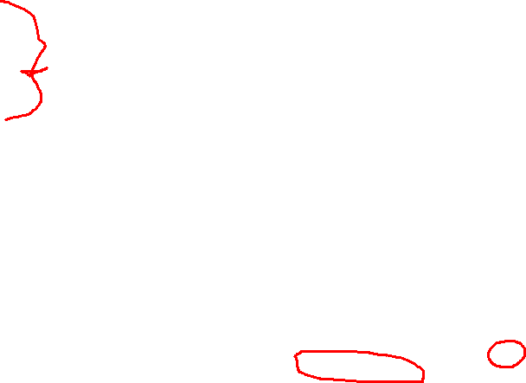
RandomForestRegressor
OpenClassrooms

Slide 11
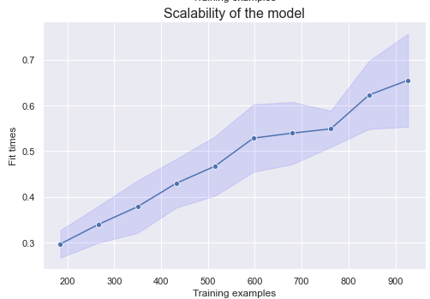
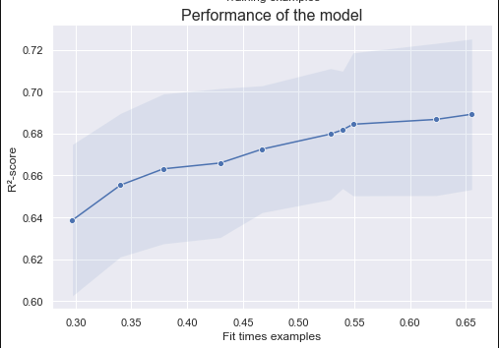
RandomForestRegressor
OpenClassrooms

Slide 12
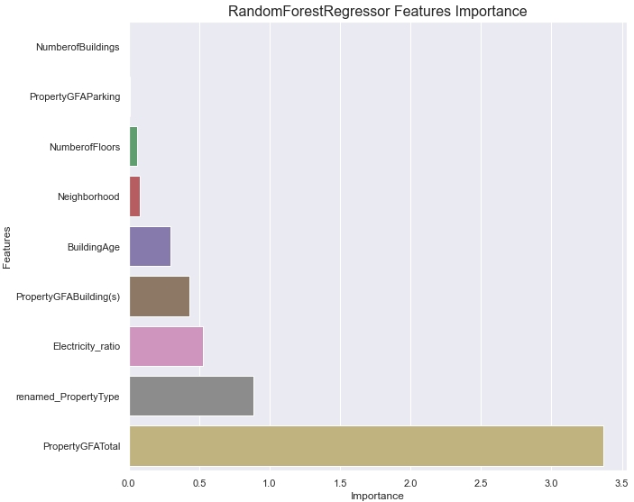
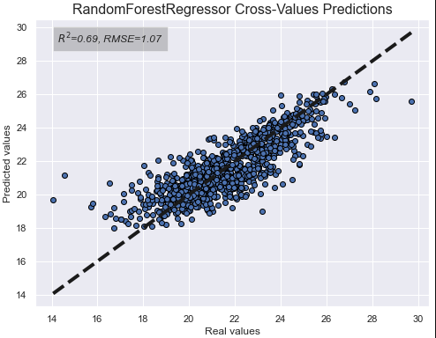
RandomForestRegressor
OpenClassrooms

Slide 13
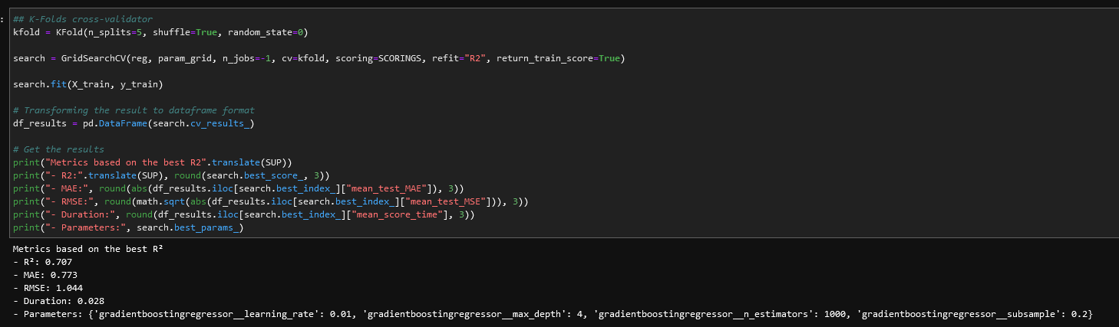
GradientBoostingRegressor
OpenClassrooms

Slide 14
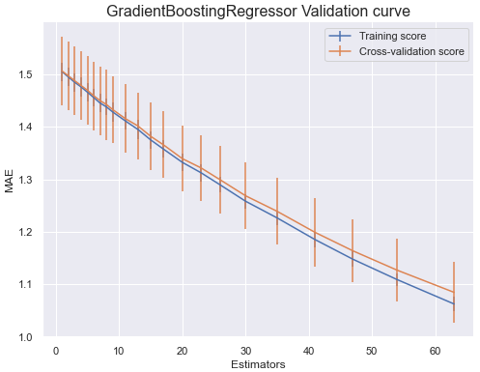
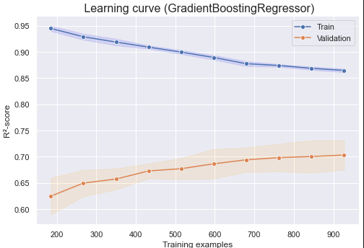
GradientBoostingRegressor
OpenClassrooms

Slide 15
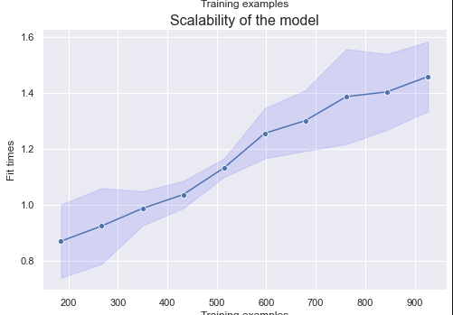
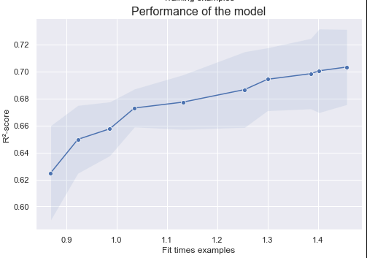
GradientBoostingRegressor
OpenClassrooms

Slide 16
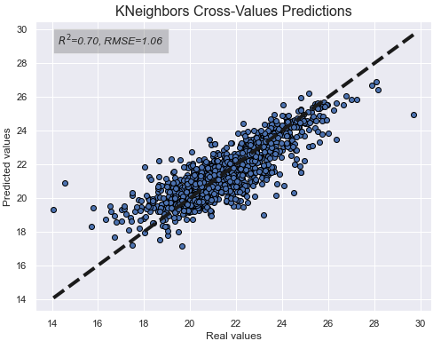
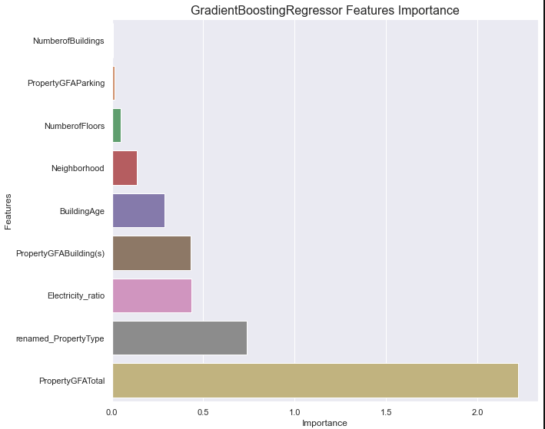
GradientBoostingRegressor
OpenClassrooms

